Slide 1
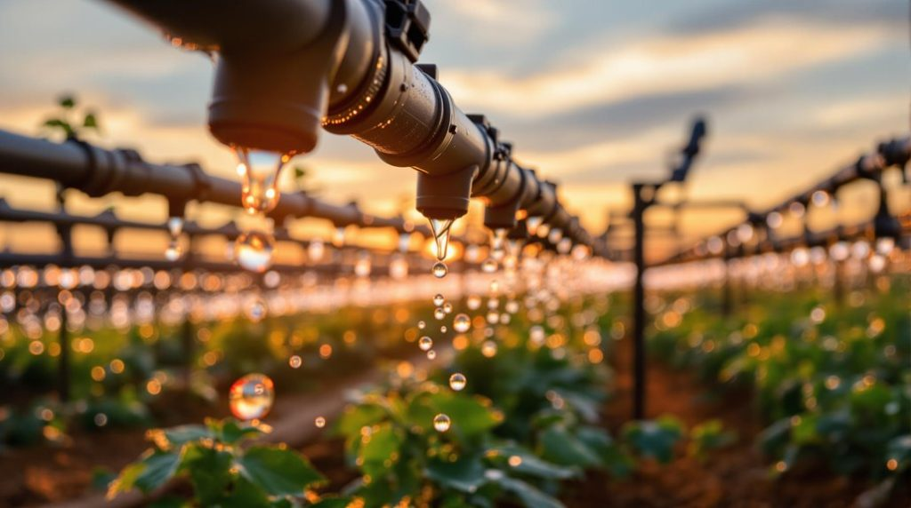
Water Management Success Stories: Driving Sustainable Farming Outcomes
.

Slide 2
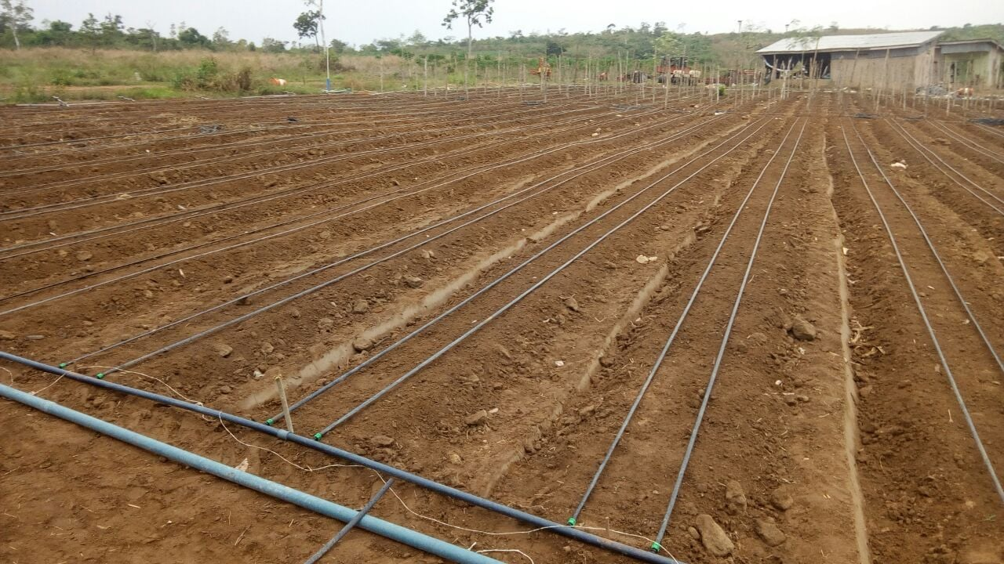
Data Story:How Water Management Improves Farm Productivity and Income

Slide 3
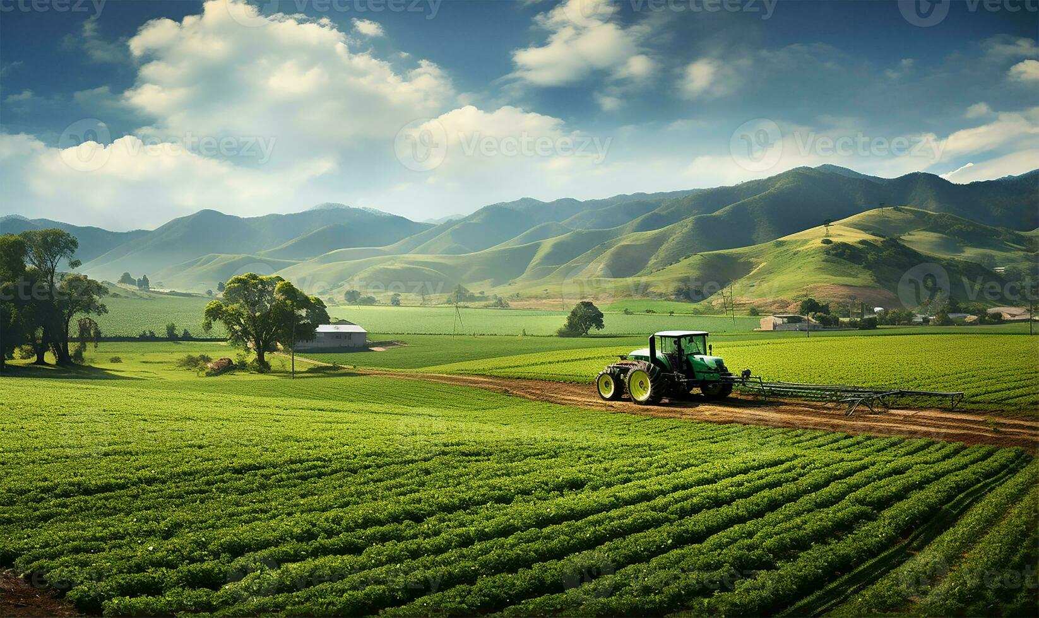
Farming depends heavily on water availability and rainfall patterns
.
However, farming depends heavily on water
availability and rainfall patterns.
Major challenges include:
• Irregular rainfall
• Seasonal droughts
• Limited irrigation infrastructure
Efficient water management is essential for sustainable agriculture.
.

Slide 4
Challenges Faced by Farmers (Conflict):
Farmers in many regions face difficult environmental conditions.
Key challenges include:
Dry Climates:
Semi arid environments with limited rainfall
Water Scarcity
.unstable crop yields and income
.Water scarcity during crop growth
.
Limited Resources:
Small and medium farmers are especially vulnerable due to limited resources and irrigation systems.
.

Slide 5
DATA SET OVERVIEW
This analysis is based on 21 farming success stories related to water management.
The dataset includes information about:
• Climatic conditions
• Land holdings
• Crops grown
• Income outcomes
• Water management techniques
Goal: Understand which strategies help farms succeed under water constraints.

Slide 6
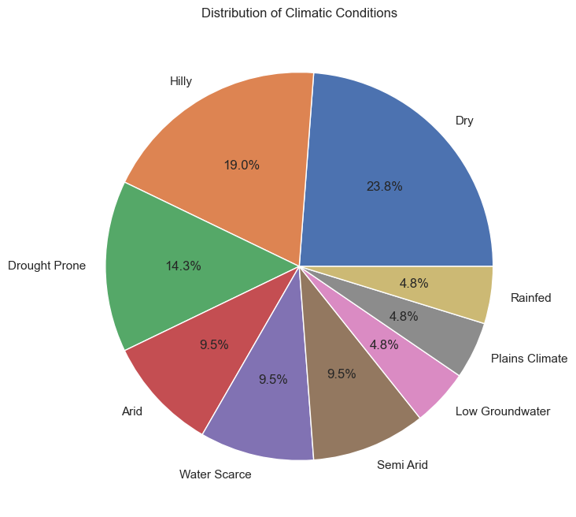
Distribution of Climatic Conditions:
Key Insight:
•Most success stories come from dry (23.8%) and hilly (19%) regions
•Water management practices are especially crucial in water-scarce areas and can significantly improve farming outcomes even under difficult climatic conditions.

Slide 7
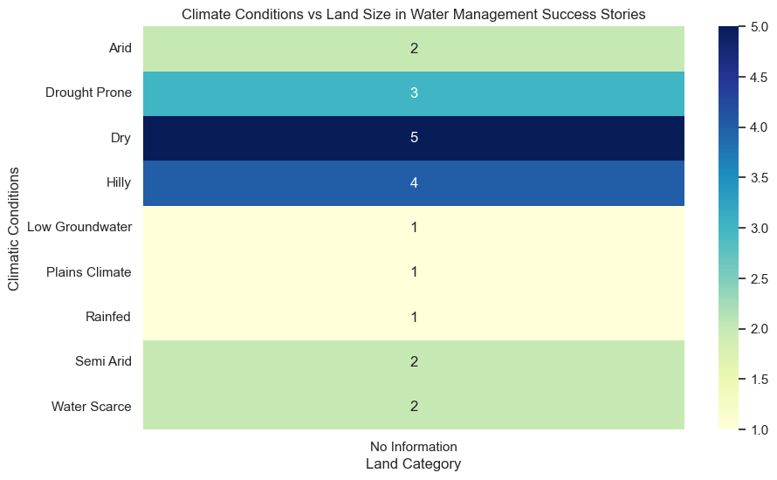
Climate vs Land Size Analysis:
Key Insight:
• Water management success is more prominent in dry and hilly regions, likely because these areas adopt innovative techniques out of necessity. Regions with fewer cases may either lack interventions or proper documentation.

Slide 8
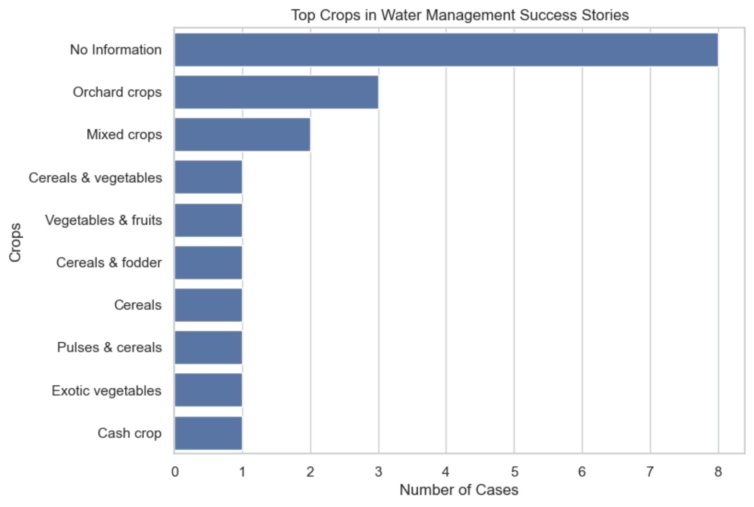
Top Crops Grown :
Key Insight:
• Farmers often practice mixed cropping or crop diversification
• Crop diversity helps reduce agricultural risk
• It also improves water use efficiency
.

Slide 9
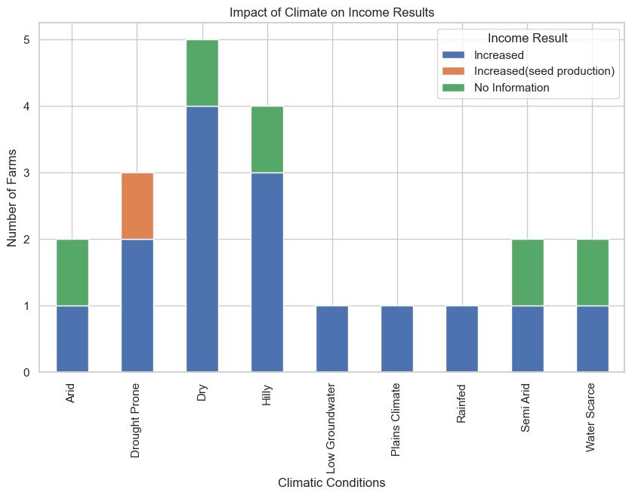
Climate vs Income Analysis:
Key Insight:
• Many farmers reported increased or stabilized income
•Water management practices generally lead to positive income outcomes, especially in challenging climates like dry, hilly, and drought-prone areas, proving their effectiveness in improving livelihoods.

Slide 10
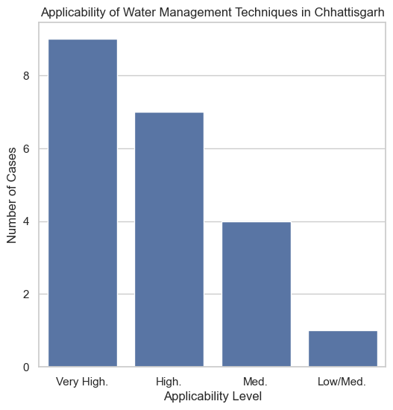
.
85%High Applicability
Most techniques are suitable for the region.
15%Very High Applicability
Some practices can be implemented immediately.
This suggests strong potential for improving agricultural sustainability in Chhattisgarh.
______________________________
( order in bar chart: Veryhigh,high ,med ,low/med)
15%Very High Applicability
Some practices can be implemented immediately.
This suggests strong potential for improving agricultural sustainability in Chhattisgarh

Slide 11
Key Patterns from the Data (Resolution):
Successful farms share several common strategies:
• Adoption of efficient irrigation techniques
• Use of rainwater harvesting systems
• Construction of farm ponds and water storage structures
• Practice of crop diversification
These strategies help farmers manage water efficiently and reduce climate risks.

Slide 12
Impact on Farming Outcomes:
The analysis highlights the positive impact of water management practices.
Key impacts include:
• Improved crop productivity
• Increased or stabilized farm income
• Better resilience to climate variability
These practices support sustainable agriculture and stronger rural livelihoods

Slide 13
Conclusion:
Water management plays a crucial role in modern agriculture.
The analysis shows that:
• Efficient irrigation improves farming outcomes
• Farmers can adapt to water scarcity through innovation
• Many techniques are suitable for regions like Chhattisgarh
Promoting these strategies can help build more resilient and sustainable farming systems.

Slide 14
Thank You!!!

