Slide 1
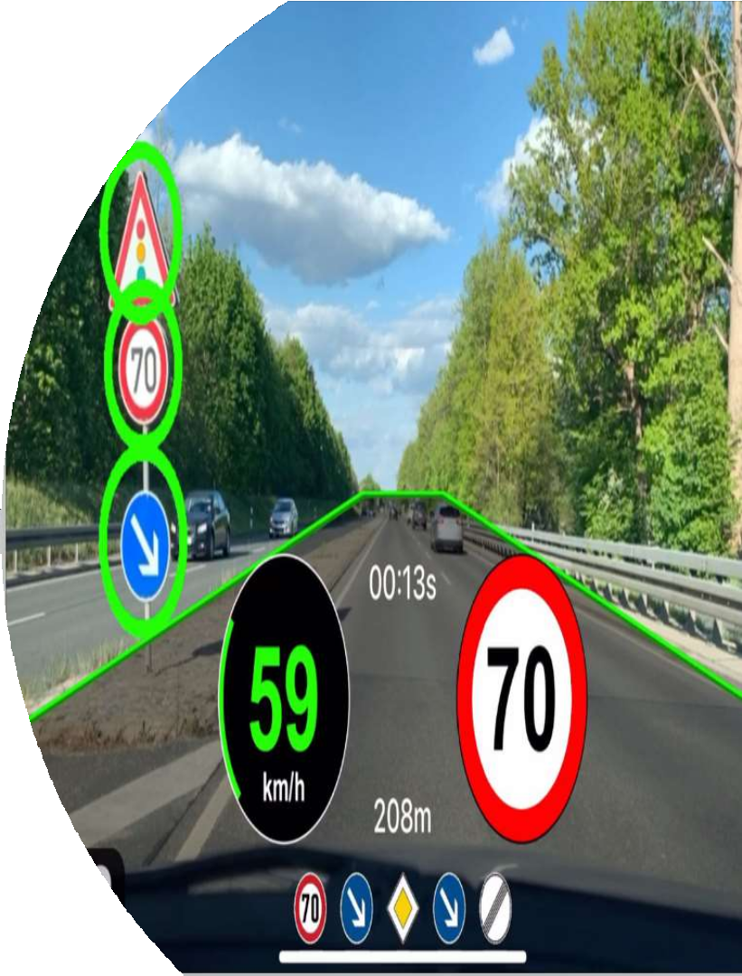
Traffic Sign Recognition
Sai Venkat Kaveti Abhishek Reddy Narahari Gopichand Seethi
Rakesh Jindam

Slide 2
Abstract
Traffic Sign Recognition: is a very important aspect of self-driving cars and driving assistance systems for humans while driving. This could potentially be used for driver assistance and warn drivers if traffic speed limit is exceeded, potential dangers, and reduce accidents. In this project, we are using Deep Neural Networks-CNN and VGG16 to develop the model for Traffic Sign Recognition. The model works in real-time by detecting and recognizing road signs and traffic signs. Here, we are developing a model based on a German dataset where we process the images around 50,000.
Key Words: Convolution Neural Networks, Traffic Sign Recognition, Self- Driving Cars, Driving Assistance System,CNN,VGG16.

Slide 3
Features
We will classify images and play audio according to the image classified
We will translate images to other languages based on image classified
we will classify traffic sign images from 43 classes

Slide 4




Design Flow
Collecting the dataset
Data preprocessing
Design website using flask and integrate model
Build and train model

Slide 5
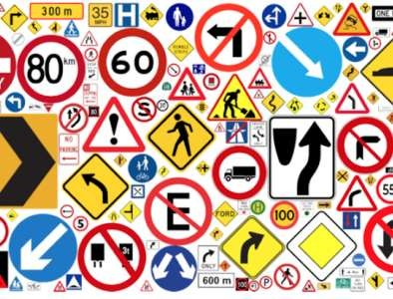
Dataset
The dataset we are using in our project is GTSRB German Traffic Sign Recognition Benchmark. GTSRB is mainly used in Image Classification and Computer Vision.
German Traffic Sign
Recognition Benchmark
This is used in multi-class
and single-image
classification problems.
The dataset has around
50000 images with more than
43 classes.

Slide 6



Data Preprocessing
Read and Resize
images
Convert images into
NumPy arrays
Splitting images and
Normalize the data
One-hot encoding the
labels

Slide 7
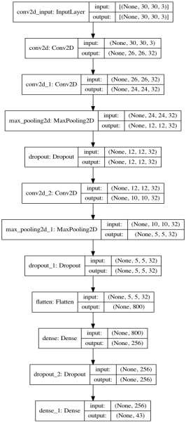
Model
CNN
It is a neural network architecture which allows us to extract higher representations for the image content.

Slide 8



Accuracy
We created a sequential CNN model to classify the images. Since the sequential model can be accurate for 80% of the use- cases we have trained this model on our dataset.
CNN
Accuracy: 0.9718

Slide 9
Technologies and Libraries
Python
NumPy
Pandas
TensorFlow
Keras
OpenCV
Matplotlib
Scikit- Learn
Flask
gTTS
PIL
Translate

Slide 10


User Interface
The website that helps to classify, translate, and play audio to the meaning of a
traffic signal
For building the web application for our model, we have used Flask with python.
In the terminal, we must install the flask for developing web application for our model which is in the python language.
Command used for installing the flask: pip install flask
We have written following Python, HTML files
○ Web.py - we created flask app in this file.
○ Index.html - Landing page of our web application
Flask environment:

Slide 11
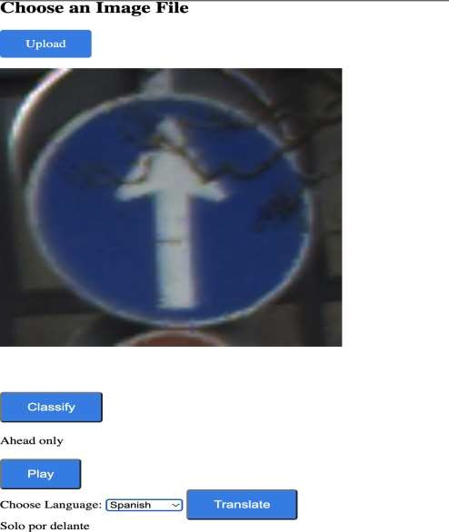
Output

Slide 12
Text Translation
We need pass to_lang parameter with the preferred language to Translator
In our application we are getting the language preferred from the the value chosen from dropdown by the user
For Text Translation we are using Translator library
We can call the translate method and pass the text we want to translate

Slide 13





Text to Speech
gTTS (Google Text-to-Speech), a Python library and CLI tool to interface with Google Translate text-to-speech API.
We need to pass text that has to be converted ,and the language to which the speech has to be generated as the parameters while creating gTTs object.
For Text to speech translation, we are using gTTS library
The we need to save the file with
.mp3 extension
For playing the audio we are using playsound library.
Call the playsound method with the audio file generated.

Slide 14
GitHub Link: https://github.com/gopichands9/traffic-sign-recognition
Video Link: https://umsystem.zoom.us/rec/play/RsiJFTvwllF5MiInLKUBQc9xZaFxEkewxgW1KkaCpf1RfWAHXxKiq- fFA0dXzdirgm6y2B6K2k8syhUN.SiY3JSZ8Bfj6LUrZ?canPlayFromShare=true&from=share_recording_de tail&continueMode=true&componentName=rec- play&originRequestUrl=https%3A%2F%2Fumsystem.zoom.us%2Frec%2Fshare%2F7tQW_qtwSe0rdBl- iJ53lFzpxuQo2gYAL3g-7mkYuXP3ED8pwbe03wLtSwz6LnuH.WNJYbS4bbCK0tGh8

Slide 15
References
Mykola (2018) https://www.kaggle.com/datasets/meowmeowmeowmeowmeow/gtsrb-german-traffic-sign
Deploy Machine Learning Model with Flask on Heroku (2020) https://medium.com/@nutanbhogendrasharma/deploy- machine-learning-model-with-flask-on-heroku-cd079b692b1d
C. Bahlmann, Y. Zhu, Visvanathan Ramesh, M. Pellkofer, T. Koehler (2005) A System for Traffic Sign Detection, Tracking,
and Recognition Using Color, Shape, and Motion Information https://ieeexplore.ieee.org/document/1505111
Flask https://flask.palletsprojects.com/en/2.0.x/

Slide 16
Thank you Questions?

