Slide 1
Exercise Pose Tracker
SL.NO | NAME | ROLL NUMBER
1 | K RISHITH PRANAV KUMAR | CB.EN.U4CSE21232
2 | K SRI SAI ADARSH | CB.EN.U4CSE21233
3 | M DEEPAK SAI | CB.EN.U4CSE21240
Subject code : 19CSE437
Subject Name : Deep Learning for Computer vision
Review-3

Slide 2
Agenda
Overall Architecture Diagram
Existing Product features
Module Diagram
Explanation of Modules
Technology Stack
UI wireframe designs --- For each module
Working of the product

Slide 3
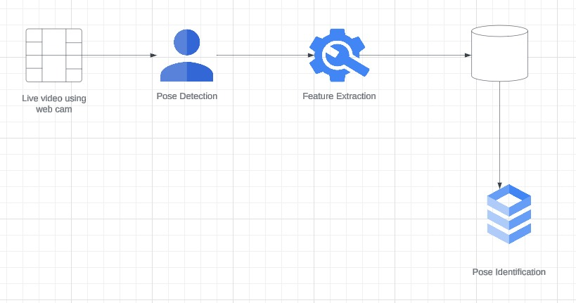
Overall Architecture Diagram
The product flow begins with live video capture using a webcam or mobile camera, which feeds into a pose detection module utilizing deep learning algorithms to extract features and segment data for storage in a database.
This enables pose identification and real-time feedback through a mobile application, augmented by additional data from integrated sensors for enhanced accuracy.

Slide 4
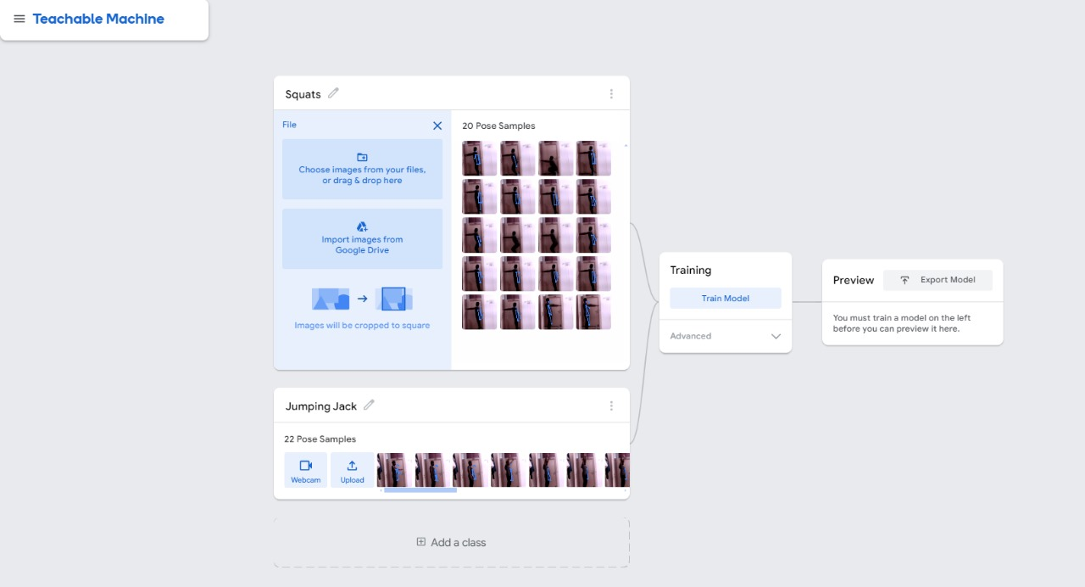
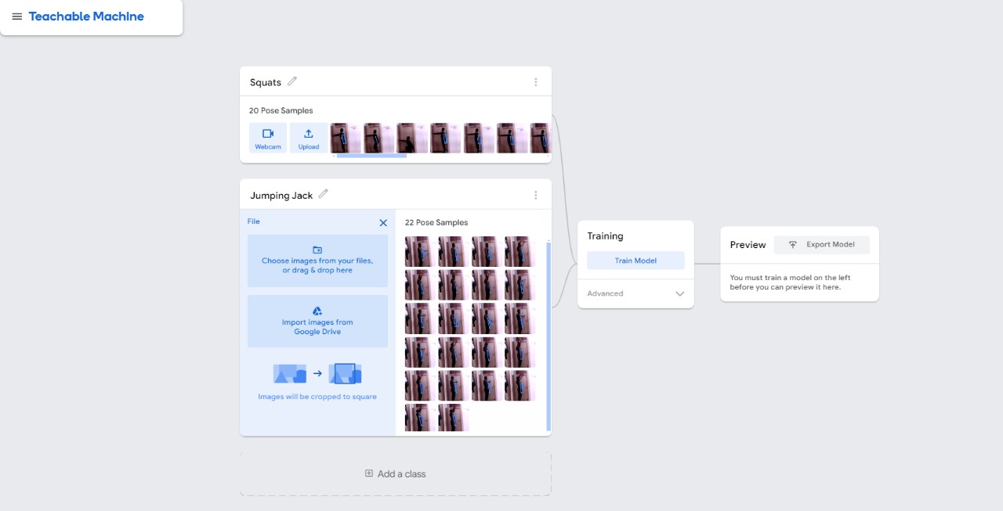
Existing product features
Teachable Machine

Slide 5
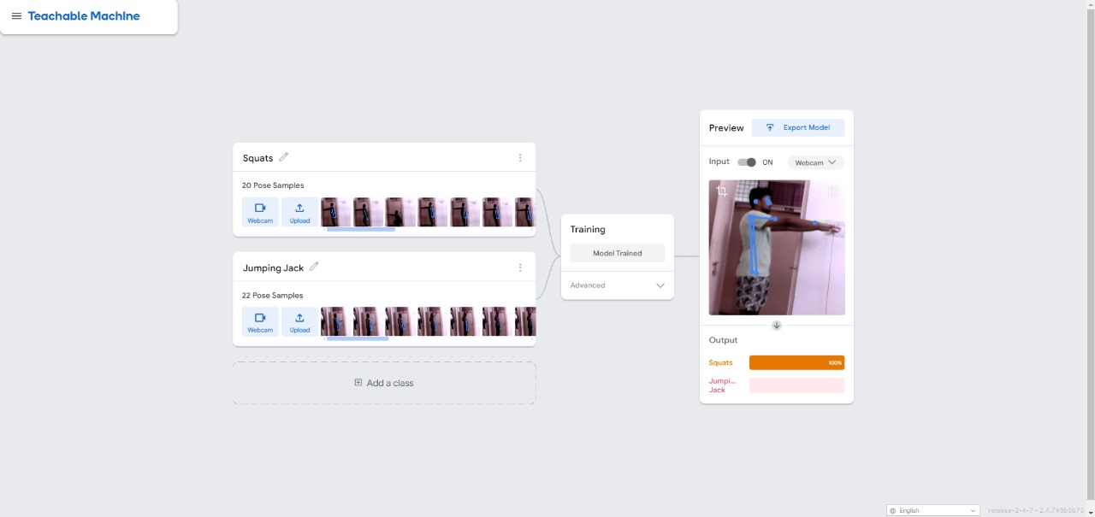
Process Flow
Data Collection:Define classes and gather pose samples for training using images or webcam.
Image Preprocessing:Standardize the images by cropping them to a consistent square format.
Model Training:Train the model to recognize different poses based on the collected samples.
Testing and Preview:Validate the model's performance using live video input and make adjustments if needed.
Exporting the Model:Export the trained model for deployment or integration with other applications.

Slide 6
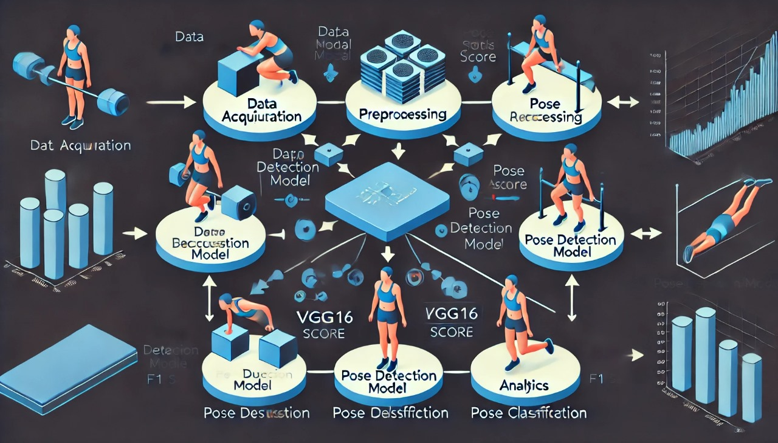
Module Diagram

Slide 7
Here’s a breakdown of the module:
Data Acquisition : This module collects the raw data required for training and testing the model. Data can include images or videos of people performing exercises (e.g., pull-ups, push-ups). This module ensures the availability of diverse data for robust model performance.
Preprocessing : Preprocessing is essential for cleaning the raw data. Tasks here include resizing images, normalizing pixel values, applying data augmentation (like rotation or flipping), and converting video frames into individual snapshots. This step ensures the data is ready for input into the deep learning model.
Pose Detection Model (VGG16) :This module houses the core deep learning model, VGG16,which is pre-trained on large image datasets. It's fine-tuned to detect key features of different exercise poses from input images, enabling the identification of human body structure and movement.

Slide 8
Pose Classification : After detecting the pose, this module classifies the specific exercise being performed (e.g., pull-ups, push-ups). It uses the output of the pose detection model to map the identified features to known exercise types.
Analytics : This module evaluates the performance of the exercise pose tracker. It calculates metrics such as accuracy, precision, recall, and F1 score, providing insights into how well the model is performing in identifying poses. This step is crucial for optimizing the model’s accuracy and ensuring reliable tracking.

Slide 9
Technology Stack of the product
Frontend (Web Interface)
HTML/CSS/JavaScript: For building the basic structure, styling, and interactive elements of the web page.
React.js or Angular.js: To create a dynamic user interface for the exercise tracker. These frameworks help build complex, interactive single-page applications.
Bootstrap or Material-UI: For responsive design and styling of the web interface.
Webcam Integration (JavaScript Libraries)
WebRTC or getUserMedia API: To access the webcam for real-time pose tracking.
Backend
Python (Flask/Django): For creating the backend server, which can handle requests, manage sessions, and serve the deep learning model predictions.
Node.js (Optional): Can be used for a non-Python backend, especially if a JavaScript stack is preferred.

Slide 10
Deep Learning Models and Libraries
TensorFlow/Keras: For building and training deep learning models such as VGG16, DenseNet, and GoogLeNet.
VGG16: Used for image classification or feature extraction to help track pose accuracy.
DenseNet: Can be applied for pose recognition with its ability to leverage feature reuse across layers.
GoogLeNet (Inception Networks): Useful for its efficiency in processing and classifying complex images.
OpenCV: For image and video processing, including preprocessing frames captured from the webcam.
MediaPipe or OpenPose: To perform human pose estimation and extract key body points for pose tracking.
Middleware
Nginx/Gunicorn: For serving the web application and handling requests efficiently.
Socket.IO or WebSockets: For real-time communication between the frontend and backend, enabling live feedback during exercise tracking.

Slide 11
Database
MongoDB/MySQL: For storing user data, exercise logs, and tracking progress over time.
Redis (Optional): For caching results to improve the performance of real-time tracking.
Cloud Services and Deployment
AWS/GCP/Azure: For hosting the web application, storage, and deploying deep learning models.
Docker/Kubernetes: For containerizing and orchestrating the deployment, making it easier to manage different environments.
CDN Services (like Cloudflare): To distribute static files and improve page load times.
Additional Libraries and Tools
NumPy, Pandas: For data manipulation and analysis in the backend.
Matplotlib or Plotly: To visualize the performance of the pose tracker or show statistics related to exercises.
Postman: For API testing during development.

Slide 12
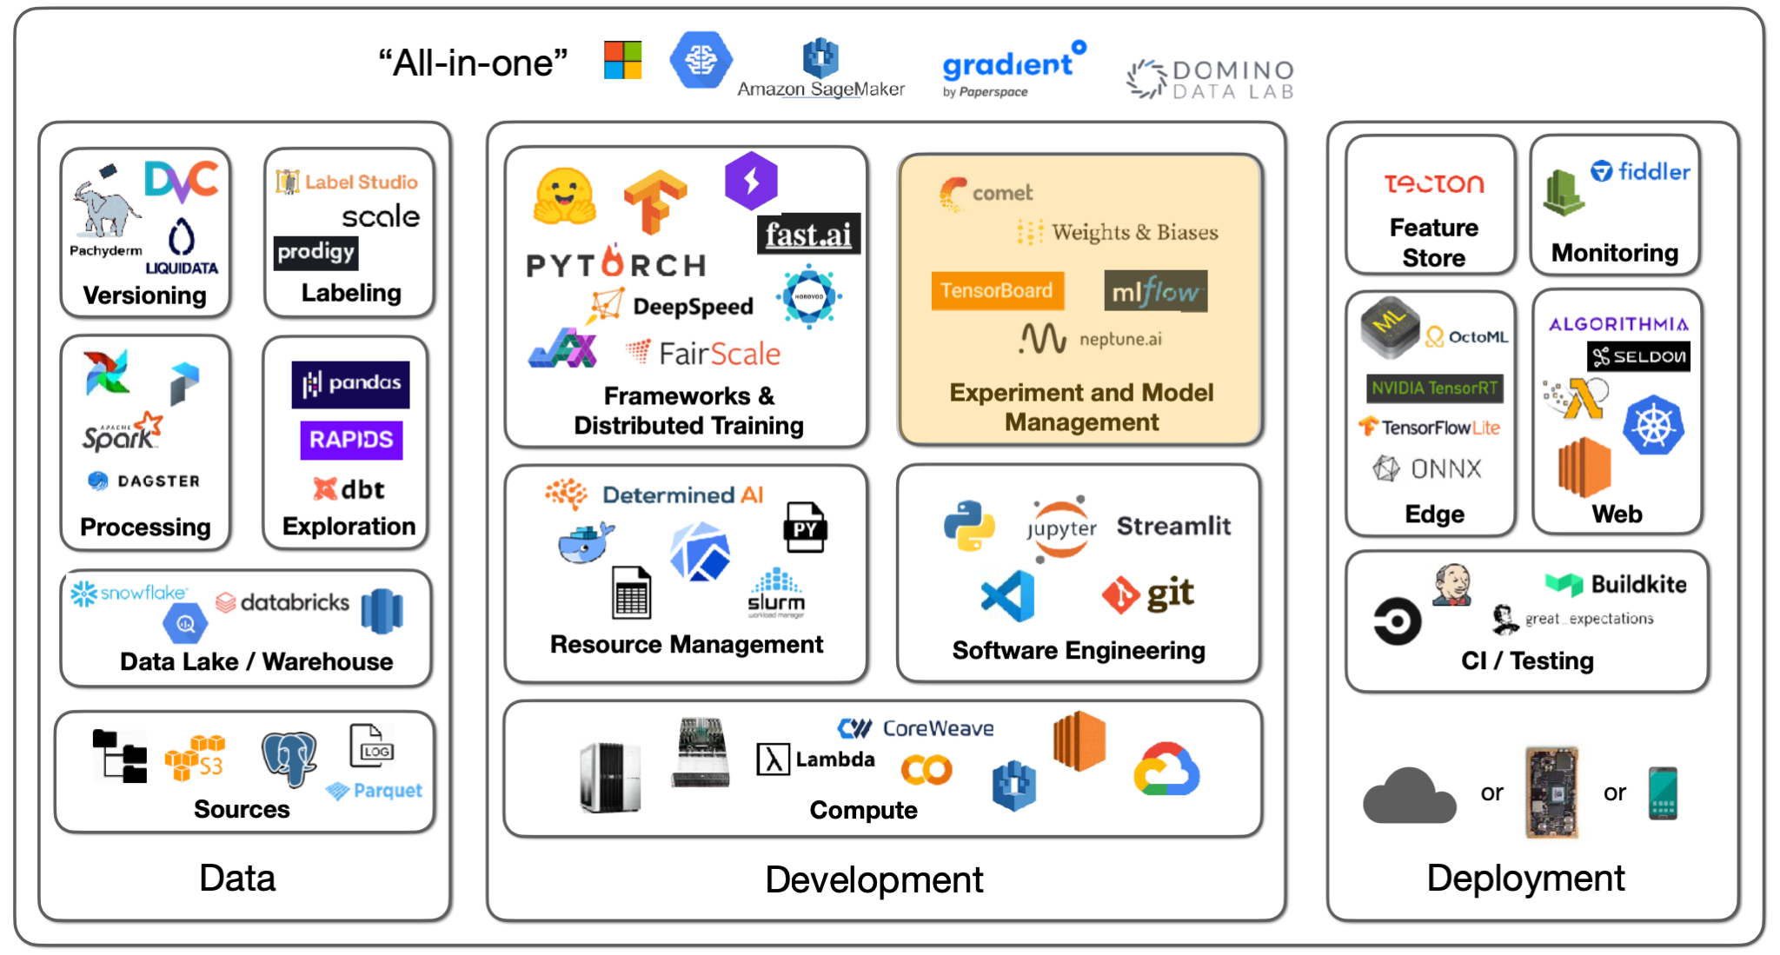

Slide 13
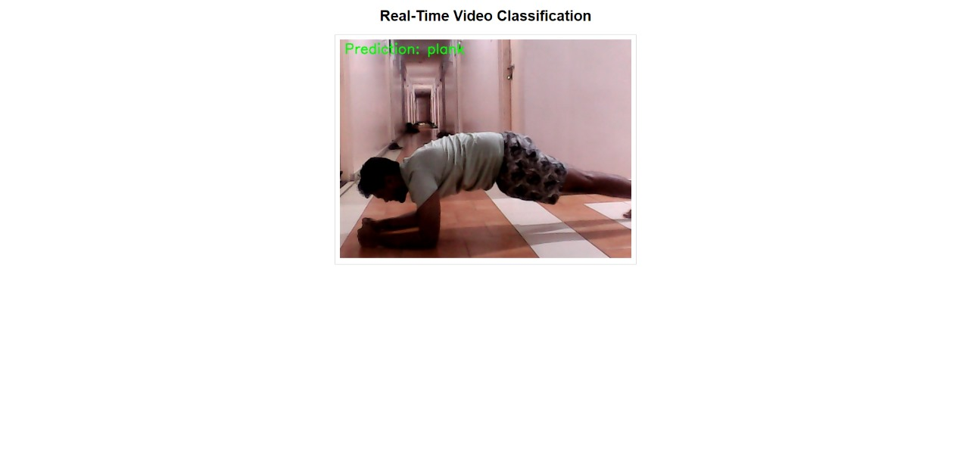
Wireframe designs
The image shows a real-time video classification system identifying a person performing a plank exercise. The system correctly labels the activity as "plank," with the prediction displayed in green text at the top of the video frame. The individual is positioned in a hallway, with their forearms on the floor and body straight, typical of a plank position. The layout suggests a live, continuous feed for exercise pose detection.

Slide 14
Working of the product
Video CaptureAI Task: Continuously capture live video from a webcam. User Interaction: The user only sets up the webcam; video capture is automatic.
PreprocessingAI Task: The system preprocesses the video by extracting frames and detecting objects. User Interaction: Users are not involved at this stage.
Incident DetectionAI Task: The AI model analyzes the frames in real-time to detect specific events, such as exercise poses or accidents. User Interaction: Users receive real-time alerts if a relevant event is detected.
AlertsAI Task: Sends notifications with event details.User Interaction: Users view the alerts and decide on actions.
Learning & FeedbackAI Task: Retrains the model based on new data for improved accuracy. User Interaction: Users provide feedback to refine the system.

