Slide 1



Exercise Pose Tracker
M Deepak Sai K Rishith Pranav
CB.EN.U4CSE21240 CB.EN.U4CSE21232
K Sri Sai Adarsh CB.EN.U4CSE21233
Github URL:https://github.com/kollepallirishith/exercise-detection-.git
Track your fitness journey by observing
count and setting achievable goals.
Professor:
Dr.Bagyammal T

Slide 2
Agenda
Introduction
Literature survey
Features of VGG16 ,dense net , google net architecture
Computer Vision Perspective of VGG16 ,dense net , google net architecture
Diagram of Architecture
Why VGG16 ,dense net , google net
Hyperparameter Table
Hyperparameter Tunning
Expected Performance Metrics
Formula for Performance Metrics

Slide 3
Introduction
Computer Vision in Exercise Pose Tracker
Pose Estimation: Uses models like OpenPose or MediaPipe to identify key body joints during exercises.
Angle Calculation: Determines angles between joints to assess movement accuracy and posture.
Real-Time Feedback: Provides instant guidance on form corrections based on user movements.
Repetition Tracking: Automatically counts reps and sets by analyzing continuous motion.
Injury Prevention: Flags incorrect posture to prevent strain or injury during workouts.
Deep Learning with Computer Vision
Image Classification: Assigns a label to an entire image based on its visual content.
Object Detection: Identifies and locates multiple objects within an image or video.
Segmentation: Divides an image into different regions or parts for detailed analysis.
Pose Estimation: Tracks human body joints and movements from visual input.
Image Generation: Creates new images by learning from existing visual data patterns.

Slide 4
Literature survey(vgg16)
Paper Title: Simonyan, K., & Zisserman, A. (2014). "Very Deep Convolutional Networks for Large-Scale Image Recognition".
Methodology:
CNN-Based Approach: VGG16, with 16 layers, is used to extract features from input images, such as detailed patterns in exercises like pull-ups or push-ups.
Transfer Learning: Pre-trained on ImageNet, allowing faster and more accurate learning when fine-tuned for exercise pose classification.
Experimental Setup:
Data Preprocessing: Involves resizing, normalization, and augmentation of exercise pose images.
Model Training & Testing: VGG16 is fine-tuned with Transfer Learning and evaluated using accuracy, precision, recall, and F1 score.
Summary of Findings:
VGG16’s deep architecture is effective at learning intricate patterns, making it highly suitable for tasks requiring detailed posture analysis.

Slide 5
Literature survey
Paper Title: Zhang, Z., Li, X., & Ren, P. (2020). "Pose Estimation with CNNs for Fitness Tracking".
Methodology:
CNN-Based Approach: The authors used deep CNNs like VGG16 for pose estimation, extracting key features such as joint angles and body alignment.
Transfer Learning: VGG16 is adapted for fitness tracking using pre-trained weights for enhanced accuracy.
Experimental Setup:
Data Preprocessing: Involves resizing, data augmentation, and normalization of fitness-related images.
Model Evaluation: Metrics such as accuracy and recall are used for evaluating pose detection accuracy.
Summary of Findings:
VGG16 demonstrated excellent performance in recognizing fitness poses, which aligns with its use in your project for detecting correct exercise forms.

Slide 6
Literature survey
Paper Title: Papandreou, G., Zhu, T., & Chen, L. (2017). "Human Pose Estimation for Fitness Tracking".
Methodology:
Pose Estimation Approach: Utilized VGG16 for real-time human pose estimation, focusing on tracking joint positions and body alignment in fitness poses.
Experimental Setup:
Dataset: The model is trained on a large dataset of human pose images, enabling it to generalize across different exercises.
Summary of Findings:
VGG16, when fine-tuned for human pose tracking, provided accurate real-time feedback on exercise correctness, making it a strong choice for your Exercise Pose Tracker.

Slide 7
Literature Survey(dense net):
Paper 1 Title: “Latent Body-Pose guided DenseNet for Recognizing Driver's Fine-grained Secondary Activities”
Methodology:
Dual-Stream Framework: Combines body pose and appearance data using DenseNet to enhance activity recognition.
Datasets: Evaluated on two datasets with labeled driver activities like texting and talking.
Experimental Setup:
Datasets: D1 (varied conditions) and D2 (controlled environment).
Comparison: Tested against models like AlexNet and Inception V3 using accuracy and loss metrics.
Summary of Findings:
Performance Boost: Incorporating body pose improves accuracy by 7% (D1) and 8% (D2).
Challenges: Lower performance when trained on one dataset and tested on another due to varying conditions.

Slide 8
Paper 2 Title: "LogRF: An Approach to Human Pose Estimation Using Skeleton Landmarks for Physiotherapy Fitness Exercise Correction"
Methodology:
LogRF Method: Uses Logistic Regression Recursive Feature Elimination to select important features for human pose estimation.
Training & Testing: Data split into 80% training and 20% testing to evaluate models for exercise correction in physiotherapy.
Experimental Setup:
Environment: Conducted in Google Colab with GPU support.
Metrics: Evaluated using accuracy, precision, recall, F1 score, and runtime.
Summary of Findings:
Improved Performance: Random Forest achieved 0.998 accuracy. LSTM reached 0.829 and GRU 0.974.
The approach helps identify incorrect movements in physiotherapy exercises.

Slide 9
Paper 3 Title: "Pose Tutor: An Explainable System for Pose Correction in the Wild"
Methodology:
Combines vision-based models and pose skeletons for pose prediction.
Uses an angle-likelihood method to explain and correct joint misalignments.
KNN classifier applied on keypoints after fine-tuning DenseNet on the Yoga-82 dataset.
Experimental Setup:
Datasets: Yoga-82, Pilates-32, and Kungfu-7.
Evaluation: Accuracy on test sets and user studies for explanation validation.
Summary of Findings:
Achieved 81% accuracy on Yoga-82.
Effectively identifies key joints for pose correction.
Explanations closely match those of human experts.

Slide 10
Literature survey(google net)
Paper Title: Simonyan, K., & Zisserman, A. (2014). "Very Deep Convolutional Networks for Large-Scale Image Recognition".
Methodology:
CNN-Based Approach: GoogLeNet is a convolutional neural network (CNN) that consists of 22 layers deep, which is significantly deeper than previous models..
Transfer Learning: While the paper primarily focuses on the VGG architecture, GoogLeNet has been widely used in transfer learning scenarios.
Experimental Setup:
Data Preprocessing: GoogLeNet, like other CNNs, requires careful data preprocessing to ensure optimal performance.
Summary of Findings:In the paper, GoogLeNet's performance is compared to that of the VGG architecture. The results indicate that GoogLeNet achieved a top-5 test error of 7.9% with a single model, while the VGG architecture achieved a lower error rate of 7.0% with its best single model.

Slide 11
Literature survey
Paper Title: Zhang, Z., Li, X., & Ren, P. (2020). "Pose Estimation with CNNs for Fitness Tracking".
Methodology:
CNN-Based Approach: The authors utilized deep CNNs like GoogLeNet for pose estimation, focusing on extracting key features such as joint angles and body alignment. The Inception modules allowed for efficient feature extraction at multiple scales.
Transfer Learning: GoogleNet was adapted for fitness tracking using pre-trained weights, enhancing accuracy and reducing training time.
Experimental Setup:
Data Preprocessing: This involved resizing, data augmentation, and normalization of fitness-related images to improve model robustness and generalization.
Summary of Findings: GoogLeNet exhibited strong performance in recognizing fitness poses, demonstrating its effectiveness for detecting correct exercise forms. Its architectural advantages make it a suitable choice for your project on exercise pose tracking.

Slide 12
Features of VGG16 architecture
16 Layers: VGG16 consists of 13 convolutional layers and 3 fully connected layers, making it deep enough to learn intricate features from images. The depth of the network allows it to detect detailed and subtle patterns, such as specific angles of limbs and body positions during exercises like push-ups or pull-ups.
3x3 Filters: The small 3x3 convolutional filters are a key feature of VGG16. These filters ensure that the model captures fine-grained details, which is crucial for detecting the correct form in exercise poses. For example, subtle changes in elbow or knee positioning during a push-up can be identified using these filters.
Max Pooling: VGG16 uses max pooling layers to reduce the spatial dimensions of the feature maps while retaining the most important information. This helps the model focus on the most relevant features of the exercise, such as the overall body posture, rather than being distracted by irrelevant background details.
Fully Connected Layers: The fully connected layers in VGG16 serve as the final classification layers. After the convolutional layers have extracted features, the fully connected layers use that information to determine whether a pose is correct or incorrect, based on the patterns learned during training.

Slide 13
Computer vision perspective of VGG16 architecture
VGG16, originally introduced for large-scale image recognition, is highly relevant in computer vision tasks due to its ability to learn and extract complex visual patterns from images. In your project, the VGG16 architecture is adapted for pose classification, a specialized computer vision task, where the goal is to evaluate the correctness of exercise poses like push-ups and pull-ups based on visual input.
Feature Extraction with VGG16 in Computer Vision
Joint Angle Detection: The convolutional layers of VGG16 capture fine details like joint angles, which are critical for determining whether an exercise is being performed correctly. This includes analyzing elbow angles in push-ups or arm extension in pull-ups.
Body Position and Alignment: By analyzing the spatial arrangement of key body parts, VGG16 helps determine whether the overall posture aligns with the expected correct form, ensuring proper body positioning.
Classification
Pose Evaluation: After extracting features, VGG16 processes this information through its fully connected layers, determining whether the detected pose is classified as correct or incorrect. This is done by comparing the visual features against a predefined dataset of correct forms.

Slide 14
Features of DenseNet Architecture
Dense Connectivity:Each layer receives inputs from all preceding layers, promoting feature reuse. This allows the model to efficiently learn complex features necessary for accurate pose estimation.
Efficient Gradient Flow:Dense connections facilitate better gradient propagation during training. This helps to prevent the vanishing gradient problem, enabling the training of deeper networks without losing important information.
Reduced Parameters:Compared to traditional architectures, DenseNet requires fewer parameters due to feature reuse. This leads to reduced memory consumption and faster computation, essential for real-time pose tracking.
Strong Feature Extraction:DenseNet’s architecture captures rich, hierarchical features from the input data. This capability enhances the model's ability to detect subtle differences in body poses, improving exercise tracking accuracy.
Versatile Transfer Learning:DenseNet can be fine-tuned for specific pose estimation tasks with minimal adjustments. This adaptability makes it suitable for diverse exercise tracking applications, allowing for quicker deployment and improved performance.

Slide 15
Computer vision perspective of DenseNet architecture
Feature Reuse: DenseNet’s ability to reuse features across layers allows for better extraction of low- and high-level features (such as joint positions and body movements), which is essential for accurate pose estimation during exercises.
Detailed Pose Estimation: Dense connectivity enables the model to capture fine-grained spatial details, enhancing its ability to track complex body movements and subtle posture changes during various exercises.
Multi-scale Feature Learning: The dense connections allow DenseNet to capture features at multiple scales, improving the system’s ability to understand different body part sizes and proportions, which is crucial for real-time exercise form correction.
Depth Efficiency: Despite being deep, DenseNet avoids redundancy by passing information directly between layers. This allows the model to efficiently handle real-time video frames, providing fast and accurate pose tracking without a computational burden.
Improved Visual Representation: DenseNet enhances the ability to represent visual data more richly by integrating features from all previous layers, leading to more robust and stable pose predictions, even in dynamic or occluded environments (e.g., partial body occlusions during exercises).

Slide 16
Features of GoogleNet architecture
22 Layers: GoogleNet consists of 22 layers, including convolutional layers, pooling layers, and inception modules, making it a deep network capable of learning complex patterns from images. The depth of the network allows it to capture detailed and subtle features, such as body alignment and joint angles during exercises like squats or push-ups.
Inception Modules: A key feature of GoogleNet is its Inception modules, which use multiple convolutional filters (1x1, 3x3, and 5x5) in parallel. This allows the network to capture features at different scales simultaneously, making it especially effective for detecting both fine-grained details (like elbow angles in push-ups) and broader body positions (such as full-body alignment in squats).
1x1 Convolutions for Dimensionality Reduction: GoogleNet uses 1x1 convolutions within its Inception modules to reduce the dimensionality of feature maps before applying larger convolutions (3x3 and 5x5). This minimizes computational complexity and ensures that the model is efficient while still capturing important details like joint angles and limb positioning.
Max Pooling: Max pooling layers are used throughout GoogleNet to reduce the spatial dimensions of the feature maps while preserving the most significant information. This helps the model focus on critical aspects of the pose, such as overall body posture, rather than getting distracted by irrelevant background details.
GoogleNet's combination of inception modules, dimensionality reduction, and deep architecture makes it highly effective for complex computer vision tasks like pose classification, enabling it to detect both fine details and global body positions efficiently.

Slide 17
Computer vision perspective of DenseNet architecture
Feature Reuse: DenseNet’s ability to reuse features across layers allows for better extraction of low- and high-level features (such as joint positions and body movements), which is essential for accurate pose estimation during exercises.
Detailed Pose Estimation: Dense connectivity enables the model to capture fine-grained spatial details, enhancing its ability to track complex body movements and subtle posture changes during various exercises.
Multi-scale Feature Learning: The dense connections allow DenseNet to capture features at multiple scales, improving the system’s ability to understand different body part sizes and proportions, which is crucial for real-time exercise form correction.
Depth Efficiency: Despite being deep, DenseNet avoids redundancy by passing information directly between layers. This allows the model to efficiently handle real-time video frames, providing fast and accurate pose tracking without a computational burden.
Improved Visual Representation: DenseNet enhances the ability to represent visual data more richly by integrating features from all previous layers, leading to more robust and stable pose predictions, even in dynamic or occluded environments (e.g., partial body occlusions during exercises).

Slide 18
Computer vision perspective of GoogleNet architecture
GoogleNet (Inception V1), originally developed for large-scale image recognition tasks, is well-suited for specialized computer vision tasks like pose classification due to its efficient feature extraction and ability to analyze complex visual patterns. In this project, the GoogleNet architecture is adapted for evaluating exercise poses such as push-ups, pull-ups, or squats, assessing the correctness of these movements based on visual input.
Feature Extraction with GoogleNet in Computer Vision:
Inception Modules in GoogleNet extract features at multiple scales by applying 1x1, 3x3, and 5x5 convolutions in parallel. This allows the model to capture both fine-grained details and high-level spatial information from body poses.
Joint Angle Detection: The inception modules efficiently capture joint angles such as elbow bends during push-ups or knee flexion in squats, making them critical for determining exercise accuracy.
Body Position and Alignment: The multi-scale feature extraction helps analyze complex body movements and spatial arrangement of key body parts, such as detecting misalignment in arm or leg positions during exercises.
Classification:
Pose Evaluation: By comparing the visual features with a predefined dataset of correct exercise forms, the model can determine whether an individual is performing the movement properly, such as ensuring proper arm extension in push-ups or leg alignment in squats. This makes GoogleNet an ideal choice for real-time pose classification and evaluation in fitness applications.

Slide 19
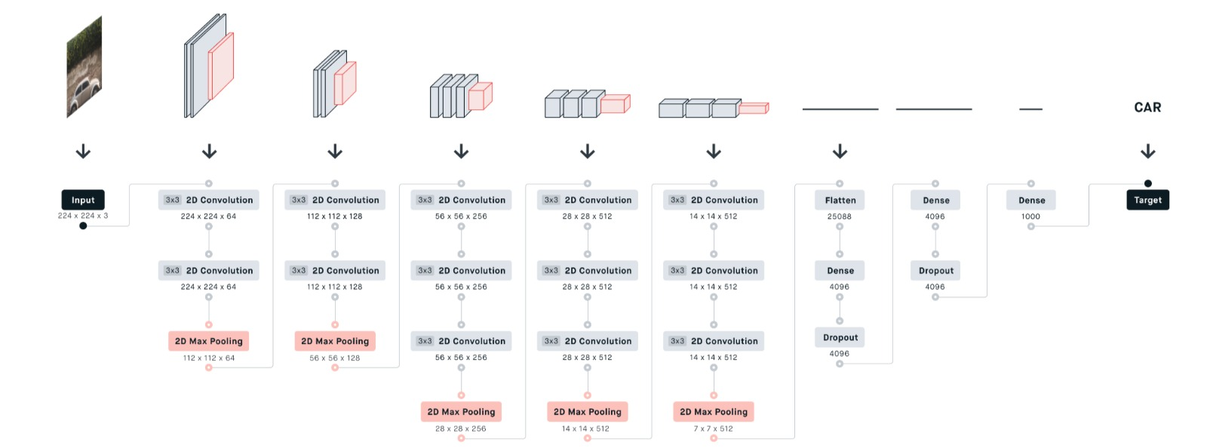
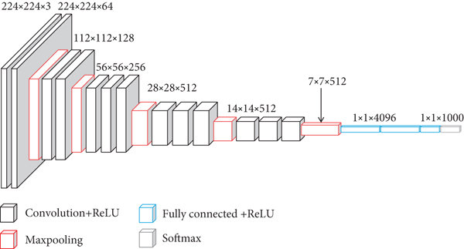
Architecture Diagram vgg16

Slide 20
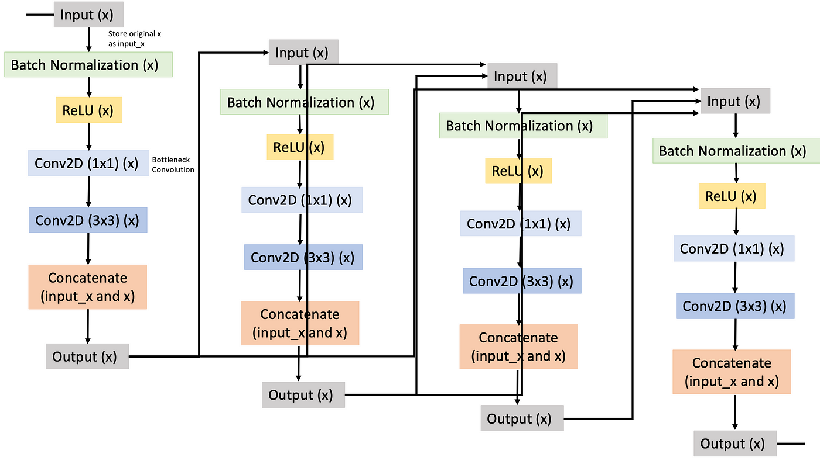
Architecture diagram DenseNet :

Slide 21
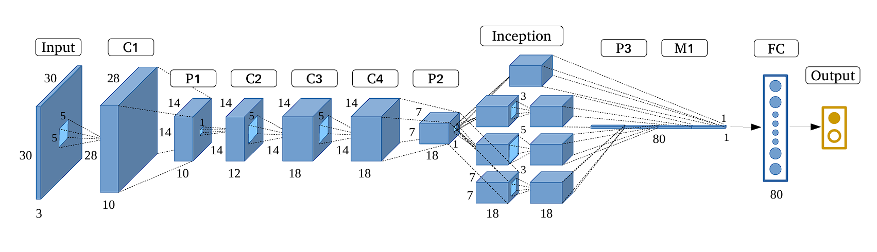
Architecture Diagram (google net)

Slide 22
Why VGG16
Depth and Simplicity: VGG16’s deep structure allows for capturing both high-level and low-level features from images. This is important in exercise pose tracking where fine posture details can affect the overall performance.
High Feature Representation: The 3x3 filters enable the model to focus on small details in the body’s positioning. This is essential for detecting whether an exercise like a push-up is being performed with the correct alignment, or if adjustments need to be made.
Max Pooling for Efficiency: By reducing the spatial dimensions with max pooling, VGG16 becomes more computationally efficient without sacrificing accuracy. This is beneficial in real-time systems where the model must quickly analyze poses and provide feedback.
Transfer Learning Capability: VGG16 is widely used for transfer learning, which means the pre-trained model can be fine-tuned with a smaller dataset. This is helpful in cases where large labeled datasets for exercise forms might not be readily available, and the model can still perform well by adapting pre-trained weights.

Slide 23
Why DenseNet Architecture
Pose Integration: It combines DenseNet with latent body-pose information, enhancing understanding of human positions and actions.
Feature Efficiency: The architecture allows efficient reuse of features, improving learning from body poses.
Robustness: It provides resilience against variations like occlusions and lighting changes by relying on contextual pose data.
Better Training: Dense connections improve gradient flow, allowing for more effective training with complex data.
Multi-tasking: The model can perform multiple related tasks (e.g., pose estimation and action recognition) simultaneously.
Contextual Awareness: It improves context understanding, crucial for accurately interpreting human actions.
Compactness: Maintains a compact model while capturing complex human behaviors, leading to efficient performance.

Slide 24
Why GoogleNet
Depth and Efficiency: GoogleNet’s deep architecture, combined with its use of Inception modules, allows for capturing both high-level and low-level features across different scales. This is especially useful in exercise pose tracking, where detecting details like joint angles and overall body alignment is critical to evaluating the correctness of movements.
Multi-Scale Feature Extraction: GoogleNet’s Inception modules use 1x1, 3x3, and 5x5 filters in parallel, enabling the model to focus on both fine details and broader patterns in the body’s positioning. This is crucial in exercises like push-ups or squats, where both small adjustments (e.g., elbow or knee positioning) and overall posture must be analyzed to ensure correct form.
Reduced Computational Complexity: Despite its depth, GoogleNet is designed to be computationally efficient due to its use of 1x1 convolutions for dimensionality reduction. This makes it suitable for real-time pose evaluation systems, where quick feedback on body posture and movement is essential without sacrificing accuracy.
Global Average Pooling for Simplicity: Instead of fully connected layers, GoogleNet uses global average pooling to reduce feature maps for classification. This simplifies the architecture, reducing overfitting while ensuring that key information about body positions, such as limb extension or overall balance, is retained.

Slide 25
Hyperparameter Table
VGG16 Architecture:
Hyperparameter | Value
Learning Rate | 0.001
Batch Size | 32
Epochs | 50
Optimizer | Adam
Dropout Rate | 0.5
Loss Function | Categorical Crossentropy

Slide 26
Hyperparameter Tuning dense net
Learning Rate Adjustment: Testing lower learning rates like 0.0001 or 0.00001 to find the best convergence rate for your model.
Batch Size: Experimenting with different batch sizes (32, 64, 128) to see what balances computational efficiency with gradient updates.
Epochs: Increasing the number of epochs to ensure the model has sufficient time to learn from the data, but preventing overfitting.
Dropout Rate: Adjusting the dropout rate to prevent overfitting and ensure generalization, particularly when using a small dataset.
Tuning Strategy: Grid search or random search methods to find the best hyperparameter combinations.
Hyperparameter | Value
Learning Rate | 0.0001
Batch Size | 64
Epochs | 100
Optimizer | Adam
Dropout Rate | 0.3
Loss Function | Categorical Crossentropy

Slide 27
Hyperparameter Table
DenseNet architecture
Hyperparameter | Typical Values
Learning Rate | 0.001, 0.01
Batch Size | 16, 32, 64
Epochs | 50, 100, 200
Weight Decay | 1 e -4, 5e-4
Dropout Rate | 02, 0.5
Number of Dense Blocks | 3,4,5
Growth Rate | 12, 24, 32
Input Image Size | 224x224, 256x256
Pose Feature Dimension | 64, 128, 256
Activation Function | ReLU, Leaky ReLU
Optimizer | Adam, SGD
Momentum (for SGD) | 0.9, 0.99

Slide 28
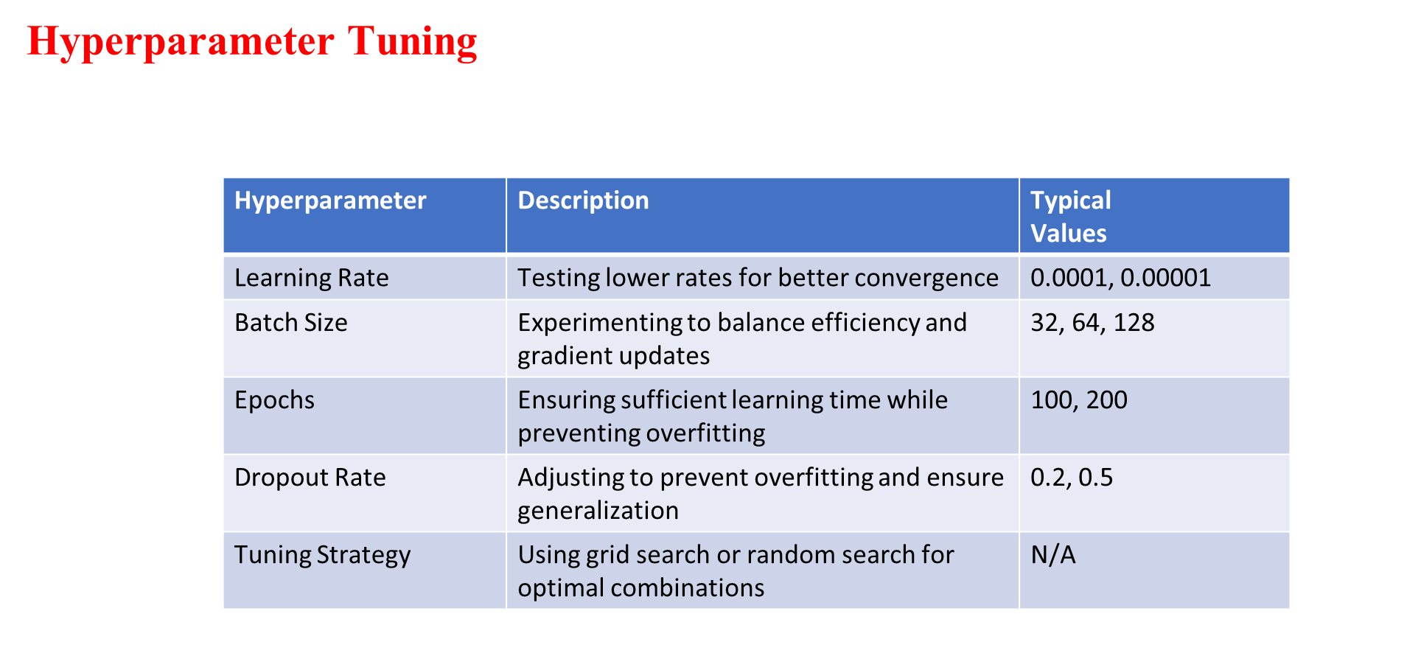

Slide 29
Hyperparameter Table
GoogleNet Architecture:
Hyperparameter | Value
Learning Rate | 0.1
Batch Size | 128
Epochs | 100
Optimizer | SGD
Dropout Rate | 0.4
Loss Function | Categorical Cross entropy

Slide 30
Setup Planned
Hardware Setup: Utilize a high-resolution camera and appropriate processing unit to capture and analyze video in real-time.
Data Collection: Gather and annotate a diverse dataset of exercise poses to train and test the pose estimation model.
Model Development: Implement the DenseNet architecture for pose estimation, leveraging transfer learning to enhance performance.
Real-time Processing: Establish a pipeline to handle video streams and provide instant feedback on user movements and form.
User Interface: Create an intuitive interface for displaying pose tracking results and exercise recommendations during workouts.

Slide 31
Expected Performance Metrics
Accuracy: The proportion of correct predictions out of all predictions made.
Precision: The ability of the model to correctly identify correct poses without labeling incorrect poses as correct.
Recall: The ability of the model to find all correct poses.
F1 Score: A balance between precision and recall, giving a more holistic view of model performance.
Why Not Use Other Metrics?
While there are other metrics like Specificity, ROC-AUC, Log Loss, Matthews Correlation Coefficient (MCC), and Kappa Score, they aren't as suitable for your Exercise Pose Tracker project. Specificity focuses on identifying incorrect poses, which isn’t the main goal. ROC-AUC and Log Loss deal with probabilistic outputs and threshold tuning, which are less relevant when the aim is to provide clear, real-time feedback on exercise form. MCC and Kappa Score, while useful in imbalanced datasets and agreement measures, would add unnecessary complexity without offering significant insights beyond precision, recall, and F1 score. These chosen metrics provide a direct and actionable evaluation of the system’s ability to detect and assess exercise poses accurately.

Slide 32
Expected Performance Metrics
Accuracy: Proportion of correct predictions out of total predictions.
Precision: Correctly identifies true poses without labeling incorrect ones as correct.
Recall: Ability to detect all correct poses.
F1 Score: Balances precision and recall for a comprehensive performance view.
Why Not Use Other Metrics?
Specificity: Focuses on identifying incorrect poses, not the main goal.
ROC-AUC and Log Loss: Less relevant for clear, real-time feedback on exercise form.
MCC and Kappa Score: Add complexity without significant insights beyond precision, recall, and F1 score.

Slide 33
Formula for Performance Metrics
Accuracy = (TP + TN) / (TP + TN + FP + FN)
Precision = TP / (TP + FP)
Recall = TP / (TP + FN)
F1 Score = 2 * (Precision * Recall) / (Precision + Recall)

