Slide 1
Dan’s Frappuccino Paradise
Group 8
John Belnap, Master of Documentation
Caden Harris, King of the Burndown Charts
Kollin Murphy, Project Manager
Trenton Peters, Senior Software Engineer

Slide 2
Kollin Murphy
Project Overview

Slide 3
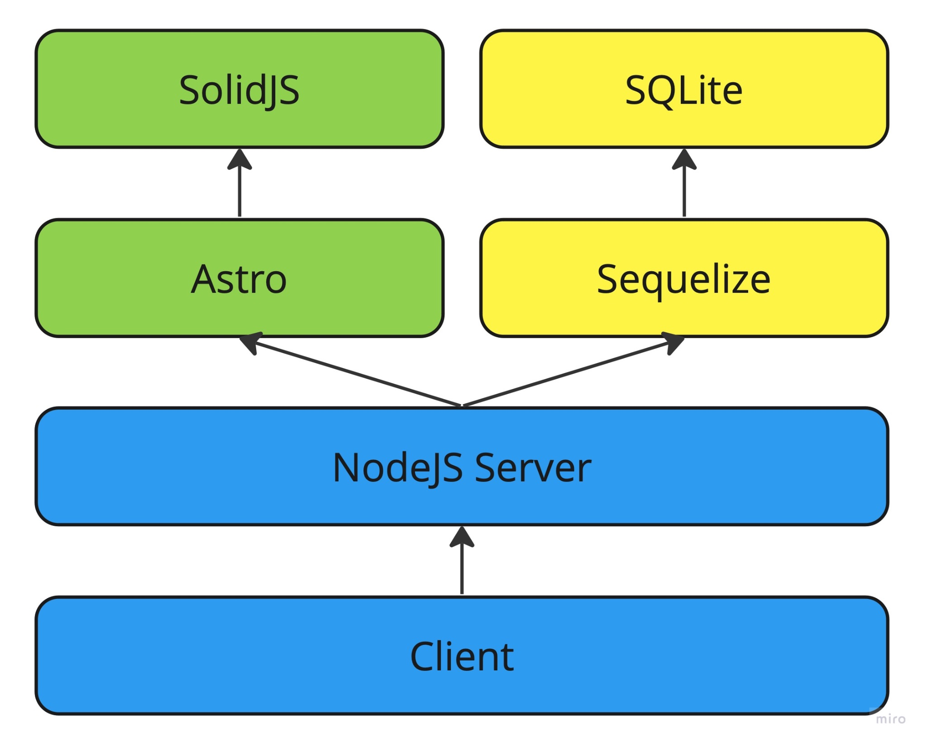
Project Architecture
In the early stages of the project, we proposed several different types of architecture. These included a Django full-stack application, a React frontend & ExpressJS backend, and Astro with a SolidJS frontend.
Due to a lack of confidence in our abilities to create a clean project using Django, we decided to use Astro. Astro is modern site builder that allows developers the freedom to use any front-end UI library. We decided to pair it with SolidJS due to its simplicity, reliability, and performance.
Furthermore, one of our team members had significant experience using Astro and was confident that it had a small enough learning curve to use for this project.

Slide 4
Project Design
To design our project, we first wrote up a complete requirements document. With our requirements in hand, we were able to design a low-fidelity prototype as a group. We used brainstorming techniques where every idea has merit to generate as many ideas as we possibly could. We explored some of those ideas as we drew out wireframe sketches, and discarded others that weren’t as promising.
At the end of our design meeting, we had a 12-page design document with sketches of each page of the website. This served as a starting point for the rest of our project. We frequently referred back to it throughout the development process.

Slide 5
Agile Practices
Planning Poker
This allowed us to express our expectations of the duration of various tasks without any anchoring of the estimates. This helped in dividing tasks between team members and assigning story points.
Daily Standup Documents
These regular documents helped us to stay focused and to follow up on previous tasks. It made sure that we were able to account for any potential loose ends during the development process.
Sprint Planning & Retrospective Meetings
During our sprint planning meetings, we were able to look at the requirements document and create tasks to accomplish specific requirements.
During our retrospective meetings, we were able to evaluate the direction the project was heading and ensure that the requirements were being successfully met.

Slide 6
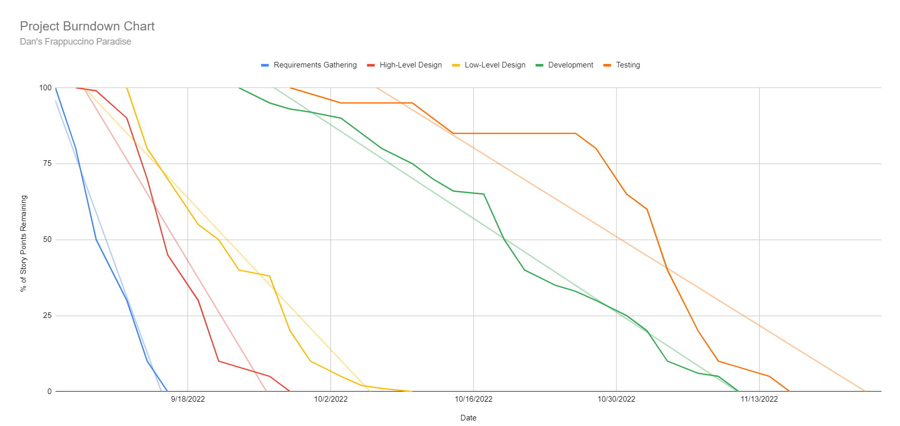
Burndown Chart

Slide 7
Team Velocity
Sprint 1 (9/5 - 9/16): 34 points per sprint
Sprint 2 (9/19 - 9/30): 46 points per sprint
Sprint 3 (10/3 - 10/14): 23 points per sprint
Sprint 4 (10/17 - 10/28): 24 points per sprint
Sprint 5 (10/31 - 11/11): 35 points per sprint
Sprint 6 (11/14 - 11/25): 5 points per sprint
Average velocity: 27.8 points per sprint

Slide 8
Deployment
The project is now ready to move into the deployment stage.
We have written unit tests for all API handlers using the Jest testing framework and have achieved 100% test coverage. This gives us significant confidence in the correctness of our code. Regression tests have also been implemented. We plan to integrate the tests as part of the CI/CD process as we prepare for deployment.
For deployment, we plan to use Netlify with the Astro Netlify Adapter. We will setup a MySQL database using Amazon Web Services RDS to host the persistent storage.
For CI/CD we will create a GitHub Action to first run the unit tests and then start the deployment on Netlify if all tests pass.

Slide 9
Caden
Requirements Tracking
Placing an Order

Slide 10
Completing an Order - Requirements
An authenticated Account (“the Account”) is presented with a list of all Products, each with an image and a price
When the Account selects a Product, they are taken to a Product page which lists the Visible ProductIngredients, each with a quantity, and a size selector, from which they can choose Small (8 oz), Medium (16 oz), Large (24 oz)
Changing the Size will modify the count of each ProductIngredient by a scale of 1x (Small), 2x (Medium), or 3x (Large), which will in turn affect the item price
The Account can add new ProductIngredients to the item, and remove ProductIngredients from the item
The Account can click a Place Order button which will do the following:
Create an Order if there is no unpaid order for the associated Account
Add an OrderProduct to the Order
Add any applicable OrderAddOns to the OrderProducts
Place the Order
Redirect them to their Account page, where they can see recent Orders and their current fulfillment status
Employees can order on behalf of another User on this page by searching for them by their username

Slide 11





Completing an Order - Scrum Tasks

Slide 12
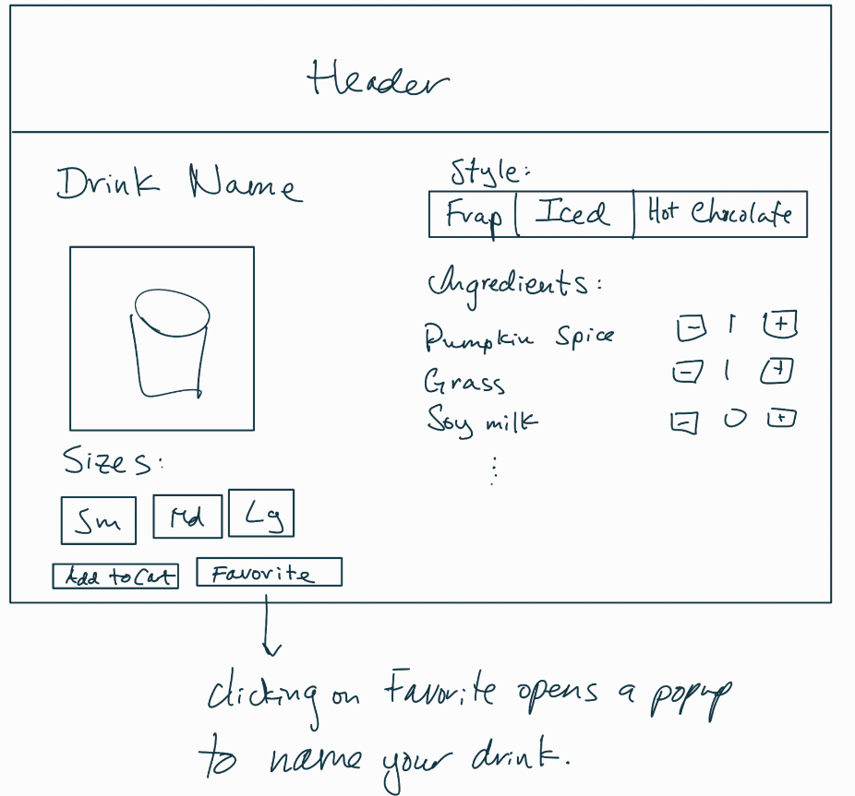
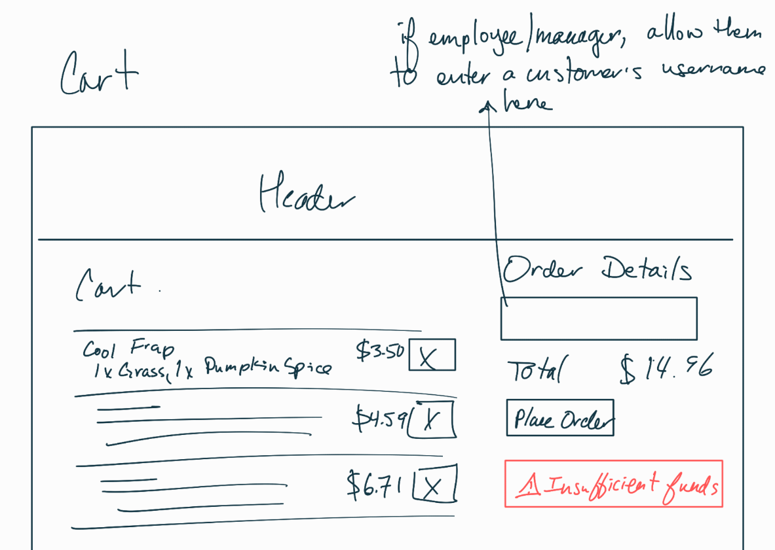
Completing an Order - Low Fidelity

Slide 13
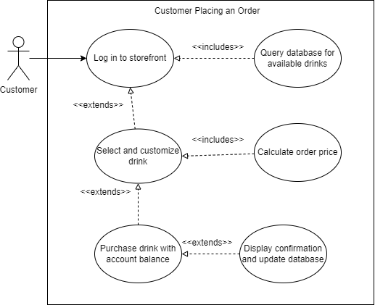
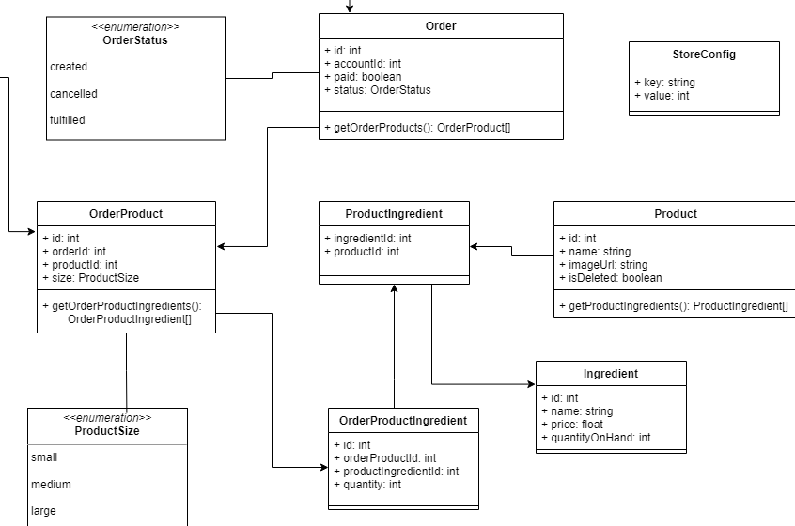
Completing an Order - Diagrams

Slide 14
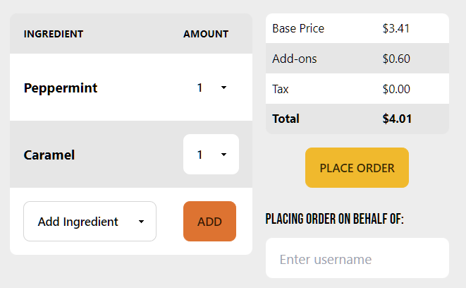
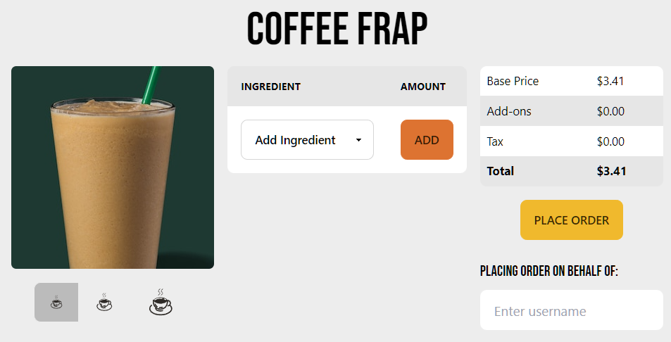
Completing an Order - Implementation

Slide 15
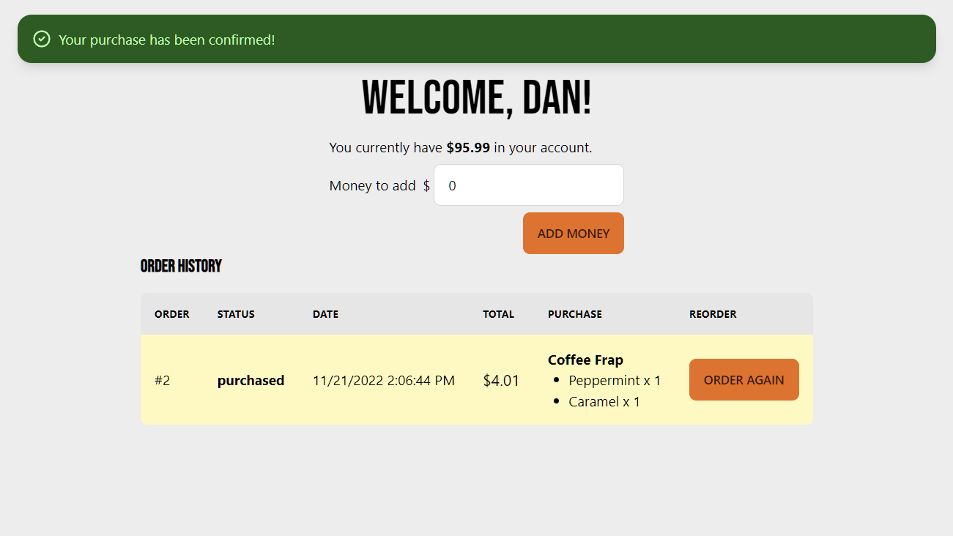

Slide 16
Trenton
Requirements Tracking
Fulfilling an Order

Slide 17
Fulfilling an Order - Requirements
After a “user” account places an order, they can see a list of their orders on their account page
This list is created by filtering from a list of all orders where the ID equals the user ID
This page will now include a “purchased” order
An employee or manager account is presented with a list of all orders that aren’t completed
This list is created by filtering from a list of all orders where the order status equals “purchased”
When the employee or manager account clicks “FULFIL ORDER”, it shifts the status of the order from “purchased” to “fulfilled”

Slide 18

Fulfilling an Order - Scrum Tasks

Slide 19
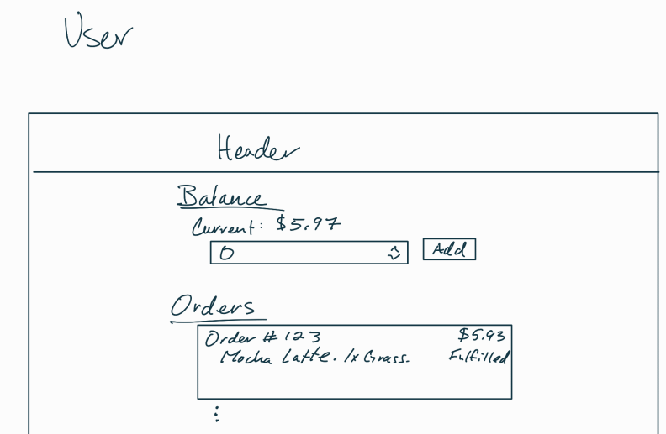
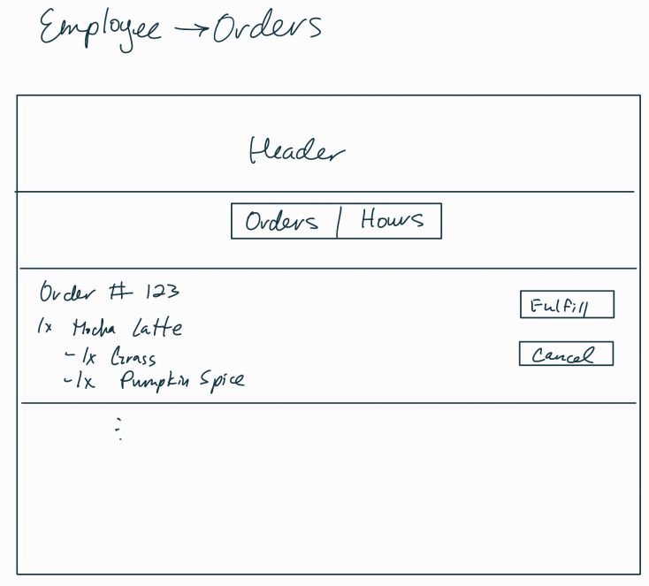
Fulfilling an Order - Low Fidelity

Slide 20
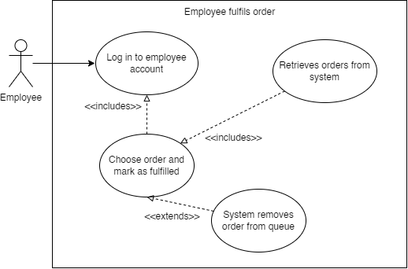
Fulfilling an Order - Diagrams

Slide 21
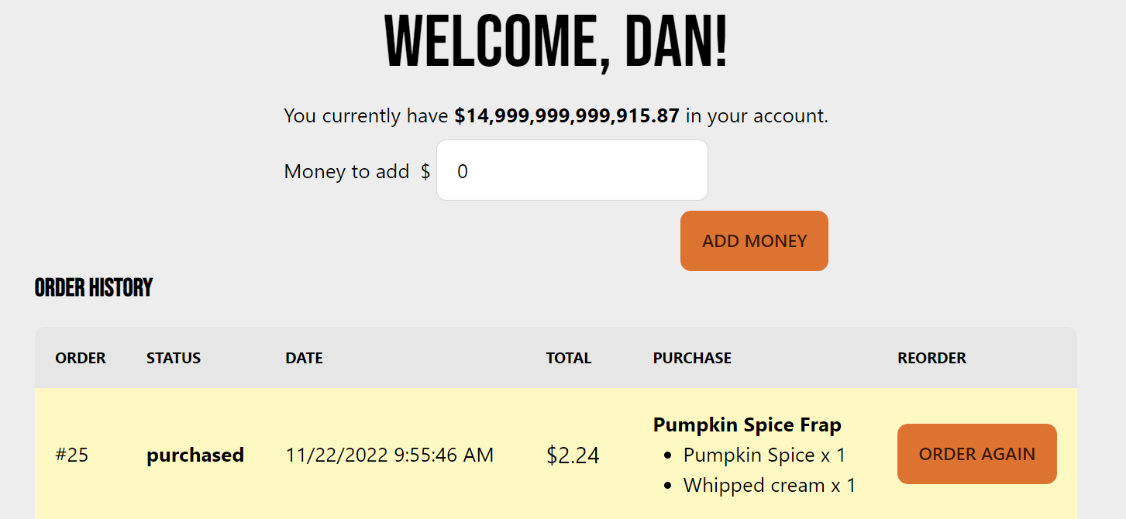
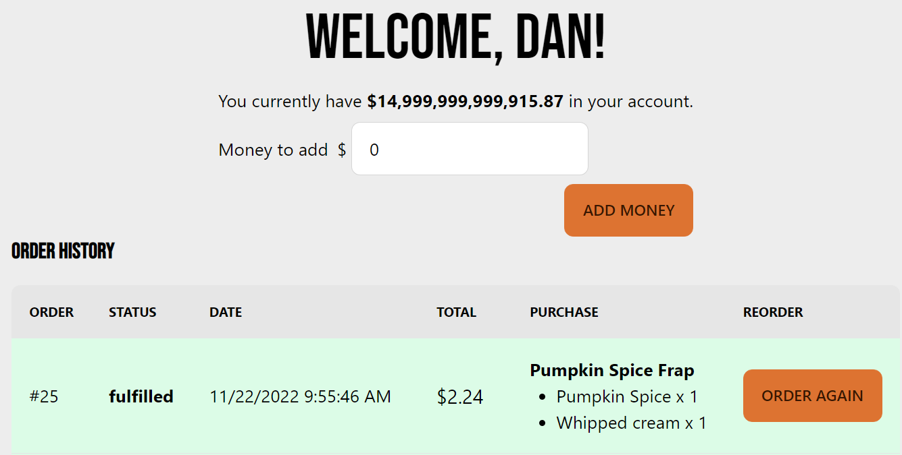
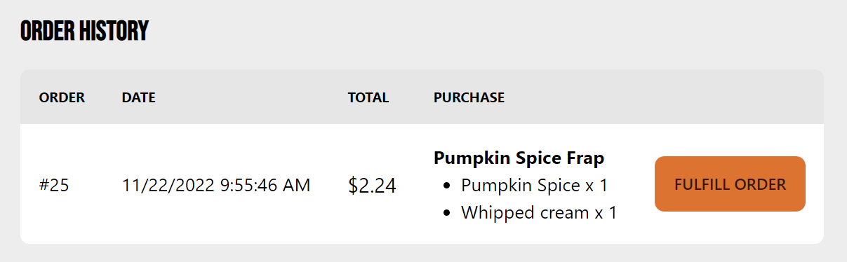
Fulfilling an Order - Implementation

Slide 22
John
Requirements Tracking
Adding Inventory

Slide 23
Adding Inventory - Requirements
After the manager has logged into their manager account they can see the manager page which includes the current inventory for each item
This list is stored in the database and updated with each order placed
This page will now include “Place An Order”
A manager account is presented with a list of all ingredients and the price for ordering more
This list displays quantity and price per unit, as well as order quantity and cost to place an order
When the manager clicks on “Place An Order”, the store balance and inventory quantity will change to reflect the order quantity and cost

Slide 24



Adding Inventory - Scrum Tasks

Slide 25
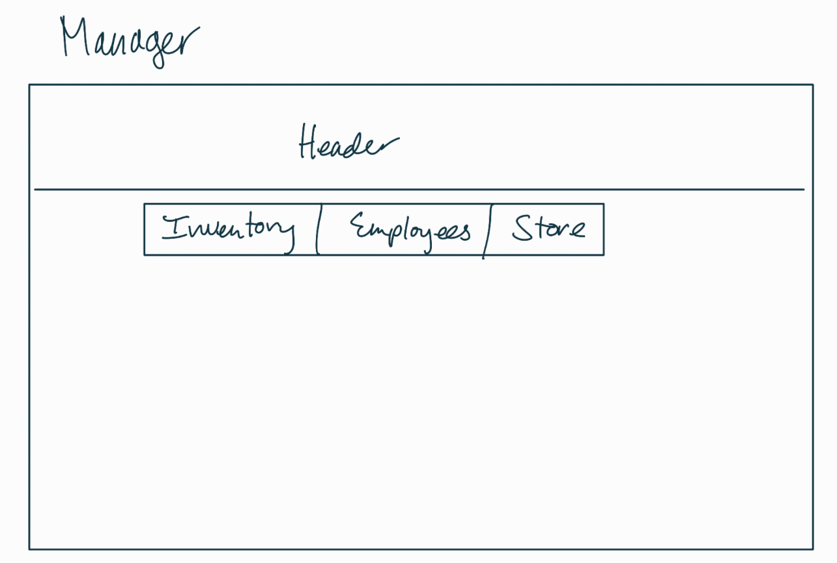
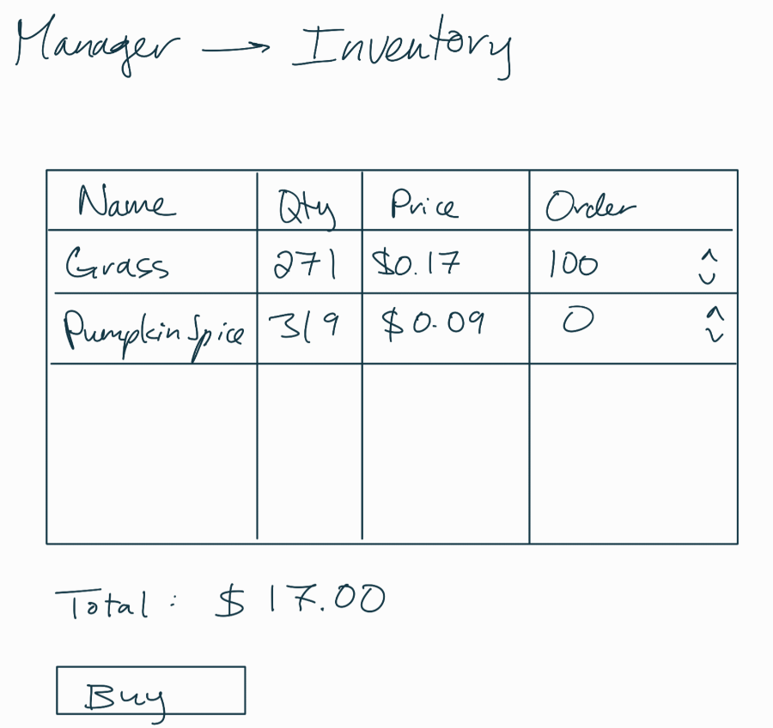
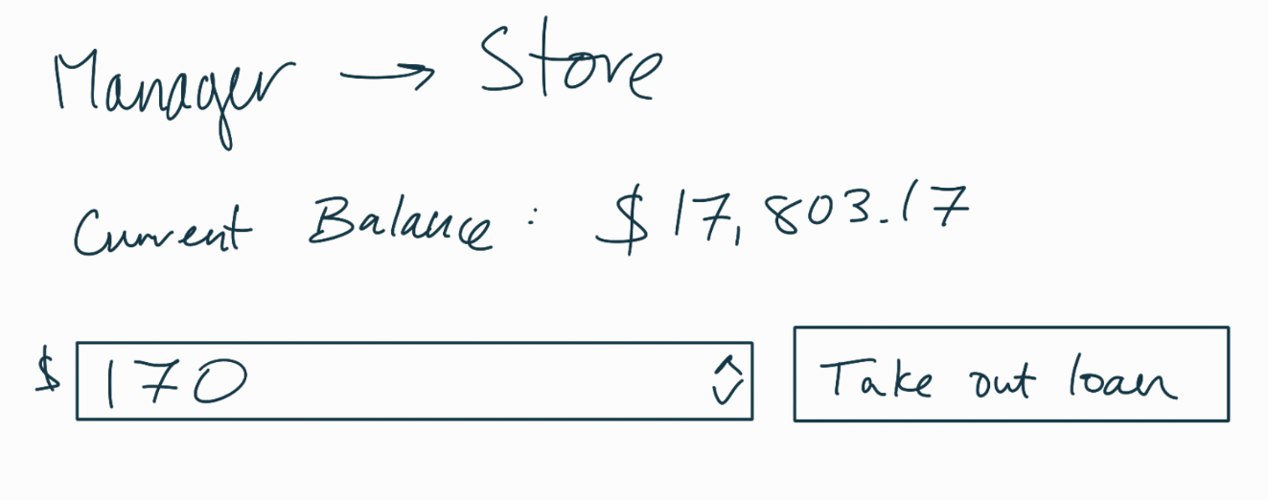
Adding Inventory - Low Fidelity

Slide 26
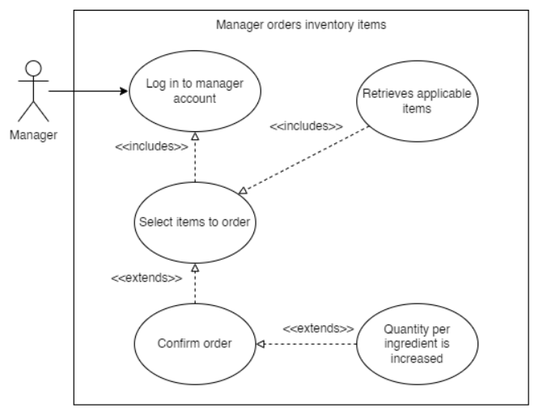
Adding Inventory - Diagrams

Slide 27
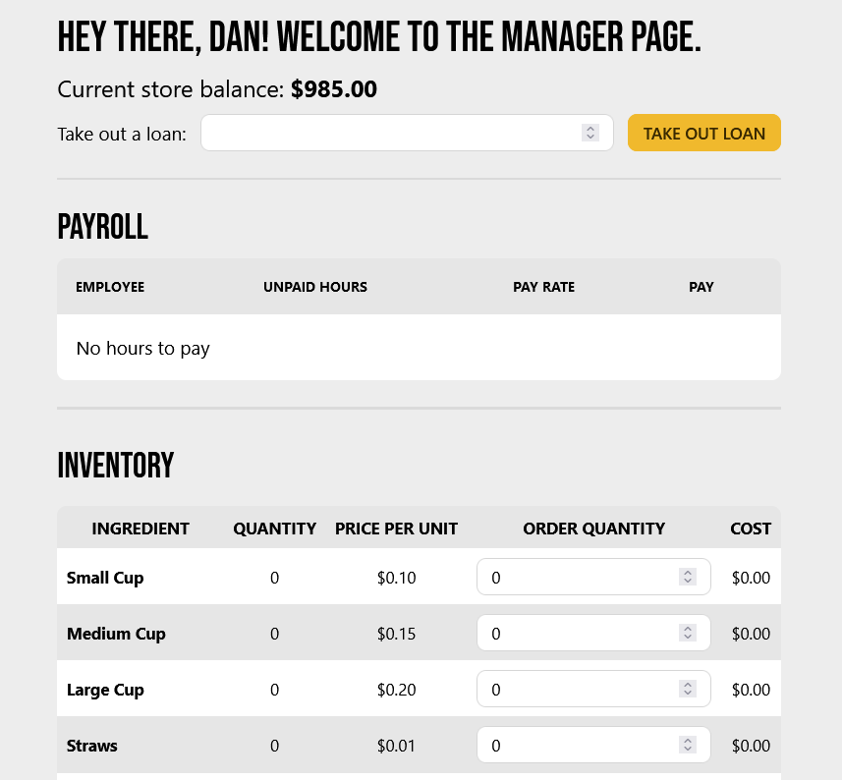
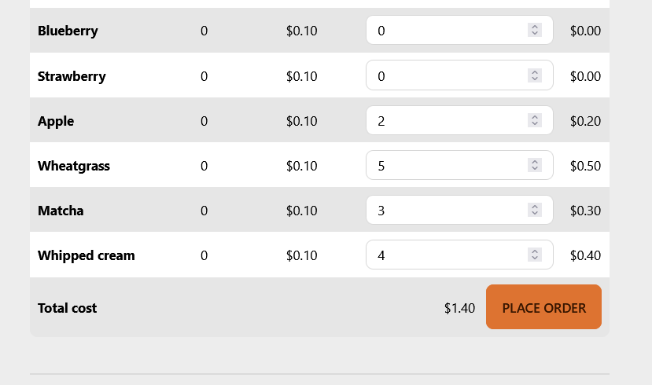
Adding Inventory - Implementation
Notes:
Clicking on the place an order button will subtract funds from the store balance. The total cost is calculated from each ingredient and their respective amounts.

Slide 28
Screen Captures

Slide 29
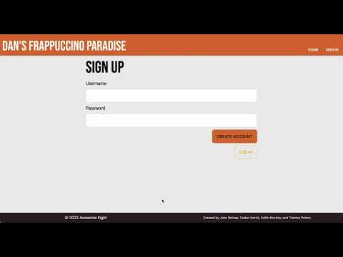
Creating an Account

Slide 30
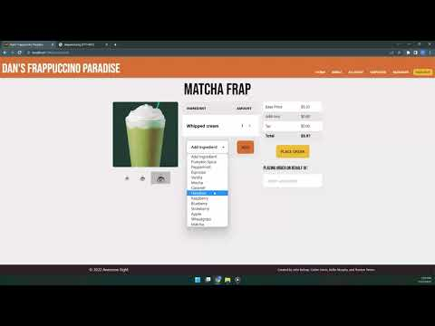
Placing
An Order

Slide 31
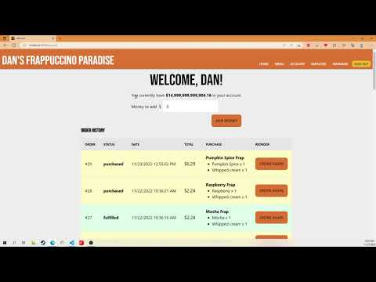
Fulfilling an Order

Slide 32

Adding Inventory

Slide 33
Resources
https://docs.astro.build/en/getting-started/
https://daisyui.com/
https://www.solidjs.com/docs/latest/api
https://tailwindcss.com/docs/installation
https://sequelize.org/docs/v6/getting-started/

Slide 34
Questions?

