Slide 1
Basics Of
Object Oriented Programming

Slide 2
Agenda
Recap of Previous Session
Class & Objects
Abstraction
Encapsulation
Inheritance
Polymorphism
Memory Management
Heap Vs Stack
Static
Variables & Functions
Constructors
Default
Copy
Parametrized

Slide 3
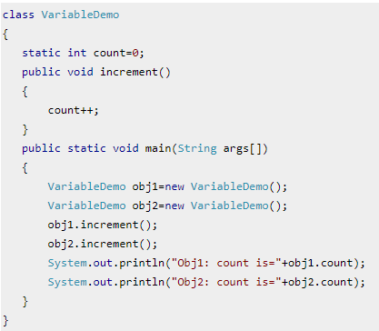
Static Variables
Static variable’s value is same for all the object(or instances) of the class
Or all instances(objects) of the same class share a single copy of static variables
Static Variable Initialization:
when class is loaded.
before any object of that class can be created
before any static method of the class runs

Slide 4
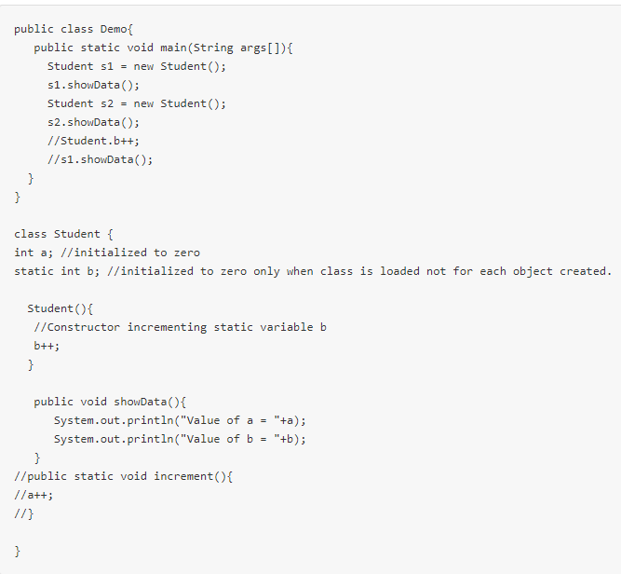
Static Methods
It is a method which belongs to the class and not to the object(instance)
A static method can access only static data. It can not access non-static data (instance variables)
A static method can call only other static methods and can not call a non-static method from it.
A static method can be accessed directly by the class name and doesn’t need any object
Syntax : <class-name>.<method-name>
A static method cannot refer to "this" or "super" keywords
in anyway

Slide 5
Constructors
Default Constructors Copy Constructors Parametrized Constructors
class MyClass1 {
int myInt;
string myString;
MyClass1()
{
myInt=0;
myString=“”;
}
}
class Program {
static void Main(string[] args)
{
MyClass m = new MyClass();
}
}
class MyClass1 {
int myInt;
string myString;
MyClass1(MyClass1 Ob)
{
myInt=ob.myInt;
myString=ob.myString;
}
}
class Program {
static void Main(string[] args)
{
MyClass m = new MyClass();
m.myInt=20;
m.String=“Hello Pal”;
MyClass ob1 = new MyClass(m);
}
}
class MyClass1 {
int myInt;
string myString;
MyClass1(int value,String st)
{
myInt=value;
myString=st;
}
}
class Program {
static void Main(string[] args)
{
MyClass m = new MyClass(5,”Hello”);
}
}

Slide 6
Constructors in Inheritance
public class ParentClass {
public ParentClass() {
Console.WriteLine("Parent Constructor.");
}
public void print() {
Console.WriteLine("I'm a Parent Class.");
}
}
public class ChildClass: ParentClass {
public ChildClass() {
Console.WriteLine("Child Constructor.");
}
public static void Main() {
ChildClass child = new ChildClass();
child.print();
}
}

Slide 7

Q & A

