Slide 1
Basics Of
Object Oriented Programming

Slide 2
Agenda
What is OOPS
Class & Objects
Abstraction
Encapsulation
Inheritance
Polymorphism
Memory Management
New Operator
Static Variables
Global Variables
Constructors

Slide 3
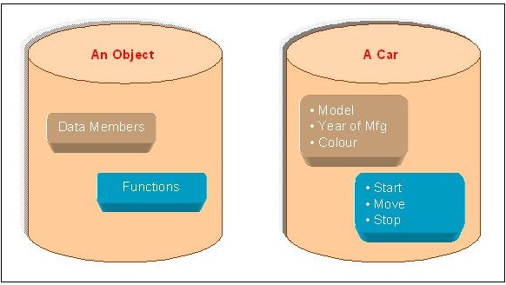
Object Oriented Programming
Object Oriented Programming (OOP) is a programming model where programs are organized around objects and data rather than action and logic
OOP allows decomposition of a problem into a number of entities called objects and then builds data and functions around these objects

Slide 4
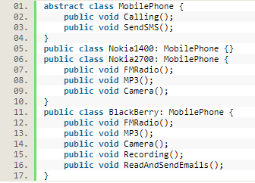
Abstraction
Abstraction is "To represent the essential feature without representing the background details.“
Abstraction lets you focus on what the object does instead of how it does it.
Abstraction provides you a generalized view of your classes or objects by providing relevant information.

Slide 5
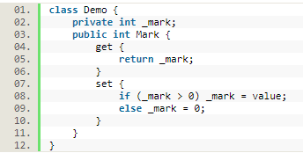

Encapsulation
Wrapping up a data member and a method together into a single unit (in other words class) is called Encapsulation
Encapsulation is like enclosing in a capsule. That is enclosing the related operations and data related to an object into that object
Encapsulation is like your bag in which you can keep your pen, book etcetera. It means this is the property of encapsulating members and functions.

Slide 6
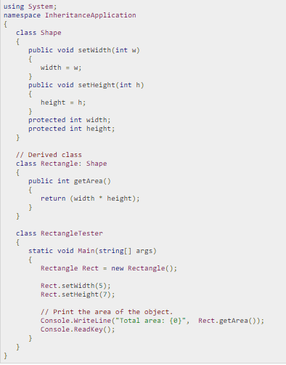
Inheritance
When a class includes a property of another class it is known as inheritance.
For example, a child includes the properties of its parents.

Slide 7
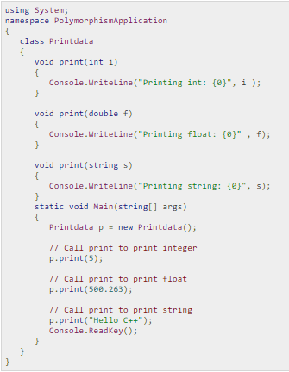
Polymorphism
The word polymorphism means having many forms. In object-oriented programming paradigm, polymorphism is often expressed as 'one interface, multiple functions'.
Polymorphism can be static or dynamic. In static polymorphism, the response to a function is determined at the compile time. In dynamic polymorphism, it is decided at run-time

Slide 8
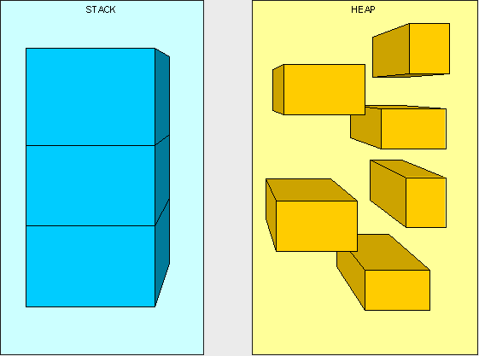
Memory Management
Stack is used for static memory allocation
Heap for dynamic memory allocation, both stored in the computer's RAM
class MyClass {
int myInt = 0;
string myString = "Something";
void Foo(int x, int y)
{
int rv = x + y + myInt;
myInt = 2^rv;
}
}
class Program {
static void Main(string[] args)
{
MyClass m = new MyClass();
}
}

Slide 9
Constructors
Default Constructors Copy Constructors Parametrized Constructors
Constructors in Inheritance
class MyClass1 {
int myInt;
string myString;
MyClass1()
{
myInt=0;
myString=“”;
}
}
class Program {
static void Main(string[] args)
{
MyClass m = new MyClass();
}
}
class MyClass1 {
int myInt;
string myString;
MyClass1(MyClass1 Ob)
{
myInt=ob.myInt;
myString=ob.myString;
}
}
class Program {
static void Main(string[] args)
{
MyClass m = new MyClass();
m.myInt=20;
m.String=“Hello Pal”;
MyClass ob1 = new MyClass(m);
}
}
class MyClass1 {
int myInt;
string myString;
MyClass1(int value,String st)
{
myInt=value;
myString=st;
}
}
class Program {
static void Main(string[] args)
{
MyClass m = new MyClass(5,”Hello”);
}
}

Slide 10
Constructors in Inheritance
public class ParentClass {
public ParentClass() {
Console.WriteLine("Parent Constructor.");
}
public void print() {
Console.WriteLine("I'm a Parent Class.");
}
}
public class ChildClass: ParentClass {
public ChildClass() {
Console.WriteLine("Child Constructor.");
}
public static void Main() {
ChildClass child = new ChildClass();
child.print();
}
}

Slide 11

Q & A

