Slide 1
Performance Testing with JMeter

Slide 2
Agenda
Test Plan
Adding/Configuring Thread groups,
Setup Thread Group
Thread Group
Teardown Thread Group
Adding/Configuring Elements

Slide 3
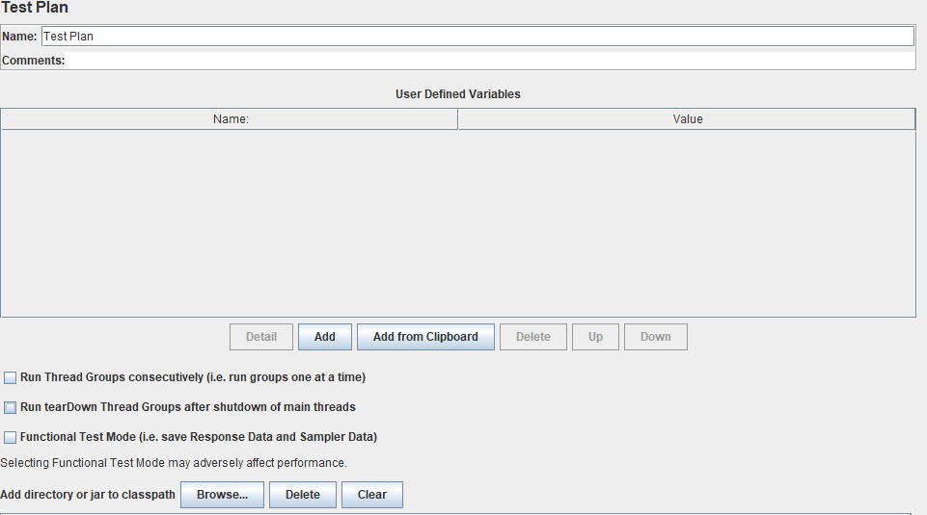
Test Plan

Slide 4
Thread Groups
Thread Group
Thread group elements are the beginning points of any test plan. All controllers and samplers must be under a thread group
Setup Thread group
Pre activities like creating user and monitoring purpose
Get a large data set from a database into a jmeter variable for use during the test.
Get and log the version number from the system under test
Teardown Thread group
A special type of ThreadGroup that can be utilized to perform Post-Test Actions. The behavior of these threads is exactly like a normal Thread Group element. The difference is that these type of threads execute after the test has finished executing its regular Thread Groups
Mainly useful for cleaning up your system (e.g. deleting users that were created during the test)

Slide 5
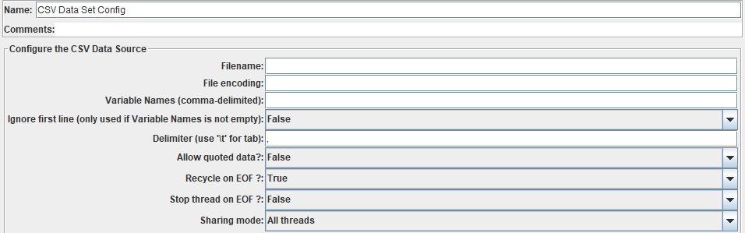
Config Elem-CSV Data Set Config

Slide 6
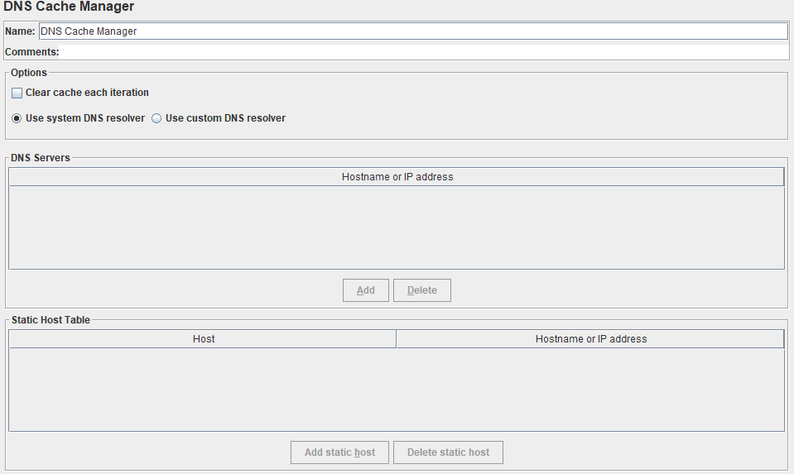
Config Elem- DNS Cache Manager

Slide 7
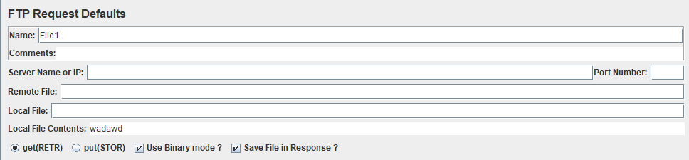
Config Elem- FTP Request Defaults

Slide 8
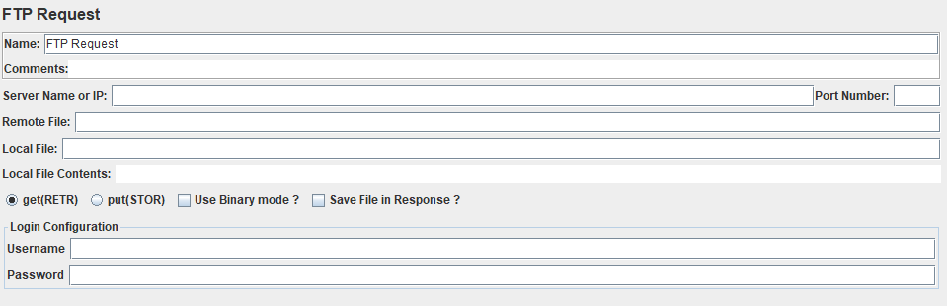
Sampler – FTP Request

Slide 9
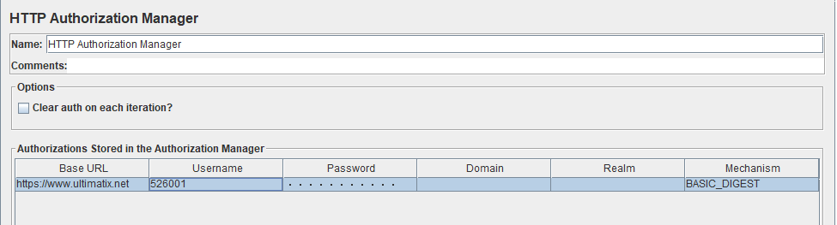
Config Elem- HTTP Auth Manager

Slide 10
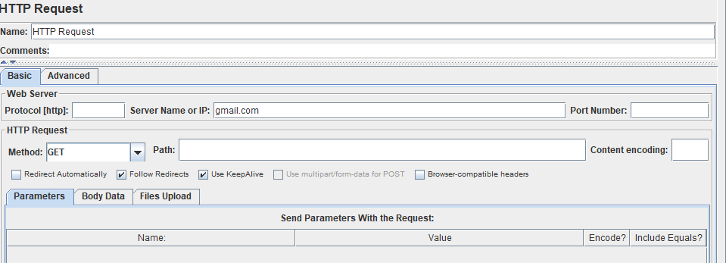
Sampler – HTTP Request

Slide 11

Q & A

