Slide 1
Performance Testing with JMeter

Slide 2
Agenda
Adding/Configuring Elements
Adding/Configuring Samplers

Slide 3
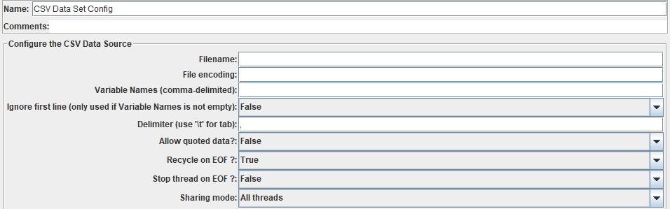
Config Elem-CSV Data Set Config

Slide 4
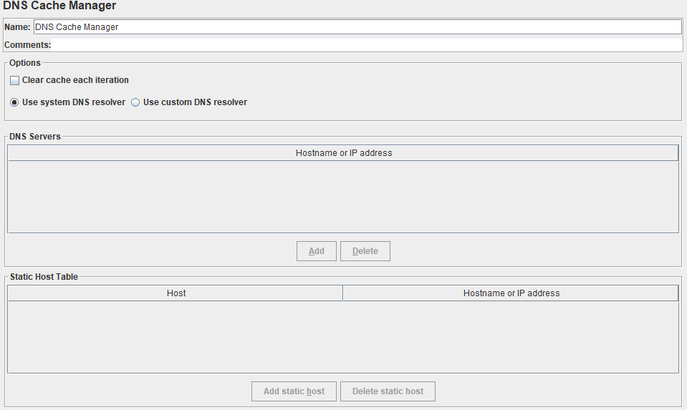
Config Elem- DNS Cache Manager

Slide 5
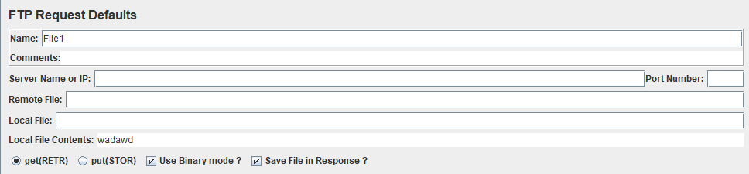
Config Elem- FTP Request Defaults

Slide 6
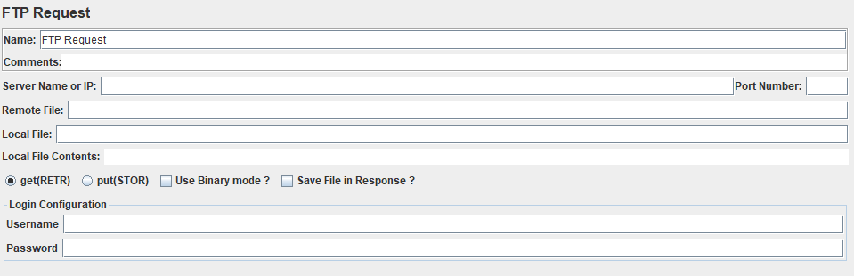
Sampler – FTP Request

Slide 7
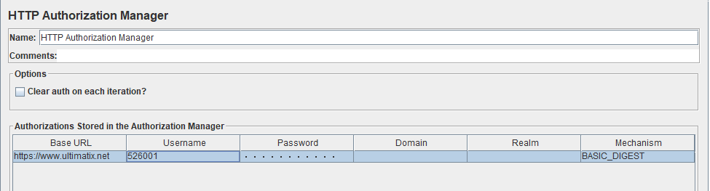
Config Elem- HTTP Auth Manager

Slide 8
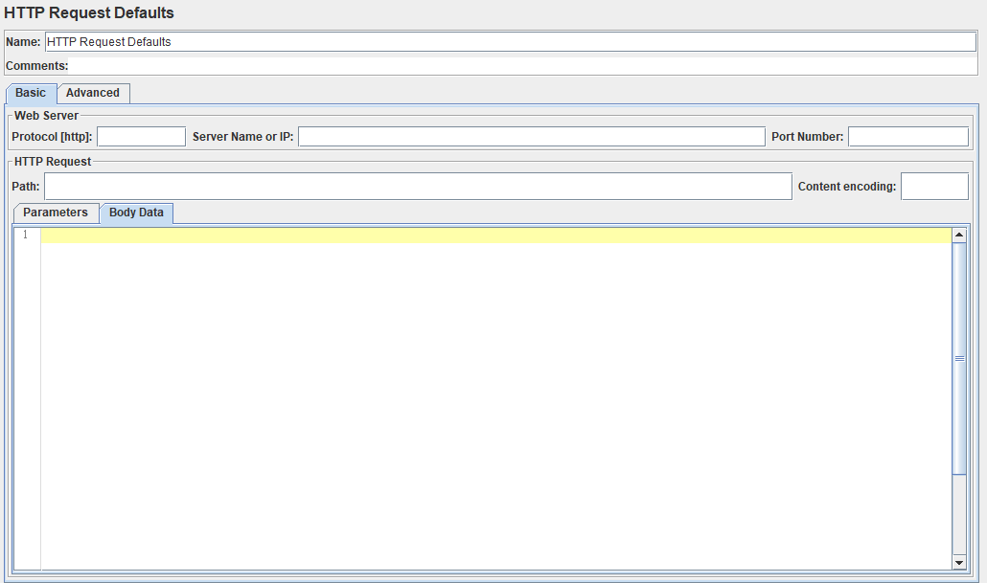
Config Elem- HTTP Request Defaults

Slide 9
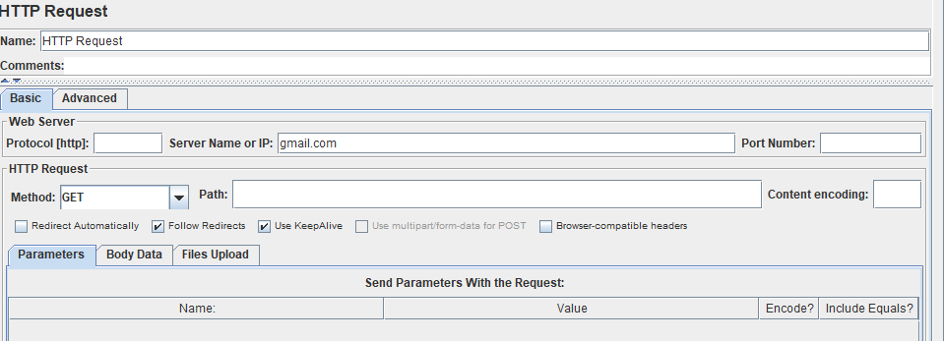
Sampler – HTTP Request

Slide 10
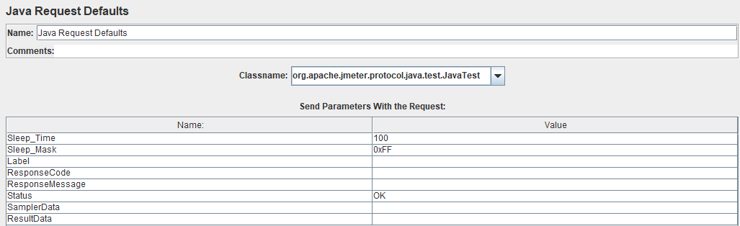
Config Elem- Java Request Defaults

Slide 11
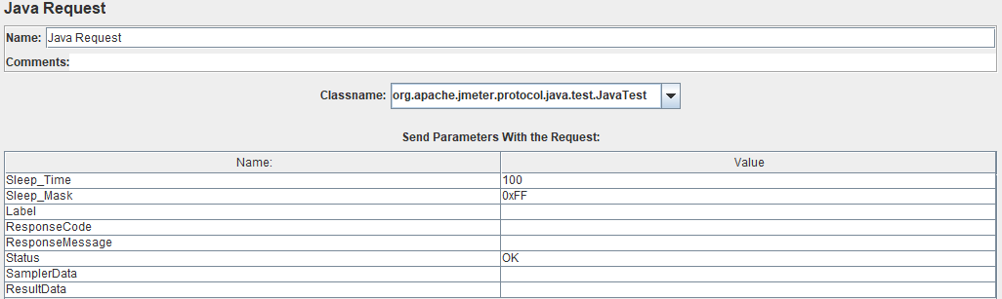
Sampler – Java Request

Slide 12
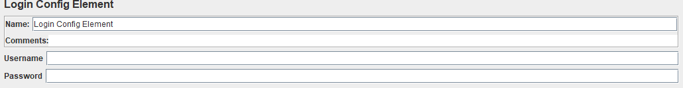
Config Elem- Login Config Element
The Login Config Element lets you add or override username and password settings in samplers that use username and password as part of their setup

Slide 13
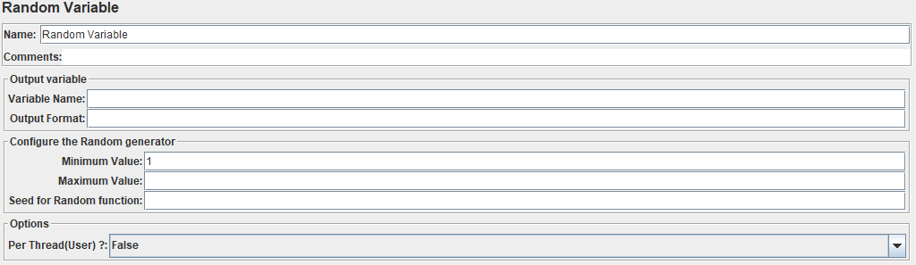
Config Elem- Random Variable
The Random Variable Config Element is used to generate random numeric strings and store them in variable for use later

Slide 14
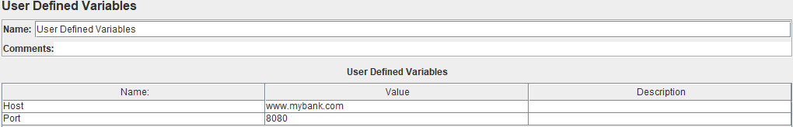
Config Elem- User Defined Variable
The User Defined Variables element lets you define an initial set of variables, just as in the test plan

Slide 15
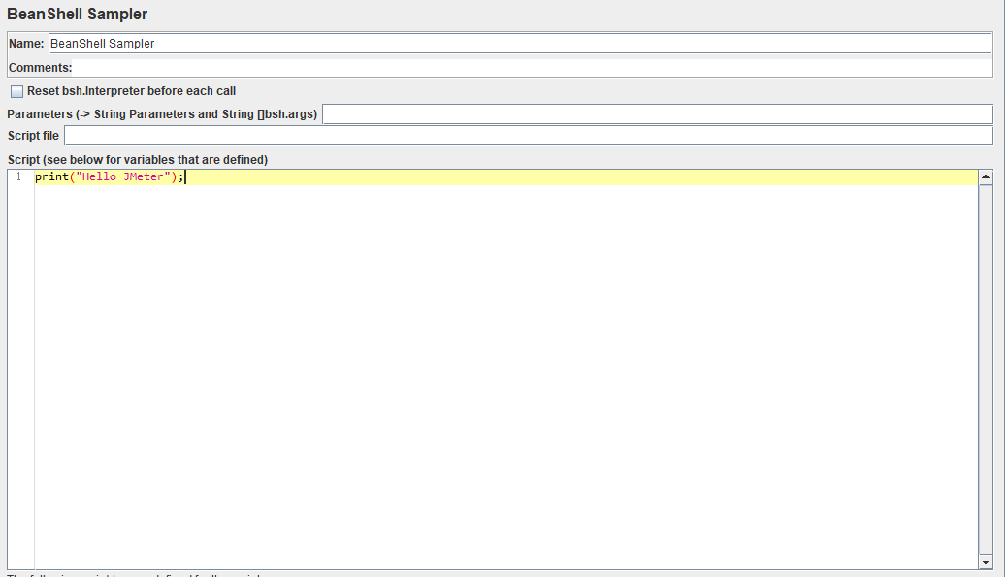
Sampler – Beanshell

Slide 16
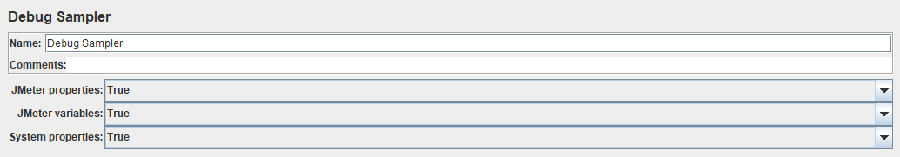
Sampler – Debug

Slide 17
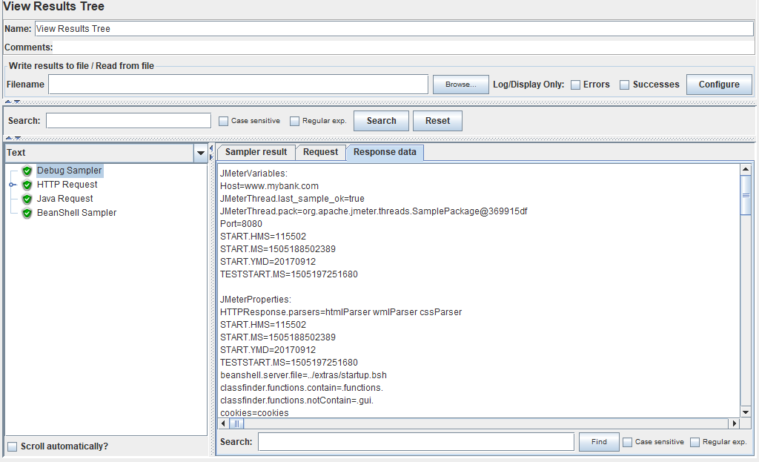

Slide 18

Q & A

