Slide 1
Performance Testing with JMeter

Slide 2
Agenda
Adding/Configuring Logic Controllers
Adding/Configuring Timers
Adding/Configuring Pre-Processors
Adding/Configuring Post-Processors
Assertions

Slide 3
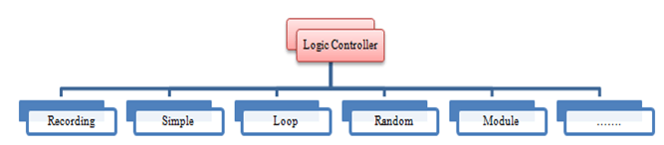
Logic Controller
Logic Controllers let you define the order of processing request in a Thread.
For example, you can use Random Controllers to send HTTP requests to the server randomly.
Logic Controllers determine the order in which user request are executed.

Slide 4
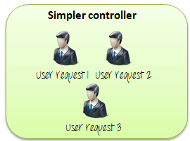
Logic Controller-Simple Controller
Simple Controller is just a container for user request.

Slide 5
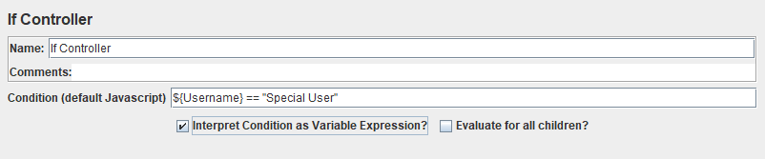
Logic Controller-If Controller
The If Controller allows the user to control whether the test elements below it (its children) are run or not.
By default, the condition is evaluated only once on initial entry, but you have the option to have it evaluated for every runnable element contained in the controller

Slide 6
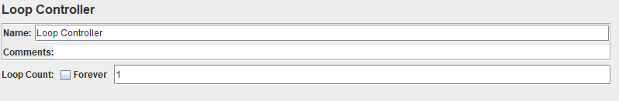
Logic Controller-Loop Controller
If you add a Loop Controller, JMeter will loop through them a certain number of times, in addition to the loop value you specified for the Thread Group
For example, if you add one HTTP Request to a Loop Controller with a loop count of two, and configure the Thread Group loop count to three, JMeter will send a total of 2 * 3 = 6 HTTP Requests

Slide 7
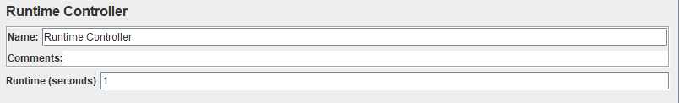
Logic Controller-Runtime Controller
The Runtime Controller controls how long its children are allowed to run

Slide 8
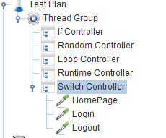
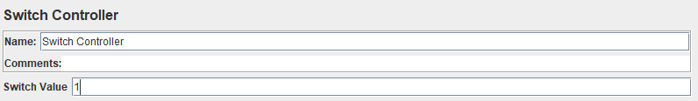
Logic Controller-Switch Controller
The Switch Controller runs one of the subordinate elements on each iteration, but rather than run them in sequence, the controller runs the element defined by the switch value.
If the switch value is out of range, it will run the zeroth element, which therefore acts as the default for the numeric case. It also runs the zeroth element if the value is the empty string.

Slide 9
Timer
The purpose of all “Timer” test elements is pausing a JMeter Thread representing a virtual user for a certain amount of time.
The main goal of using timers is simulating a virtual user’s “think time”. In the world of load testing, “think time” stands for simulating real user behavior which causes people to wait between interactions with a web application.
JMeter Timers also have their scope, but they are executed before each sampler in their scope.
If there is more than one timer in the scope, all the timers will be processed before the sampler occurs.
Additionally, timer execution time is not being recorded, so if the Timer pauses the thread for 1 second and the sampler execution time is 3 seconds, 3 seconds will be recorded as the sampler execution time

Slide 10
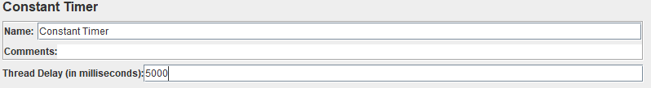
Timer- Constant Timer
The Constant Timer can be used to pause each thread for the same “think time” between requests

Slide 11
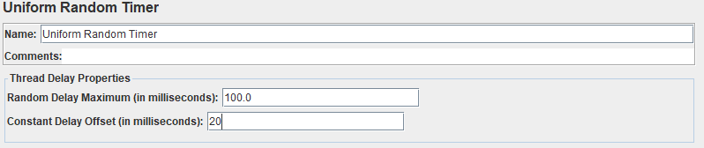
Timer- Uniform Random Timer
The Constant Timer can be used to pause each thread for the same “think time” between requests

Slide 12
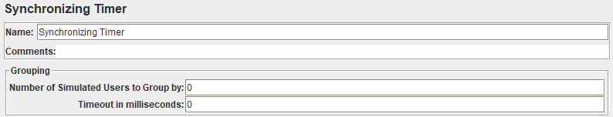
Timer- Synchronizing Timer
A Synchronizing Timer is it pauses all the threads in its scope unless their number won’t be equal or greater than the number, specified in “Number of Simulated Users to Group by” input.
It is possible to set a Synchronizing Timer’s timeout. The idea of the change is that if for some reason, the “Number of Simulated Users to Group by” will not be achieved, the test will be paused forever.
So starting from JMeter 2.12, it is possible to set the timeout value so the test could continue even if desired number of threads to kick off is not reached.

Slide 13
Pre-processors
A Pre-Processor executes some action prior to a Sampler Request being made.
If a Pre-Processor is attached to a Sampler element, then it will execute just prior to that sampler element running. A Pre-Processor is most often used to modify the settings of a Sample Request just before it runs, or to update variables that aren't extracted from response text

Slide 14
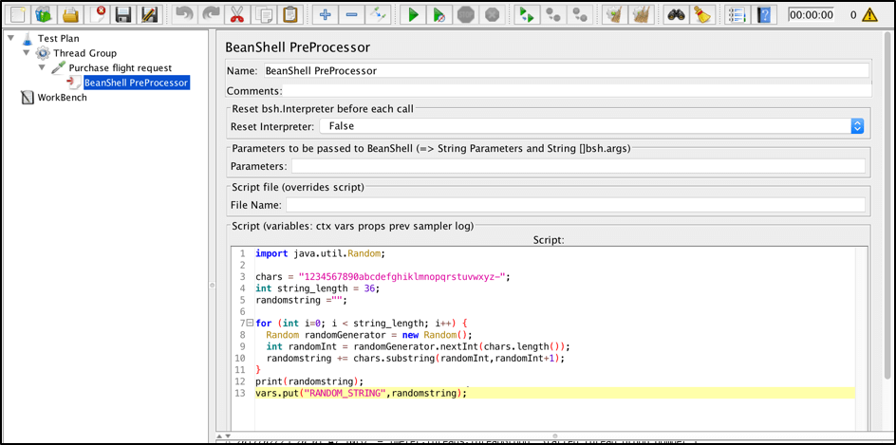
Pre-processor – Bean Shell

Slide 15
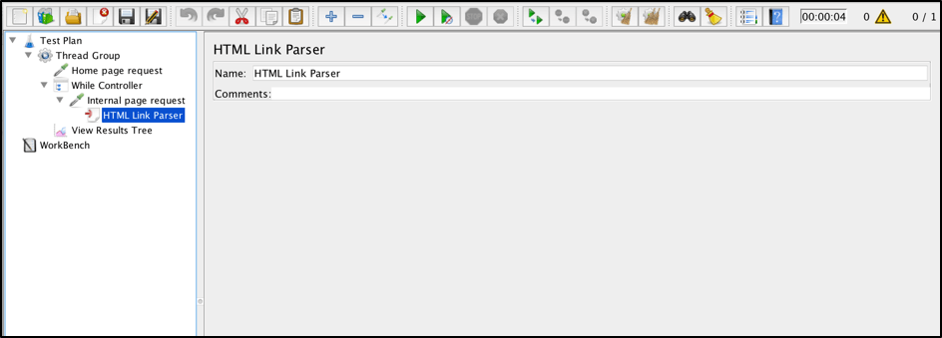
Pre-processor - HTML Link Parser
The HTML Link Parser PreProcessor can be used to parse a response, extract all the found links and request them further. This can be useful when the main goal of your script is to simulate Web Crawling

Slide 16
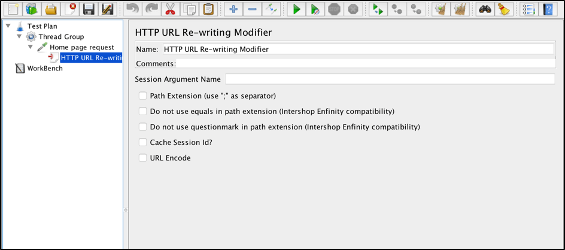
Pre-processor-HTTP URL Re-writing Modifier
The HTTP URL Re-writing Modifier Pre-Processor can be used if your application uses URL rewriting in order to store a connection session. Briefly, it allows your script to find a session id parameter on a page and add that parameter to all the requests in its scope
Path Extension - should be checked in case your application rewrites URLs by appending a semi-colon with the session parameter.
Do not use equals in path extension - should be checked if your application rewrites URLs without the “=” sign between the parameter name and value
Do not use questionmark in path extension - should be checked if your application needs to prevent query strings from ending up in the path extension
Cache Session Id - should be checked in case your application requires a session Id for later use when the session Id is not present
URL Encode URL Encode - should be checked if your application needs encoded URLs

Slide 17
Post-processors
A Post-Processor executes some action after a Sampler Request has been made.
If a Post-Processor is attached to a Sampler element, then it will execute just after that sampler element runs.
A Post-Processor is most often used to process the response data, often to extract values from it

Slide 18
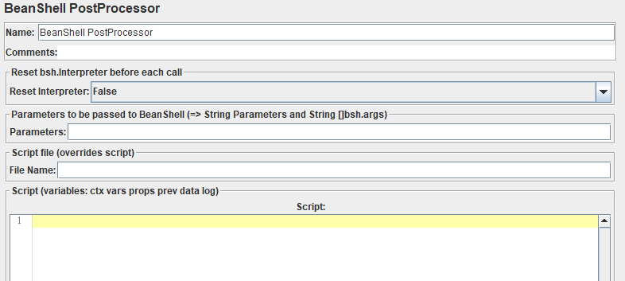

Post-processor – Bean Shell
If you want to perform computations between requests, Beanshell will help you to achieve it in jmeter
You can call java methods of a jar (should be in jmeter_folder/lib/ext) using beanshell script

Slide 19
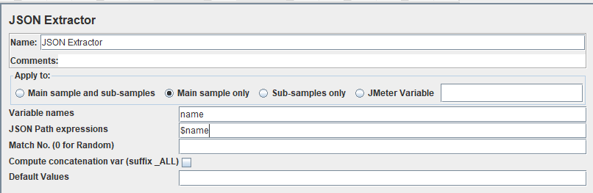
Post-processor – JSON Extractor
{
"name" = "John",
"age" = 32,
"City" = "Taipei"
}

Slide 20
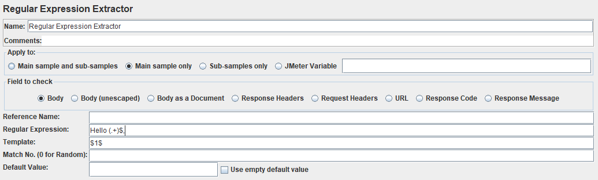
Post-processor – RegEx Extractor
Regular expression is a pattern matching language that performs a match on a given value, content or expression. The regular expression is written with series of characters that denote a search pattern. The pattern is applied on strings to find and extract the match

Slide 21
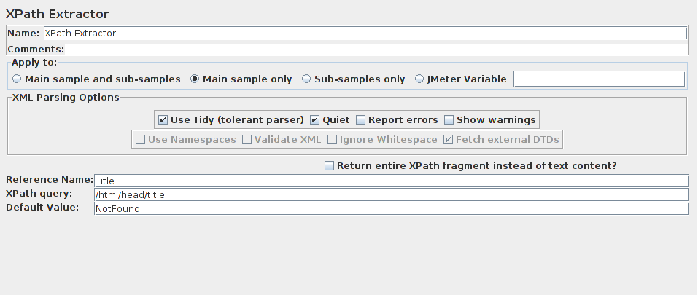
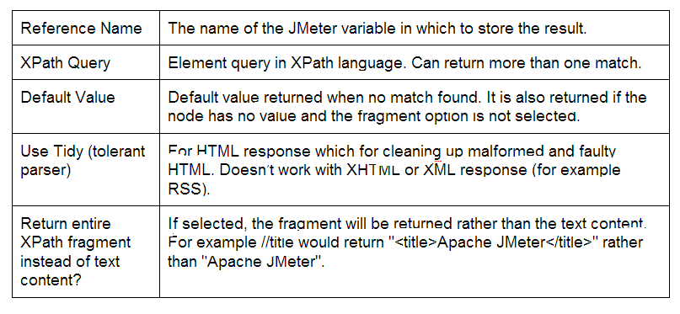
Post-processor – Xpath Extractor
When you’re writing JMeter scripts, the XPath Extractor prove to be very useful in cases where data from the response body is needed and when it becomes overly difficult to extract information using the Regular Expressions

Slide 22
Assertions
Assertion in JMeter is used to validate response of the request, that you have sent to the server.
Assertion is a process where you verify expected result with the actual result of the request at run time

Slide 23
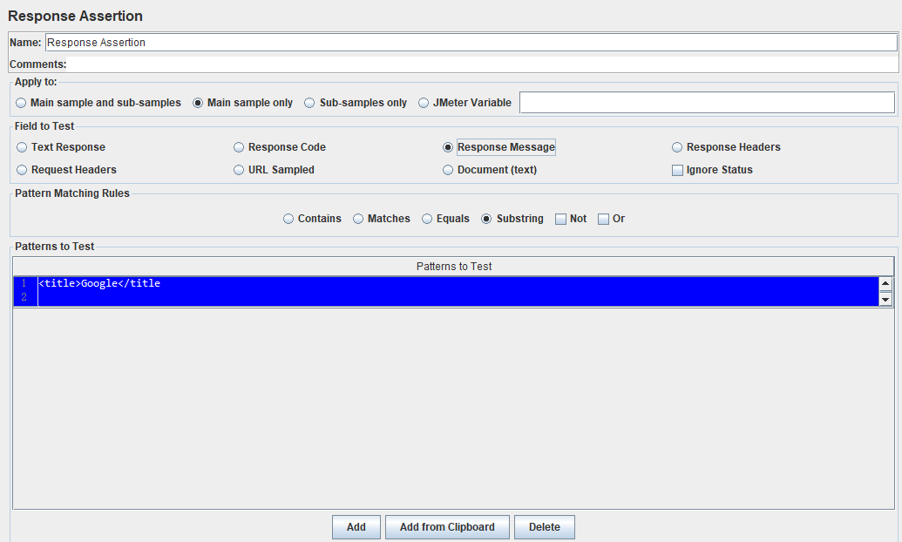
Assertion – Response Assertion
Response Assertion can be used to add and compare pattern strings against one or many values of server response
For Example, when you send a request to the URL: https://www.google.com and get the server response.
Here, you can verify this response by using Response Assertion. You can insert “<title>Google</title>” as a “Pattern to Test” field value in Response Assertion.
If response doesn’t contain this string, it will fail the sampler

Slide 24
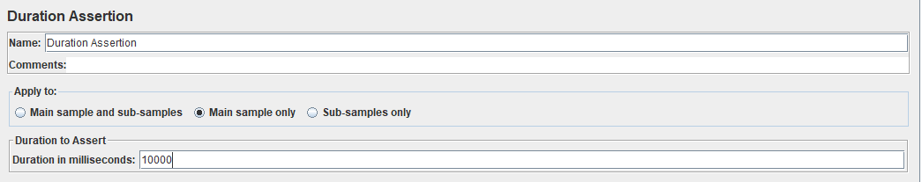
Assertion – Duration Assertion
Duration Assertion is used to verify that server response is received within a specified time constraint or not.
It will mark the sample request as failed, if response takes longer time duration than the given amount of time

Slide 25

Q & A

