Slide 1
Non Functional Testing
測試規劃科(Quality Assurance)

Slide 2
Agenda
Non-Functional Testing
What is it ?
Why should we do it?
When should we do it?
Automation Testing
What is it?
Why to Automate?
When to Automate?
Proposed CUB Testing Flow
Verification & Validation of Mybank Team’s Adoption of Software Testing

Slide 3
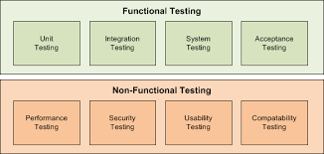

Slide 4
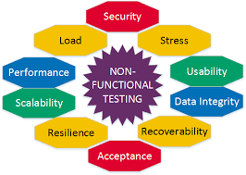
Non Functional Testing

Slide 5
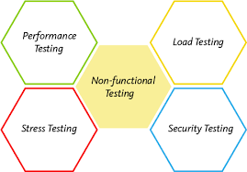
Non- Functional Testing
Non-Functional testing is a software testing technique that verifies the attributes of the system such as memory leaks, performance or robustness of the system
Our Focus Areas:
Load Testing
Performance Testing
Stress Testing
Security Testing

Slide 6

Performance Testing
It is performed to determine the system parameters in terms of responsiveness and stability under various workload.
Performance testing measures the quality attributes of the system, such as scalability, reliability and resource usage.
Performance testing is done to derive benchmark numbers for the system.
Heavy load is not applied to the system
Tuning is performed until the system under test achieves the expected levels of performance

Slide 7
Why Performance Testing
Identifies problems early on before they become costly to resolve.
Reduces development cycles.
Produces better quality, more scalable code.
Prevents revenue and credibility loss due to poor Web site performance.
Enables intelligent planning for future expansion.
To ensure that the system meets performance expectations such as response time, throughput etc. under given levels of load.
Expose bugs that do not surface in cursory testing, such as memory management bugs, memory leaks, buffer overflows, etc.

Slide 8
When to test ? & What to test?
Design Phase: Pages containing lots of images and multimedia for reasonable wait times. Heavy loads are less important than knowing which types of content cause slowdowns.
Development Phase: To check results of individual pages and processes, looking for breaking points, unnecessary code and bottlenecks.
Deployment Phase: To identify the minimum hardware and software requirements for the application.
High frequency transactions: The most frequently used transactions have the potential to impact the performance of all of the other transactions if they are not efficient.
Mission Critical transactions: The more important transactions that facilitate the core objectives of the system should be included, as failure under load of these transactions has, by definition, the greatest impact.
Read Transactions: At least one READ ONLY transaction should be included, so that performance of such transactions can be differentiated from other more complex transactions.
Update Transactions: At least one update transaction should be included so that performance of such transactions can be differentiated from other transactions.

Slide 9

Load Test
Load testing is usually defined as the process of exercising the system under test by feeding it the largest tasks it can operate with.
Load testing is sometimes called volume testing, or longevity/endurance testing.

Slide 10
Why to test ? & How to test?
User load estimation
User load distribution
User activity analysis
Production environment analysis
Database size
Simple metric collection
CPU utilization : should not exceed 60%.
Per page size. This is a indicator of the bulky-ness of the page. Response time for each transaction.
Total hits and hits/second, should not be greater than 20 or request queue details need to be collected.
% Failed transactions, should not be greater than 5%.
Number of processes running on server.
Memory details.
Measuring end-user response time
Defining optimal hardware configuration
Checking reliability
Assist the development team in determining the performance characteristics for various configuration options
Ensure that the new production hardware is no slower than the previous release
Provide input data for scalability and capacity-planning efforts
Determine if the application is ready for deployment to production
Detect bottlenecks to be tuned

Slide 11

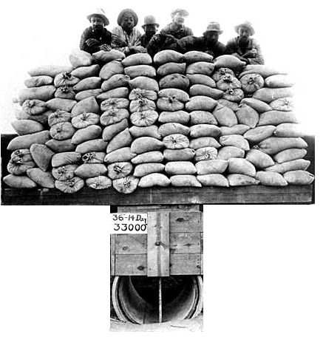
Load Testing Vs Stress Testing

Slide 12
Load Testing Vs Stress Testing
Load Testing
Process of exercising the system under test by feeding it the largest tasks it can operate with.
Constantly increasing the load on the system via automated tools to simulate real time scenario with virtual users.
Examples:
Testing a word processor by editing a very large document.
For Web Application load is defined in terms of concurrent users or HTTP connections.
Stress Testing
Trying to break the system under test by overwhelming its resources or by taking resources away from it.
Purpose is to make sure that the system fails and recovers gracefully.
Example:
Double the baseline number for concurrent users/HTTP connections.
Randomly shut down and restart ports on the network switches/routers that connects servers.

Slide 13

Automation Testing

Slide 14
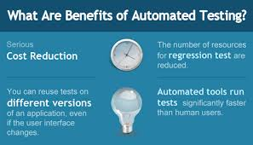

Slide 15
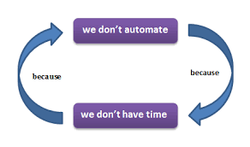

Slide 16
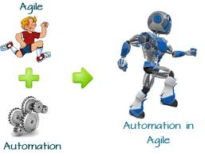

Slide 17


Raise defect and continue testing
Regression Testing
Fail
Development Of
Project Code
Code Quality Review
Unit Testing
Smoke/Sanity Testing
Pass
Pass
Pass
Pass
End Of Regression Testing
Fail
Fail
Functional Testing (Manual)
Fail
Fail
Raise defect and continue testing
Pass
Pass
Functional Testing (Manual)
Regression Testing
Pass
Smoke/Sanity Testing
No
Non-Functional Testing
Yes
Performance
Pass
Fail
Fail
Pass
Development & UT
Fail
Fail
Compatibility
Fail
SIT
Raise defect and continue testing
UAT
Optional SIT
Pass
Defect Triage
End Of Non-Functional Testing
Security
Pass
Fail
Successful Completion

Slide 18
Development Computer
UT
SIT
UAT
Manual
Ad hoc
Testing
Code Quality Review
Functional
Functional
Unit
Testing (Current feature)
Smoke Testing
(Services/UI)
Performance
(Basic)
Smoke Testing
(Services/UI)
Performance
(Basic)
Code Quality
(SonarQube
Continuous
Unit
Testing (Full)
Regression
(Full)
Performance
(Full)
Regression
(Full)
Performance
(Full)
Nightly

Slide 19
Verification & Validation of Mybank Team’s Adoption of Software Testing
Unit Testing for MyBank
Identify the test cases for Current Sprint
Coding of the Test Cases for Current Sprint
Run Unit Test cases for CI
User Story Testing For MyBank
Identify the test cases for Current Sprint
Writing Test cases in TFS
Attaching evidences to test cases after execution
Target to complete it in this sprint

Slide 20

Q & A

