Slide 1
Software Testing – Quality Assurance
27-April-2017

Slide 2
Agenda
Regression Testing
Regression Vs Retesting
System Testing
Why & When
Integration Testing
Why & When
Use Case for System & Integration Testing
Example Test Case Structure

Slide 3
Regression Testing
It is a type of software testing which verifies that software, which was previously developed and tested, still performs correctly after it was changed or interfaced with other software. Changes may include software enhancements, patches, configuration changes, etc.
New data flow paths established
New I/O may occur
New control logic invoked
Regression testing is re-execution of subset of tests that have already been conducted
Approaches
Manual testing
Capture/Playback tools
Hand Coding in Automation Frameworks (Coded UI, Selenium)

Slide 4
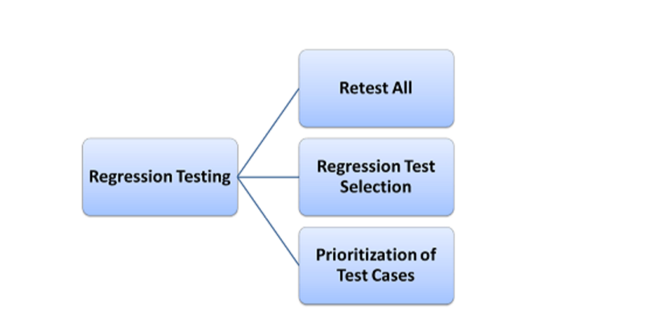
Regression Testing …contd
When to perform Regression Testing:
When we try to enhance the software
We may also bring in bugs
The software works yesterday, but not today
How to perform Regression Testing
Run old test cases on the new version of software
Efficient Regression Testing
Test prioritization
Rank all the test cases
Run test cases according to the ranked sequence
Test relevant code
Identify the test cases for the modules/features impacted

Slide 5
Regression Testing Vs Re-testing
Regression | Retesting
It is done to find out the issues which may get introduced because of any change or modification in the application. | It is done to confirm whether the failed test cases in the final execution are working fine or not after the issues have been fixed.
The purpose of regression testing is that any new change in the application should NOT introduce any new bug in existing functionality. | The purpose of retesting is to ensure that the particular bug or issue is resolved and the functionality is working as expected.
Testing test cases can be automated. | For retesting the test cases cannot be automated.
During regression testing even the passed test cases are executed. | During retesting only failed test cases are re-executed.
Regression testing is carried out to check for unexpected side effects. | Retesting is carried out to ensure that the original issue is working as expected.
Regression testing is done only when any new feature is implemented or any modification or enhancement has been done to the code. | Retesting is executed in the same environment with same data but in new build.

Slide 6
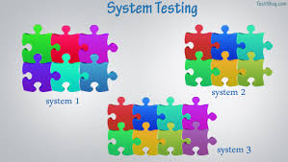
System Testing
System Testing is a level of the software testing where a complete software is tested. The purpose of this test is to evaluate the system's compliance with the specified requirements
The system test should detect any errors promoted between modules within the same system. As a result of a completed system test, all internal 'hand-shaking' will have been verified.

Slide 7
Why & When to Perform System Testing
Why System Testing ?
First level of testing where the System is tested as a whole.
Check if system meets functional requirement or not.
System is tested in an environment that particularly resembles the production environment where the application/software will be deployed
When ?
Unit Testing should be finished
Smoke & Sanity Testing should be finished
Integration of modules should be fully integrated

Slide 8
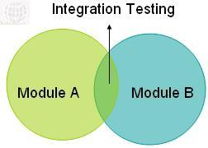
Integration Testing

Slide 9
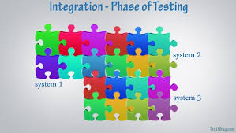
Integration Testing
Integration testing is the phase in software testing in which individual software systems are combined and tested as a group.
It occurs after system testing and before Acceptance Test.

Slide 10
Why & When to Perform Integration Testing
Why Integration Testing ?
Fields are defined differently. For instance, one system assumes a field can hold 10 characters, while another system is programmed to hold 11
One system expects a phone number to be 10 digits. Another expects the phone number to include the dashes
The modules still have errors that were not uncovered in unit/system testing
When to Perform Integration Testing
Unit and System testing has been completed and signed-off for all the systems
All code and applications are present in the environment
All test cases have been documented and approved

Slide 11
System & Integration Testing Scenario
User Story
CUB has implemented a new feature by allowing foreigners able to open new account in any of CUB branches in Taiwan with proper visa/residency documents
How do we perform System Testing ?
How do we perform Integration Testing ?

Slide 12
Example Test Case
Test case ID: 123_Add_New_Foreign_Account
Pre-conditions: Condition-1 Condition-2
Scenario: Creating a new foreign customer
Expected result | Action
Result-1 | Step-1
Result-2 | Step-2
Final Result | Step-3
Test results
Actual results: <Actual Result> Expected and Actual are matching and so, the test case is PASS |  | Passed Failed
Defect diagnosis:

Slide 13


