Slide 1
Serialization

Slide 2
Agenda
What is Serialization & DeSerialization
Why do we need Serialization.
How to do Serialization
How to do Deserialization

Slide 3
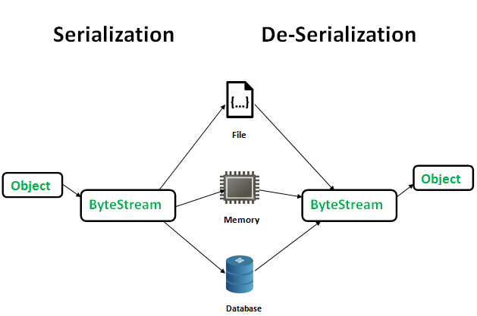
Serialization
Serialization is the process of converting an object into a stream of bytes in order to store the object in disk or database, or a file.
Its main purpose is to save the state of an object in order to be able to recreate it when needed.
The reverse process is called deserialization

Slide 4
Why Serialization ?
Serialization is the only way to persist the state of an object.
It can store the objects in a disk/database/file
We already have the object in memory. Why do we need to persist/store in disk again ?

Slide 5
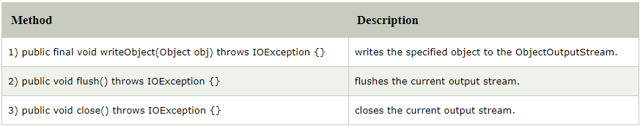
Implementing Serialization
Serializable is a marker interface (has no data member and method). It is used to "mark" classes so that objects of these classes may get certain capability.
It must be implemented by the class whose object you want to persist
import java.io.Serializable;
public class Student implements Serializable{
int id;
String name;
public Student(int id, String name) {
this.id = id;
this.name = name;
}
}

Slide 6
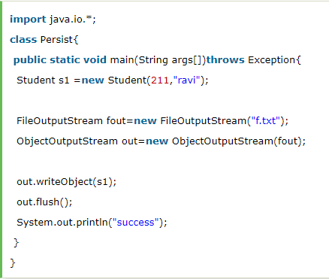
Serialization Example
import java.io.Serializable;
public class Student implements Serializable{
int id;
String name;
public Student(int id, String name) {
this.id = id;
this.name = name;
}
}

Slide 7
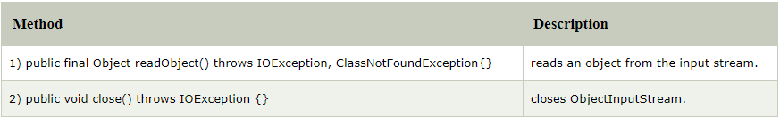
DeSerialization
Deserialization is the process of reconstructing the object from the serialized state.
It is the reverse operation of serialization.
An ObjectInputStream deserializes objects and primitive data written using an ObjectOutputStream

Slide 8
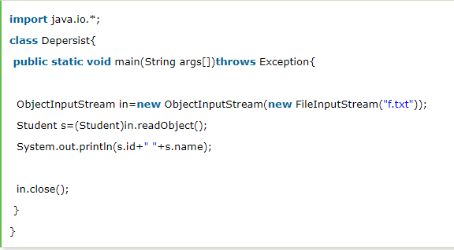
DeSerialization Example

Slide 9

Q & A

