Slide 1
Software Testing – Quality Assurance
25-April-2017

Slide 2
Agenda
What is Software Testing
Why, When & Who
Testing Tactics
White Box Testing
Black Box Testing
Grey Box Testing
Software Testing Lifecycle
Testing Phases

Slide 3
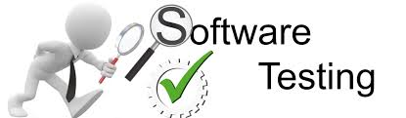
What is Software Testing
Software testing is a process of executing a program or application with the intent of finding the software bugs.
It can also be stated as the process of validating and verifying that a software program or application or product: Meets the business and technical requirements that guided it's design and development.

Slide 4
Why Testing is a skill
To develop an effective test, one must have:
Detailed understanding of the system
Application and solution domain knowledge
Knowledge of the testing techniques
Skill to apply these techniques
Testing is done best by independent testers
We often develop a certain mental attitude that the program should behave in a certain way when in fact it does not
Programmers often stick to the data set that makes the program work
A program often does not work when tried by somebody else.
Notes:
Testing often viewed as dirty work.
To develop an effective test, one must have:
Detailed understanding of the system
Knowledge of the testing techniques
Skill to apply these techniques in an effective and efficient manner
Testing is done best by independent testers
We often develop a certain mental attitude that the program should in a certain way when in fact it does not.
Programmer often stick to the data set that makes the program work
"Don’t mess up my code!"
A program often does not work when tried by somebody else.
"Every new user uncovers a new class of bugs”

Slide 5


Why do we Test ?
Provide confidence in the system
Identify areas of weakness
Establish the degree of quality
Establish the extent that the requirements have been met, i.e. what the users asked for is what they got not what someone else though they wanted
To provide an understanding of the overall system
To prove it is both usable and operable
To provide sufficient information to allow an objective decision on applicability to deploy

Slide 6

How much do we need to test
How good does the product need to be?
How do we measure it?
How do we make a decision?
Are there any legal or compliance issues?
What industry are you in?
What will it cost?
Time and resources ?
Are we capable?
We know what we need to do but can we do it?

Slide 7
When do we need to test
Once the code is complete?
As soon as the architecture is defined?
Once the system delivery is complete?
During development?
Once the business requirements have been defined?
As soon as the project is given the go-ahead?

Slide 8
Who will test
Developers
Testers
Analysts
Customers/End Users
Users: those who will ultimately use the system
Customers: those who define the system – are they the same as the users?

Slide 9
Evolution Of Software Testing
Alpha & Beta Testing (Traditional COTS Products)
System Testing -> Integration Testing
Unit Testing -> System Testing -> Integration Testing
Unit Testing -> System Testing(Functional/Non-Functional) -> Integration Testing(Functional/Non-Functional)
Unit Testing -> System Testing(Functional/Non-Functional/Automated) -> Integration Testing(Functional/Non-Functional/Automated)

Slide 10
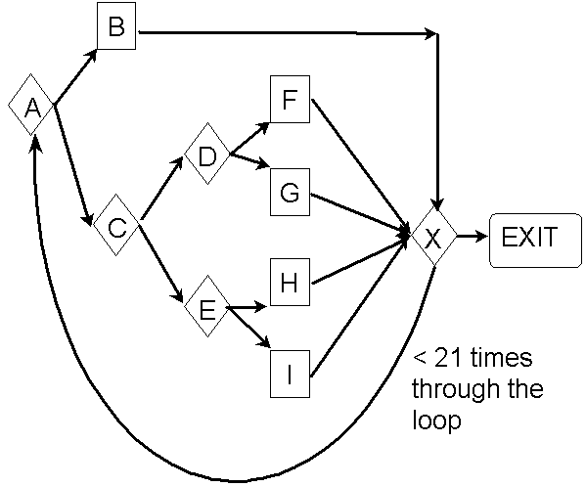



Still Defects in Code .... WHY???
User executed untested code.
User executed statements in a different order than was tested.
User entered an untested combination of inputs.
User’s operating environment was not tested.
Too many possible paths.
Too many possible inputs.
Too many possible user environments

Slide 11
Testing Tactics
White Box
Black Box
Grey Box

Slide 12
White Box Testing
Testing based on Complete knowledge of internal code
structure and logic
The System
Meets
Specs ?
Logic
Works ?
„White Box”

Slide 13
Black Box Testing
Testing based on external specifications without
knowledge of how the system is constructed
The System
Meets
Specs ?
„Black Box”
Fit for
Use

Slide 14
Grey Box Testing
Testing based on external specifications with
limited knowledge of how the system is constructed
The System
Meets
Specs ?
Known Logic
Works ?
„Grey Box”
Fit for
Use

Slide 15
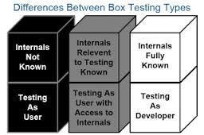
Black Vs Grey Vs White

Slide 16
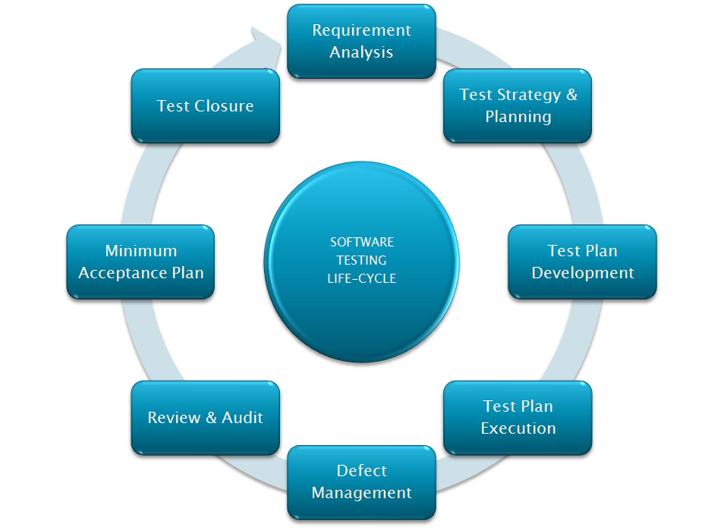
Software Testing Lifecycle

Slide 17
Testing Phases
Object Design
Document
Requirements Analysis
Document
System Design
Document
Client
Expectation
Unit Testing
System Testing
Integration Testing
Acceptance Testing
Developer
Tester
Customer

Slide 18


