Slide 1
Software Testing – Quality Assurance
25-April-2017

Slide 2
Agenda
Unit Testing
What is Unit Testing
Importance of Unit Testing
Unit Testing Approach
Coverage Testing
Boundary Value Testing
Code Coverage Testing
Boundary Value Testing
Negative Testing
Smoke Testing
Advantages
Scope Of Smoke Testing
Process Of Smoke Testing
Sanity Testing
Smoke Vs Sanity Testing

Slide 3
Unit Testing
Unit
Unit
Unit
Unit
System

Slide 4
What is Unit Testing
Unit Testing is a level of software testing where individual units/ components of a software are tested.
The purpose is to validate that each unit of the software performs as designed. A unit is the smallest testable part of software. It usually has one or a few inputs and usually a single output.
Unit
Unit
Unit
Unit
System

Slide 5
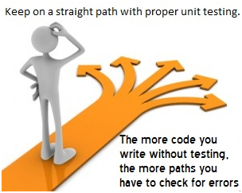
Importance Of Unit Testing

Slide 6
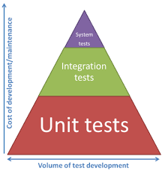
Of course .. Cost Effective

Slide 7
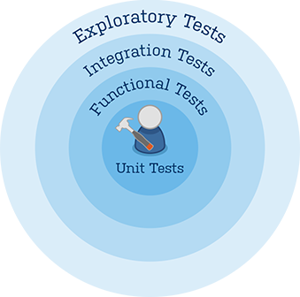
Unit Testing ..contd.
How to perform Unit Testing
Individual component (class or subsystem)
Carried out by developers
Goal: Confirm that the component or subsystem is correctly coded and carries out the intended functionality
Static Testing (at compile time)
Static Analysis
Compiler warnings on uninitialized variables
Undocumented coding blocks
Review
Walk-through (informal)
Code inspection (formal)
Dynamic Testing (at run time)
White-box testing.

Slide 8
Coverage Testing
Feature Based Coverage
Requirement Coverage
User Stories Coverage
Code Based Coverage
Statement Coverage
Branch Coverage
Path Coverage
Condition Coverage
Boundary Value Testing

Slide 9
Statement Coverage
Following test set will give us statement coverage:
T₁ = {
(x=12,y=5), (x= −1,y=35),
(x=115,y=−13),(x=−91,y= −2)
}
There are smaller test cases which will
give us statement coverage too:
T₂ = {
(x=12,y= − 5), (x= −1,y=35)
}
Which is correct ?
areTheyPositive(int x, int y)
{
if (x >= 0)
print(“x is positive”);
else
print(“x is negative”);
if (y >= 0)
print(“y is positive”);
else
print(“y is negative”);
}

Slide 10
Statement Vs Branch Coverage
assignAbsolute(int x)
{
if (x < 0)
x := -x;
z := x;
}
Consider this program segment, the test set
T = {x=−1} will give statement coverage,
however not branch coverage
B0
Control Flow Graph:
(x < 0)
true
false
B1
Test set {x=−1} does not
execute this edge, hence, it
does not give branch coverage
x := -x
B2
z := x

Slide 11
Path Coverage
areTheyPositive(int x, int y)
{
if (x >= 0)
print(“x is positive”);
else
print(“x is negative”);
if (y >= 0)
print(“y is positive”);
else
print(“y is negative”);
}
B0
(x >= 0)
true
false
B1
B2
print(“x is p”)
print(“x is n”)
B3
(y >= 0)
true
false
B4
B5
Test set:
T₁ = {(x=12,y=5), (x= −1,y=35),
(x=115,y=−13),(x=−91,y= −2)}
gives both branch, statement and path
coverage
print(“y is p”)
print(“y is n”)
B6
return

Slide 12
Condition Coverage
something(int x)
{
if (x < 0 || y < x)
{
y := -y;
x := -x;
}
z := x;
}
T = {(x=−1, y=1), (x=1, y=1)} will achieve
statement, branch and path coverage, however T will not achieve condition coverage because the boolean term (y < x) never evaluates to true. This test set satisfies part (1) but does not satisfy part (2).
B0
T = {(x=−1, y=1), (x=1, y=0)}
will not achieve condition coverage either. This test set satisfies part (2) but does not satisfy part (1). It does not achieve branch coverage since both test cases take the true branch, and, hence, it does not achieve condition coverage by definition.
(x < 0 || y < x)
true
false
B1
y := -y;
x := -x;
Control Flow Graph
B2
T = {(x=−1, y=−2), {(x=1, y=1)}
achieves condition coverage.
z := x

Slide 13
Boundary Value Testing
Boundary value analysis focuses on the boundary of the input space to identify test cases.
The rationale behind boundary value analysis is that errors tend to occur near the extreme values of an input variable.
Programs written in non-strongly typed languages are more appropriate candidates for boundary value testing.
The basic idea in boundary value analysis is to select input variable values at their:
Minimum
Just above the minimum
A nominal value
Just below the maximum
Maximum

Slide 14
Example For Boundary Value Testing
public class MyCalendar {
public int getNumDaysInMonth(int month, int year)
throws InvalidMonthException
{ … }
}
Representation for month:
1: January, 2: February, …., 12: December
Representation for year:
1904, … 1999, 2000,…, 2006, …
How many test cases do we need for the black box testing of getNumDaysInMonth()?

Slide 15

Smoke Testing
Smoke Testing, also known as “Build Verification Testing”, is a type of software testing that comprises of a non-exhaustive set of tests that aim at ensuring that the most important functions work. The results of this testing is used to decide if a build is stable enough to proceed with further testing.
The term ‘smoke testing’, it is said, came to software testing from a similar type of hardware testing, in which the device passed the test if it did not catch fire (or smoked) the first time it was turned on
ADVANTAGES
It exposes integration issues.
It uncovers problems early.
It provides some level of confidence that changes to the software have not adversely affected major areas (the areas covered by smoke testing, of course)

Slide 16
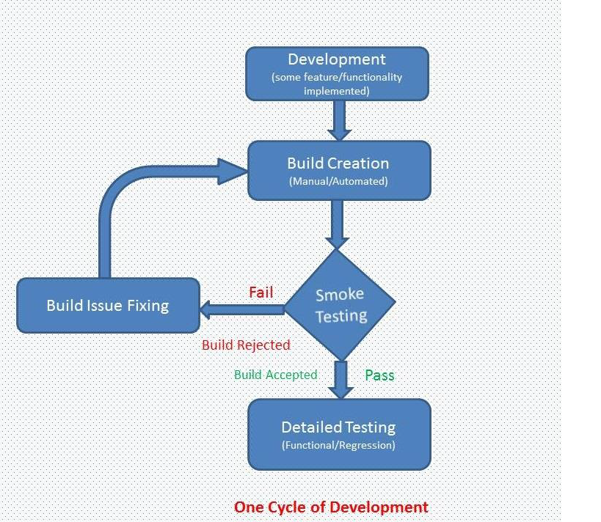
Scope Of Smoke Testing

Slide 17
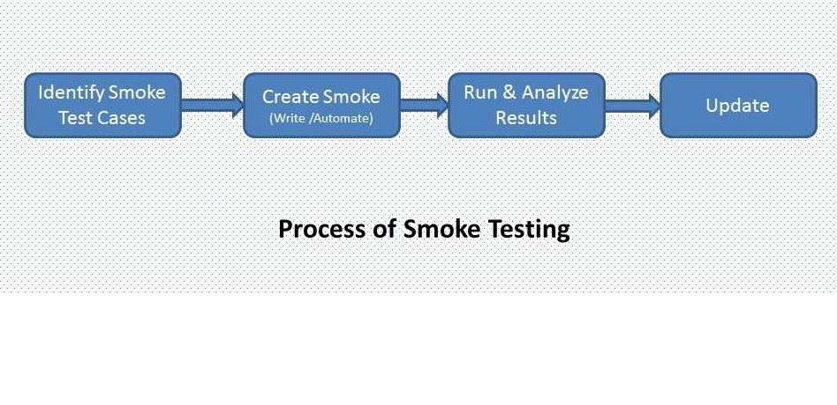
Process Of Smoke Testing

Slide 18
Sanity Testing
Sanity testing is a kind of Software Testing performed to ascertain that the bugs have been fixed and the proposed new functionality works roughly as expected and no further issues are introduced due to these changes.
If sanity test fails, the build is rejected to save the time and costs involved in a more rigorous testing.
The objective is "not" to verify thoroughly the new functionality, but to determine that the developer has applied some rationality (sanity) while producing the software. For instance, if your scientific calculator gives the result of 2 + 2 =5! Then, there is no point testing.

Slide 19
Smoke Testing Vs Sanity Testing
Smoke Testing | Sanity Testing
Smoke Testing is performed to ascertain that the critical functionalities of the program is working fine | Sanity Testing is done to check the new functionality / bugs have been fixed
The objective of this testing is to verify the "stability" of the system in order to proceed with more rigorous testing | The objective of the testing is to verify the "rationality" of the system in order to proceed with more rigorous testing
This testing is performed by the developers or testers | Sanity testing is usually performed by testers
Smoke testing is usually documented or scripted | Sanity testing is usually not documented and is unscripted
Smoke testing is a subset of Regression testing | Sanity testing is a subset of Acceptance testing
Smoke testing exercises the entire system from end to end | Sanity testing exercises only the particular component of the entire system
Smoke testing is like General Health Check Up | Sanity Testing is like specialized health check up

Slide 20


