Slide 1
Web Service Testing
測試規劃科(Quality Assurance)

Slide 2
Agenda
Evolution of Software Architecture.
What is SOA ?
What is an API ?
What is a Web Service ?
Types of Web services
SOAP (WSDL)
REST (JSON)
Web Service Topology

Slide 3
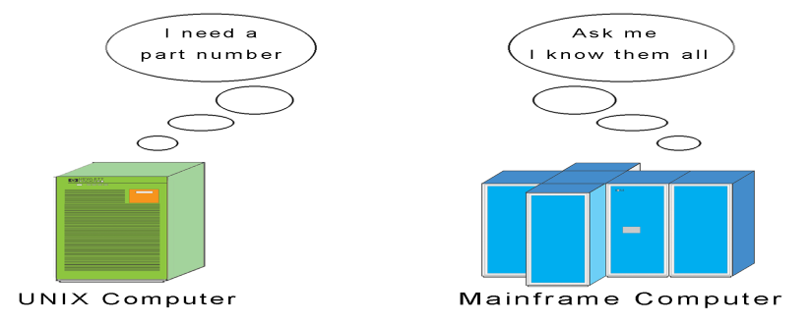
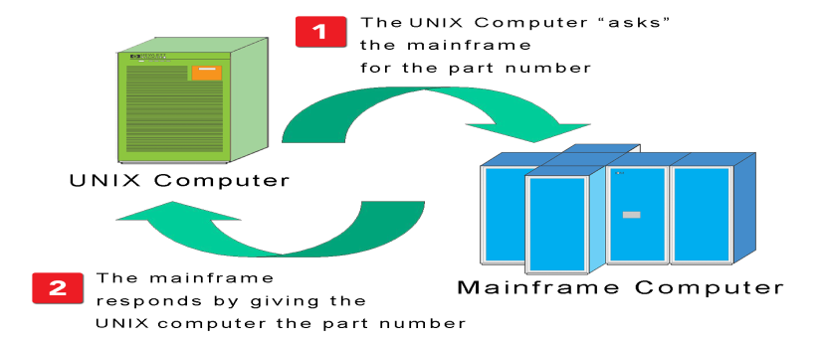
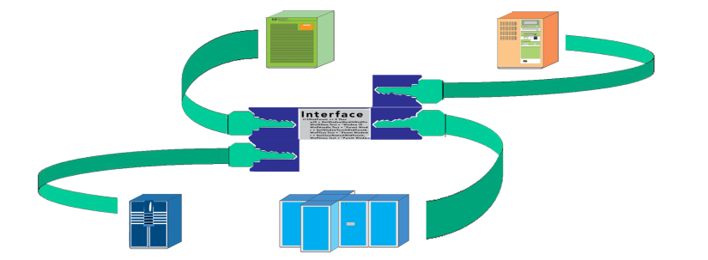
Client/Server Architecture
Data and functionality typically reside on more than one system (and application)
Applications need to be able to “talk to each other”
Proprietary or custom communication interfaces between applications

Slide 4
N- Tier Architecture
Tier1 belongs to traditional Web browsers and Web-centric applications
Tier 2 runs on any server that can support HTTP and CORBA clients
CORBA objects, like EJBs, encapsulate business logic
Tier 3 consists of almost anything a CORBA object can access

Slide 5
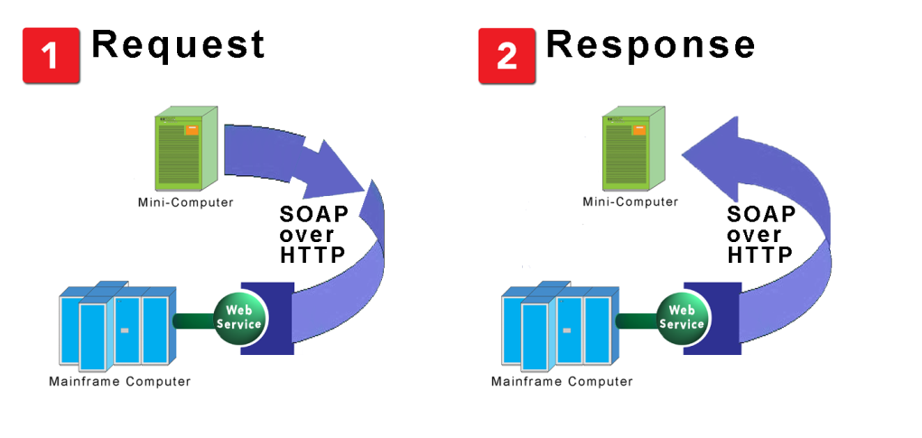
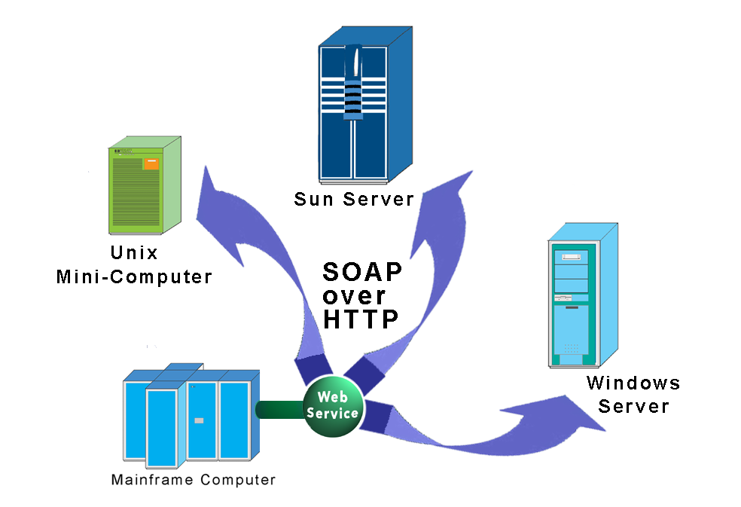
SOA: The Idea of Open Interoperability
An IT architecture composed of software that has been exposed as “Services” – i.e. invoked on demand using a standard communication protocol.
“Web Services” – software available as a “service” using Internet protocols.
One software application talking to another using a standards-based (i.e. non-proprietary) language over a standards-based communication protocol.
Universal “Dial Tone” between software applications
An IT architecture that enables “loose coupling” of applications

Slide 6
Core SOA Definitions
XML – Extensible Markup Language
SOAP – Simple Object Access Protocol
WSDL – Web Services Description Language
UDDI - Universal Description, Discovery and Integration
ESB – Enterprise Service Bus
Key Concepts
Network Transparency
Virtualized endpoint
Self-describing software
Universally discoverable software
Universally understood software
Machine to machine interaction
Source: H. Taylor, “Service-Oriented Architecture (SOA) 101 ‘What’s Hype, What’s Real?’“, Juniper Networks, Inc.,2007.
Notes:
6

Slide 7
SOA Usage & Supporting Platforms
Source: H. Taylor, “Service-Oriented Architecture (SOA) 101 ‘What’s Hype, What’s Real?’“, Juniper Networks, Inc.,2007.
SOA Usage
B2B
Enterprise Application Integration (EAI)
Application to Application
Government
Major Players in SOA Space
IBM: WebSphere SOA Product Suite
BEA: Aqualogic (WebLogic)
Oracle: Fusion Middleware
Microsoft: .NET
SAP: NetWeaver
Notes:
7

Slide 8
Sample Web Service Topology
Web
Service ₁
Web
Service _{N}
Web
Service ₁
Web
Service _{M}
Web
Service ₁
Web
Service _{K}
….....
….....
….....
Organization 3
Organization 4
Organization 1
Internet
Web
Service ₁
Web
Service _{L}
….....
Appliance 1
Organization 2
Web
Service ₁
Web
Service _{Q}
….....
Device 1
Device 2
Web
Service ₁
Web
Service _{J}
Web
Service ₁
Web
Service _{P}
…….....
….....

Slide 9

Q & A

