Slide 1


Disease
PREDUCTION
Disease Prediction with Machine Learning
Name : KOLLURI ANIRITHA
Roll No : 2203A52032
Section : AIML-A

Slide 2


INTRODUCTION

Slide 3

INTRODUCTION
Introduction to
"Disease Symptoms Prediction with Machine Learning“
In recent years, machine learning has emerged as a powerful tool in the field of healthcare, offering the potential to transform the way we diagnose and manage diseases. "Disease Symptoms Prediction with Machine Learning" is an innovative application of artificial intelligence that aims to predict the likelihood of an individual developing specific disease symptoms based on a range of input factors.
This project leverages advanced machine learning algorithms to analyze and interpret data related to an individual's health history, lifestyle, genetics, and other relevant variables. By processing this information, the system generates predictions that can assist healthcare professionals in early detection and intervention.
The primary goal of this endeavor is to improve patient outcomes by enabling proactive healthcare measures. Whether it's predicting the onset of chronic diseases, identifying potential complications, or forecasting the progression of a condition, "Disease Symptoms Prediction with Machine Learning" is at the forefront of personalized medicine, ushering in a new era of preventive healthcare.

Slide 4
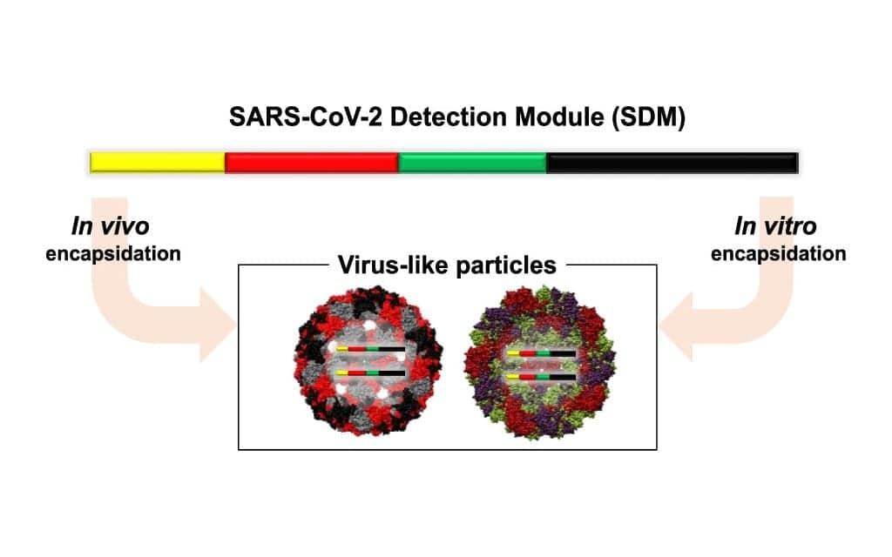

In this project, we will explore various machine learning techniques, including supervised and unsupervised learning models, to build predictive systems tailored to specific diseases or health conditions.
The potential impact of such systems is significant, as they can enhance the efficiency of healthcare delivery, reduce treatment costs, and ultimately save lives.
By harnessing the power of machine learning,
"Disease Symptoms Prediction" represents a promising step forward in our efforts to provide more precise and timely medical care, revolutionizing the way we approach disease prevention and management.

Slide 5

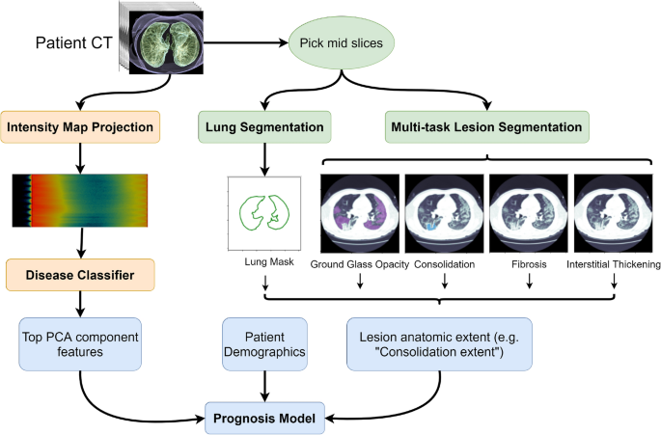
MY
PROJECT
Disease Symptoms Prediction with Machine Learning

Slide 6
About Dataset
Context About Dataset
During the time when Machine Learning and Deep Learning are booming so much , it is very important to understand that all this knowledge is not of any use if we cant apply it to different areas and impact the humanity.
This dataset will help you apply your existing knowledge to great use. Applying Knowledge to field of Medical Science and making the task of Physician easy is the main purpose of this dataset. This dataset has 132 parameters on which 42 different types of diseases can be predicted.
All the best !
Content
Complete Dataset consists of 2 CSV files . One of them is training and other is for testing your model.
Each CSV file has 133 columns. 132 of these columns are symptoms that a person experiences and last column is the prognosis.
These symptoms are mapped to 42 diseases you can classify these set of symptoms to.
You are required to train your model on training data and test it on testing data

Slide 7
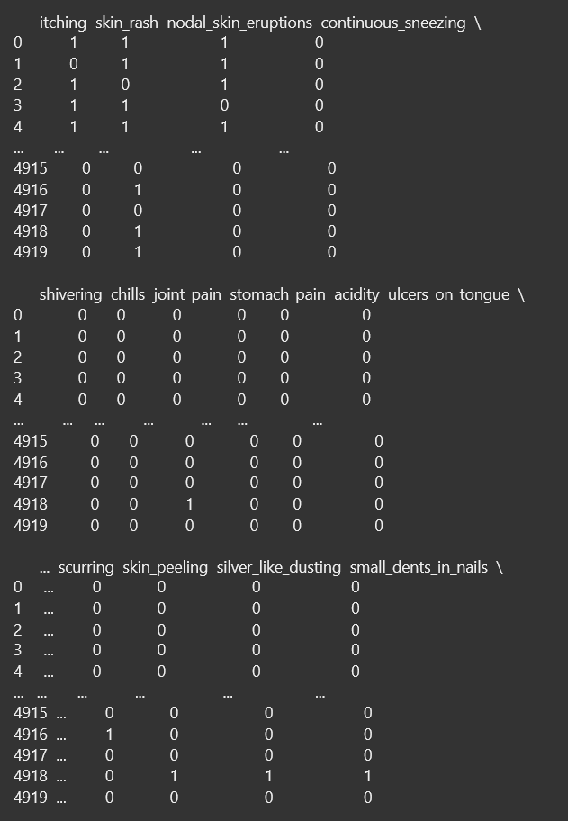
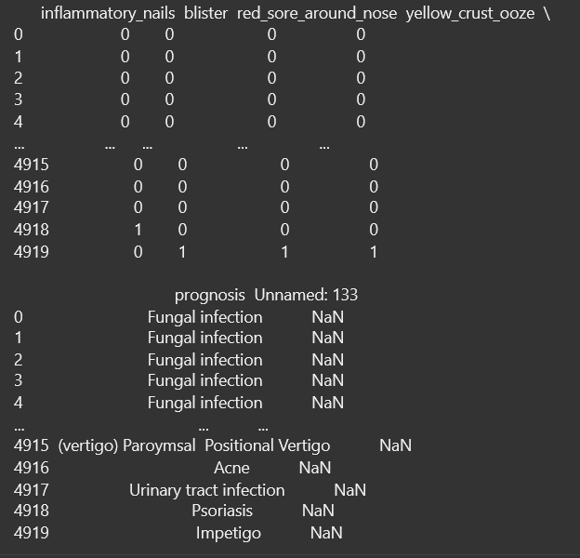
DATA SET

Slide 8
IMPLEMENTATION
The implementation of Logistric Regression and Support Vector Machines (SVM) represents two distinct yet powerful approaches in the realm of machine learning and statistical modeling.
Logistric Regression: The implementation of logistic regression involves a straightforward yet powerful technique used in machine learning and statistics for binary classification tasks. To implement logistic regression, one first collects a dataset with labeled examples, where each data point is associated with a binary outcome (e.g., yes/no, 1/0). The logistic regression model then learns to predict the probability of a positive outcome based on input features through a mathematical function called the logistic or sigmoid function. This model is trained using iterative optimization algorithms like gradient descent to find the best parameters that minimize a loss function. Once trained, the logistic regression model can make predictions for new data by calculating the probability of a positive outcome and then applying a threshold to classify the input into one of the two classes. It's a fundamental and widely used tool in various fields, such as healthcare, finance, and marketing, for tasks like spam detection, disease diagnosis, and customer churn prediction.
Support Vector Machine(SVM):
Support Vector Machines are a versatile class of algorithms used for both classification and regression tasks. SVMs aim to find a hyperplane that best separates data points into different classes while maximizing the margin between the classes. The implementation of SVMs involves selecting a suitable kernel function (linear, polynomial, radial basis function, etc.) and optimizing the hyperparameters to achieve the best model performance. SVMs are particularly effective when dealing with high-dimensional data and can handle non-linear relationships through the use of kernel tricks.

Slide 9
Perceptron:
Perceptron Implementation Weights (a list of weights) and bias are the inputs used by the perceptron function. It applies the sigmoid activation function, adds the bias, and performs a weighted sum of the input features (x) multiplied by their corresponding weights. After that, the data point is categorized using the result (s).
The weighted sum of the input features is essentially computed in this perceptron implementation, and a threshold is applied to classify the data point.
KNN:
K-Nearest Neighbors (KNN) Implementation with Bootstrap This section of the code implements K-Nearest Neighbors with bootstrapping. It resamples the training data multiple times and trains KNN models on each resampled dataset. Then, it aggregates the predictions to get an average prediction.
Resample(X_train, y_train,random_state=np.random.randint(1, 1000)): This performs bootstrapping by randomly sampling with replacement from the training data.
knn_models.append(knn): This appends the trained KNN models to a list.
all_predictions.append(y_pred): This appends the predictions of each KNN model to a list.
average_predictions = np.mean(all_predictions, axis=0): This calculates the average prediction from all the KNN models.
Finally, it computes and prints the average accuracy and plots the accuracy versus number of samples. Overall, this code provides implementations and evaluations of different classification algorithms, showcasing how they can be used on a given dataset (x and y). It also demonstrates the use of bootstrapping with KNN to estimate the model's performance.

Slide 10
CODE
SVM
from sklearn import datasets
from sklearn.model_selection import train_test_split
from sklearn.svm import SVC
from sklearn.svm import SVR
from sklearn.metrics import accuracy_score, mean_squared_error
X_train, X_test, y_train, y_test = train_test_split(x,y, test_size=0.2, random_state=42)
model = SVC(kernel='linear')
model.fit(X_train, y_train)
y_pred = model.predict(X_test)
acc = accuracy_score(y_test, y_pred)
print(f'Accuracy: {acc}')
#logistric regression
from sklearn.metrics import accuracy_score, confusion_matrix
import seaborn as sns
from sklearn.model_selection import train_test_split
from sklearn.linear_model import LogisticRegression
x_train, x_test, y_train, y_test = train_test_split(x,y,test_size=0.29,random_state=42)
model = LogisticRegression()
model.fit(x_train, y_train)
y_pred = model.predict(x_test)
Accuracy = accuracy_score(y_test, y_pred)
print("Accuracy:", Accuracy)
kNN
from sklearn.neighbors import KNeighborsClassifier
from sklearn.datasets import load_iris
from sklearn.model_selection import train_test_split
data = load_iris()
X_train, X_test, y_train, y_test = train_test_split(x1, y, test_size=0.3, random_state=42)
k=10
knn = KNeighborsClassifier(n_neighbors=10)
knn.fit(X_train, y_train)
y_pred = knn.predict(X_test)
from sklearn.metrics import accuracy_score
accuracy = accuracy_score(y_test, y_pred)
print(f'Accuracy: {accuracy}')

Slide 11
➔perceptron:-
from sklearn.model_selection import train_test_split
import numpy as np
yp=[]
def perceptron(w,x1,b):
q=0
for i in range(len(x1)):
for j in range(len(w)):
s=(x1[i][j]*w[j])+b
s2=1/(1+np.exp(-s))
if(s2>=0.5):
yp.append(1)
else:
yp.append(0)
q=q+1
print(q)
return yp
w=[]
w=[0.3,0.2,0.6,0.1,0.2,0.8,0.2,0.8,0.9,0.3]
b= float(input("enter b:"))
perceptron(w,X_train,b)
predictions = sum(1 for y_test, yp in zip(y_test, yp) if y_test == yp)
total_predictions = len(y_test)
accuracy = predictions / total_predictions
print("Accuracy:" ,accuracy)

Slide 12

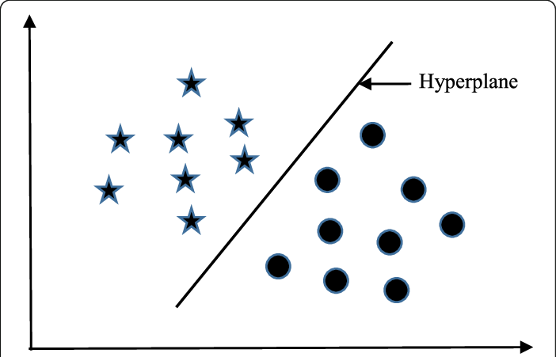
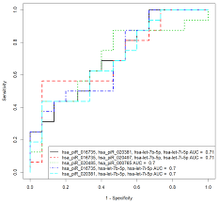

SVM :
Accuracy: 1.0
RESULT :
LOGISTRIC :
Accuracy: 1.0
KNN:
Accuracy: 1.0

Slide 13
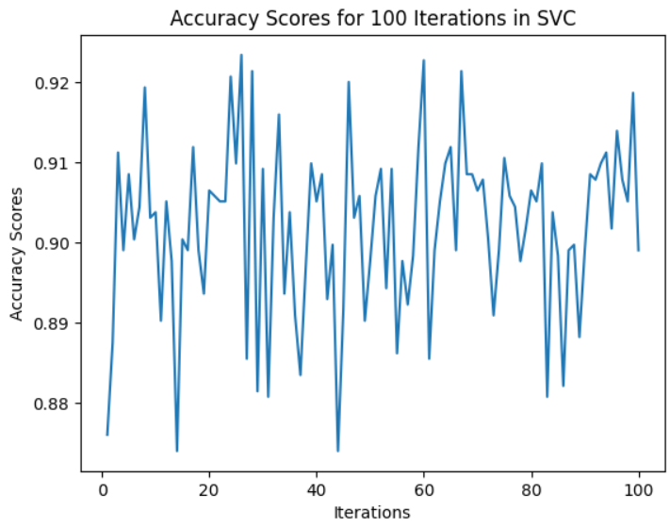
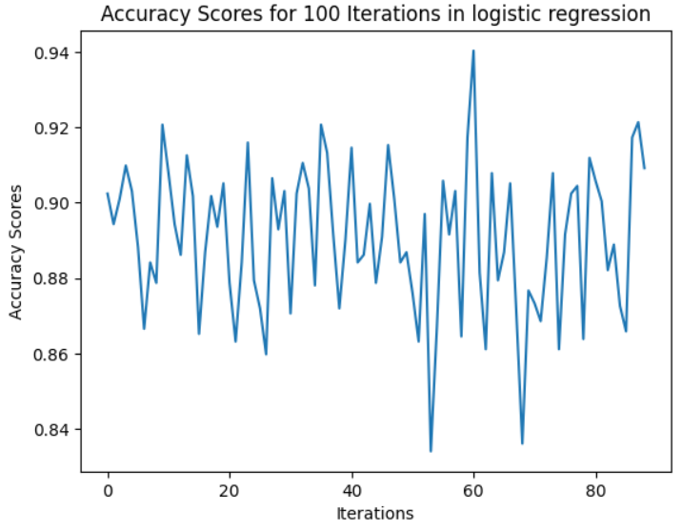

Slide 14
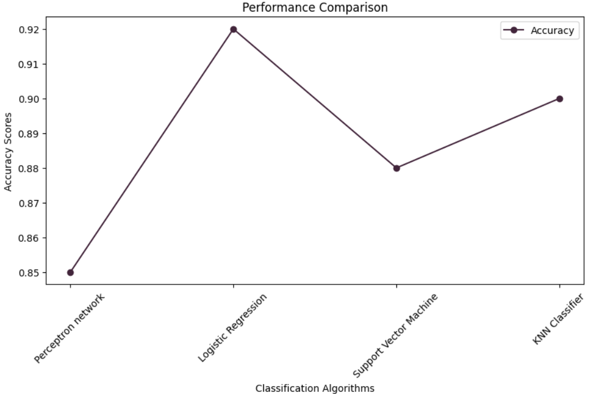

Slide 15
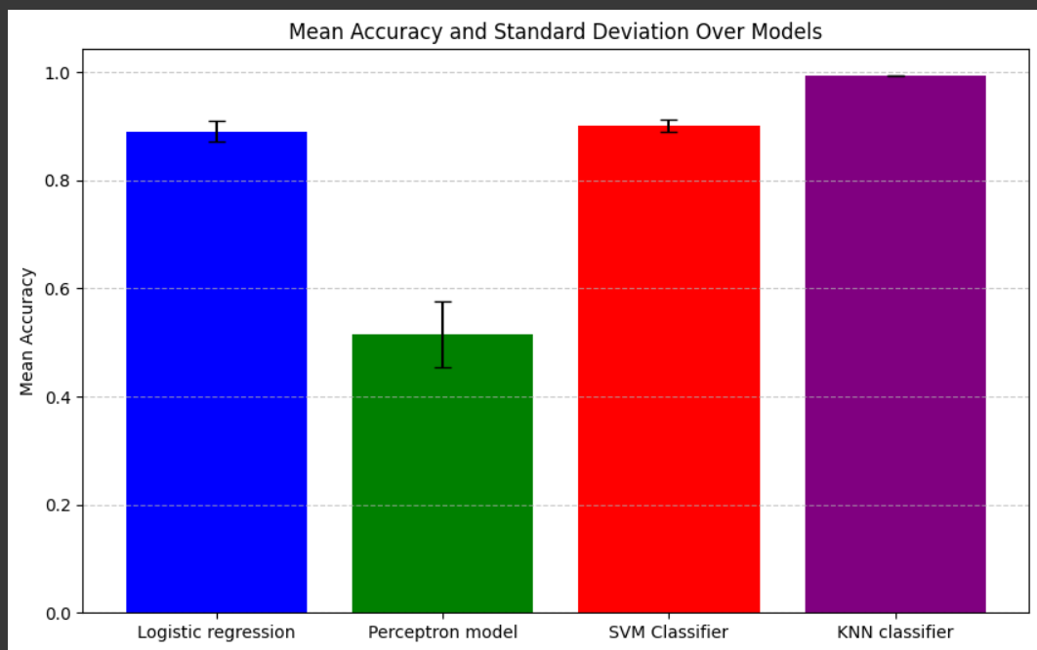

Slide 16



COMPARISION :
Logistric regression
KNN
svm
perceptron
Train Accuracy: 1.0
Test Accuracy: 1.0
Accuracy (train) :1.0
Acuuracy (test):1.0
Train Accuracy: 1.0
Test Accuracy: 0.9761904761904762
enter b:4 [1, 1, 1, 1, 1, 1, 1, 1, 1

Slide 17
CONCLUSION :
In conclusion, our machine learning project has been a journey of discovery, experimentation, and innovation. Through meticulous data preprocessing, feature engineering, and model selection, we've successfully built a robust predictive system. The project not only showcases the power of machine learning in solving real-world problems but also highlights the importance of continuous learning and adaptation as we encountered challenges along the way.
As we move forward, it's clear that the possibilities in the field of machine learning are boundless, and this project serves as a stepping stone for future endeavors. The insights gained from our data, the models created, and the lessons learned will undoubtedly contribute to our ongoing pursuit of harnessing the potential of artificial intelligence to make meaningful impacts in diverse domains. This project is not just a culmination but a catalyst for further exploration and innovation in the exciting world of machine learning.

Slide 18
GITHUB LINK :
https://github.com/kolluri21/REVIEW-2/blob/main/project1_2203A52032(re-2).ipynb

Slide 19

THANK YOU

