Slide 1
A Comparison Study: Fractal Image Compression and Wavelet Based Compression
CSC 8260 Final Project
Kolluri, Navya Sree

Slide 2
Overview
Introduction
Fractal Compression
Collage Theorem
Coding and Decoding
Wavelet Based Compression
EZW (Embedded Zerotree Wavelet Algorithm)
Comparison
References
Plan for the demo

Slide 3
Introduction
Type of Compression techniques
1. Lossy Compression
2. Lossless Compression
It is difficult to obtain error free lossless compression with better than 2:1 compression ratio
There are many lossy compression techniques . Fractal Compression and Wavelet image compression are lossy compression techniques.

Slide 4

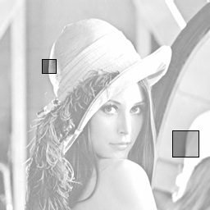
What is Fractal Image Compression?
Michael Barnsley was the first one to use fractals as the basis image compression and promised to attain compression ratios of up to 10000:1
Try and find a set of transforms that map an image onto itself
Takes advantage of the similarities with in the image
Barnsley’s fern can be generated with just 28 coefficients
Self similarity portions of the image

Slide 5
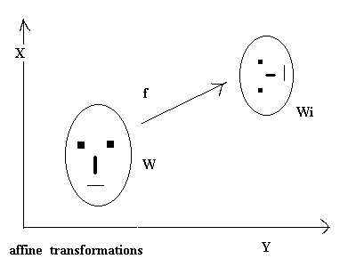
Affine Transformation
Affine transformation is any transformation that preserves collinearity and ratio of distances.
Geometric contraction, expansion, dilation, reflection, rotation, shear, similarity transformations, spiral similarities, and translation are all affine transformations, as are their combinations
Collage Theorem:
States that if the error difference between the target image and the transformation of that image is less than a certain value the transforms are an equivalent representation of the image.

Slide 6
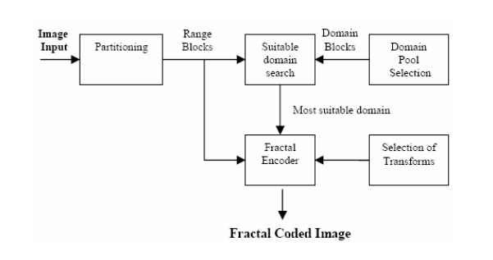
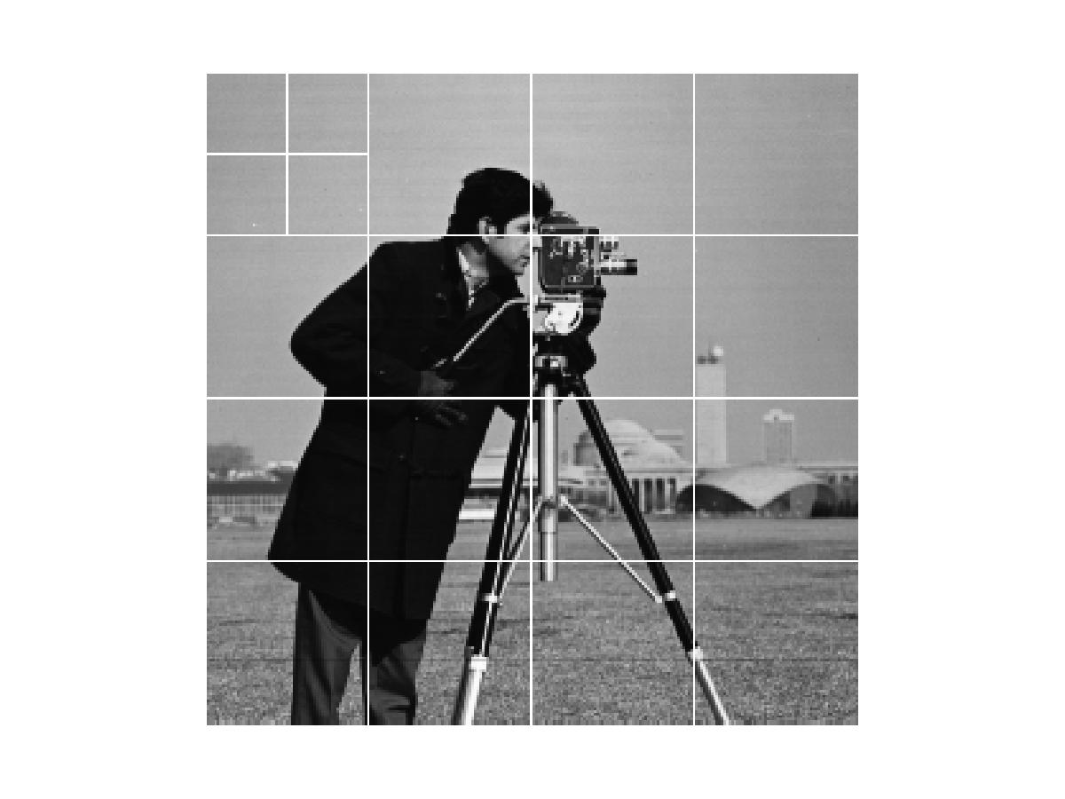
Encoding
Range Image: The original image is called the range image. Partitioning of which would give range blocks.
Domain Blocks: The original image is averaged (down sampled and apply lowpass filtered) and then partitioned into blocks then each block is called domain block.

Slide 7
Decoding
Read in domain block and transform block position, transform, and size information.
Use any blank starting image of same size as original image
For each domain block apply stored transforms against specified transform block
Overwrite child block pixel values with transform block pixel values
Repeat until acceptable image quality is reached.

Slide 8
Wavelet based Image Compression

Slide 9
Why wavelet transform?
Wavelets (are little waves) are functions that are concentrated in time as well as frequency around a certain point
The basic function varies both in frequency range and in spatial range
The wavelet transform is designed in such a way that we get good frequency resolution for low frequency components and high temporal resolution for high frequency components

Slide 10
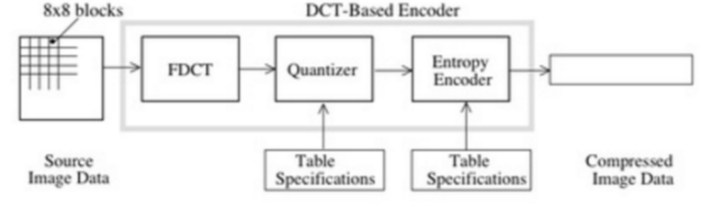
Wavelet compression technique
The compression technique has 3 steps
Transform
Quantize
Encode

Slide 11
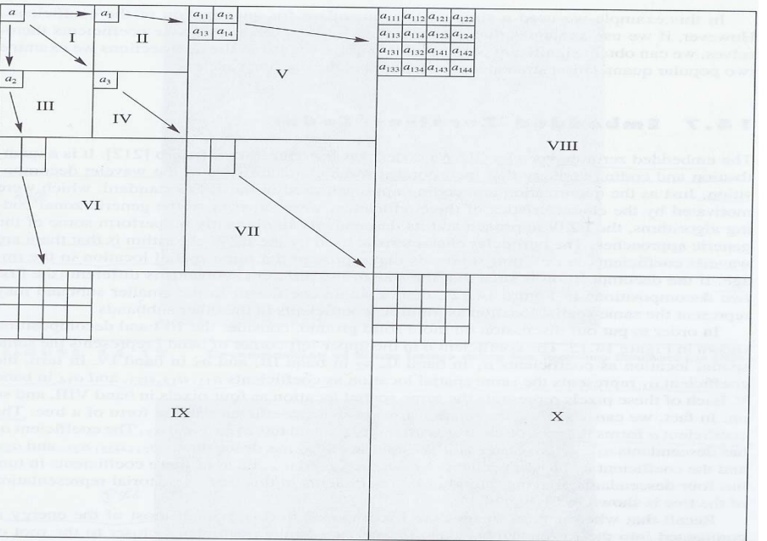
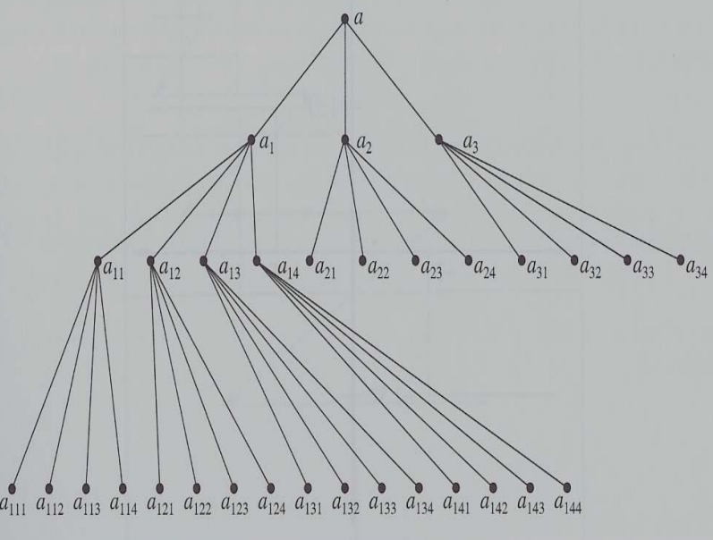
Embedded Zerotree Wavelet algorithm
EZW scans through the wavelet coefficients in zig-zag pattern.
Embedded encoding is used for quantization in that algorithm which is called bit-plane coding.
prediction of the absence of significant information across scales by exploiting the self-similarity inherent in images
A zero tree is a quad tree with no significant elements in the child nodes.
10 band wavelet decomposition
Datastructure of EZW coder

Slide 12
Cont..
Each root node in the quad tree is associated with one of the following codes.
Significant Coefficient: Given a threshold T, if a given coefficient is greater has magnitude greater than T then it is called significant coefficient.
Significant Negative: Same as above but the sign for the coefficient is negative.
Zero tree root: If the value of coefficient is less than Threshold . All its decendants have magnitude less than T.
Isolated zero tree: If the coefficient itself is less than T but some of its coefficients are more than Threshold then it is called Isolated zero tree.

Slide 13
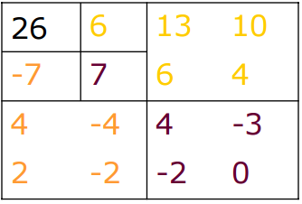
Examples
EZW is a progressive algorithm. We start with high value of Threshold and reduce it by half for every pass.
For the first pass:
T₀ = 2^{|log2 26|} = 16
6<16 ->
all decendents of 6 < 16 . Hence it is a zero tree.
Similarly -7 and 7 are zero trees
During the next pass T₁= 16/2 and again the process is repeated.

Slide 14
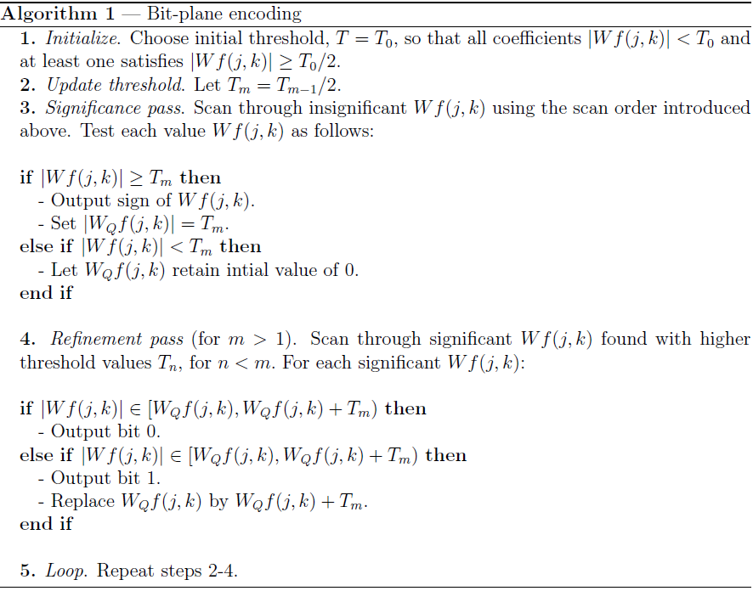
Algorithm for EZW

Slide 15
Discussion
FIC takes lot of time for encoding due to large number of comparisons.
Wavelet based compression performs better than Fractal compression in most cases. But fractal compression can attain better resolution during compression
Wavelet compression is a progressive transmissions as it improves the image for every pass.
Compression ratio of wavelet compression is definitely better than Fractal compression

Slide 16
References
Jacquin, A. E., "A novel fractal block-coding technique for digital images". In Proceedings ICASSP-90 (IEEE International Conference on Acoustics, Speech and Signal Processing.
Yuval Fisher, Fractal Image Compression - Theory and Application, Springer-Verlag, ISBN 0-387-94211-4, 1994
M. C. Pereyra and L. A. Ward, Harmonic Analysis: From Fourier to Wavelets. Amer-ican Mathematical Soc., 2012, vol. 63.
J. M. Shapiro, \Embedded image coding using zerotrees of wavelet coecients," Signal Processing, IEEE Transactions on, vol. 41, no. 12, pp. 3445{3462, 1993.

Slide 17
Plan for demo
I would describe the working of both the algorithms on different images and comparing the Mse with the original image.
Comparing the time taken for each compression technique
Comparing the compression ratios

Slide 18


