Slide 1
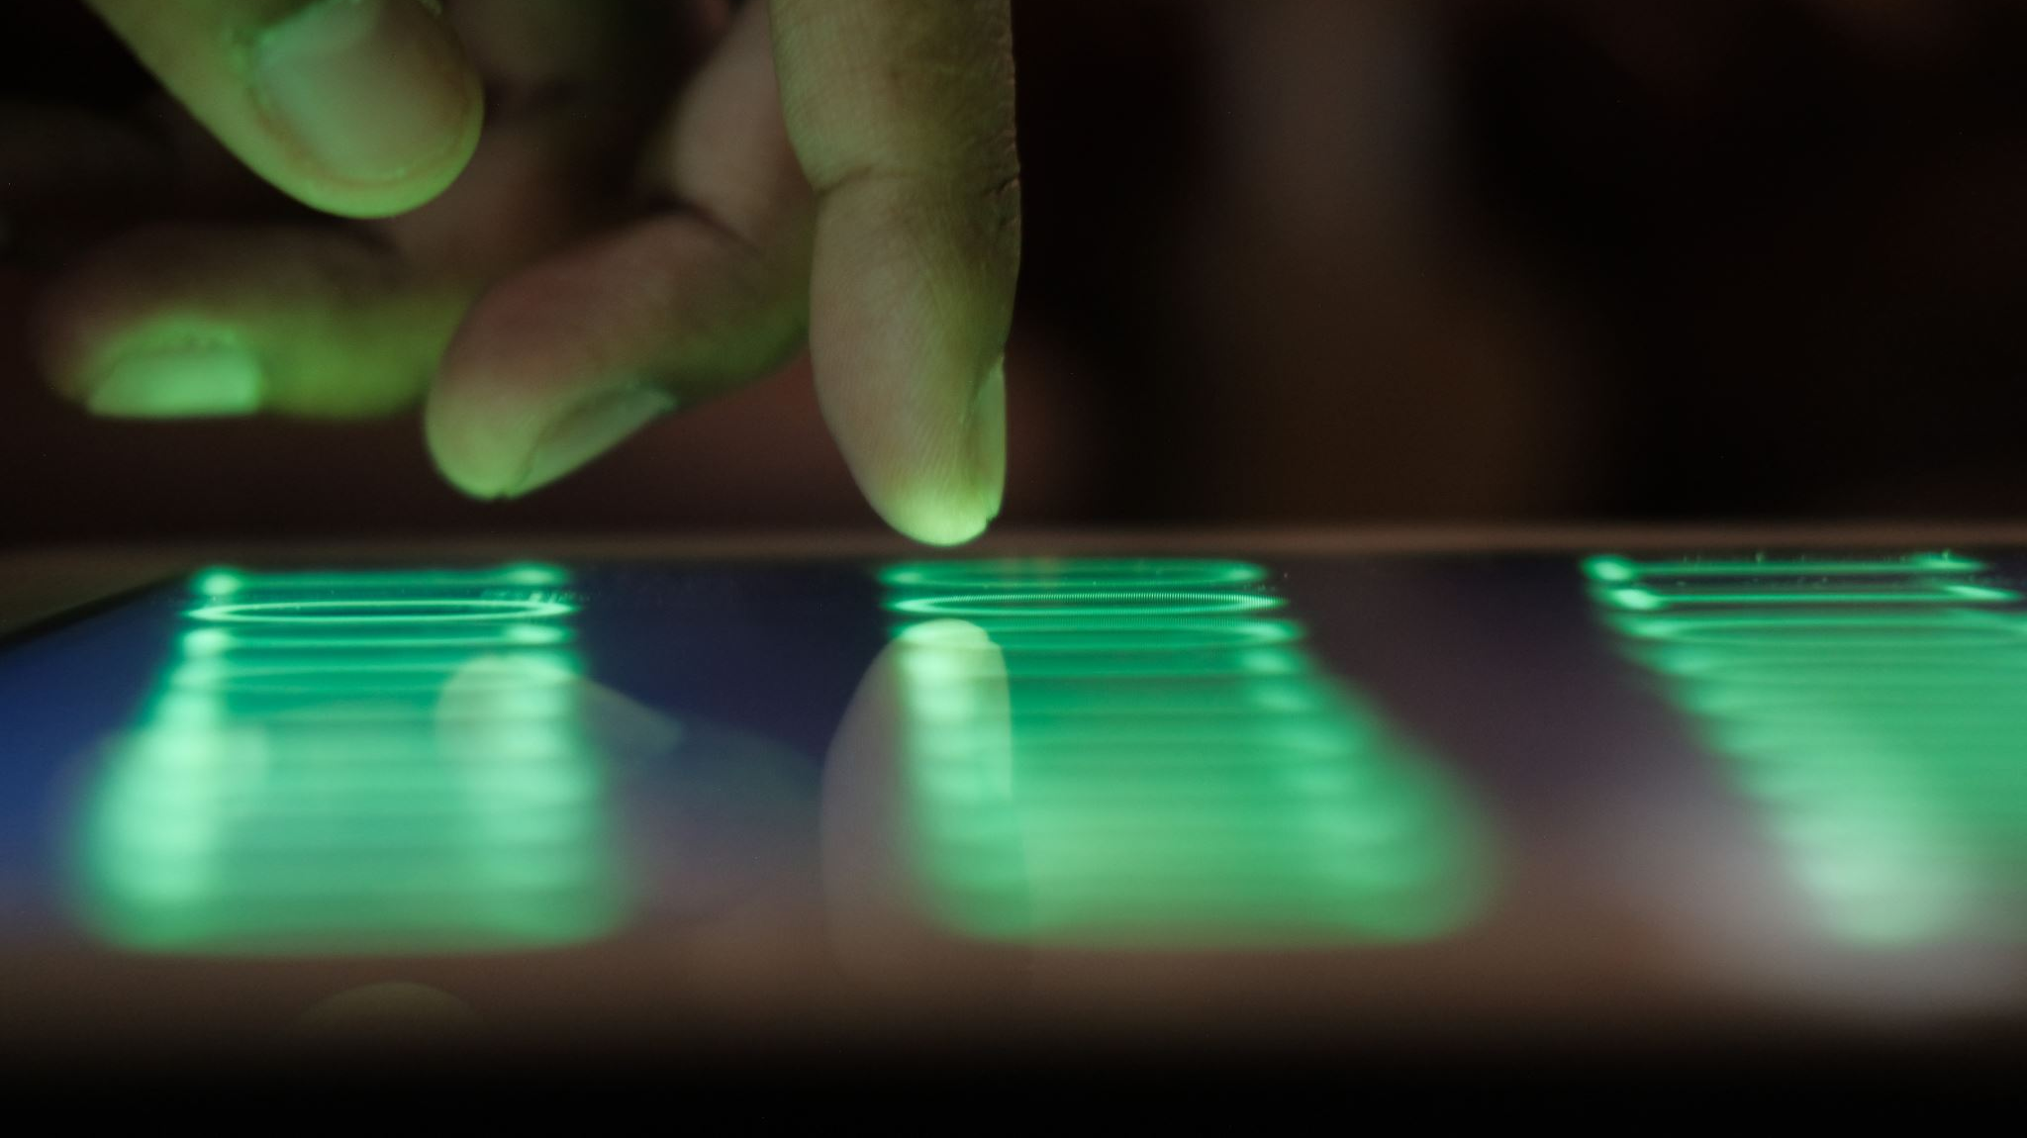
Real-Time Finger Sign Detection Using Convolutional Neural Networks
Hemanth Kumar Suddala-700750205
Srikanth Kolluri-700741300
Dheeraj Annam-700759413
Avinash Palagani-700761023

Slide 2
Role/Responsibilities and Contribution
Member 1: Srikanth Kolluri
Role and Responsibilities:
Overseeing the entire project and ensuring all milestones are met.
Coordinating communication between team members and managing timelines.
Sourcing and curating the dataset for training and validation.
Preprocessing data to ensure quality and consistency for the CNN.
Implementing data augmentation strategies to enhance model robustness.
Contribution:
Successfully managed the acquisition and curation of a balanced dataset.
Developed preprocessing pipelines that transformed raw image data into a format suitable for training the CNN, which significantly contributed to the high validation accuracy achieved by the model.
Member 2: Hemanth Kumar Suddala
Role and Responsibilities:
Designing the CNN architecture to suit the requirements of finger sign detection.
Implementing the neural network using appropriate machine learning frameworks.
Fine-tuning hyperparameters to optimize model training and validation.
Regularly evaluating the model's performance and iterating on the design based on feedback.
Contribution:
Engineered a highly effective CNN model that achieved over 99% accuracy in detecting finger signs, which outperformed several benchmark models in related literature.

Slide 3
Roles and Responsibilities
Member 3: Dheeraj Annam
Role and Responsibilities:
Establishing rigorous testing frameworks to assess model accuracy and performance.
Conducting validation tests to prevent overfitting and ensure generalizability.
Comparing model performance against existing solutions in the field.
Documenting all testing protocols and results for project reporting.
Contribution:
Played a pivotal role in the model reaching and sustaining a 100% validation accuracy through the introduction of effective validation techniques and thorough testing methodologies.
Member 4: Avinash Palagani
Role and Responsibilities:
Preparing the model for deployment in real-time environments.
Optimizing the model for efficient performance on target hardware.
Developing application interfaces for real-world testing of the CNN.
Troubleshooting deployment issues and ensuring smooth integration with various applications.
Contribution:
Enabled the seamless integration of the trained CNN into real-time applications, thus showcasing the model's practical utility beyond the testing environment.

Slide 4
Motivation
The field of HCI is evolving to allow more natural interaction between humans and digital systems.
Gesture recognition is key, especially for enhancing user experience and supporting the deaf and hard-of-hearing.
Current challenges include the variability of hand gestures and environmental influences.
Traditional methods lag in real-time accuracy and adaptability.
This project employs CNNs to recognize and interpret finger signs effectively and in real time.
Aims to close the gap between human intention and machine interpretation.
Enhances inclusivity, allowing individuals of all abilities to better engage with technology.
Believes in the transformative potential of gesture recognition for a more interactive HCI future.

Slide 5
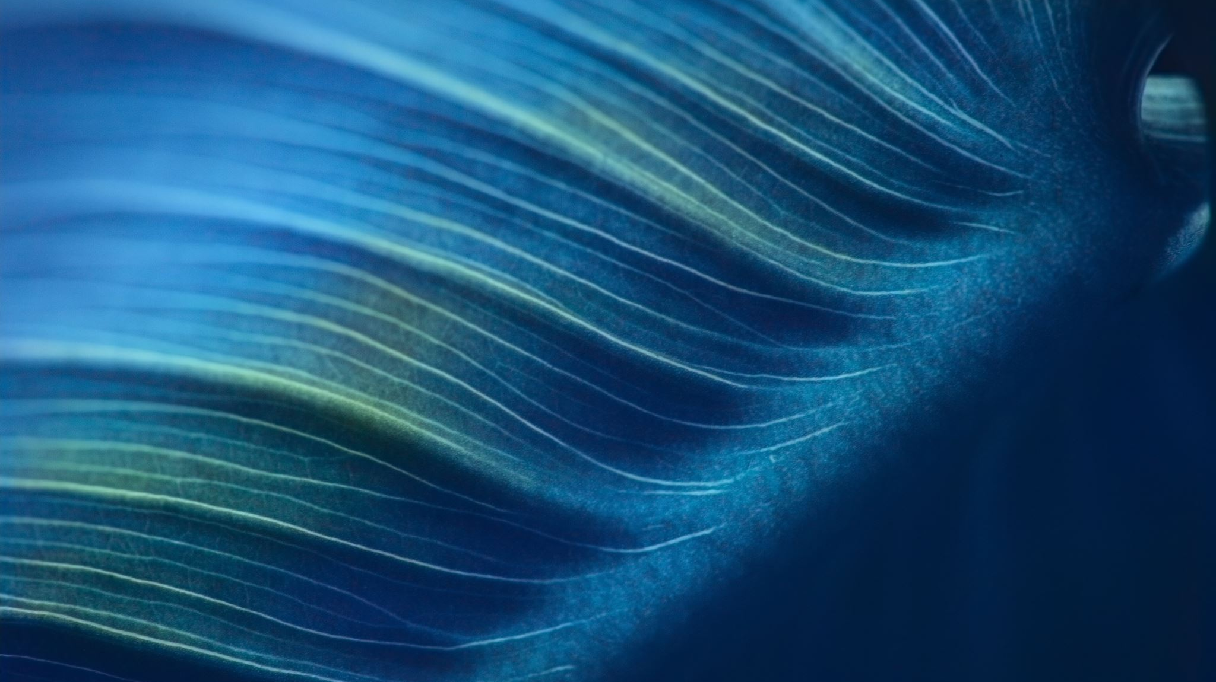
Objectives
Development of a CNN-based system for real-time finger sign detection.
Implementation of transfer learning to enhance model training efficiency.
Application of data augmentation to improve system robustness.
Evaluation of lightweight neural network models for mobile deployment.
Comparative analysis with existing gesture recognition methods.

Slide 6

Related Work
State-of-the-Art Techniques and CNN Breakthroughs
Deep learning, especially CNNs, is advancing accuracy and reducing execution times across fields like NLP, scene labeling, and medical imaging.
Despite progress, challenges remain in video classification due to difficulty in integrating spatial and ephemeral data.
Some models incorporate depth cameras for additional correlation data, yet struggle with overall accuracy.
New methods bypass the need for pre-trained models, employing capsule networks and adaptive pooling for enhanced results.

Slide 7
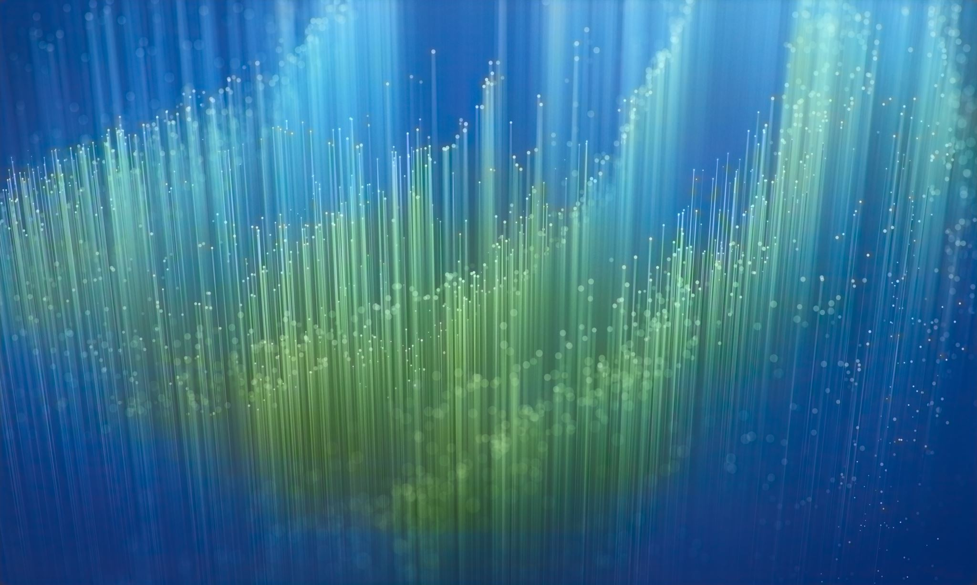
Related Work
Comparative Approaches and Innovative Methodologies
CNNs have outperformed traditional methods, like SIFT, by extracting features more effectively for tasks such as sign language recognition.
Novel approaches include 3DRCNNs, which use depth channels and edge detection to inform gesture recognition systems.
Kinect and Leap Motion demonstrate practical applications of gesture recognition but face limitations such as background dependency and orientation invariance.
The goal is to refine models to reduce computational demands and improve training efficacy, moving away from reliance on simplistic datasets.

Slide 8
Related Work
Contributions and Emerging Research in CNN Applications
Recent CNN adaptations focus on multi-modal inputs, combining RGB and depth data for richer feature sets, achieving up to 93.3% accuracy in ASL recognition.
CNNs are being tailored to handle complex backgrounds, aiming to surpass the limitations of previous models requiring controlled environments.
Current research contributes new preprocessing techniques, like skin segmentation, and evaluates CNNs on complex datasets like NUS II, without prior benchmarks.
The integration of CNNs with novel preprocessing methods shows promise in pushing gesture recognition forward, emphasizing the need for versatile, robust systems.

Slide 9

Problem Statement
The accurate and real-time recognition of finger signs presents significant challenges in HCI due to the variability of hand gestures and the dynamic nature of human-computer interaction environments.
Traditional gesture recognition systems struggle with real-time accuracy and often fail in complex settings, hindered by the limitations of current algorithms to adapt to diverse hand shapes, movements, and varying backgrounds.
Insufficient computational power and lack of robust training data further exacerbate the problem, leading to systems that cannot effectively translate human intent into machine-understood commands.
There is a critical need for a sophisticated finger sign detection system that utilizes advanced CNN models to learn from complex visual inputs and perform with high accuracy in real-time across various user demographics and environmental conditions.

Slide 10
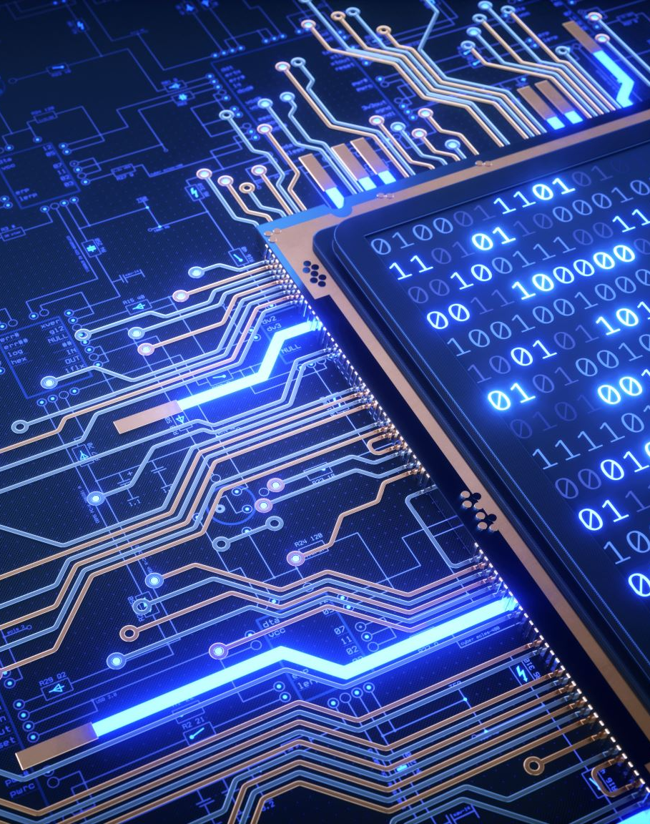
Proposed Solution
We propose a sophisticated CNN-based system designed for the real-time detection and interpretation of finger signs.
Utilizing advanced deep learning techniques, our model learns to recognize a wide array of hand gestures by processing complex visual data efficiently.
The system features a robust architecture that accounts for variability in hand shapes, sizes, and dynamic gesture execution, enhancing its accuracy and responsiveness.
By leveraging data augmentation, transfer learning, and real-time processing frameworks, our solution is crafted to operate seamlessly in diverse settings, ensuring inclusivity and accessibility for all users.
Our approach aims to overcome the limitations of traditional gesture recognition systems, offering a pathway to more intuitive and seamless human-computer interaction

Slide 11

Results and Simulation
The CNN model, after rigorous training and validation, achieved a remarkable 99% accuracy in recognizing finger signs, indicating superior performance compared to traditional gesture recognition systems.
Real-time simulations demonstrated the model’s ability to accurately interpret gestures in a fraction of a second, catering to the need for swift human-computer interactions.
Testing against complex backgrounds and under varying lighting conditions showed the model's robustness and adaptability, confirming its potential for deployment in real-world scenarios.
The success of the model in simulations suggests its readiness for integration into HCI applications such as assistive technologies, virtual reality, and smart home systems, promising to enhance the interactivity and accessibility of digital environments.

