Slide 1

Institute of Aeronautical Engineering
Department of Electronics and Communication Engineering
PILL REMINDER AND MONITORING SYSTEM
Supervisor Details
Miss.Doma Sreelakshmi
Assistant professor
Electronics and Communication Engineering
Batch members:
19951A04L4-K.Varshini
19951A04N2-K.Yoshitha
19951A04J7-S.Tharun

Slide 2
LITERATURE SURVEY
1. Mobile Phone in Health Applications:
Authors: Evgeny Stankevich, Ilya Paramonov, Ivan Timofeev
Today in medical services frameworks, the usage of cell phones is turning into an expanding number of values.
For now, mobile phones can use a variety of wireless communication techniques (GSM, Wi-Fi, Bluetooth and others). It allows to integrate mobile phones into existing healthcare services and also to create new services and applications in this area.

Slide 3
2. MyMediHealth-Designing a next generation system for child-centered medication management.
Authors :Jason M. Slagle , Jeffry S. Gordon e , Christopher E. Harris
Taking medicine on time has been very crucial for every individual health.
MyMediHealth- It will remind to take medicine for the updated time.

Slide 4
3.Medicine reminder :
Authors: Zao et al.
Zao et al. have created application - a smartphone application intended to help patients to avoid prescription organization mistakes

Slide 5
4. Medicine update expert
Authors: Prasad B
This App has a limit of 15 updates. A patient can select these updates while rehashing or Non-rehashing caution designs. Between the two caution designs at a time should be selected. The duration between two caution designs should be at least one hour. A reminder shall be delivered at the schedule time. This reminder could be caution vibration or LED sign [4].

Slide 6
5.Wearable insomnia monitoring system
Authors: Hamida et al.
The sleeping data of patient at home could be received by Remote clinical background system with the help of recent technology like an experimental estimation of communication and security measures protocols in terms of security and overhead.

Slide 7
6. Home Health Hub
Author: P.Ray
According to Ray, (Home Health Hub Internet of Things 2014), health is one of the most important part of the life span. Making life easier is one of the most desired thing that humans want to achieve with the help of recent development of IoT . The novel framework designed by Ray, helps to monitor the health of old people at their residence places through this H3IoT system.

Slide 8
7. Home Tele Health :
Authors: Al Majeed et al.
The related devices can sense, transfer data and do analysis in order to perform healthcare process. In this proposed system, they are using cost effective feasible algorithm to minimize the complexity in order to process huge data. These data are being generated by imaging devices, sensing devices and Human interaction.

Slide 9
8. Intelligent Pillbox system
Authors: Haung et al.
The purpose of this work is to provide safe and secure medication on time.

Slide 10
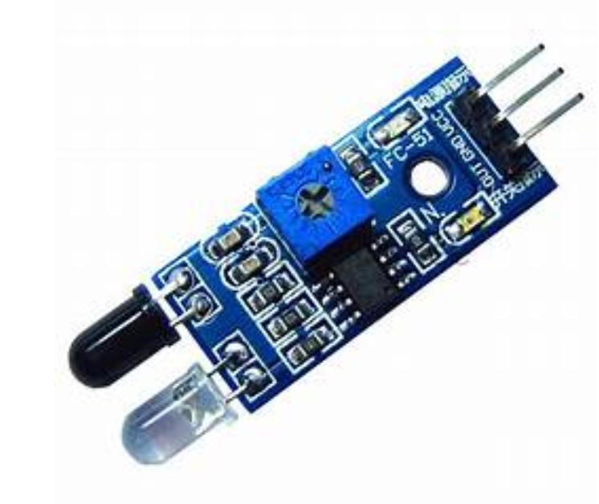
PROBLEM DEFINED
Based on the previous works, we have noticed that it need a sensor to detect whether the patient has took the medicine or not.
The patient would be reminded until the box detect the touch.

Slide 11
THANK YOU

