Slide 1

Marketing Campaign Performance: Malaysia
Carlos Andrés Pareja

Slide 2
Overview
Campaign Data
Dataset contains the following campaign information:
5000 campaigns
Year 2023
Regions: Kuala Lumpur, Sarawak, Penang, Johor, Sabah, Malacca
Covers different channels and product categories

Slide 3
Channels, products and regions
Univariate analysis

Slide 4
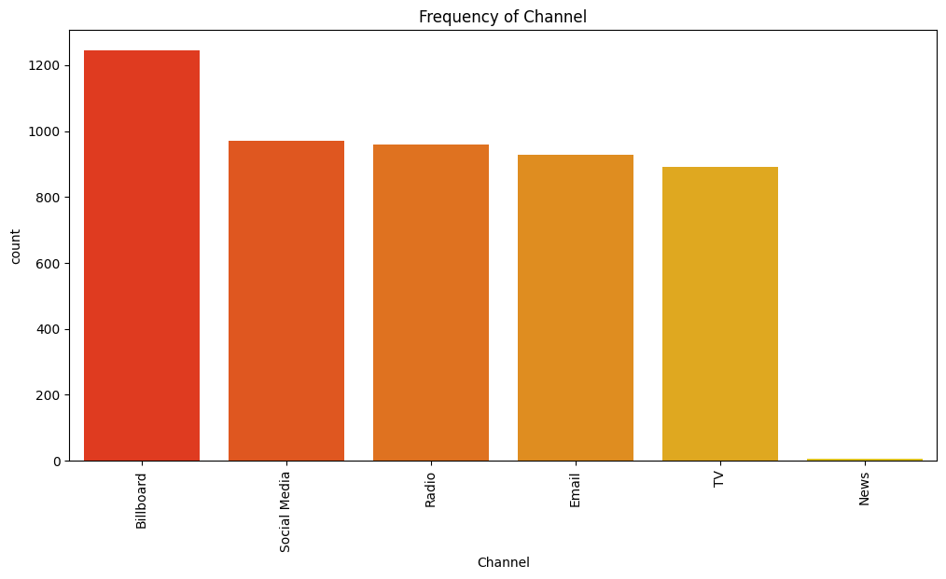
Frequency of channel

Slide 5
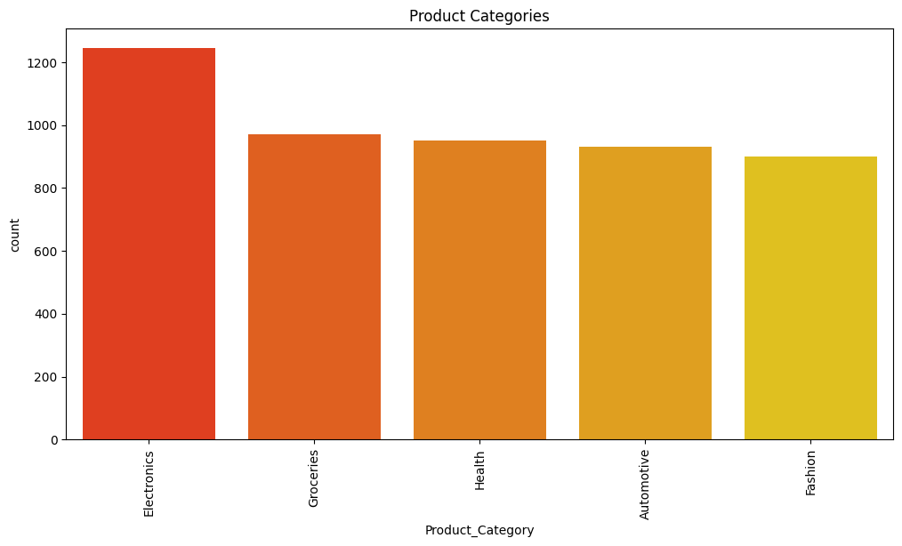
Product Categories

Slide 6
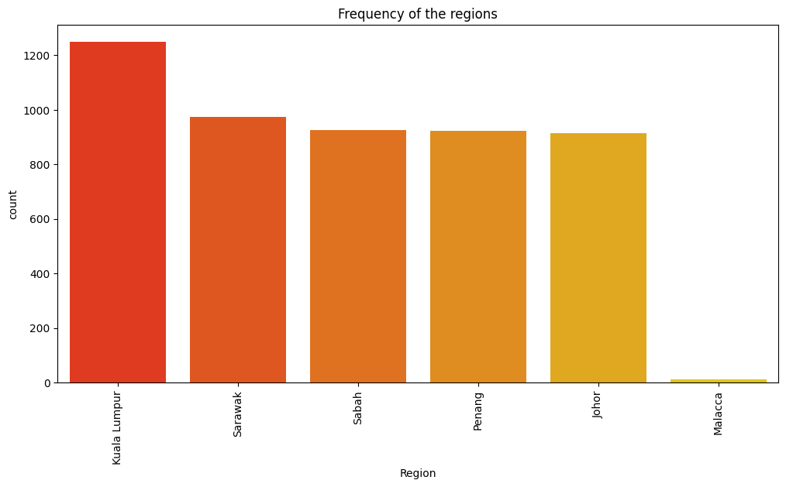
Regions

Slide 7
Heatmap
Bivariate analysis

Slide 8
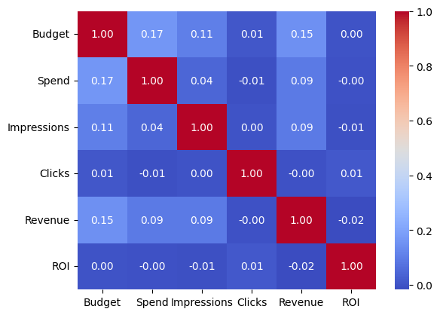
Heatmap for numerical variables

Slide 9
Budget, spend, revenue and ROI
Multivariate analysis

Slide 10
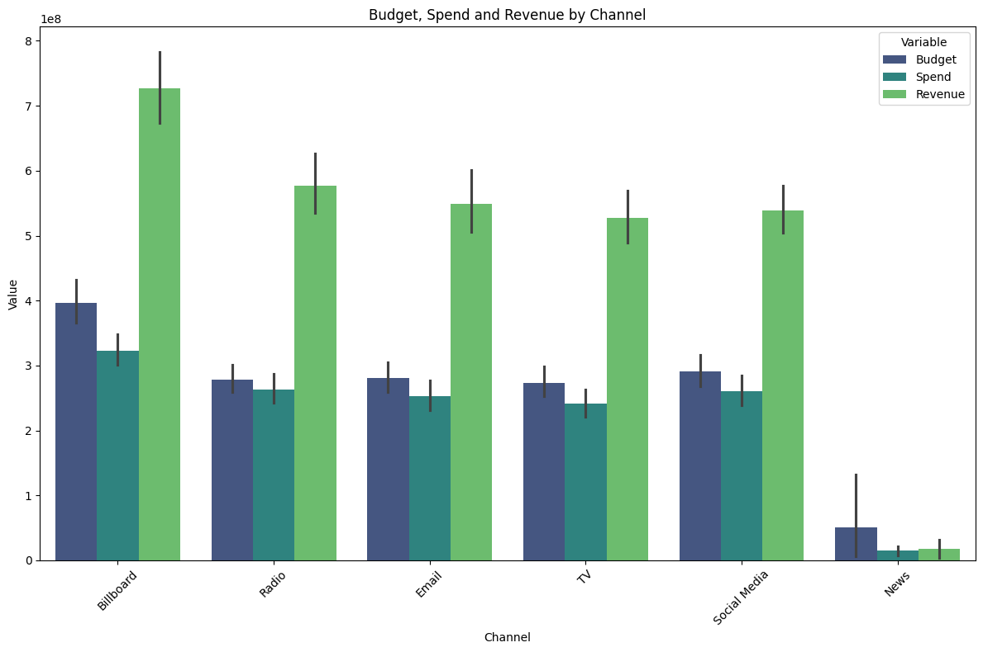
Budget, spend and revenue by channel

Slide 11
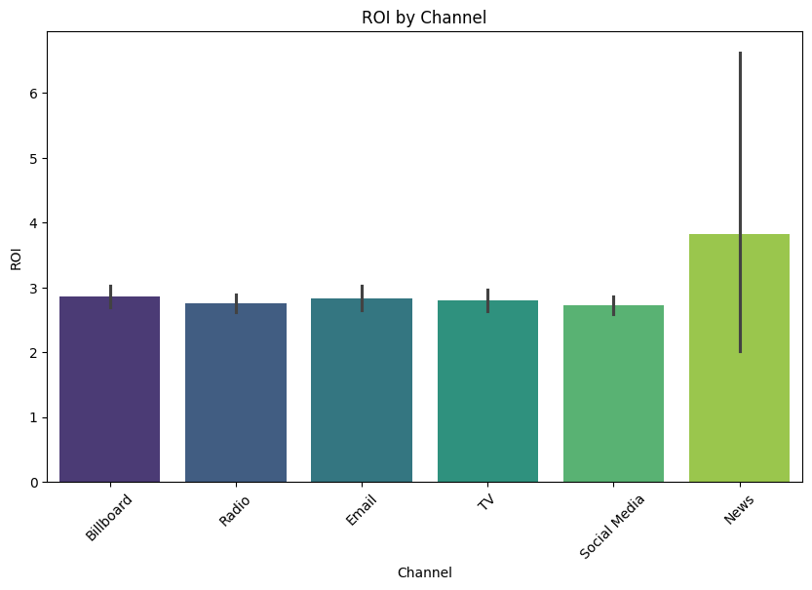
ROI by channel
Important:
The news ROI may seem higher at a glance but only 6 campaigns were executed via this channel, whereas the other channels have more than 800 campaigns.

Slide 12
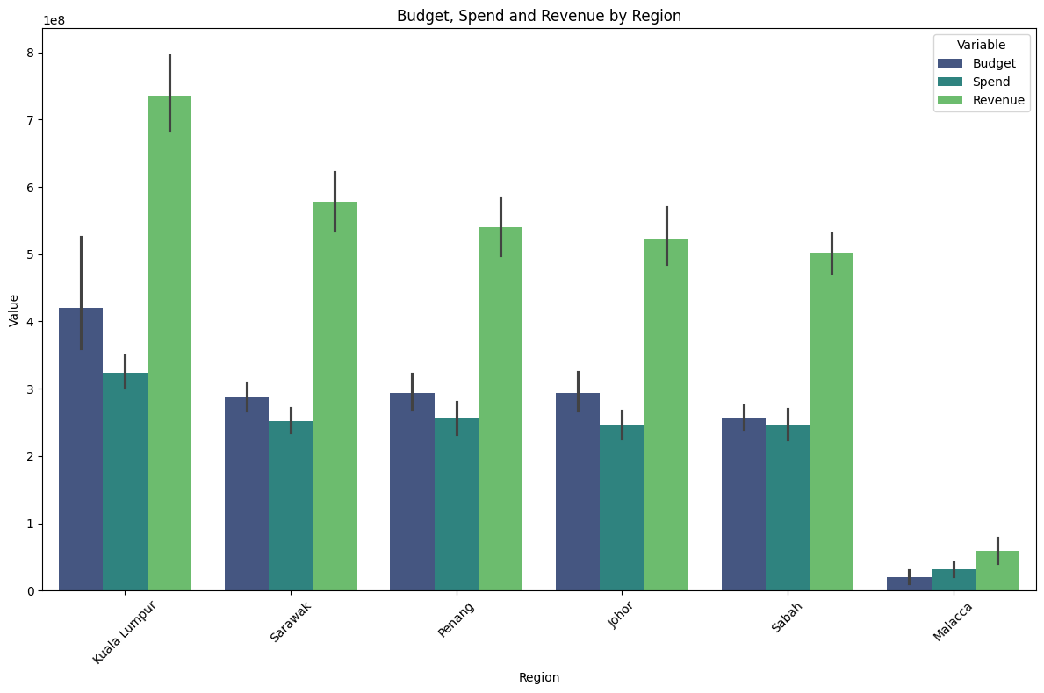
Budget, spend and revenue by region

Slide 13
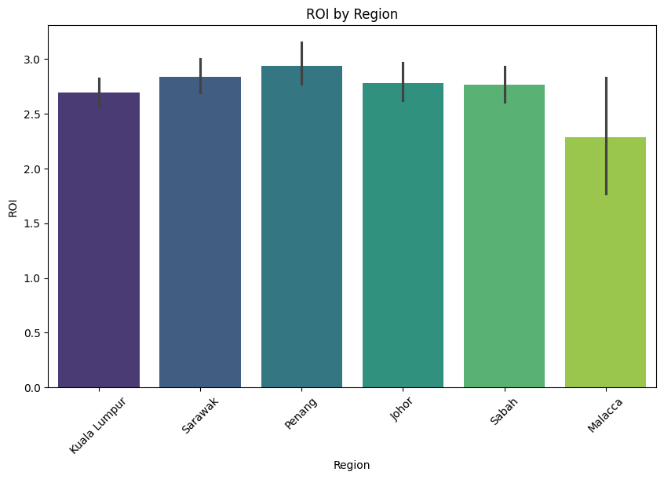
ROI by region

Slide 14
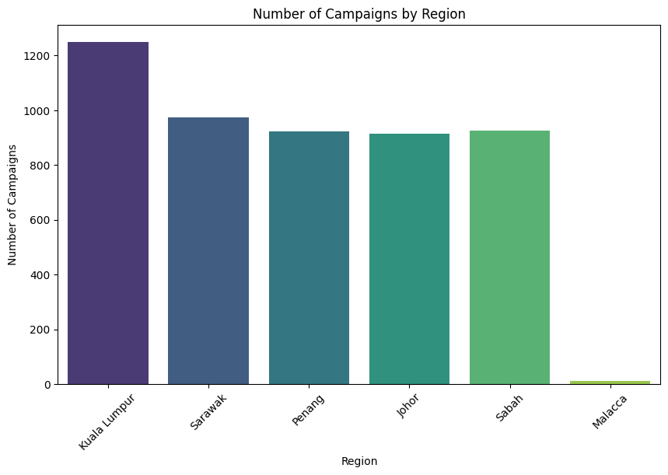
Campaigns by region

Slide 15
Campaign effectiveness
Multivariate analysis

Slide 16
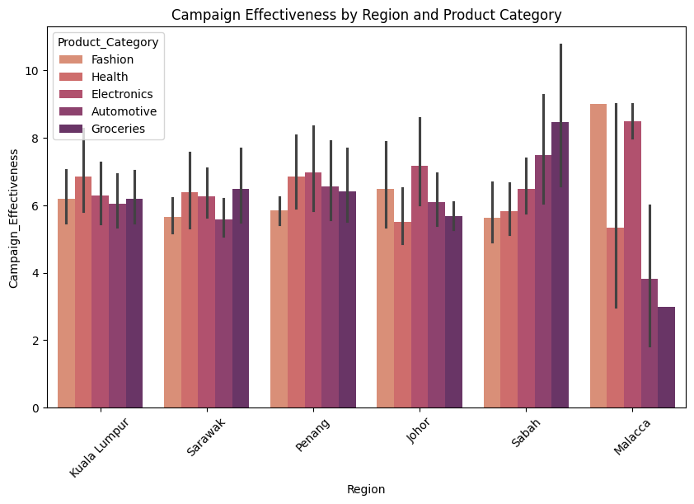
Campaign effectiveness by region and product

Slide 17
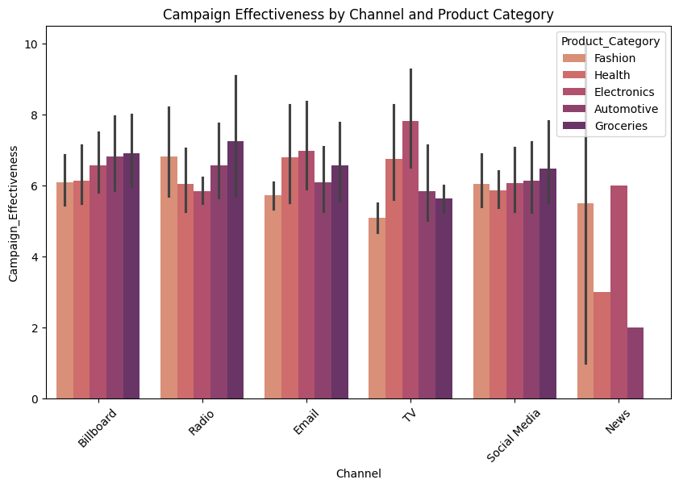
Campaign effectiveness by channel and product

Slide 18
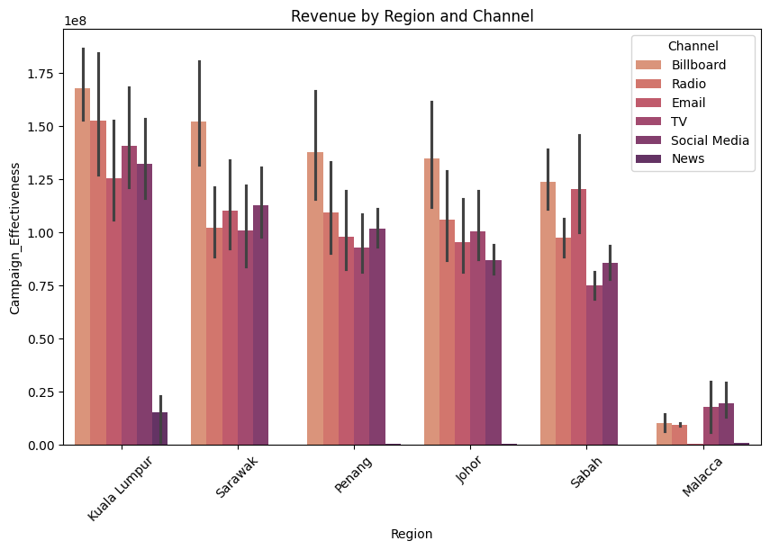
Revenue by region and channel

Slide 19
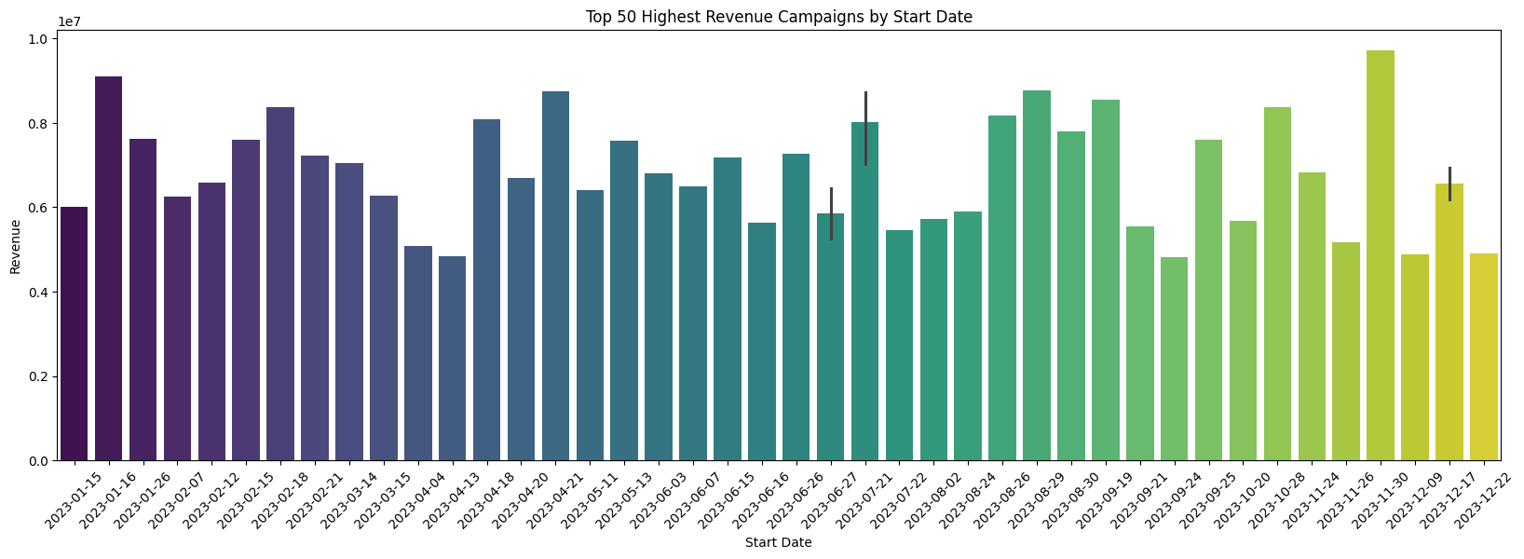
Highest revenue campaigns by start date

Slide 20
Conclusion and recommendations

Slide 21
Conclusion
Most variables behave similarly across regions, products and channels.
With the current amount of data, there’s almost no correlation between the variables.
There are a lot of outliers in the data (review what happened in each case)
Something happened in July. It affected impressions, clicks and CTR.

Slide 22
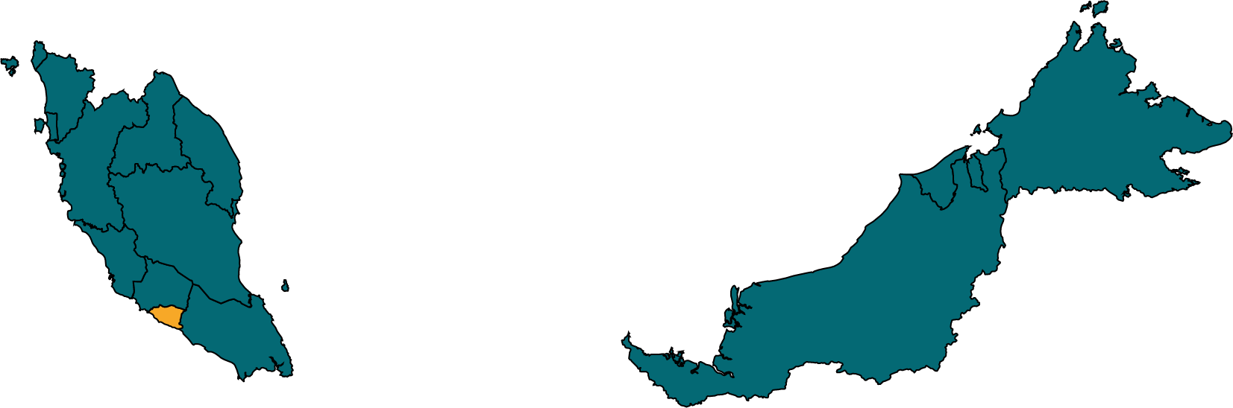
Recommendations
Opportunity:
Explore the Malaccan territory
Advertise through social media and TV
Fashion and electronics
Months: July – August
Average Budget: 1230550
Average Duration: 203
Average Revenue: 4526300
Average ROI: 2.52

Slide 23
Marketing Campaign Performance: Malaysia
Carlos Andrés Pareja

