Slide 1
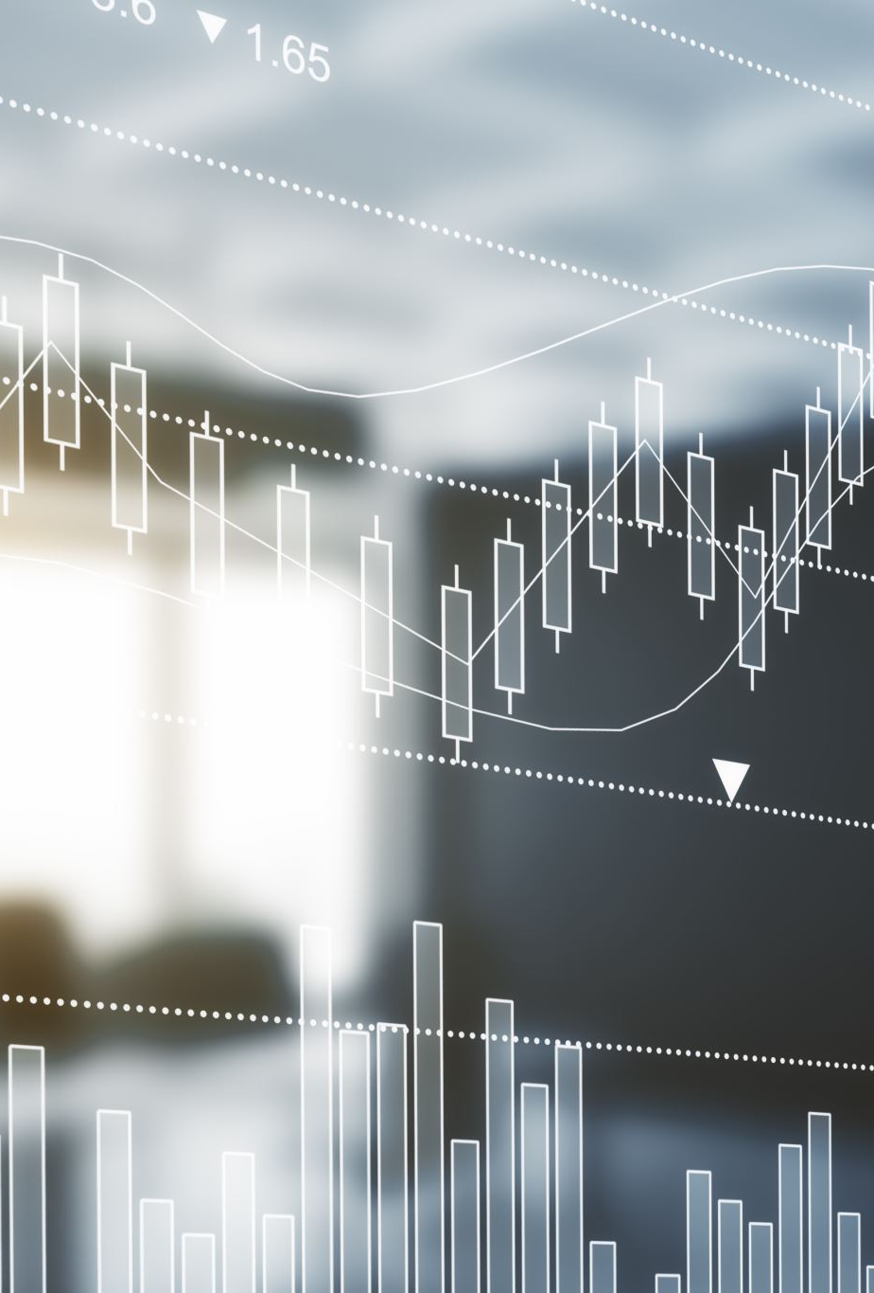
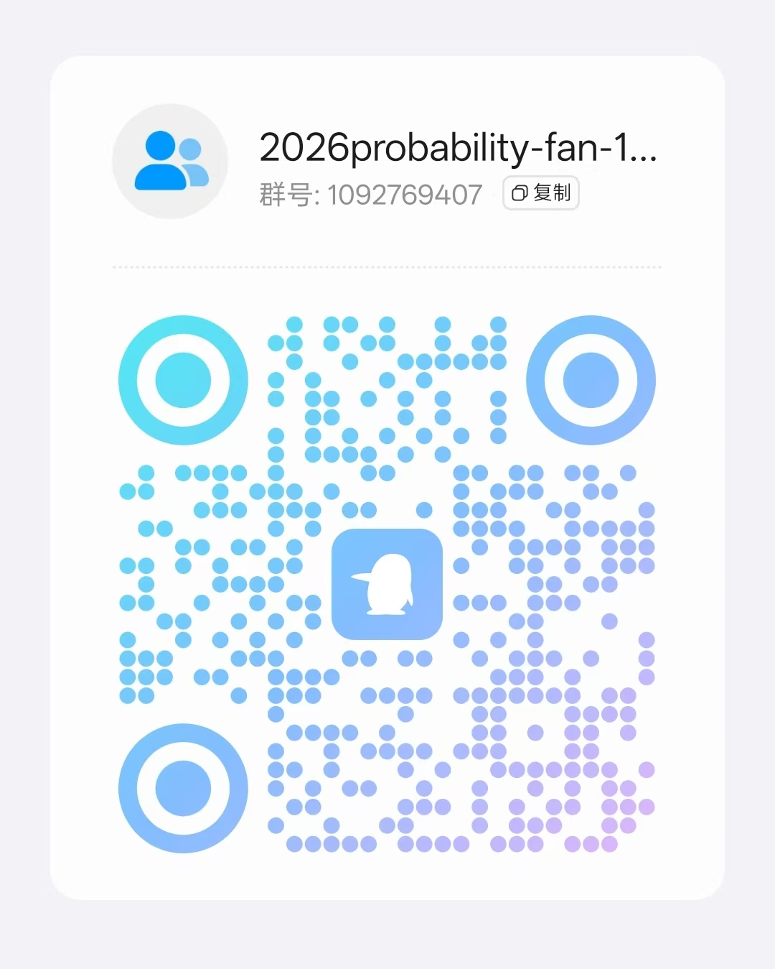
Probability and Statistics
Lectured by Fan Youhua
yhfan@hit.edu.cn
18665887603
Course QQ group: 1092769407
（Computer Science and Technology 1，Mechanical Design, Manufacturing and Automation 67，Robotics Engineering 51）
TA: Peng Zhuohuang
Autumn, 2026

Slide 2
Course Description
This course is designed to provide undergraduate students with a comprehensive understanding of statistical concepts and their applications. This course aims to develop students' quantitative reasoning skills and equip them with the tools necessary to analyze and interpret data for decision-making.

Slide 3
Course Objectives
Understand the fundamental concepts of descriptive and inferential statistics.
Learn various techniques for data collection, organization, and presentation.
Develop the ability to analyze and interpret data using appropriate statistical methods.
Apply statistical tools to solve real-world problems.
Enhance critical thinking skills by evaluating the validity and reliability of statistical results.
Basic probability and statistical concepts and methods.
Emphases on what, how, when and why certain statistical methods can and cannot be applied.
Solving simple real-life problems by statistics.

Slide 4
Course Topics
Introduction to Statistics: Importance and role in decision-making, ethical considerations.
Descriptive Statistics: Measures of central tendency, variability, and graphical representation of data.
Probability: Basic concepts, probability distributions, and their applications.
Sampling and Estimation: Sampling techniques, confidence intervals, and sample size determination.
Correlation and Regression Analysis: Relationship between variables, linear regression, and interpretation of regression models.

Slide 5
Assessment
Homeworks (10%)（ more then 2 times）
In-class quizzes(30%)（more then 6 times）
Final exam(60%)

Slide 6
Homeworks Requirements
You are encouraged to discuss homework problems with others, but must write your homework independently.
Duplicated homework or solution with no supporting work receives no credit.
Please complete and hand in your assignments before the deadline.

Slide 7
In-class Quiz Requirements
Discussion during quizzes is allowed, but each student must write and submit their own work independently.
Quizzes must be handed in during class and will also serve as verification of attendance.
Writing or submitting quizzes on behalf of others is strictly forbidden and will result in disqualification of the quiz score.

Slide 8
Homeworks and quizzes score grades
90-100: Correct answers with detailed problem-solving steps. Submission made prior to the deadline. Small errors in calculation. No plagiarism involved. No detectable traces of AI usage.
70-89: Wrong answers with correct detailed problem-solving steps. A few errors in calculations. Submission made prior to the deadline. No plagiarism involved. No detectable traces of AI usage.
61-69: Wrong answers. Wrong problem-solving steps. Many errors in calculations. Submitted prior to the deadline. No plagiarism involved. No detectable traces of AI usage.
≤60: Submitted 1 day later then deadline (and apply above criteria simultaneously). No detailed problem-solving steps. No plagiarism involved. No detectable traces of AI usage.
0: Submitted 3 days later then deadline (and apply above criteria simultaneously). Obvious traces of plagiarism or AI usage.
One day late, 60 in maximum. Three days late, zero score might be given. If plagiarism is found, a zero score will be given.
晚一天提交，最多60分。晚三天及以上，可以给予零分。有抄袭痕迹为零分。

Slide 9
Final Exam
The final exam will be held at a unified time for all class sections.
It is a closed-book exam.
A formula sheet will be provided for reference.

Slide 10
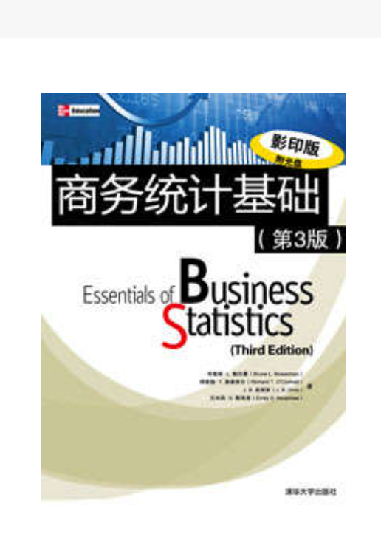
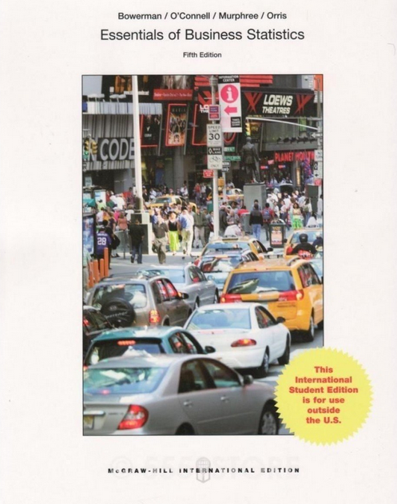
Textbook
Bowerman, O'Connell and Murphree
Business Statistics in Practice
Bruce L. Bowerman, Richard T. O’Connell , Emily S. Murphree
Business Statistics in Practice (Seventh Edition)
ISBN-10：0-07-352149-3 Copyright © 2014 by The McGraw-Hill Companies.

Slide 11
Reference
D. Freedman, R. Pisani and R. Purves, Statistics, 3rd Ed., Norton, 1998.
Chapter 1-18, 20-23, 26-28.
W. Feller, Introduction to Probability Theory and Its Applications, Vol. 1, 3rd Ed., Wiley, 1968. page 1-258 J.E. Freund, Mathematical Statistics, 5th Ed., Prentice Hall, 1992, Chapter 1-9.
Salsburg, The Lady Tasting Tea. How Statistics Revolutionized Science in the Twentieth Century, Freeman, 2001, Chapter 11-12
Viktor Mayer-Schönberger and Kenneth Cukier, Big Data: A Revolution That Will Transform How We Live, Work, and Think, Eamon Dolan/Mariner Books, 2014.
Charles Wheelan, Naked Statistics: Stripping the Dread from the Data, W. W. Norton & Company, 2014.
Joel Best and Patrick Lawlor, Damned Lies and Statistics: Untangling Numbers from the Media, Politicians, and Activists, University of California Press; First Edition, 2012.
Dana K. Keller, The Tao of Statistics: A Path to Understanding (With No Math), SAGE Publications, Inc, 2005.
Gary Smith, Standard Deviations: Flawed Assumptions, Tortured Data, and Other Ways to Lie with Statistics, Overlook Hardcover, 2014.
Matthew B. Robinson, Lies, Damned Lies, and Drug War Statistics, State University of New York Press, 2nd edition, 2014.
Introduction to Mathematical Statistics. ROBERT V.HOGG， ALLEN T. CRAIG
Essentials of Business Statistics. Bowerman, O'Connell, Murphree and Orris. 2015. McGraw-Hill/Irwin. ISBN10: 0078020530.
Business Statistics in Practice. Bowerman, O'Connell, Murphree and Orris. McGraw-Hill/Irwin. ISBN 978-0-07-352149-7.

Slide 12
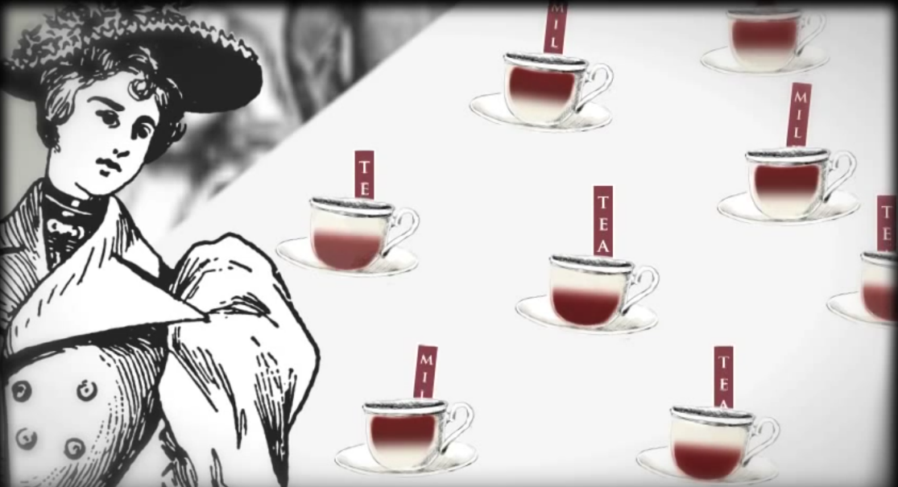
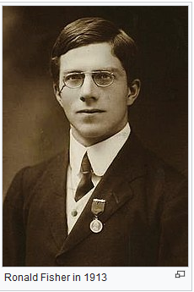
The Lady Tasting the tea

Slide 13
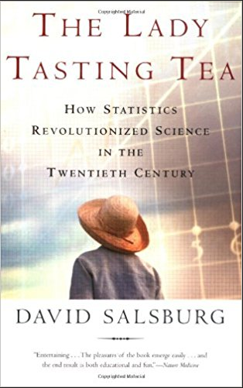
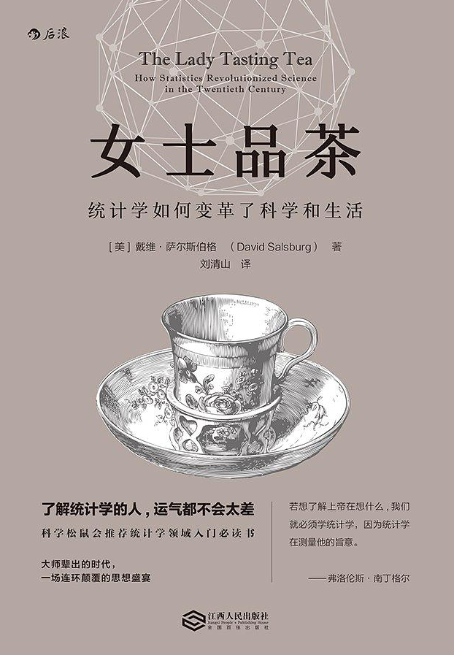
Books

Slide 14
Reading List
Darrell Huff (1991) How to Lie with Statistics New Ed edition, ISBN 0-14-013629-0
Rao C R. (1997) Statistics and truth: putting chance to work World Scientific.
Salsburg, D. (2002) The Lady Tasting Tea: How Statistics Revolutionized Science in the Twentieth Century, W.H. Freeman / Owl Book. ISBN 0-8050-7134-2
Reinhart A. (2015) Statistics done wrong: The woefully complete guide No Starch Press.
Moore S. and Notz W. (2017) Statistics: Concepts and Controversies 9th Edition.

Slide 15
What is Statistics all about?
The subject of statistics involves the study of how to collect, summarize, analyze and interpret data.
Statistics is described as a mathematical body of science that pertains to the collection, analysis, interpretation or explanation, and presentation of data or as a branch of mathematics concerned with collecting and interpreting data.

Slide 16
What is Statistics all about?
Data are numerical facts and figures from which conclusions can be drawn. Such conclusions are important to the decision-making processes of many professions and organizations.
Examples:
How many sisters/brothers do you have?
How often do you exercise? ----Never(1); rarely(2); often (3); always (4)
How happy are you with your life? ----Very low (1); Very high (10)

Slide 17
Why Study Statistics?
Generally, make “decision”
Statistical techniques are used to make decisions that affect our daily lives (without knowing it)
Choose the university
To buy a car or a house
Choose common stock from the stock markets
Numerical information is everywhere
No matter what your career, you will make professional decisions that involve data
Joy of Statistics https://www.bilibili.com/video/BV1TJ411y7Mp?from=search&seid=1904466107273049131

Slide 18
Statistics
Statistics is the art of learning from data
Statistics is concerned with
the collection of data
their description or sum
their analysis, which often leads to the drawing of conclusions (interpretation)

Slide 19
Example
A survey is conducted among 50 people, asking them: “Which one of the following is your favorite, Orange juice(O), Apple juice(A), Coca Cola(C), Pepsi(P) or Coconut Juice (L) ? ”
Data collected are
O, A, C, A, C, P, C, A, C, C, C, A, L, O, C, P, A, O, L, P, L, O, C, L, P, O, O, C, A, L, C, L, L, C, C, L, C, L, P, O, C, A, P, A, C, C, L, L, C, P
Question: Which one is the most popular?

Slide 20
Table: Frequency and percentage of favorite drink
Drink | Frequency | Percentage
Orange Juice | 7 | 14
Apple Juice | 8 | 16
Coca Cola | 17 | 34
Pepsi | 7 | 14
Coconut Juice | 11 | 22
Total | 50 | 100

Slide 21
Coconut Juice

Slide 22
Coconut Juice

Slide 23
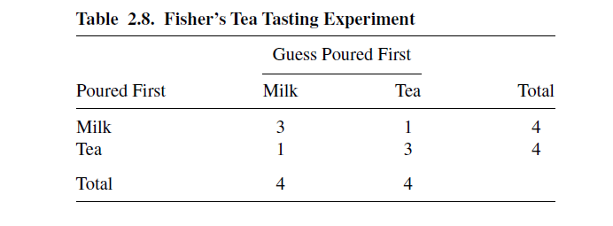
Example: Fisher’s Tea Taster
When drinking tea, a colleague of Fisher’s at Rothamsted Experiment Station near London claimed she could distinguish whether milk or tea was added to the cup first. To test her claim, Fisher designed an experiment in which she tasted eight cups of tea.
Four cups had milk added first, and the other four had tea added first. She was told there were four cups of each type and she should try to select the four that had milk added first. The cups were presented to her in random order.

Slide 24


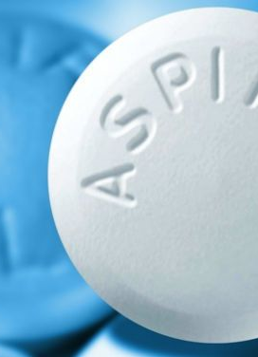
Example: Aspirin and Heart Attacks
?

Slide 25
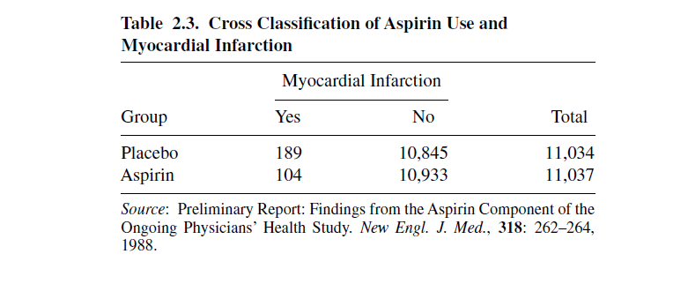
Example: Aspirin and Heart Attacks
Table 2.3 is from a report on the relationship between aspirin use and myocardial infarction (heart attacks) by the Physicians’ Health Study Research Group at Harvard Medical School.
The Physicians’ Health Study was a five-year randomized study testing whether regular intake of aspirin reduces mortality from cardiovascular disease.
Every other day, the male physicians participating in the study took either one aspirin tablet or a placebo. The study was “blind”- the physicians in the study did not know which type of pill they were taking.

Slide 26
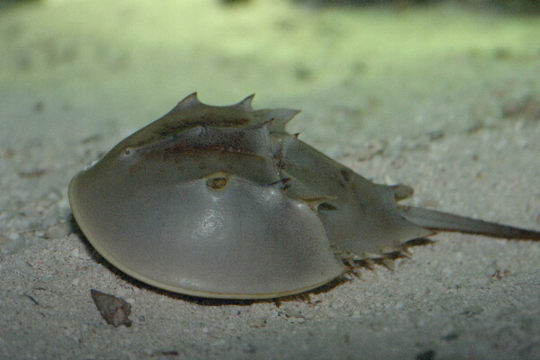
Example: Female Horseshoe Crabs and their Satellites
A study of nesting horseshoe crabs (J. Brockmann, Ethology,102: 1–21, 1996). Each female horseshoe crab in the study had a male crab attached to her in her nest.
The study investigated factors that affect whether the female crab had any other males, called satellites, residing nearby her. The response outcome for each female crab is her number of satellites.

Slide 27
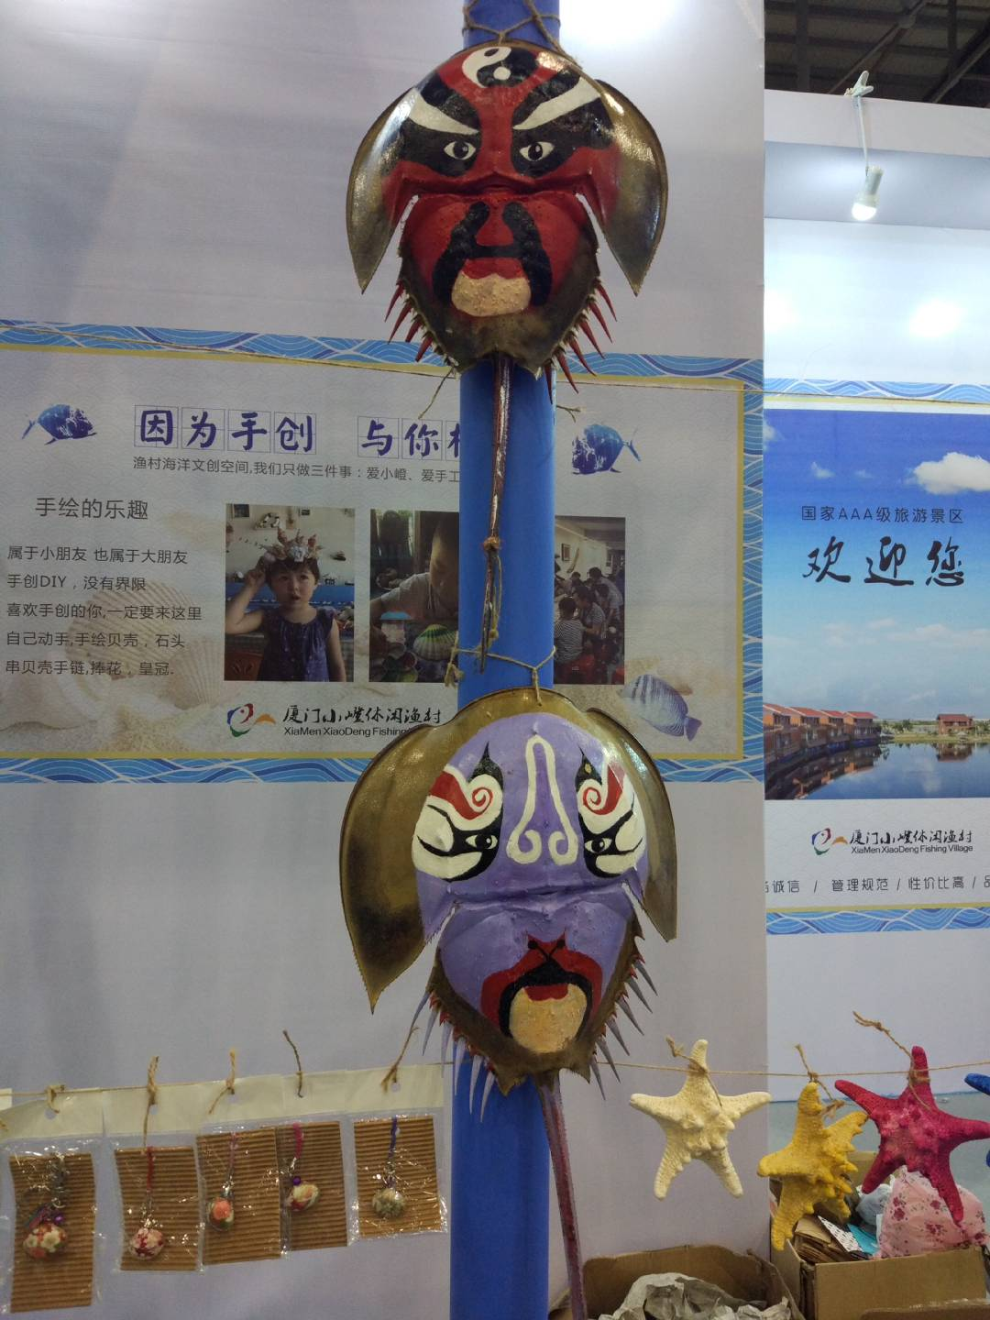
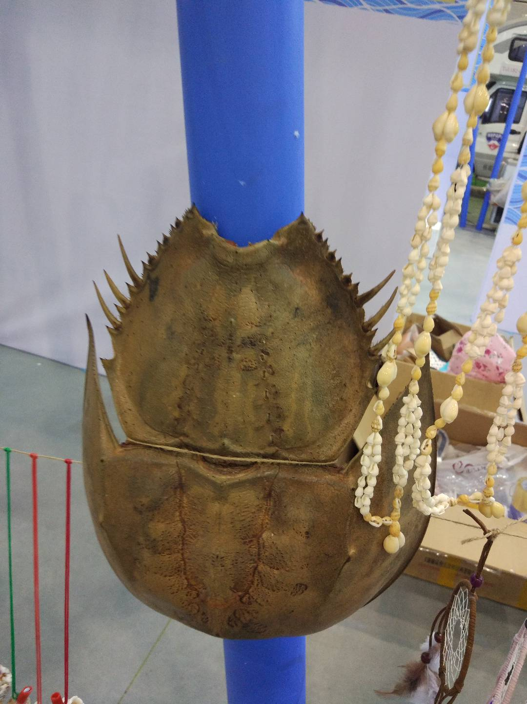

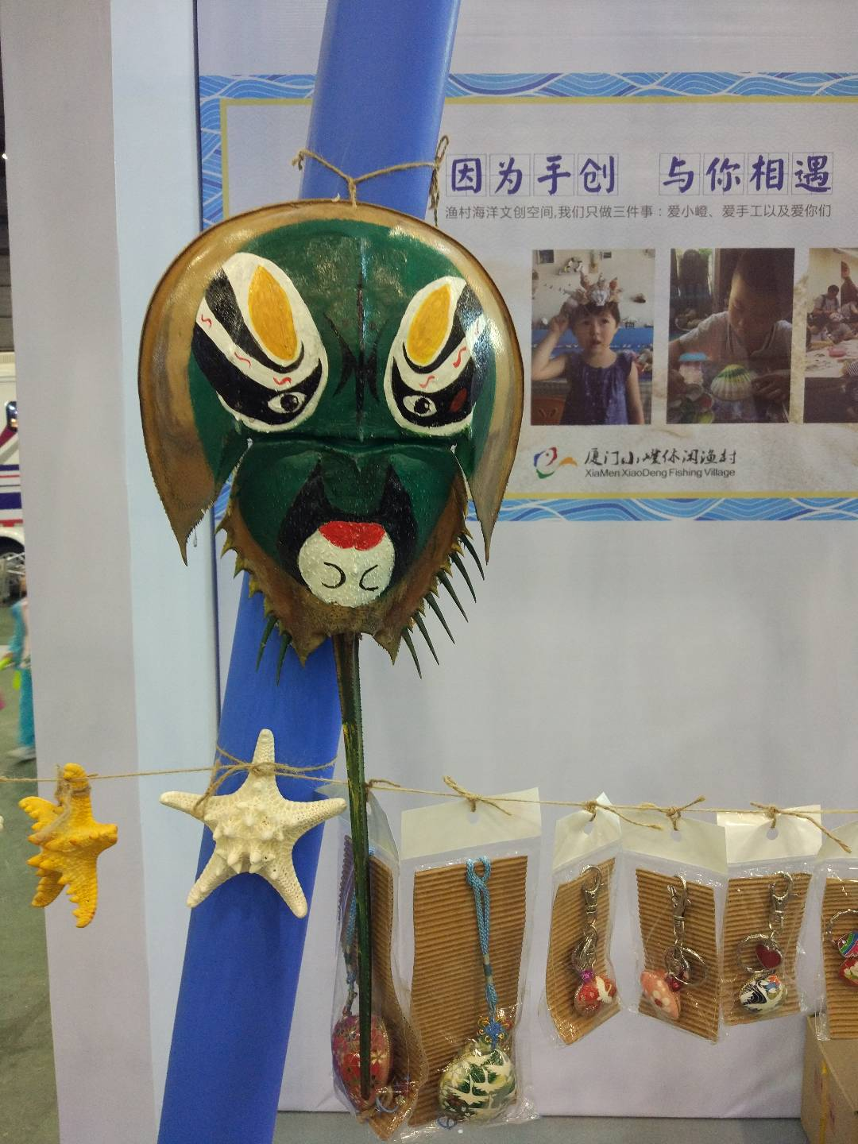

Slide 28
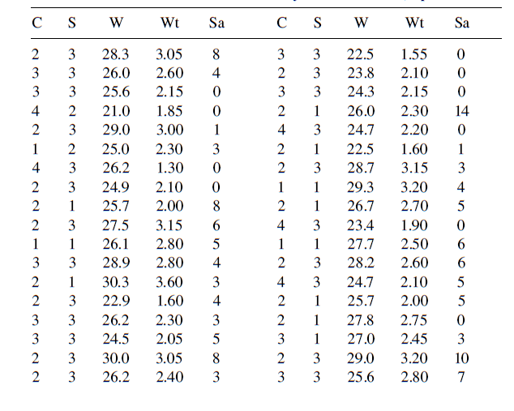
C: color S: spine condition W: width Wt: weight Sa: number of satellites

Slide 29
Extensions
Big Data
Machine Learning
Deep learning
Supervised
Unsupervised
Anomaly (Outlier) Detection
Notes:
Taxonomy: 分类学

Slide 30
MNIST
The MNIST database (Modified National Institute of Standards and Technology database) is a large database of handwritten digits that is commonly used for training various image processing systems. It was created by "re-mixing" the samples from NIST's original datasets. The MNIST database contains 60,000 training images and 10,000 testing images. ----Wikipedia

Slide 31
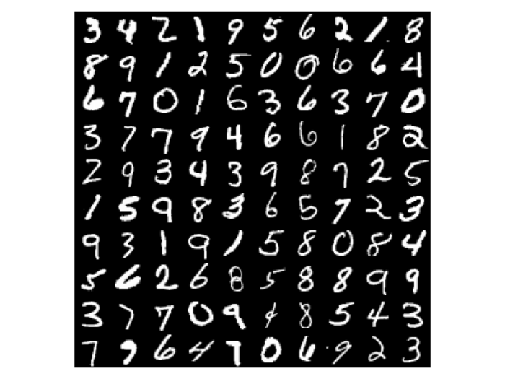

Slide 32
CIFA-10
The CIFAR-10 dataset (Canadian Institute For Advanced Research) is a collection of images that are commonly used to train machine learning and computer vision algorithms. It is one of the most widely used datasets for machine learning research. The CIFAR-10 dataset contains 60,000 32x32 color images in 10 different classes. The 10 different classes represent airplanes, cars, birds, cats, deer, dogs, frogs, horses, ships, and trucks. There are 6,000 images of each class. ----Wikipedia

Slide 33
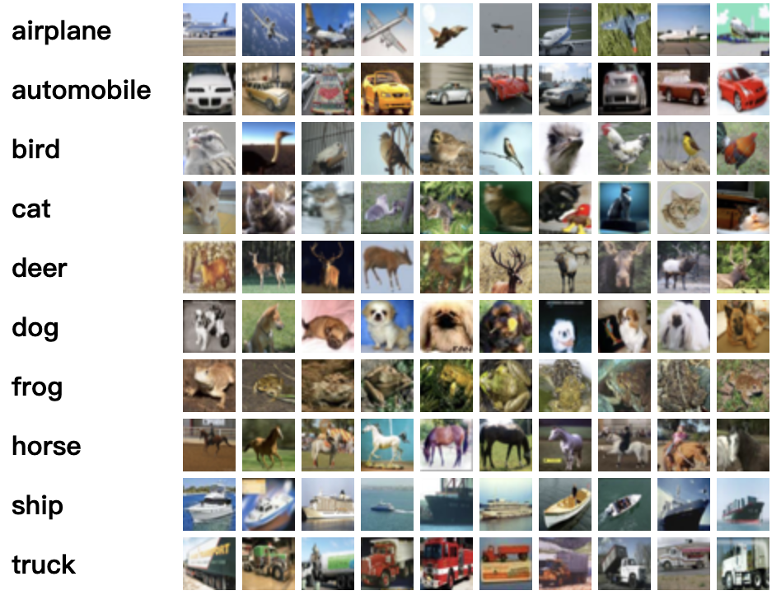

Slide 34
Think
What will we learn in this course?
How to use them in real data analysis?
What else can we do? (innovation)

Slide 35
Thank you!

