Slide 1
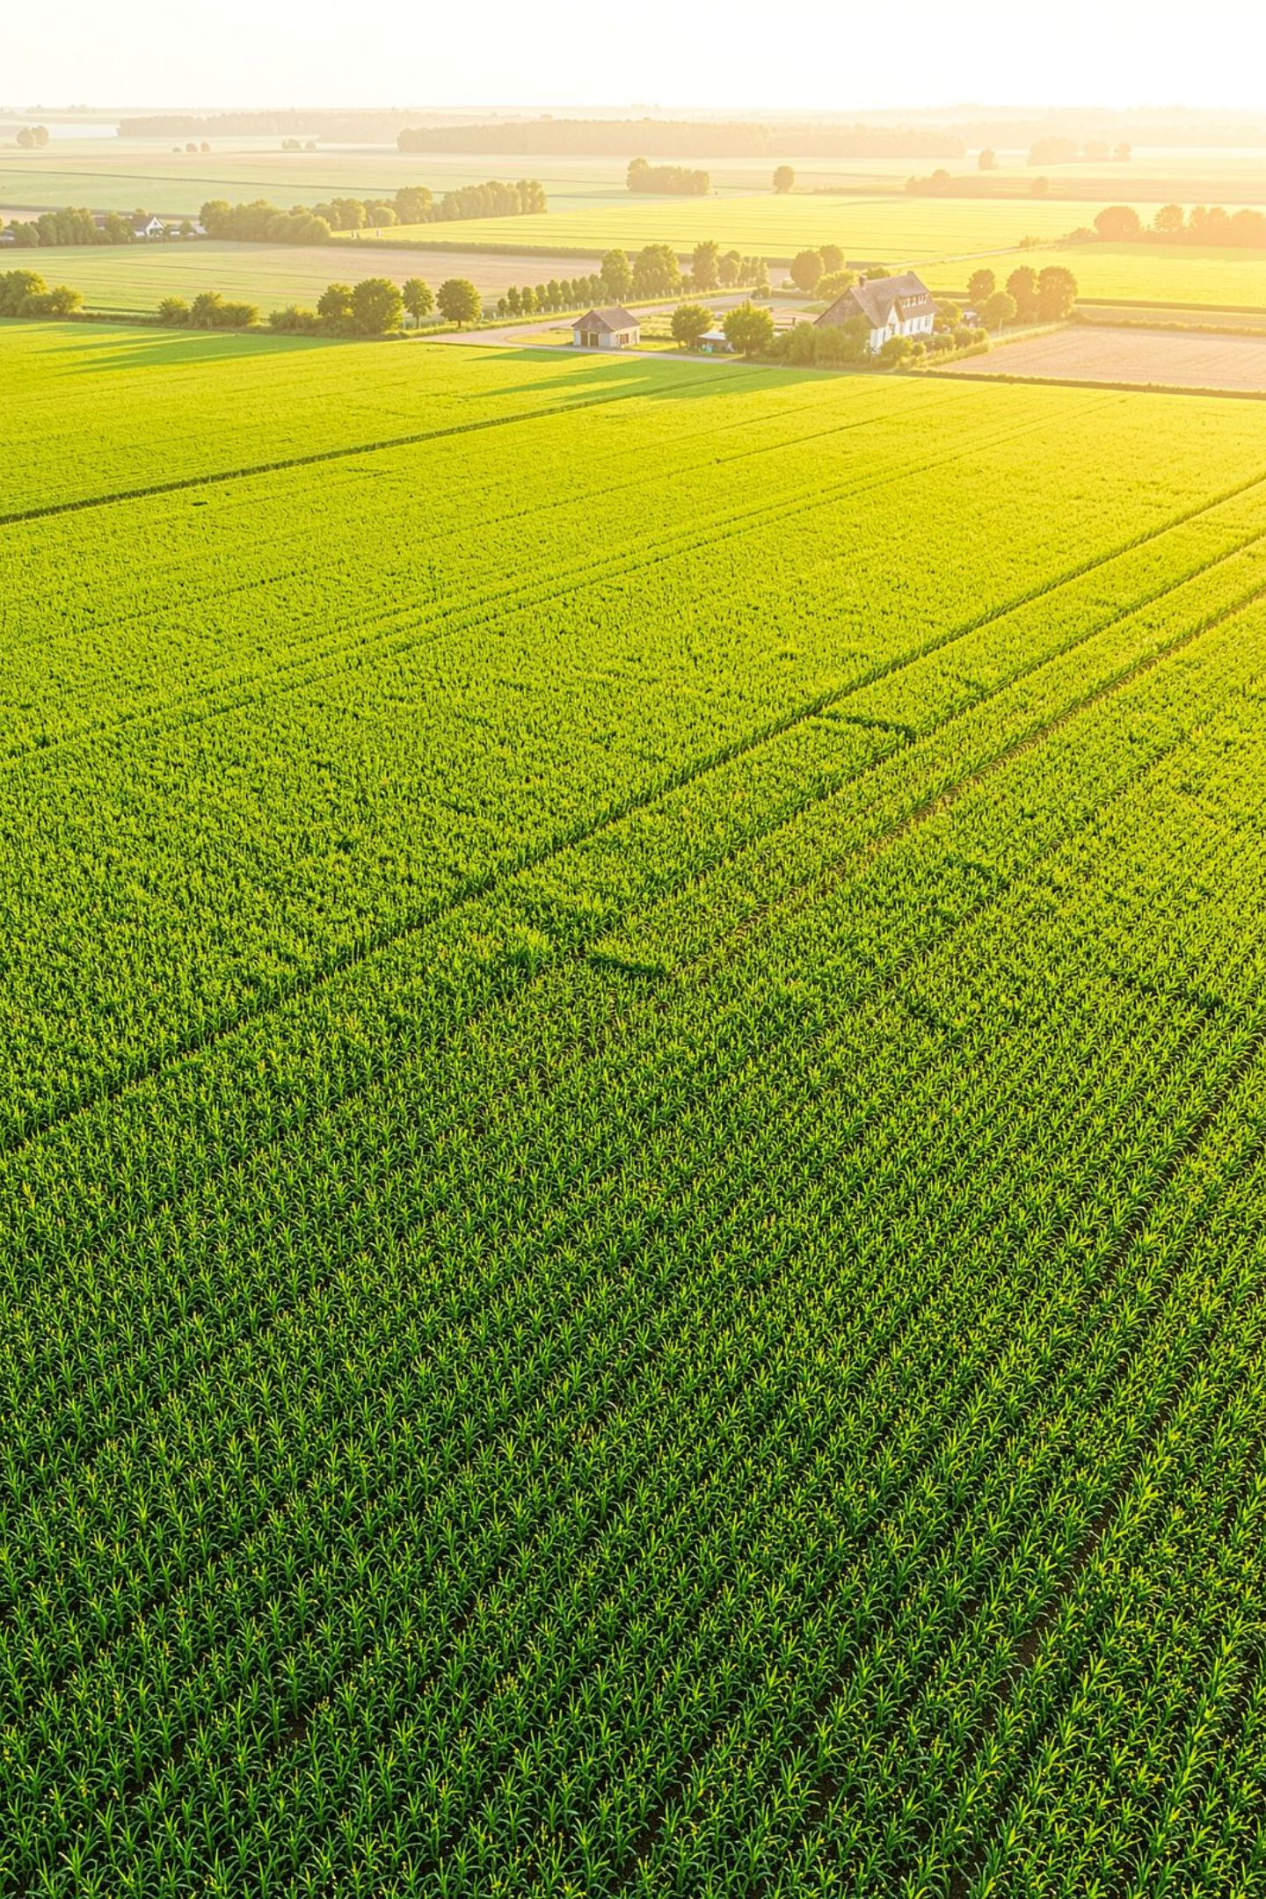
Growing Smarter, One Field at a Time
FarmVerse — Smart Farm & Crop Management Platform

Slide 2
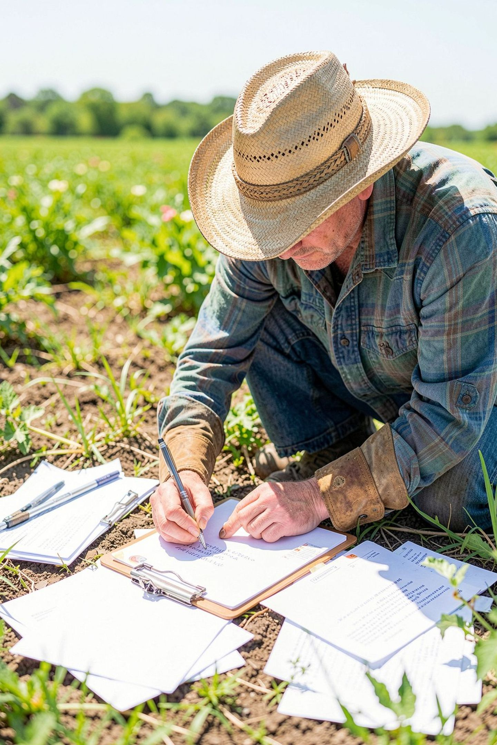

Problem Statement
Fragmented Tracking
Crops, sowing/harvest cycles, and yields managed manually or across disconnected spreadsheets
No Central System
No single platform to manage multiple farms, crops, and yield history together
Poor Decision-Making
Without structured records, harvest planning and data-driven decisions are nearly impossible

Slide 3
Proposed Solution
FarmVerse
Secure Login & Registration
A centralized web platform for farmers to register, manage multiple farms, track crops, and monitor yield and harvest timelines — all in one dashboard.
Add, View & Delete Farms and Crops
Detailed Crop Insights
Sown/harvest months, yield data, soil type

Slide 4






Key Features
Secure Authentication
Farm Management
Login & Registration with validation
Add, view, and manage multiple farms per user
Crop Management
Crop Yield Details
Add, track, and delete crops linked to specific farms
Soil type, sown/harvest month, yield per acre, insights
Responsive Modern UI
Data Validation
Clean dashboard-style interface built for usability
Form-level validation across all entry points

Slide 5








Tech Stack
Frontend
React.js, React Router, Axios, custom CSS — component-based architecture
Backend
Spring Boot / Java REST APIs
Database
PostgreSQL
API Communication
REST endpoints with credential-based sessions

Slide 6

System Architecture
React SPA (Client)
Component-based frontend
Three-tier Architecture
PostgreSQL Database
REST API Layer
Persistent relational store
Spring Boot services
A clean 3-tier architecture — component-based React frontend, dedicated service layers (CropService, FarmService, LoginService) calling REST endpoints, backed by a PostgreSQL database.

Slide 7


UI/UX Highlights
Themed Login & Registration
Custom-designed experience with FarmVerse branding
Data Tables with Inline Actions
Farm List and Crop List with View Yield and Delete actions
Dedicated Crop Detail View
Farm name, soil type, crop area, sown/harvest month, yield per acre, insights
Real-Time Form Validation
Inline error feedback across all entry points

Slide 8





Core Modules — End-to-End Farmer Workflow
Register
Login
Farmer Dashboard
Add Farm / Crop
View Crop Yield Details
Every step of the farmer journey — from onboarding to detailed crop yield insights — is handled within a single, cohesive platform.

Slide 9



Challenges & Solutions
Data Consistency
Ensuring integrity between farm and crop relationships across all operations
Clean API Integration
Structuring reusable service functions (CropService, FarmService, LoginService) for maintainable code
Intuitive Multi-Step Flow
Building a seamless user journey from registration through to crop tracking

Slide 10





Future Enhancements
Yield Prediction
Weather API Integration
Analytics Dashboard
ML integration using historical yield data
Real-time weather data for smarter crop planning
Charts for yield trends across seasons
Mobile App
Multi-Language Support
Native mobile version for on-field access
Localization for farmers across regions

Slide 11
Learnings, Takeaways & Thank You
Key Learnings
Thank You
01
We appreciate the opportunity to present FarmVerse as part of the Infosys Internship Project Review.
Full-Stack Integration
Frontend–backend–database end-to-end development
Questions & Feedback Welcome
02
REST API Design
Designing and consuming structured REST endpoints
03
React State Management
Real-world form validation and component state in React
04
Usability-First UI/UX
Applying design principles for accessible, intuitive interfaces

