Slide 1
Python OOP
Orest Furda

Slide 2
Programming paradigms
Action
Agent-oriented
Array-oriented
Automata-based
Concurrent computing
Relativistic programming
Data-driven
Differentiable
Dynamic/scripting
Event-driven
Generic
Declarative
Functional
Functional logic
Purely functional
Logic
Abductive logic
Answer set
Concurrent logic
Functional logic
Inductive logic
Constraint
Constraint logic
Concurrent constraint logic
Dataflow
Flow-based
Reactive
Ontology
Structured
Block-structured
Object-oriented
Actor-based
Class-based
Concurrent
Prototype-based
By separation of concerns:
Aspect-oriented
Role-oriented
Subject-oriented
Recursive
Symbolic
Value-level
Orest Furda

Slide 3
Object-oriented programming (OOP) is a programming paradigm based on the concept of "objects", which can contain data, in the form of fields (often known as attributes or properties), and code, in the form of procedures (often known as methods).
A feature of objects is an object's procedures that can access and often modify the data fields of the object with which they are associated (objects have a notion of "this" or "self").
OOP languages are diverse, but the most popular ones are class-based, meaning that objects are instances of classes, which also determine their types.
Many of the most widely used programming languages (such as C++, Java, Python, etc.) are multi-paradigm and they support object-oriented programming to a greater or lesser degree, typically in combination with imperative, procedural programming.
Orest Furda

Slide 4
ABAP
Ada 95
AmigaE
Apex
BETA
Boo
C++
C#
Ceylon
Chapel
Clarion
CLU
COBOL
Cobra
ColdFusion
Common Lisp
COOL
CorbaScript
Curl
D
Dart
DataFlex
Dylan
E
Eiffel
Sather
Elixir
Fortran 2003
FPr
FreeBASIC
F-Script
F#
Gambas
Genie
Go
Graphtalk
IDLscript
J
J#
JADE
Java
Groovy
Join Java
X10
Julia
Kotlin
Lasso
Lava
Lexico
Lingo
LISP
Logtalk
MATLAB
Modula-3
Nemerle
NetRexx
Nim
Noop
Oberon (Oberon-1)
Oberon-2
Object Pascal
Delphi
Free Pascal
Turbo Pascal
Object REXX
Objective-C
Ocaml
Perl since v5
PHP since v4, greatly enhanced in v5
Power Builder
Prototype-based languages
Actor-Based Concurrent Languages: ABCL/1, ABCL/R, ABCL/R2, ABCL/c+
Agora
Cecil
ECMAScript
ActionScript
JavaScript
JScript
Etoys (in Squeak)
Io
Lua
Lisaac
MOO
NewtonScript
Obliq
REBOL
Self
Python
REALbasic
Ruby
Rust
S
R
Scala
Scriptol
Seed7
SenseTalk
Simula
Smalltalk
Self
Bistro
Squeak
Pharo
Newspeak
Swift
Visual FoxPro
Visual Prolog
XBase++ (extends xBase standard language)
Xojo
TypeScript
Ubercode
Vala
Visual Basic
Visual Basic .NET (VB.NET)
VBScript
Orest Furda
Notes:
Об’єктно-орієнтовні мови програмування.

Slide 5
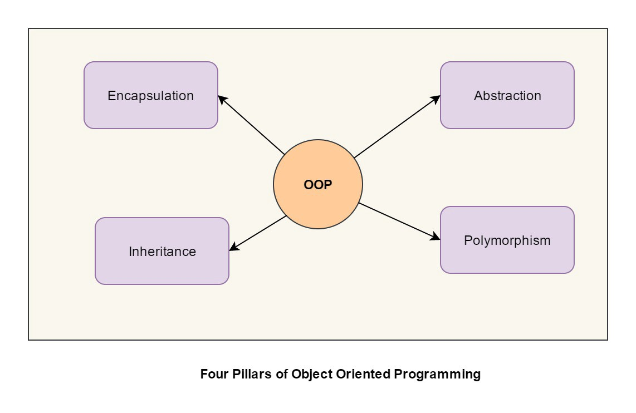
OOP paradigms
Encapsulation
Abstraction
Polymorphism
Inheritance
Orest Furda

Slide 6
Encapsulation
Encapsulation is the mechanism of hiding of data implementation by restricting access to public methods. Instance variables are kept private and accessor methods are made public to achieve this.
Abstraction
Abstract means a concept or an Idea which is not associated with any particular instance. In a way, one class should not know the inner details of another in order to use it, just knowing the interfaces should be good enough.
Orest Furda

Slide 7
Polymorphism
It means one name many forms. It is further of two types — static and dynamic. Static polymorphism is achieved using method overloading and dynamic polymorphism using method overriding.
Inheritance
Inheritances expresses “is-a” and/or “has-a” relationship between two objects. Using Inheritance, In derived classes we can reuse the code of existing super classes.
Orest Furda

Slide 8
Introduction in Python
Python is a multi-paradigm programming language. Meaning, it supports different programming approach. One of these is OOP.
Everything in Python is an object.
Object is simply a collection of data (variables) and methods (functions) that act on those data.
Class is a prototype (template, blueprint) for the object. We can create many objects from a class.
Instantiation - the process of creating object. And this object is also called an instance of a class.
Orest Furda

Slide 9



Defining a Class
To determine the class, you use class operator:
The smallest possible class definition looks like
The (object) part in parentheses specifies the parent class that you are inheriting from. In Python 3 this is no longer necessary because it is the implicit default.
Supperclass[1, 2, …] – parent class for ClassName.
ClassName – child class for superclass[1, 2, …].
Orest Furda

Slide 10

Defining a Class
Although not mandatory, but recommended in the first line of class add docstring, for example:
And when we call ClassName.__doc__, we will get information about this class:
Orest Furda

Slide 11
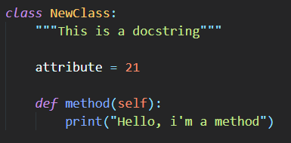


Defining a Class
As soon as we define a class, a new class object is created with the same name.
This class object allows us to access the different attributes as well as to instantiate new objects of that class.
Example:
Orest Furda

Slide 12


Methods and attributes
In the terminology of the Python members of the class are called attributes, functions of the class - methods and fields of the class - properties (or simply attributes).
Definitions of methods are similar to the definitions of functions, but methods always have the first argument, called on the widely accepted agreement self.
Definitions of properties - the usual assignment operators that connect some of the values with attribute names.
Orest Furda

Slide 13
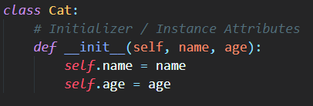
Instance attributes
All classes create objects, and all objects contain characteristics called attributes. Use the __init__() method to initialize an object’s initial attributes by giving them their default value (or state).
This method must have at least one argument as well as the self variable, which refers to the object itself (e.g., Cat).
In the case of our Cat() class, each cat has a specific name and age, which is obviously important to know for when you start actually creating different dogs.
Remember: the class is just for defining the Cat, not actually creating instances of individual cats with specific names and ages.
Not all cats share the same name, we need to be able to assign different values to different instances. Hence the need for the special self variable, which will help to keep track of individual instances of each class.
Orest Furda

Slide 14
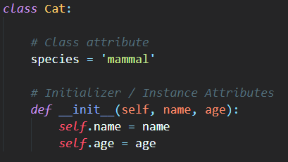
Class attributes
While instance attributes are specific to each object, class attributes are the same for all instances—which in this case is all cats.
So while each cat has a unique name and age, every cat will be a mammal.
Orest Furda

Slide 15
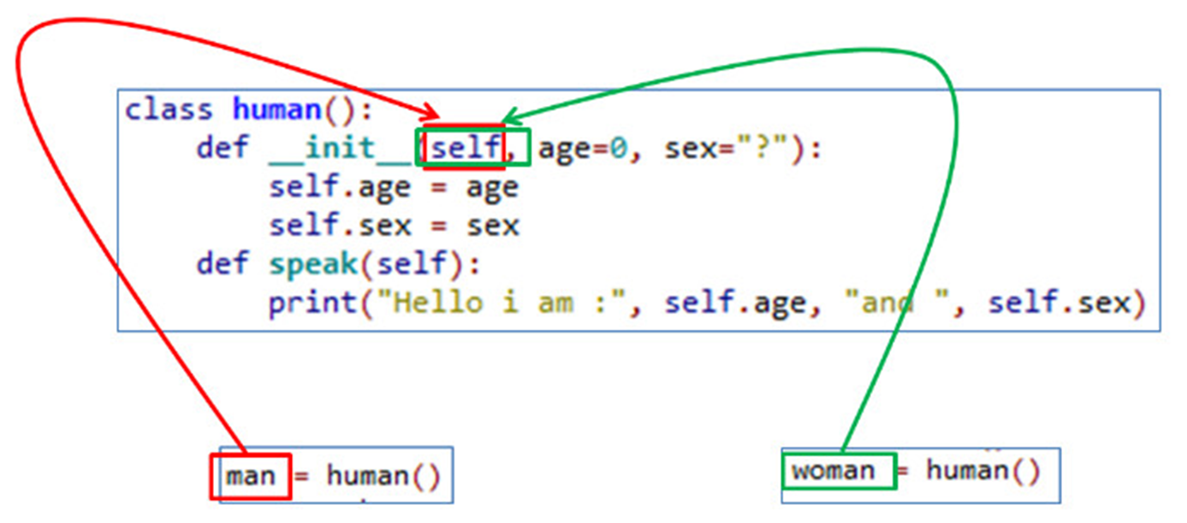
Всередині котів є мурчалка.
Вона реалізована для всіх котів з класу Кіт.
В об’єкті кіт потрібно якось викликати метод мурчало з класу Кіт. Як ти це зробиш?
Кіт.мурчало()
Якщо ти викличеш Кіт.мурчало(), то муркнуть одразу всі коти на світі.
А якщо викличеш self.мурчало(), то муркне тільки той кіт, на якого вказує self.
Self
Python Self
Java This
Self - reference to the current object. Through this reference inside the class, we can access the methods or attributes of the same class.
Instead of self, you can write anything and everything will work, but it is accepted that it was self.
Orest Furda

Slide 16
Constructors
Class functions that begins with double underscore (__) are called special functions as they have special meaning.
Of one particular interest is the __init__() function. This special function gets called whenever a new object of that class is instantiated.
You will never have to call the __init__() method; it gets called automatically when you create a new instance.
This type of function is also called constructors in Object Oriented Programming (OOP). We normally use it to initialize all the variables.
If we can create something, we can also destroy it and if we have a constructor, we must have a destructor.
Orest Furda

Slide 17
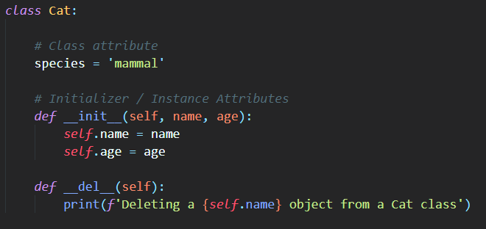
Destructors
In Python is implemented automatic memory management, so the destructor is required very often, for resources, that require an explicit release.
Orest Furda

Slide 18
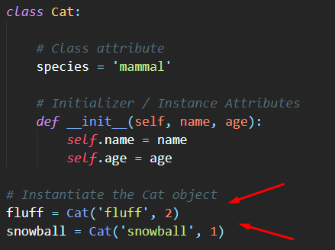
Creating an Object
Once created, we can refer to the instance attributes
Orest Furda

Slide 19
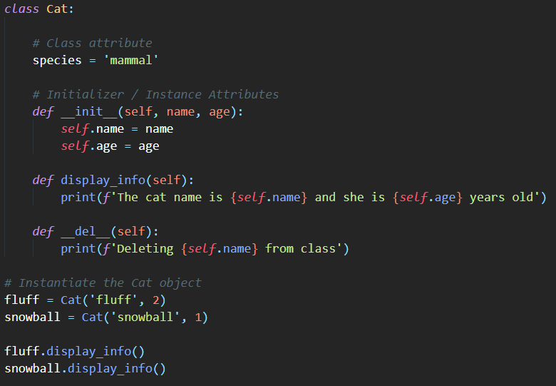
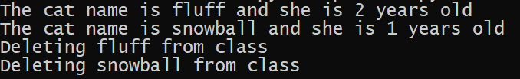
Not a bug but a feature
Because, the interpreter saw that the program was completed and we would no longer need the objects.
Orest Furda

Slide 20
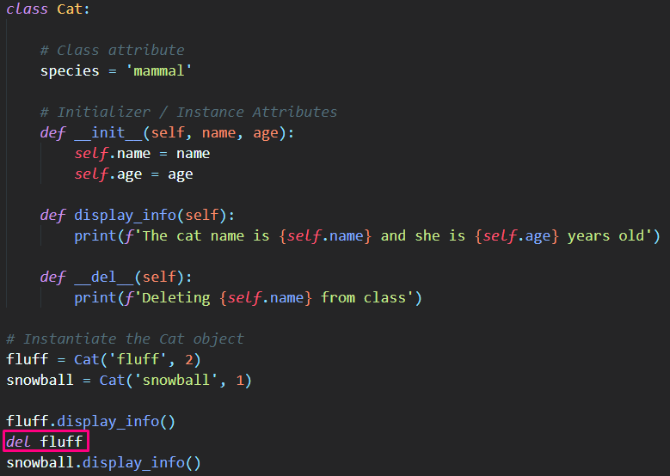

Delating an Object
If we no longer need the object, we can tell python to remove it by freeing up memory.
But Python's well-organized memory management and self-removal are not required. As shown above, if the object is no longer needed, the garbage collector will remove it.
We can also delete not only the entire object, but also it’s individual attributes.
Orest Furda

Slide 21
Method __new__()
By overriding the class method __new__, you can control the process of creating an instance of the class. This method is called before the method __init__ and should return a new instance, or None (in the latter case will be called __new__ of the parent class).
Method __new__ is used to control the creation of unchangeable (immutable) objects, managing the creation of objects in cases when __init__ is not invoked.
Most often, the __new__ method is exemplified by a pattern programming called Singleton.
Orest Furda

Slide 22
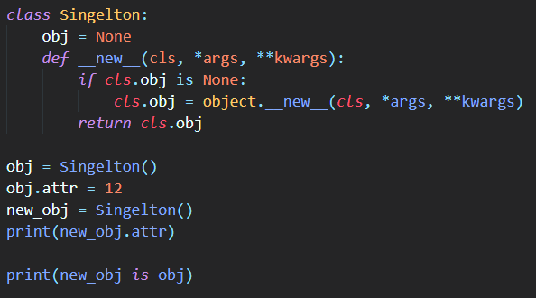

Singleton
If object doesn’t yet exist, then call __new__ of the parent class, else return the same object.

Slide 23
Inheritance
Inheritance is the process by which one class takes on the attributes and methods of another. Newly formed classes are called child classes, and the classes that child classes are derived from are called parent classes.
Python supports both single inheritance and multiple, allowing the class to be derived from any number of base classes.
Derived class inherits features from the base class, adding new features to it. This results into re-usability of code.
Let’s return to cats :)
Orest Furda

Slide 24
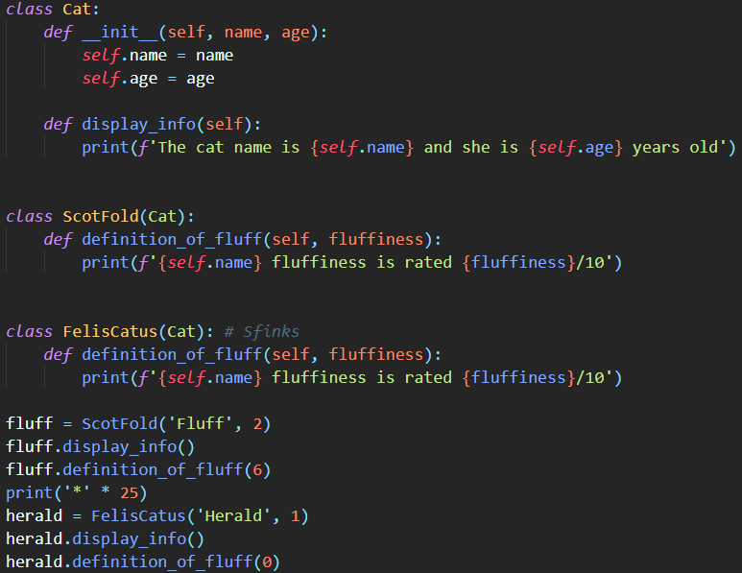
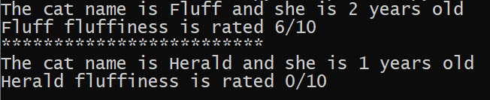
Inheritance
Orest Furda

Slide 25




isinstance() and issubclass()
isinstance() returns True if the object is an instance of the class or other classes derived from it. Each and every class in Python inherits from the base class object.
issubclass() is used to check for class inheritance.
Orest Furda

Slide 26
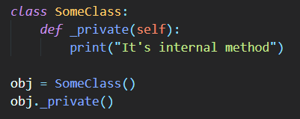
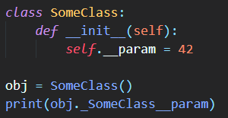
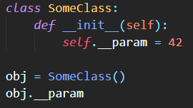

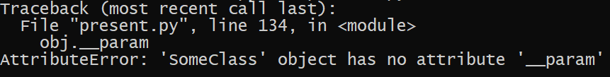
Encapsulation
All objects in Python encapsulate data and methods of working with them, providing public interfaces for interaction.
An attribute can be declared private (internal) using the underscore in front of the name, but this hiding does not actually happen - everything is at the agreement level.
If you put two underscores in front of the attribute name, it cannot be accessed directly. But still there is a workaround:
Orest Furda

Slide 27
But in the example above, not a true encapsulation is given.
Very often, encapsulation is confused with simple data hiding.
Using encapsulation gives us several important benefits:
Monitoring the correct state of the object.
Convenience for the user due to the interface.
We leave “outside” for user access only methods. It is enough for him to call them to get the result, and he does not need to delve into the details of their work at all.
Changes to the code do not affect users.
We make all changes inside the methods. This will not affect the user. The fact that we changed something in the operation of the method will remain invisible to him: he, as before, will simply get the desired result.
Orest Furda

Slide 28
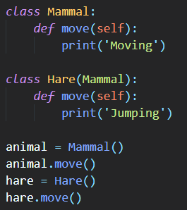
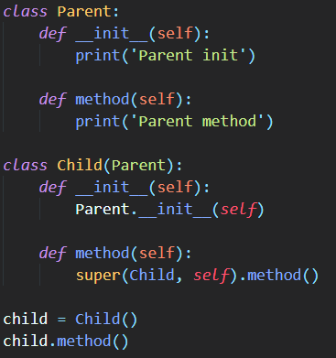


Polymorphism
Poly = many: Morph = change or form
So polymorphism is the ability (in programming) to present the same interface for differing underlying forms (data types).
All methods are initially virtual. This means that child classes can redefine them and solve the same problem in different ways, and a specific implementation will be selected only during program execution. Such classes are called polymorphic.
However, you can also access the methods of the ancestor class either by direct access, or by using the super function:
Orest Furda

Slide 29
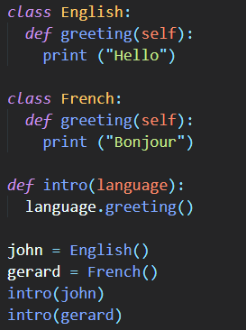

Polymorphism
The same interface with different implementations may have classes that are not related by related ties.
In the example, the code can equally conveniently work with the English and French classes, since they have the same interface:
This is possible thanks to duck typing.
Orest Furda

Slide 30
Abstraction
In object-oriented programming, this is giving the object characteristics that distinguish it from all other objects, clearly defining its conceptual boundaries.
The main idea is to separate the way of using composite data objects from the details of their implementation in the form of simpler objects.
This allows you to work with objects without going into the features of their implementation. In each case, one or another approach is used: encapsulation, polymorphism or inheritance. For example, if you need to access the hidden data of an object, you should use encapsulation by creating a so-called access function or property.
The fundamental idea is to separate the non-essential details of the subprogram implementation and the essential characteristics for its correct use. Such a separation can be expressed through a special “interface” that focuses on the description of all possible applications of the program.
Orest Furda

Slide 31
Duck typing
If it looks like a duck, swims like a duck and quacks like a duck, then it probably is a duck.
Cat typing
If it looks like a cat, walks like a cat and purrs like a cat, then it probably is a cat.
Orest Furda

Slide 32
Thanks for your attention
Orest Furda

