Slide 1
HTML5
Valentyn Malenchak

Slide 2
HTML5
Hypertext Markup Language (HTML) is the standard markup language for documents designed to be displayed in a web browser.
It can be assisted by technologies such as Cascading Style Sheets (CSS) and scripting languages such as JavaScript.
Valentyn Malenchak

Slide 3

HTML VERSIONS
HTML 2 (November 24, 1995)
HTML 3 (January 14, 1997)
HTML 4 (December 18, 1997)
HTML 5 (October 28, 2014)
HTML 5.1 (November 1, 2016)
HTML 5.2 (December 14, 2017)
Valentyn Malenchak
Notes:
https://flask.palletsprojects.com/en/master/

Slide 4
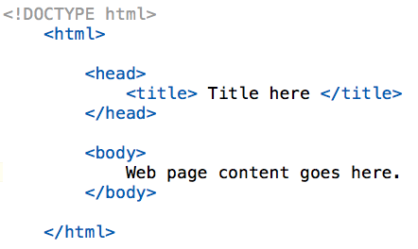
HTML document
HTML document is a text document created to represent formatted information including text, vide, images, sounds.
HTML document is created by tags and consists of sections.
Valentyn Malenchak

Slide 5
<head> and <body>
The <head> element is a container for metadata (data about data) and is placed between the <html> tag and the <body> tag. HTML metadata is data about the HTML document. Metadata is not displayed. Metadata typically define the document title, character set, styles, scripts, and other meta information. The following tags describe metadata: <title>, <style>, <meta>, <link>, <script>, and <base>. The <meta> element is used to specify which character set is used, page description, keywords, author, and other metadata.
The <body> element contains all the contents of an HTML document, such as text, hyperlinks, images, tables, lists, etc.
Valentyn Malenchak

Slide 6
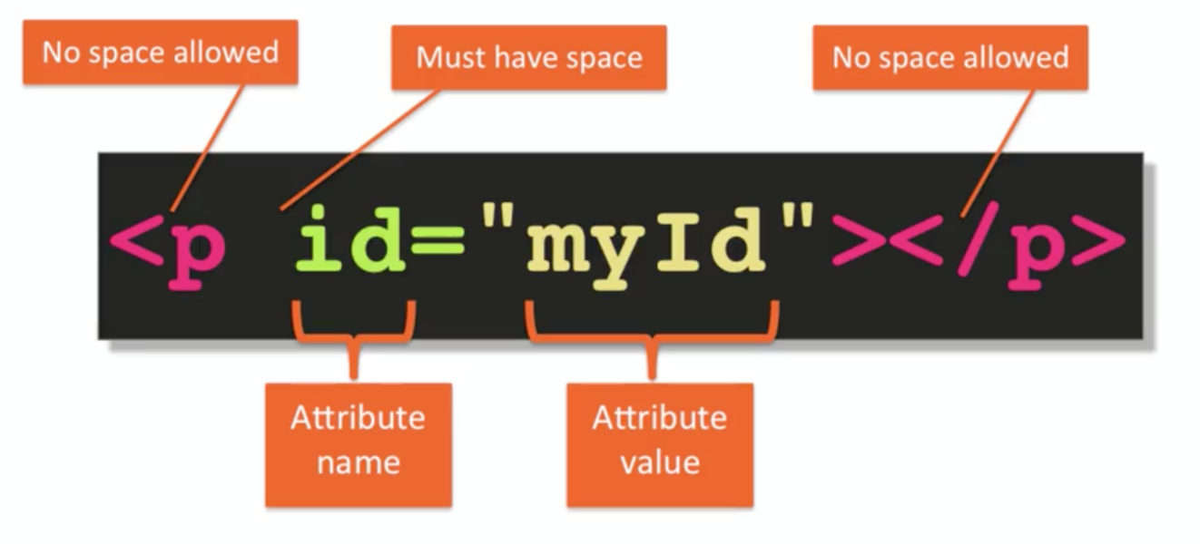
Paired tags
Tags are keywords that determine structure of an HTML page.
There are two types of tags: start tags and end tags. Start tags are used to begin an effect, and end tags are used to end that effect. End tags always repeat the keyword with a slash (/) in front.
Valentyn Malenchak

Slide 7
Unpaired tags, HTML elements
An unpaired tag does not have a companion tag. Unpaired tags are also known as Singular tags or Stand-Alone Tags.
1 2 3 4 5 6 | <br> <hr> <img> <meta> <!DOCTYPE>
Paired tags or unpaired tags also called element.
An element can describe content, insert graphics, and create hyperlinks.
Valentyn Malenchak

Slide 8
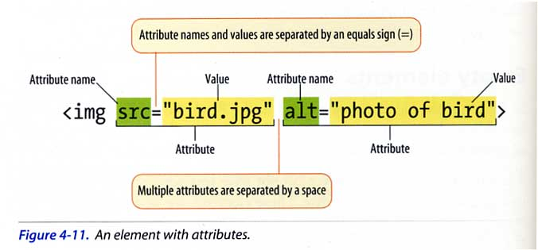
Attributes
Attributes provide additional information about HTML elements.
All HTML elements can have attributes
Attributes provide additional information about an element.
Attributes are always specified in the start tag.
List: https://is.gd/Sdsyv9
Valentyn Malenchak

Slide 9
Common HTML tags
<a href=URL>: defines a hyperlink, which is used to link from one page to another.
<h[1-6]>: creates a heading
<p>: defines text as a paragraph
<b>: applies boldface to text
<i>: defines a part of text in an alternate voice or mood.
<img>: Inserts an image from a file or another Web site.
Valentyn Malenchak

Slide 10
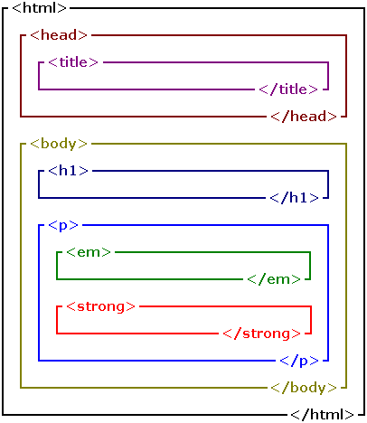
Nested tags
HTML elements can be nested (elements can contain elements).
All HTML documents consist of nested HTML elements.
Valentyn Malenchak

Slide 11
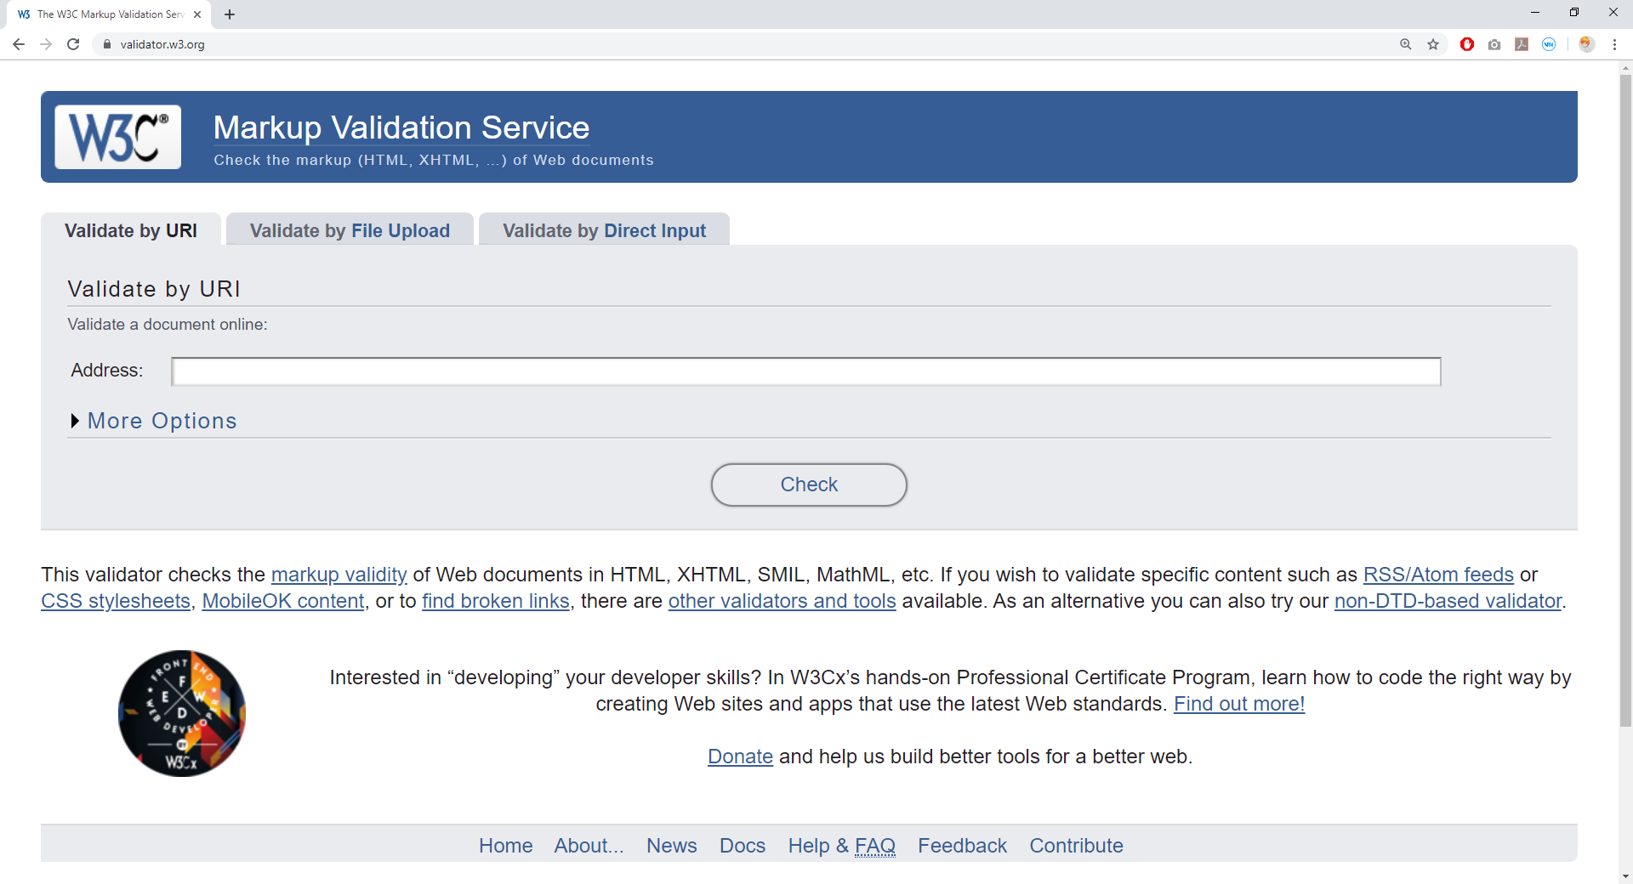
HTML Validators
https://validator.w3.org/
Valentyn Malenchak

Slide 12
Tag <img>
The <img> tag defines an image in an HTML page.
The <img> tag has two required attributes: src and alt.
Ex.:
<img src="smiley.jpg" alt="Smiley face" height="42" width="42">
Valentyn Malenchak

Slide 13
Tags <svg>, <video>, <audio>
The <audio> tag defines sound, such as music or other audio streams.
<audio controls src="/media/examples/t-rex-roar.mp3">
Your browser does not support the <code>audio</code> element.
</audio>
The HTML <svg> element is a container for SVG graphics.
<svg width="100" height="100">
<circle cx="50" cy="50" r="40" stroke="green" stroke-width="4" fill="yellow" />
</svg>
The <video> tag specifies video, such as a movie clip or other video streams.
<video width="320" height="240" controls> <source src="movie.mp4" type="video/mp4"> <source src="movie.ogg" type="video/ogg"> Your browser does not support the video tag. </video>
Valentyn Malenchak

Slide 14
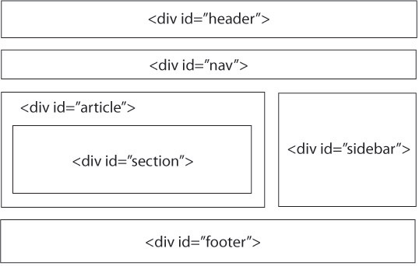
Tag <div>
The HTML Content Division element (<div>) is the generic container for flow content. It has no effect on the content or layout until styled using CSS.
This image for HTML 4.01
Valentyn Malenchak

Slide 15
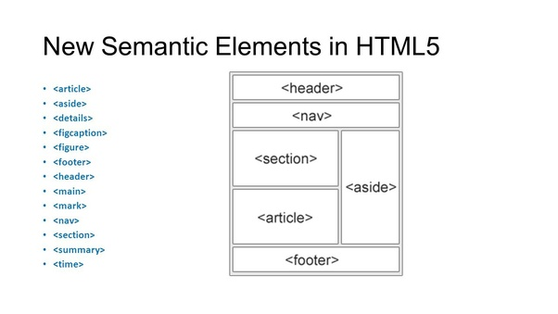
Semantic elements
A semantic element clearly describes its meaning to both the browser and the developer.
Examples of non-semantic elements: <div> and <span> - Tells nothing about its content.
Examples of semantic elements: <form>, <table>, and <article> - Clearly defines its content.
Valentyn Malenchak

Slide 16
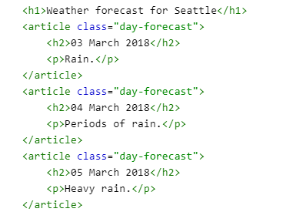
<article>
The HTML <article> element represents a self-contained composition in a document, page, application, or site, which is intended to be independently distributable or reusable.
Valentyn Malenchak
Notes:
https://sanic.readthedocs.io/en/latest/

Slide 17
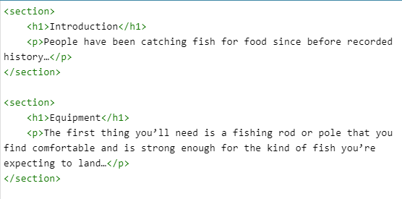
<section>
The HTML <section> element represents a standalone section — which doesn't have a more specific semantic element to represent it — contained within an HTML document. Typically, but not always, sections have a heading.
Valentyn Malenchak
Notes:
https://sanic.readthedocs.io/en/latest/

Slide 18


<article> vs <section>
Valentyn Malenchak
Notes:
https://sanic.readthedocs.io/en/latest/

Slide 19
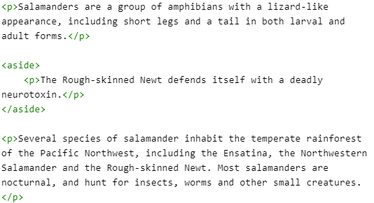
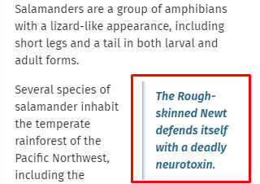
<aside>
The HTML <aside> element represents a portion of a document whose content is only indirectly related to the document's main content. Asides are frequently presented as sidebars or call-out boxes.
Valentyn Malenchak
Notes:
https://sanic.readthedocs.io/en/latest/

Slide 20
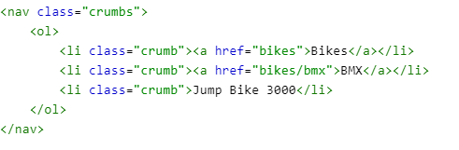
<nav>
The HTML <nav> element represents a section of a page whose purpose is to provide navigation links, either within the current document or to other documents. Common examples of navigation sections are menus, tables of contents, and indexes.
Valentyn Malenchak

Slide 21
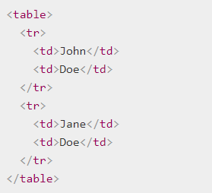
<table>
<table> defines overall table
<tr> defines rows
<th> defines column headers
<td> defines cells
Long, scrolling tables use <thead>, <tfoot>, and <tbody> tags
Valentyn Malenchak

Slide 22
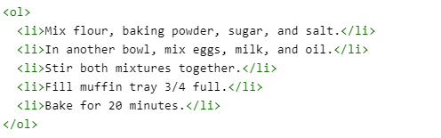
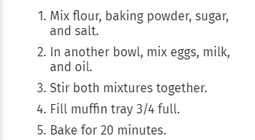
Ordered lists
The HTML <ol> element represents an ordered list of items, typically rendered as a numbered list.
compact .
Attributes:
reversed (HTML5)
start (HTML5 for example, to start numbering elements from the letter "d" or the Roman numeral "iv," use start="4“)
Type - this attribute sets the numbering type:
'a' indicates lowercase letters
'A' indicates uppercase letters
'i' indicates lowercase Roman numerals
'I' indicates uppercase Roman numerals
'1' indicates numbers (default)
Valentyn Malenchak
Notes:
https://sanic.readthedocs.io/en/latest/sanic/request_data.html

Slide 23
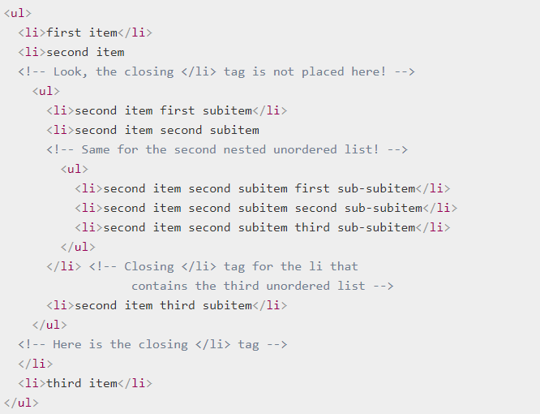
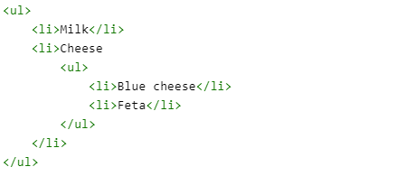
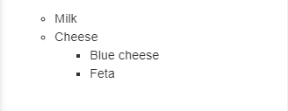
Unordered lists
The HTML <ul> element represents an unordered list of items, typically rendered as a bulleted list.
Valentyn Malenchak
Notes:
https://sanic.readthedocs.io/en/latest/sanic/request_data.html

Slide 24
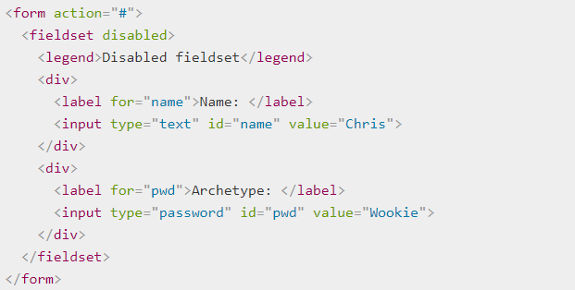
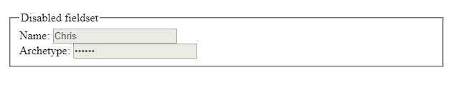
Forms
Form input is the information a user enters into fields in a Web or client application form.
Common syntax:
<form id="keyword">
<content and fields>
</form>
The fieldset element is used with many forms to group related elements.
The <fieldset> tag draws a box around individual elements and/or around the entire form.
Valentyn Malenchak
Notes:
https://sanic.readthedocs.io/en/latest/sanic/request_data.html

Slide 25


Inputs
The HTML <input> element is used to create interactive controls for web-based forms in order to accept data from the user; a wide variety of types of input data and control widgets are available, depending on the device and user agent.
Input types and attributes:
https://is.gd/21bZnB
Valentyn Malenchak
Notes:
https://sanic.readthedocs.io/en/latest/sanic/request_data.html

Slide 26
Thank you for attention!
Valentyn Malenchak

