Slide 1
JavaScript Syntax (part 1)
Valentyn Malenchak

Slide 2
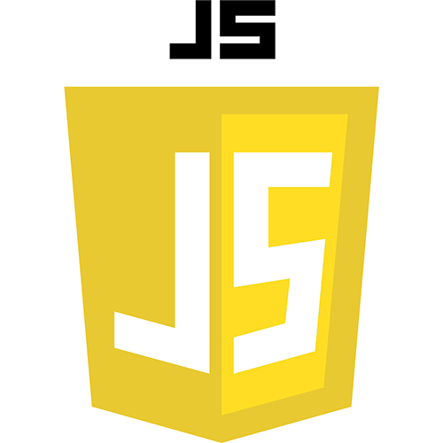
JavaScript
JavaScript is a scripting or programming language that allows you to implement complex things on web pages — every time a web page does more than just sit there and display static information for you to look at — displaying timely content updates, interactive maps, animated 2D/3D graphics, scrolling video jukeboxes, etc.
Valentyn Malenchak

Slide 3
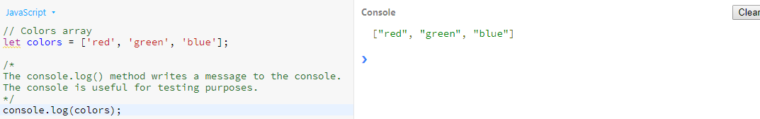
Comments
Comments - part of the program text which will be ignored by language interpreter.
Valentyn Malenchak
Notes:
https://flask.palletsprojects.com/en/master/

Slide 4
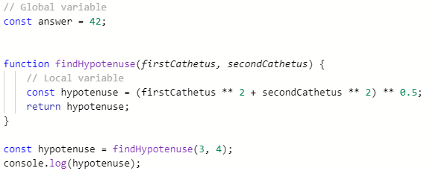
Variables
A JavaScript variable is simply a name of storage location.
There are two types of variables in JavaScript : local variable and global variable.
Naming conversation:
https://www.freecodecamp.org/news/javascript-naming-conventions-dos-and-don-ts-99c0e2fdd78a/
Valentyn Malenchak

Slide 5
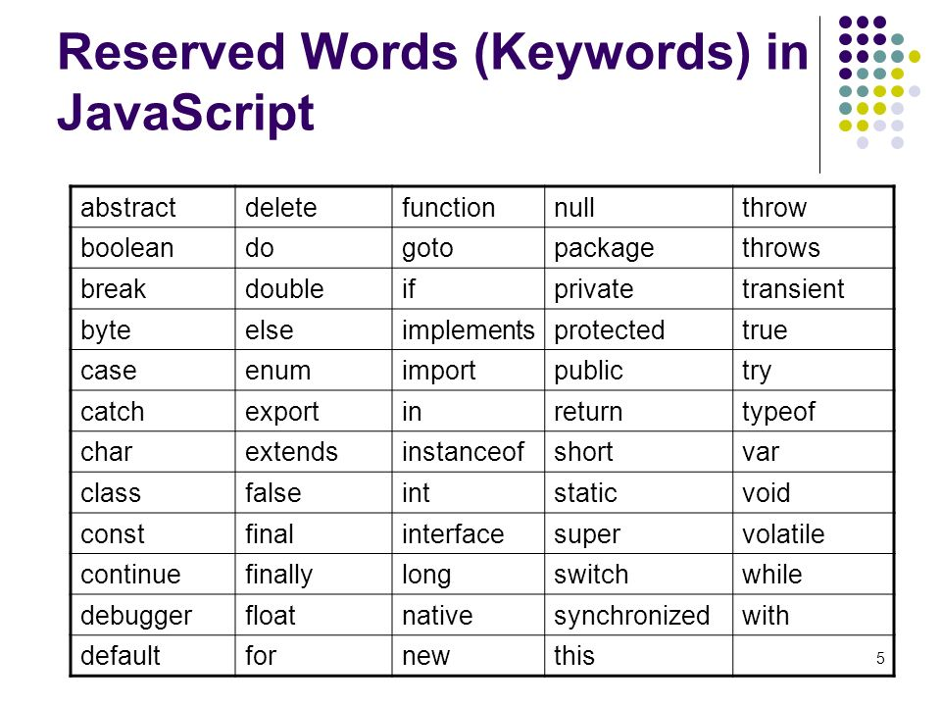
Variable declaration rules and keywords
Rules:
name must start with a letter (a to z or A to Z), underscore( _ ), or dollar( $ ) sign;
after first letter we can use digits (0 to 9), for example value1.
JavaScript variables are case sensitive, for example x and X are different variables;
You can't use one of JavaScript's reserved words as a variable name
Valentyn Malenchak

Slide 6
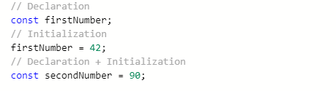
Variable declaration and initialization
Declaration – process of variable's specifying. Usually declaration consist of defining: type, name and default value of variable.
Initialization - process in which a variable is set to its first value is called.
Valentyn Malenchak

Slide 7
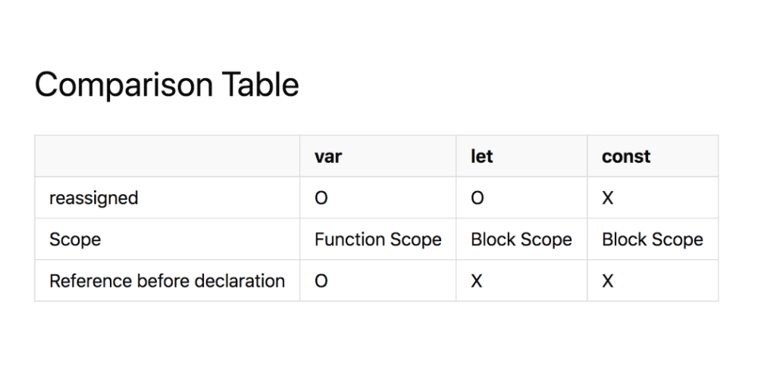
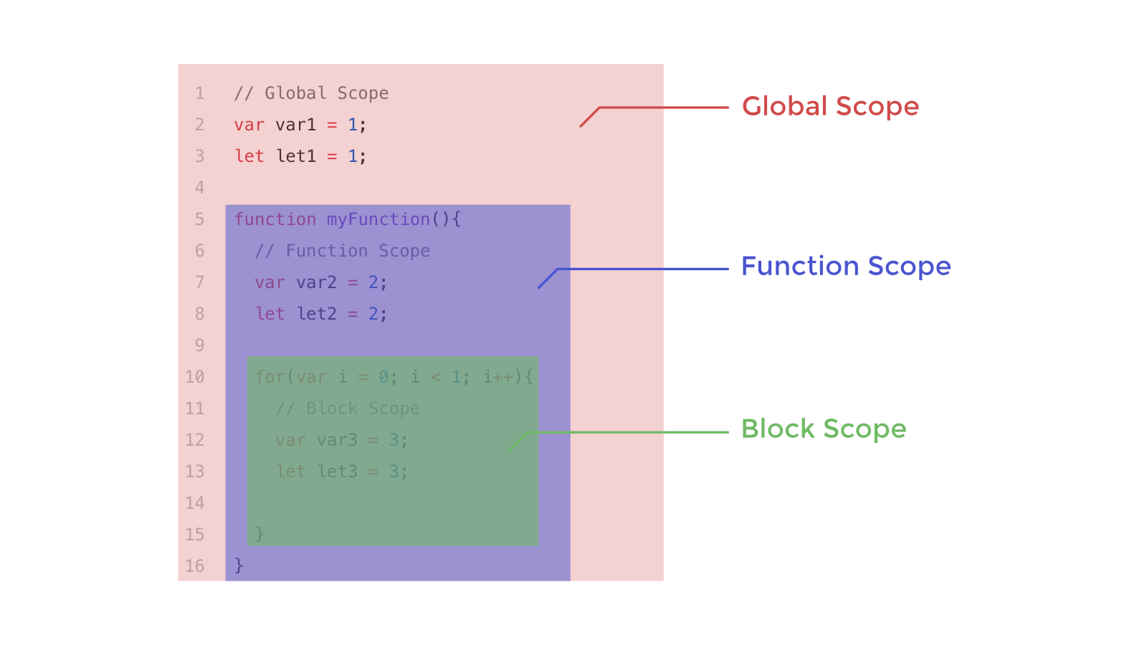
let / var / const
Valentyn Malenchak

Slide 8
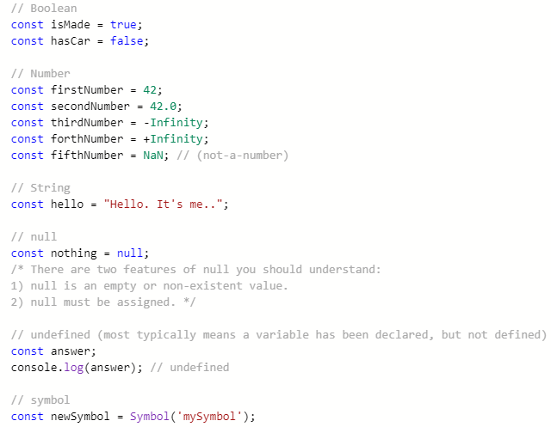
Primitive data types
In JavaScript there are two different kinds of data: primitives, and objects. A primitive is simply a data type that is not an object, and has no methods.
In JS, there are six primitive data types:
Boolean
Number
String
Null
Undefined
Symbol
Valentyn Malenchak

Slide 9
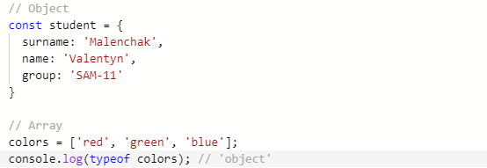
Objects
Objects are not a primitive data Type.
An object is a collection of properties. These properties are stored in key/value pairs. Properties can reference any type of data, including objects and/or primitive values.
The JavaScript Array class is a global object that is used in the construction of arrays; which are high-level, list-like objects.
Valentyn Malenchak

Slide 10
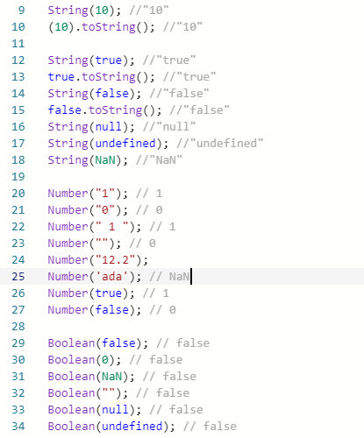
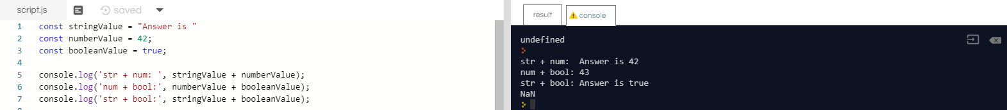
Casting
All scalar types try to convert itself to largest scalar type: Boolean to Number, Number to String.
Valentyn Malenchak

Slide 11
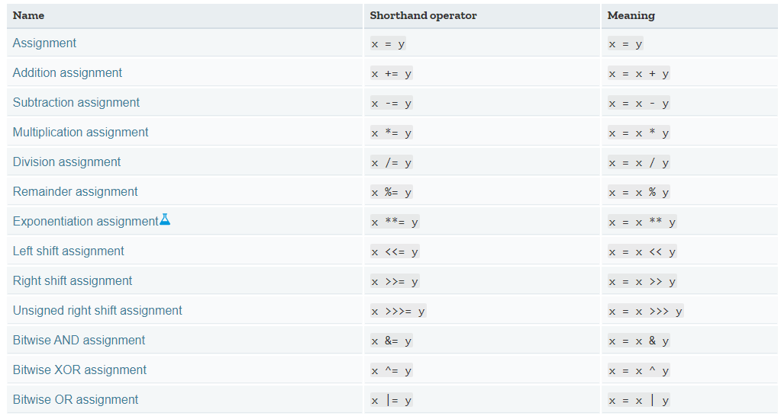
Assignment operators
Valentyn Malenchak

Slide 12
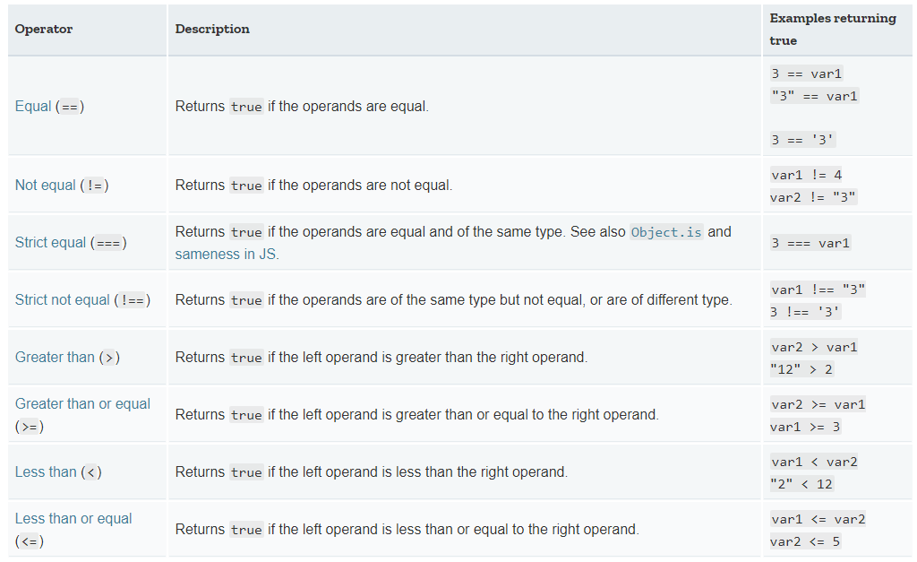
Comparison operators
Valentyn Malenchak

Slide 13
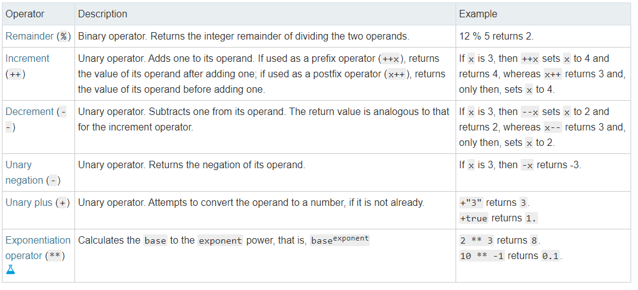
Arithmetic operators
Valentyn Malenchak

Slide 14
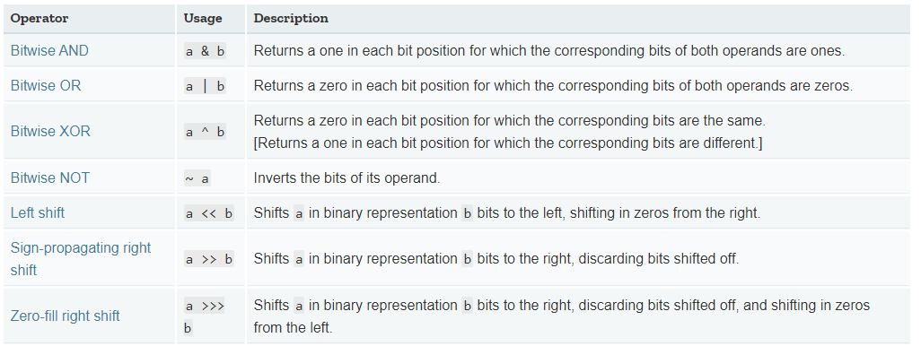
Bitwise operators
Valentyn Malenchak

Slide 15
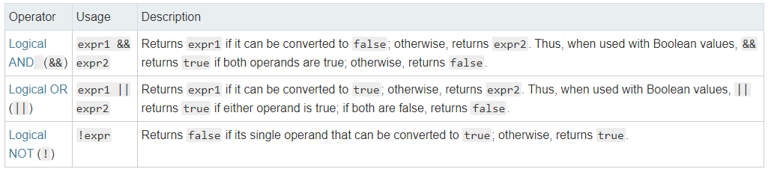
Logical operators
Valentyn Malenchak

Slide 16
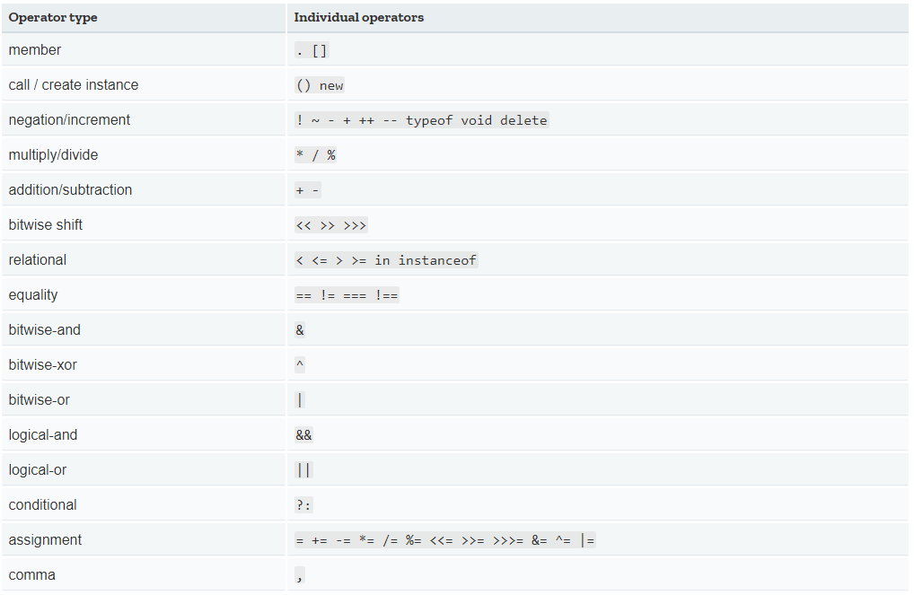
Operator precendence
Valentyn Malenchak

Slide 17
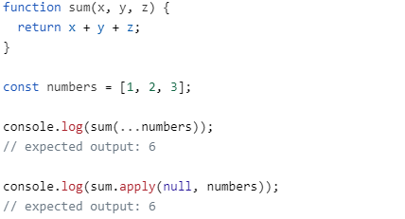
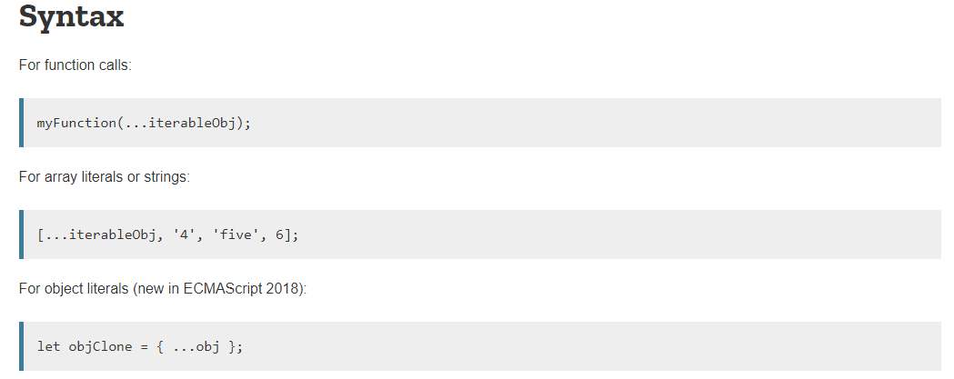
Spread syntax
Spread syntax allows an iterable such as an array expression or string to be expanded in places where zero or more arguments (for function calls) or elements (for array literals) are expected, or an object expression to be expanded in places where zero or more key-value pairs (for object literals) are expected.
Valentyn Malenchak

Slide 18
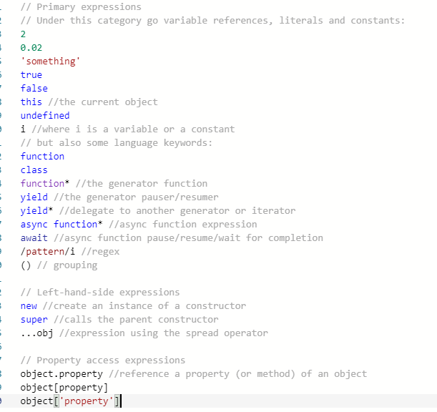
Expressions
Arithmetic expressions
String expressions
Primary expressions (under this category go variable references, literals and constants)
Logical expressions
Left-hand-side expressions
Property access expressions
Object creation expressions
Function definition expressions
Invocation expressions (the syntax for calling a function or method)
Valentyn Malenchak
Notes:
https://sanic.readthedocs.io/en/latest/

Slide 19
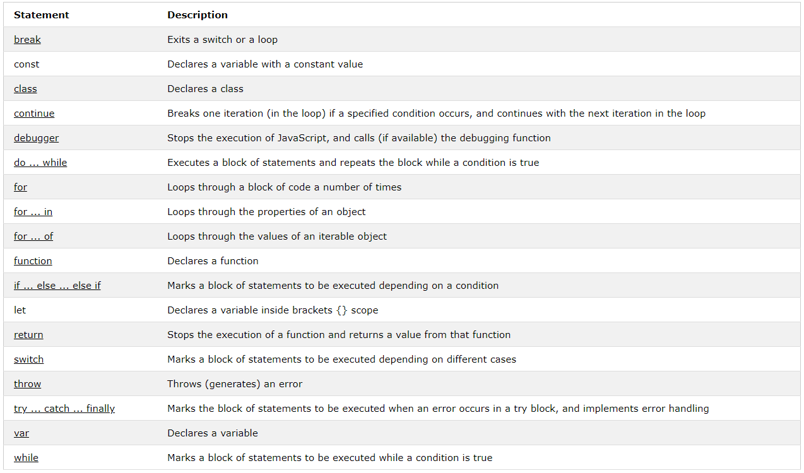
Statements
Control flow
Declarations
Functions and classes
Iterations
Other (export, import, etc.)
Valentyn Malenchak
Notes:
https://sanic.readthedocs.io/en/latest/

Slide 20
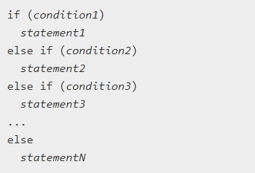

if … else and ternary operator
The conditional (ternary) operator is the only JavaScript operator that takes three operands: a condition followed by a question mark (?), then an expression to execute if the condition is truthy followed by a colon (:), and finally the expression to execute if the condition is falsy.
Valentyn Malenchak
Notes:
https://sanic.readthedocs.io/en/latest/

Slide 21
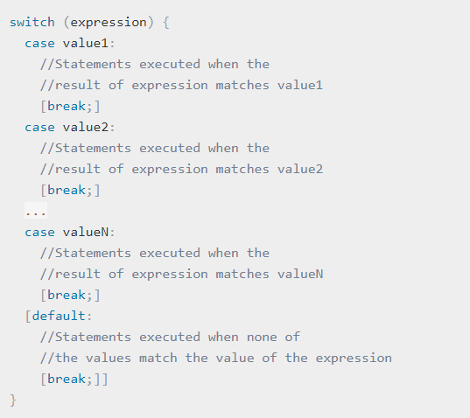
switch
The switch statement evaluates an expression, matching the expression's value to a case clause, and executes statements associated with that case, as well as statements in cases that follow the matching case.
Valentyn Malenchak
Notes:
https://sanic.readthedocs.io/en/latest/

Slide 22
Thank you for attention!
Valentyn Malenchak

