Slide 1
JavaScript Syntax (part 2)
Valentyn Malenchak

Slide 2

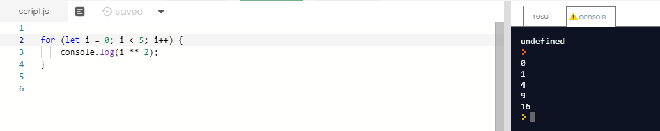
Loops: for
The for statement creates a loop that consists of three optional expressions, enclosed in parentheses and separated by semicolons, followed by a statement (usually a block statement) to be executed in the loop.
Valentyn Malenchak

Slide 3


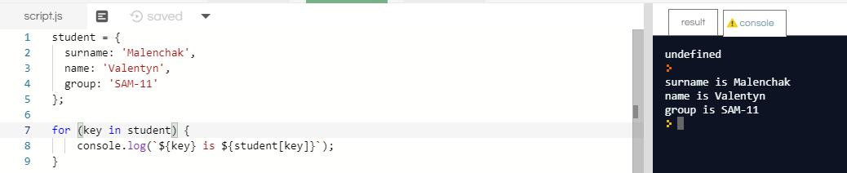
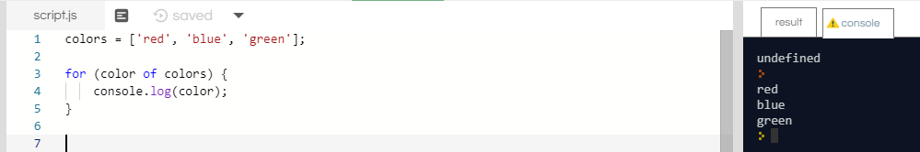
Loops: for .. in and for .. of
The for...in statement iterates over all non-Symbol, enumerable properties of an object.
The for...of statement creates a loop iterating over iterable objects, including: built-in String, Array, array-like objects (e.g., arguments or NodeList), TypedArray, Map, Set, and user-defined iterables.
Valentyn Malenchak

Slide 4


Loops: while and do .. while
The while statement creates a loop that executes a specified statement as long as the test condition evaluates to true. The condition is evaluated before executing the statement.
The do...while statement creates a loop that executes a specified statement until the test condition evaluates to false. The condition is evaluated after executing the statement, resulting in the specified statement executing at least once.
Valentyn Malenchak
Notes:
https://sanic.readthedocs.io/en/latest/sanic/request_data.html

Slide 5
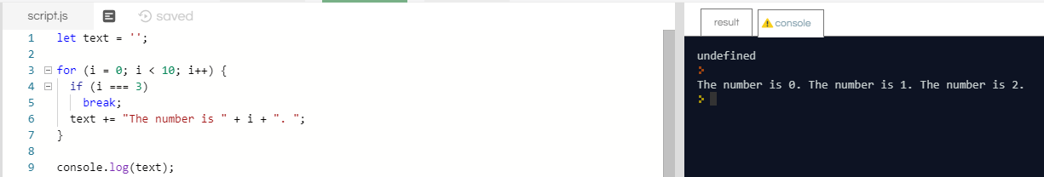
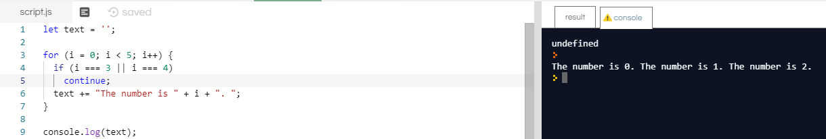
Loops: break and continue
There are two keywords for loops control :
break – aborts loop and moves control to next statement after the loop;
continue – aborts current iteration and immediately starts next iteration.
Valentyn Malenchak
Notes:
https://sanic.readthedocs.io/en/latest/sanic/request_data.html

Slide 6
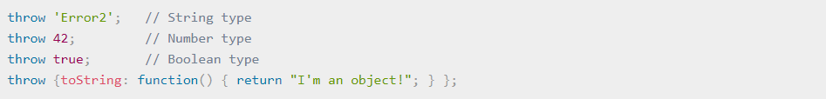
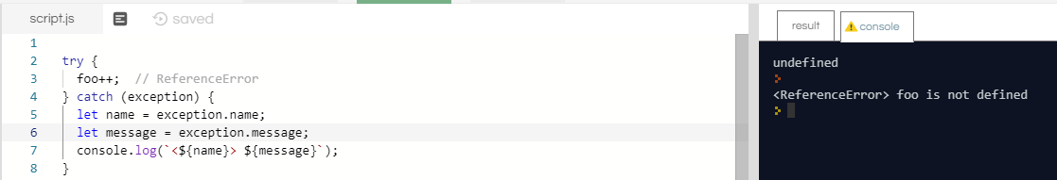
Errors handling
You can throw exceptions using the throw statement and handle them using the try...catch statements.
Valentyn Malenchak
Notes:
https://sanic.readthedocs.io/en/latest/sanic/request_data.html

Slide 7
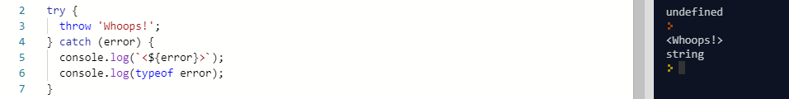
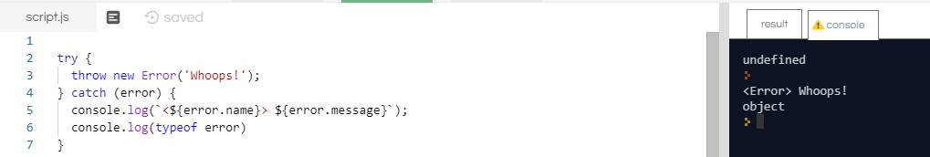
Errors handling
The Error constructor creates an error object. Instances of Error objects are thrown when runtime errors occur. The Error object can also be used as a base object for user-defined exceptions.
Valentyn Malenchak
Notes:
https://sanic.readthedocs.io/en/latest/sanic/request_data.html

Slide 8
Error types
Besides the generic Error constructor, there are seven other core error constructors in JavaScript.
EvalError сreates an instance representing an error that occurs regarding the global function eval().
InternalError сreates an instance representing an error that occurs when an internal error in the JavaScript engine is thrown. E.g. "too much recursion".
RangeError сreates an instance representing an error that occurs when a numeric variable or parameter is outside of its valid range.
ReferenceError сreates an instance representing an error that occurs when de-referencing an invalid reference.
SyntaxError сreates an instance representing a syntax error that occurs while parsing code in eval().
TypeError сreates an instance representing an error that occurs when a variable or parameter is not of a valid type.
URIError сreates an instance representing an error that occurs when encodeURI() or decodeURI() are passed invalid parameters.
Valentyn Malenchak
Notes:
https://sanic.readthedocs.io/en/latest/sanic/request_data.html

Slide 9
Strict mode
JavaScript's strict mode, introduced in ECMAScript 5, is a way to opt in to a restricted variant of JavaScript, thereby implicitly opting-out of "sloppy mode". Strict mode isn't just a subset: it intentionally has different semantics from normal code.
Strict mode makes several changes to normal JavaScript semantics:
Eliminates some JavaScript silent errors by changing them to throw errors.
Fixes mistakes that make it difficult for JavaScript engines to perform optimizations: strict mode code can sometimes be made to run faster than identical code that's not strict mode.
Prohibits some syntax likely to be defined in future versions of ECMAScript.
Valentyn Malenchak
Notes:
https://sanic.readthedocs.io/en/latest/sanic/request_data.html

Slide 10
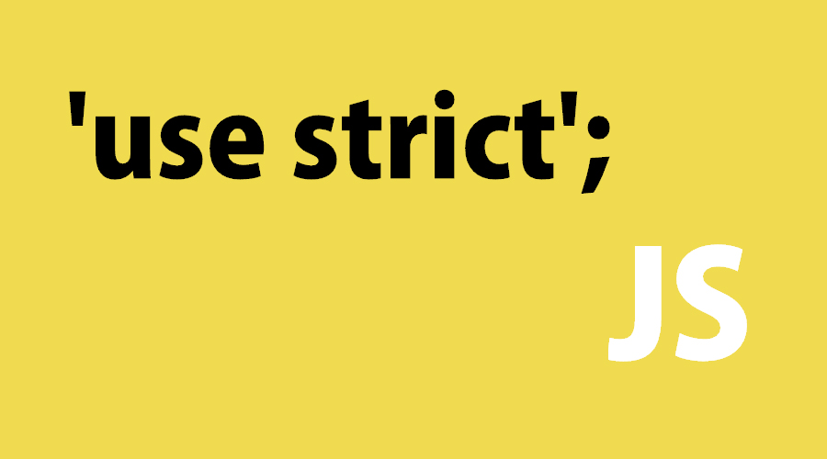
Strict mode
More information:
https://is.gd/8cuqG6
https://is.gd/Am6gJA
Valentyn Malenchak
Notes:
https://sanic.readthedocs.io/en/latest/sanic/request_data.html

Slide 11
Thank you for attention!
Valentyn Malenchak

