Slide 1
Code conventions
Andrew Stanishevskyi

Slide 2
The Zen of Python
Beautiful is better than ugly.
Explicit is better than implicit.
Simple is better than complex.
Complex is better than complicated.
Flat is better than nested.
Sparse is better than dense.
Readability counts.
Special cases aren't special enough to break the rules.
Although practicality beats purity.
Errors should never pass silently.
Unless explicitly silenced.
In the face of ambiguity, refuse the temptation to guess.
Now is better than never.
….
>>> import this
Andrew Stanishevskyi

Slide 3
PEP 8
Python Enhancement Proposal
Python coding style is covered in PEP 8.
Code is read much more often than it is written.
However, know when to be inconsistent -- sometimes style guide recommendations just aren't applicable. When in doubt, use your best judgment. Look at other examples and decide what looks best. And don't hesitate to ask!
Andrew Stanishevskyi

Slide 4
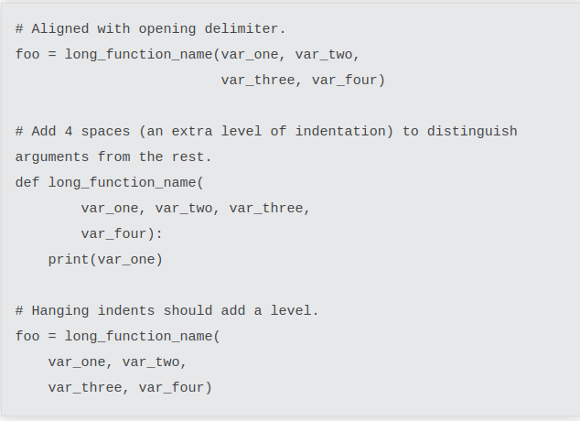

Indentation
YES
Use 4 spaces per indentation level
NO
Andrew Stanishevskyi

Slide 5
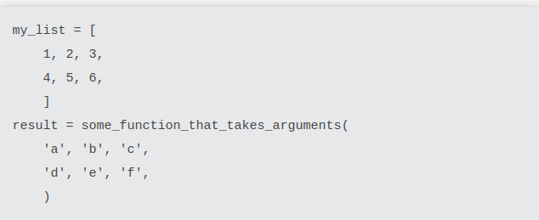
Brackets/parenthesis
End parenthesis and brackets should be on their own lines
Andrew Stanishevskyi

Slide 6
Tabs or spaces?
Spaces are the preferred indentation method
Tabs should be used solely to remain consistent with code that is already indented with tabs
Python 3x disallows mixing the use of tabs and spaces for indentation
Python 2x code indented with a mixture of tabs and spaces should be converted to using spaces exclusively
Andrew Stanishevskyi

Slide 7
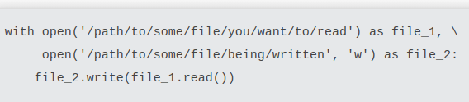
Maximum Line Length
Limit all lines to a maximum of 79 characters
For flowing long blocks of text with fewer structural restrictions (docstrings or comments), the line length should be limited to 72 characters
The preferred way of wrapping long lines is by using Python's implied line continuation inside parentheses, brackets and braces
Andrew Stanishevskyi

Slide 8
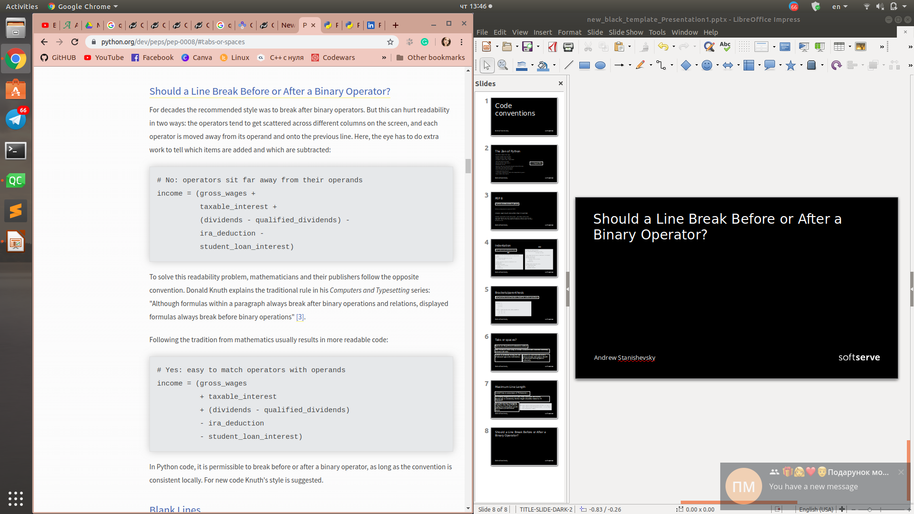
Should a Line Break Before or After a Binary Operator?
NO
YES
Andrew Stanishevskyi

Slide 9
Blank Lines
Surround top-level function and class definitions with two blank lines
Method definitions inside a class are surrounded by a single blank line
Use blank lines in functions, sparingly, to indicate logical sections
Andrew Stanishevskyi

Slide 10
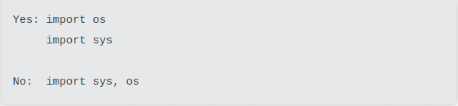
Imports
Imports should usually be on separate lines:
Imports should be grouped in the following order:
1. Standard library imports.
2. Related third party imports.
3. Local application/library specific imports.
Imports should usually be on separate lines:
Imports should usually be on separate lines:
Imports are always put at the top of the file, just after any module comments and docstrings, and before module globals and constants
Andrew Stanishevskyi

Slide 11
String Quotes
In Python, single-quoted strings and double-quoted strings are the same. This PEP does not make a recommendation for this
Andrew Stanishevskyi

Slide 12
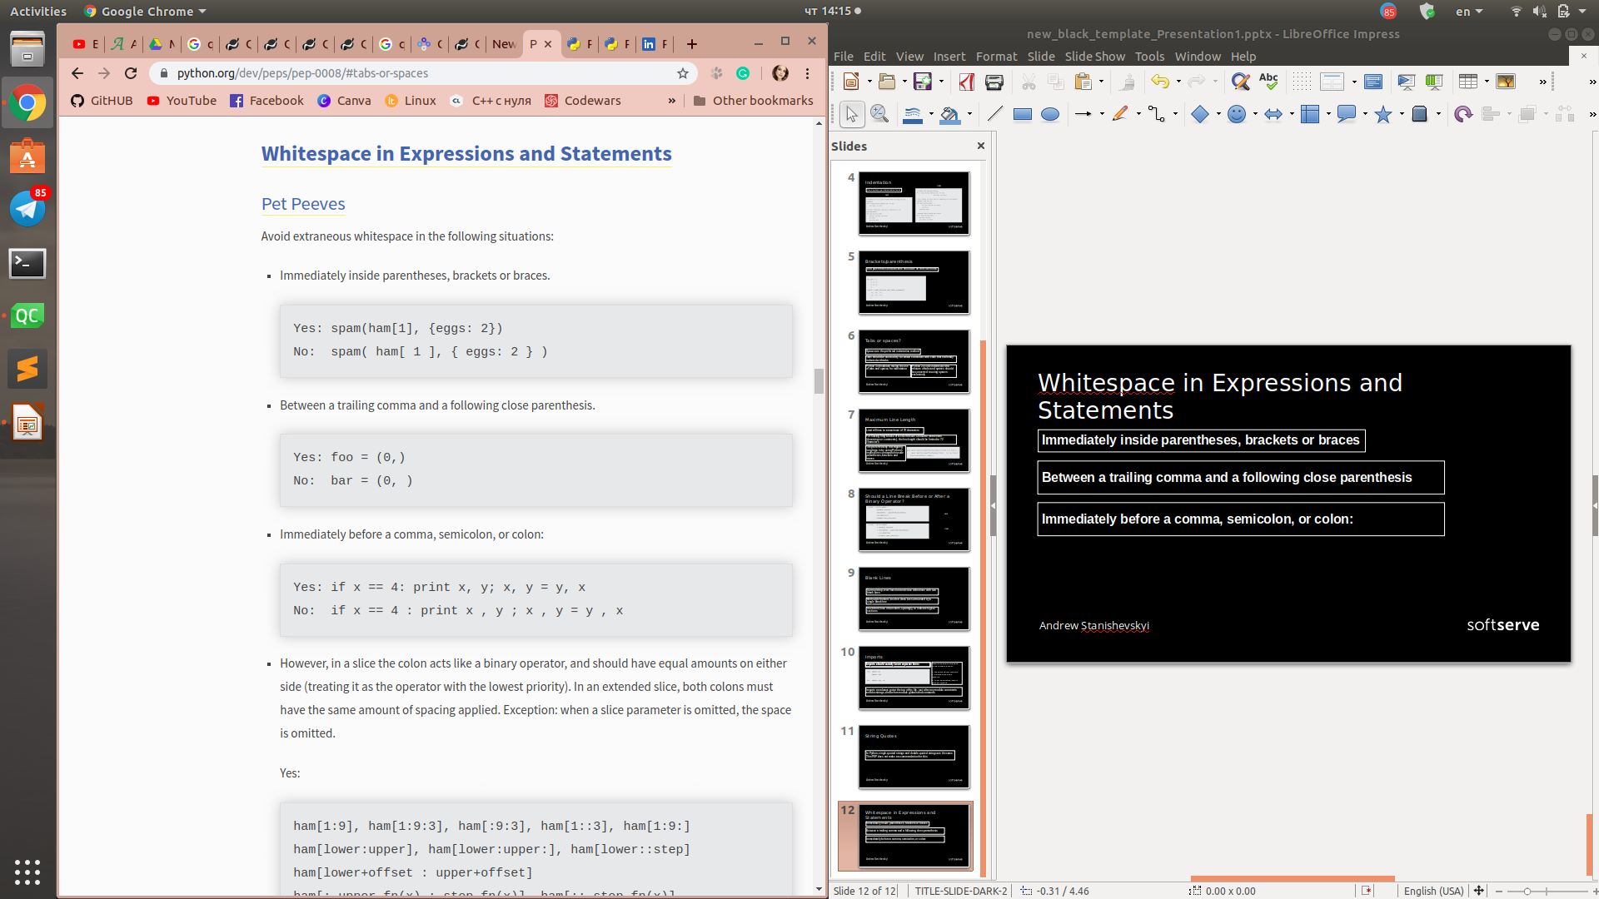
Whitespace in Expressions and Statements
Immediately inside parentheses, brackets or braces
Between a trailing comma and a following close parenthesis
Immediately before a comma, semicolon, or colon:
Andrew Stanishevskyi

Slide 13
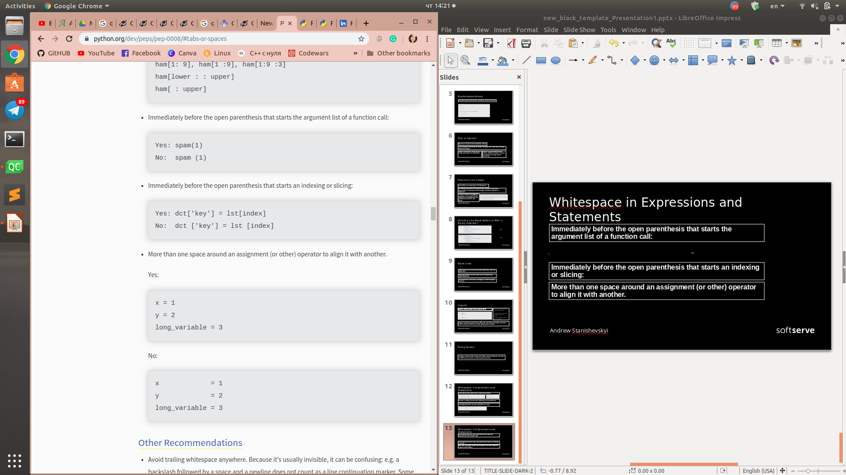
Whitespace in Expressions and Statements
Immediately before the open parenthesis that starts the argument list of a function call:
Immediately before the open parenthesis that starts an indexing or slicing:
More than one space around an assignment (or other) operator to align it with another.
Andrew Stanishevskyi

Slide 14
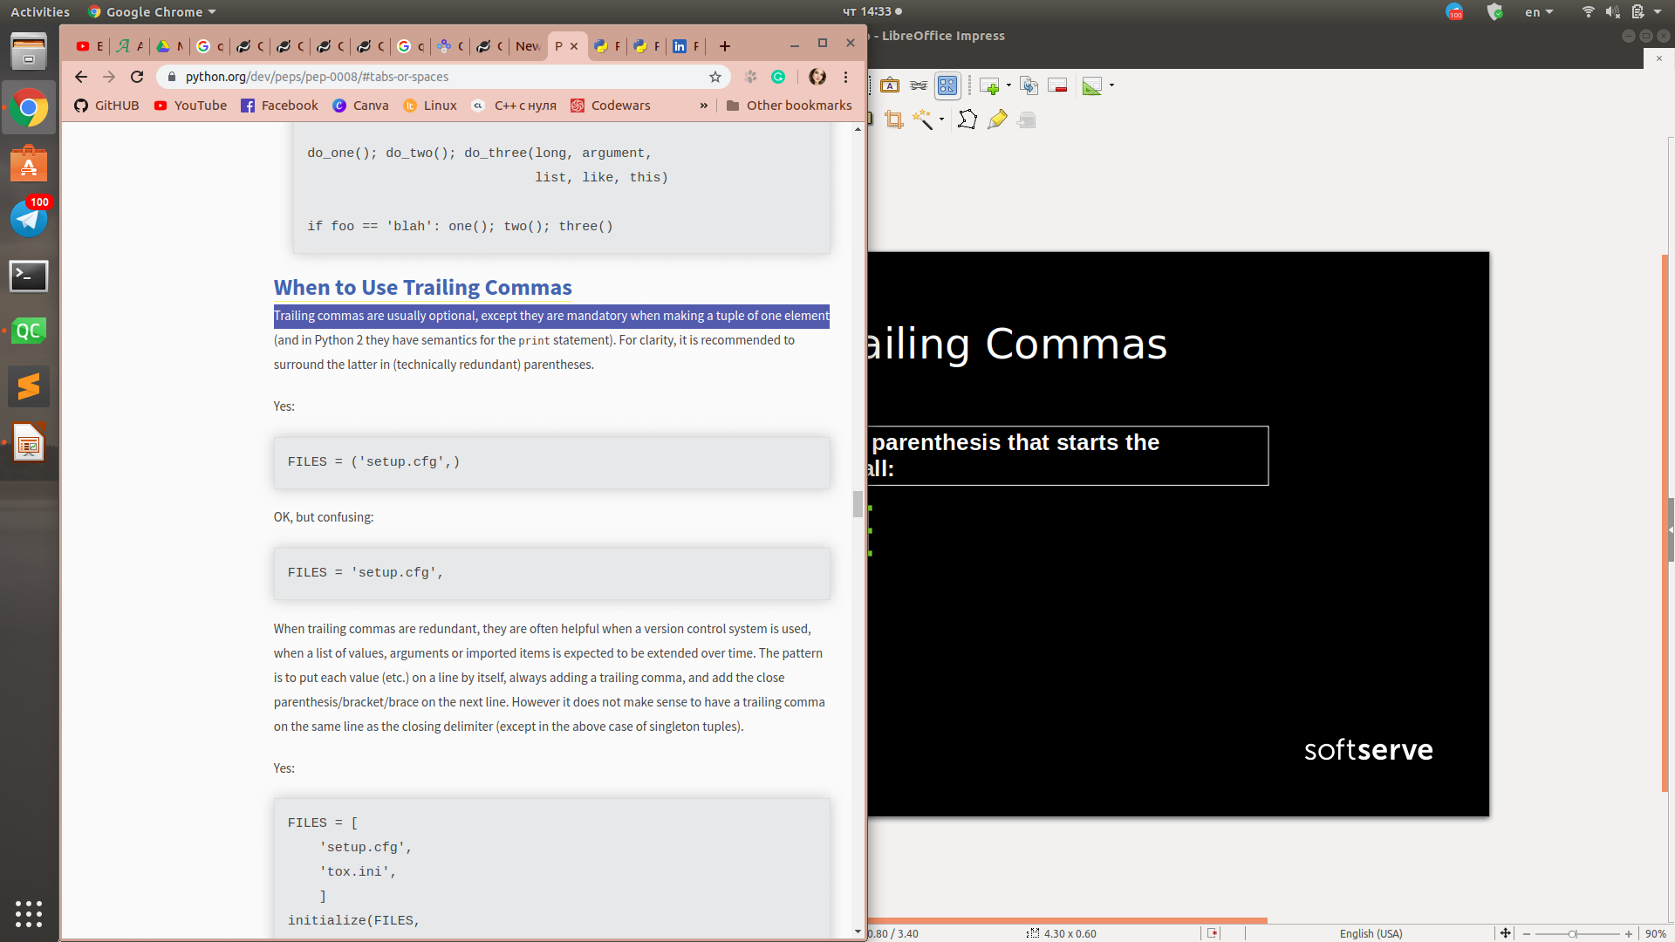
When to Use Trailing Commas
Trailing commas are usually optional, except they are mandatory when making a tuple of one element.
Andrew Stanishevskyi

Slide 15
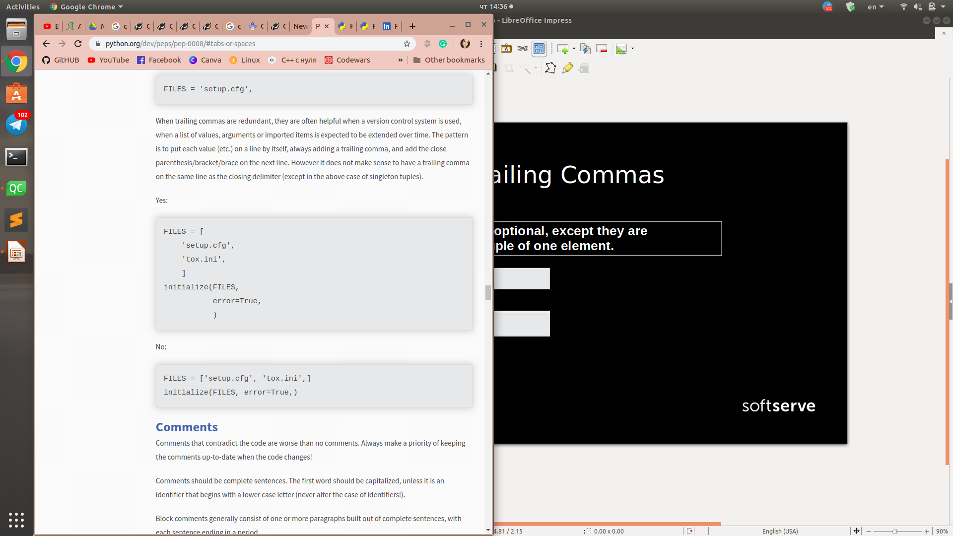
When to Use Trailing Commas
When trailing commas are redundant, they are often helpful when a version control system is used, when a list of values, arguments or imported items is expected to be extended over time.
YES
NO
Andrew Stanishevskyi

Slide 16
Naming Conventions
Overriding Principle
Names that are visible to the user as public parts of the API should follow conventions that reflect usage rather than implementation.
Andrew Stanishevskyi

Slide 17
Linter
Pychecker (now defunct), pyflakes, flake8, and mypy.
The default coding style used by Pylint is close to PEP 8.
Andrew Stanishevskyi

Slide 18
Pylint
pip install pylint
pylint <module or package>
Andrew Stanishevskyi

Slide 19
Messages control
pylint accepts the following values:
a symbolic message: no-member, undefined-variable etc.
a numerical ID: E1101, E1102 etc.
Corresponding category of the checks
C convention related checks
R refactoring related checks
W various warnings
E errors, for probable bugs in the code
F fatal, if an error occurred which prevented pylint from doing further processing.
Andrew Stanishevskyi

Slide 20
Thank you
Andrew Stanishevskyi

