Slide 1
AI & BIG DATA EXPO EUROPE · AI DEVELOPER
ENTERPRISE
Beyond the Demo:
Building Trusted AI Agents
with MCP
A startup story, an enterprise reality,
and lessons from a production MCP codebase.
Konstantin Grigorov
Principal Data & AI Engineer · Shell Trading & Supply
STARTUP
20 OCT 2026 · RAI AMSTERDAM
AI DEVELOPER · 12:05–12:35
Notes:
TIMING: 12:05:00–12:05:45 · 0:45
TRANSCRIPT
Good afternoon. I am Konstantin Grigorov, and this is a story about what happens after the MCP demo works. Quick show of hands: who has seen a convincing agent demo become a much larger engineering programme once real users, real data and real accountability arrived?
We will follow one architecture through two worlds. First comes a nine-person startup where speed and a Friday demo are rational priorities. Then comes the enterprise version, where the question changes from “can the agent answer?” to “should this identity receive this answer from this data, and can we prove the controls worked?” The story is composite, but the implementation lessons come from a working FastMCP service.
TRANSITION
Let us begin with the legally safest slide in the presentation.
[Sources]
- https://www.ai-expo.net/europe/agenda/ai-developer/

Slide 2
THE SET-UP
Fictional story. Real failure modes.
You are the founding engineer.
Team of 9. Funding secured. Friday demo.
GOAL: CONNECT AN LLM TO REAL DATA THROUGH MCP
9
Trusted users. One identity path. One team.
A tool catalogue small enough to understand.
PEOPLE
ASSUMPTION DEBT
Small solutions are safe only while
their hidden assumptions remain true.
ACT I · PRODUCT
02
Notes:
TIMING: 12:05:45–12:07:15 · 1:30
TRANSCRIPT
This is a fictional story inspired by true events. You have just joined a startup with nine people, actual funding and an investor update on Friday. The pitch is direct: connect an AI assistant to useful data through MCP and let customers ask questions in natural language.
At this stage, the problem is not an enterprise operating model. The problem is whether the team can connect the model to real data and return something useful before money or patience runs out. That is a legitimate phase. Every serious platform begins as a smaller and more optimistic system.
The danger sits in the assumptions under the demo. The users are trusted. There is one identity path. One team understands every box. The tool catalogue is small enough to hold in one person’s head. Those assumptions make the first version safe enough. Assumption debt appears when the product grows and nobody notices that the conditions have changed.
TRANSITION
So what does the first credible implementation actually look like?

Slide 3
MAKE IT WORK
Grounded in a working FastMCP service
A practical MCP implementation
Client
LLM host
Client tool loop
FastMCP service
SQL policy
Data
Chat / Copilot
Intent + tool choice
Follows the returned next step
25 narrow tools
Parse + authorize
Bearer context
User identity on every call
Cached metadata
FAISS index + schema cache
OUTPUT ADAPTERS
THE DESIGN PRINCIPLE
A deterministic spine around a probabilistic model.
Table
CSV
Excel
Chart
Map
The model interprets language. Code constrains execution.
STARTUP QUESTION: HOW DO WE CONTROL WHAT THE MODEL DOES?
ACT I · PRODUCT
03
Notes:
TIMING: 12:07:15–12:10:30 · 3:15
TRANSCRIPT
This diagram now follows the implementation more closely. The client owns the conversation and the tool loop. The host model interprets the request and chooses a tool, but it never receives direct database access. The FastMCP service contains no second model. It exposes 25 narrow tools and returns structured guidance about the next required step.
That detail matters. Prompt routing is itself an MCP tool inside the service. It preserves the user’s original wording and returns a next step. It does not secretly invoke the next tool. The client remains the orchestrator. Routing guidance improves repeatability, but it is still model-facing instruction. The hard security boundary comes later.
Every remote call carries bearer identity through middleware. At startup, the service loads its table index, schema metadata, dataset catalogue and trusted-template index into memory. Discovery can stay fast without asking the business database to explain itself on every prompt. Output tools return tables, files, charts, grids or maps as in-memory resources.
Before a data query executes, procedural code takes over. The service parses one T-SQL statement into an abstract syntax tree. It permits read-only query shapes, rejects writes, external rowsets, cross-database sources and unsupported functions, then extracts every physical relation, including relations hidden in a CTE, subquery or union. A separate authorization check verifies that the caller may read every relation. The database connection also declares read-only intent.
This is the design principle: a deterministic spine around a probabilistic model. The model interprets language. Code constrains execution. When an answer is wrong, we can locate the failure in routing, retrieval, schema choice, SQL, authorization or presentation instead of treating the whole system as one mysterious prompt.
TRANSITION
The implementation works. Now somebody has to find it and decide whether to trust it.
[Implementation evidence]
- Reviewed codebase snapshot, 29 September 2026: src/server.py, src/tools/routing/prompt_routing.py, src/safety/prompt_safety.py, src/security/authorization.py and src/tools/outputs/. Identifiers and data details are omitted.

Slide 4
FIND · CONNECT · VERIFY
Discovery outpaces approval
Official Registry
Community
Publisher
Allowlist
Runtime
Canonical metadata
Directories + search
Namespace + source
Approved versions
Scope + telemetry
DISCOVER
VERIFY
AUTHENTICATE
SCOPE
OBSERVE
Local
Remote
Users
DEV
HTTP
IDP
stdio · credentials from the local environment
OAuth 2.1 · scoped bearer tokens · PKCE
Identity provider manages sign-in, roles and offboarding
REGISTRY ≠ ENDORSEMENT
ACT I · PRODUCT
04
Notes:
TIMING: 12:10:30–12:12:45 · 2:15
TRANSCRIPT
Discovery scales faster than approval. The official MCP Registry provides canonical server metadata. Community directories add search and convenience. Those surfaces can help a developer find a server, but they cannot decide whether an organisation should trust that publisher, version, tool set or data path.
A practical review has several stages. Verify the publisher and source. Put approved versions on an allowlist. At runtime, authenticate the caller, narrow the scope and observe the call. Local and remote deployments have different credential paths, but the principle stays the same: discovery metadata does not replace runtime policy.
The reviewed service makes that distinction concrete. Streamable HTTP sits behind bearer-token middleware. Transport security restricts allowed hosts and origins. The token validator checks signature, issuer, audience, tenant, expiry and the delegated scope. That proves who is calling the service. It does not yet prove which business data the caller may use. Dataset authorization performs that second decision.
This is where small systems and enterprise systems begin to diverge. A registry answers “where is the server?” Enterprise controls must answer “is this server approved, is this caller entitled, and is this operation allowed now?”
TRANSITION
Customer acquisition now gives us exactly the user who tests every hidden assumption.
[Sources]
- https://registry.modelcontextprotocol.io/
- https://modelcontextprotocol.io/specification/2026-07-28/basic/authorization
- https://modelcontextprotocol.io/specification/2026-07-28/basic/authorization/security-considerations

Slide 5
BORED APES · MEME COINS · VERY CALM MARKETS
Customer acquisition: the VC arrives
PRIORITY CUSTOMER
BAYC FLOOR · ETH
MEME TOKEN · USD
~145
$73.43
~$4.8
~6.2
~$2.0
0.08
2021
2022
2026
JAN 25
DEC 25
SEP 26
VC
THE REQUIREMENTS CHANGE
“Can your agent analyse
my portfolio?”
Can another user see my data?
Can the agent invoke a write tool?
Nothing clarifies product priorities
like consequences.
Can I reproduce the answer?
Milestone illustration, not a daily price series.
ACT I · PRODUCT
05
Notes:
TIMING: 12:12:45–12:15:15 · 2:30
TRANSCRIPT
In the first customer batch, one user is a very important venture capitalist with a portfolio that includes Bored Ape NFTs and a famously volatile meme token. The story is fictional, although the price milestones are real.
I am reliably informed that collectors of volatile assets are highly disciplined people. They think carefully about diversification, liquidity and, on rare occasions, the floor price of a cartoon ape at three in the morning. This is not investment advice. The point is that volatile assets make consequences visible very quickly.
The customer asks three reasonable questions. Can another user see my data? Can the agent invoke a write tool? Can I reproduce the answer that influenced a decision? Those questions turn a clever demo into a system with a blast radius.
The reviewed implementation gives us concrete responses. The data path accepts only read-only SQL shapes. Authorization evaluates the user against every referenced relation, including a restricted table hidden inside a nested query. File outputs stay in memory rather than accepting a path on the server. Those controls matter because a model can propose an operation, but deterministic code decides whether it may execute.
Customer acquisition has converted security, isolation and evidence from roadmap items into product requirements. Nothing fundamental changed in MCP. The value and sensitivity on the other side of the tool changed.
TRANSITION
The demo passes. Production expands the control surface.
[Sources]
- https://nftpricefloor.com/bored-ape-yacht-club
- https://www.coingecko.com/en/coins/official-trump

Slide 6
FROM CAPABILITY TO CONTROL
Production expands the control surface
Identity & entitlements
Least privilege
Guardrails
Delegated JWT · dataset grants
Read-only SQL · exact relations
AST validation · fail closed
Audit & telemetry
Evidence & provenance
Tests & release gates
Request ID · route · outcome
Dataset · SQL · source metadata
470 passed · lint · security scans
STARTUP
Implement controls inside one product.
ENTERPRISE
Enforce controls consistently across every product.
TRUST = CONTROL + EVIDENCE
BRIDGE · PRODUCT → PLATFORM
06
Notes:
TIMING: 12:15:15–12:18:15 · 3:00
TRANSCRIPT
These controls are product code. Identity begins with a delegated bearer token. Authorization maps the caller to existing business entitlements and verifies every physical relation in the query. Least privilege appears as narrow tools, structural SQL validation and a read-only database connection.
The SQL gate does more than search for dangerous words. It parses exactly one statement, permits SELECT and set operations, rejects mutation, SELECT INTO, external rowsets, temporary sources, cross-database names and unsupported functions. Scope-aware relation extraction means a restricted table inside a CTE, subquery or union still causes the whole request to fail.
Evidence also needs care. Structured logs carry request and trace context, but audit data can itself contain identity and prompt content. Redaction, access and retention therefore belong in the trust model. Provenance should connect the dataset, query, source metadata and policy result. A final answer without that chain remains difficult to defend.
Reliability comes from testing the path, not only the prose. The latest reviewed CI run collected 470 tests. All passed with 89 percent coverage, alongside lint, secret, dependency and static-analysis checks. One adversarial matrix sends six unsafe SQL forms through eight output tools and asserts that the database cursor is never called.
Those numbers do not prove the system is finished. They show where production effort goes: around the tool call. A startup can implement these controls inside one product. An enterprise has to make them consistent across many clients, servers and data owners.
TRANSITION
Here is what those implementation receipts look like on one slide.
[Sources]
- https://owasp.org/projects/mcp-top-10
[Implementation evidence]
- Reviewed main-branch CI snapshot, 29 September 2026: 470 tests passed, 89% coverage.
- Relevant modules: src/safety/prompt_safety.py, src/security/authorization.py, src/authentication/jwt_validator.py and tests/test_output_tools.py.

Slide 7
WHAT BUILDERS REPORT
Security is not a workstream. It is the work.
50%
“Security and access control is the top challenge
for builders, cited by 50% of respondents.”
of MCP builders
Zuplo · State of MCP survey · fielded Nov–Dec 2025 · self-selected, no N published
cite security / access control
as their top challenge.
38%
blocked by security concerns
~24%
of respondents run servers
with no authentication
Authentication is mature.
Authorization is contextual.
MEASURED, NOT SELF-REPORTED: 40.55% OF 7,973 LIVE SERVERS EXPOSE TOOLS WITH NO AUTH · arXiv:2605.22333
ACT II · ENTERPRISE
12:16:35–12:18:45 · 2:10
08
Notes:
TIMING: 12:16:35–12:18:45 · 2:10
TRANSCRIPT
A survey of MCP builders fielded in late 2025 found security and access control the top challenge, cited by half of respondents. Thirty-eight per cent said security was actively blocking adoption; twenty-four per cent ran servers with no authentication. Be careful with that survey: self-selected, one vendor's network, and it publishes no respondent count. Directional only.
If you want a measured number, there is one. A study last May identified seven thousand nine hundred and seventy-three live remote MCP servers and found forty per cent expose tools with no authentication. Of the OAuth servers the authors could test, every single one had at least one flaw, and ninety-seven per cent of those were in dynamic client registration. Nine CVEs came out of it. That is why the specification deprecated dynamic registration. Not fashion. Measured breakage.
Authentication has mature standards. But "it authenticates" and "it is authenticated" are not the same sentence, and I have the commit to prove it. Our first bearer-token check resolved the signing key and verified the RS256 signature — and then explicitly switched off audience, issuer and expiry verification. Scope was never checked at all. So any Microsoft-signed token would have passed: another tenant, another application, long expired. The signature was the only security-meaningful check left standing.
That is what I mean when I say authorization is contextual. The cryptography was never the hard part.
TRANSITION
That is the moment our engineer receives a very familiar chat message.
[Sources]
- https://zuplo.com/blog/mcp-survey
- https://arxiv.org/abs/2605.22333

Slide 8
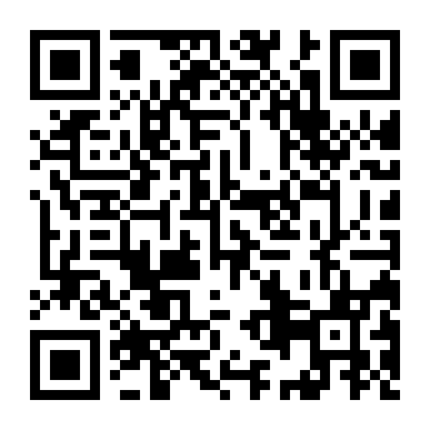
THE ENTERPRISE INFLECTION POINT
“This might take longer.”
PROJECT CHAT
TARGET: ENTERPRISE MCP GATEWAY
Founder
GATEWAY
Can we add enterprise SSO?
Client
identity · policy · audit
Engineer
Sure. That should be manageable.
Security
Authenticate once
Delegate identity
Great. Also delegated identity, user + non-user personas, entitlements, token exchange, audit, tenant isolation, offboarding…
Enforce policy
Unify telemetry
Engineer
arXiv:2608.10760 · production pattern
This might take longer.
OWASP MCP TOP 10
IMPLEMENTED: STATELESS HTTP
Stateless requests scale cleanly; session context remains optional.
ACT II · ENTERPRISE
08
Notes:
TIMING: 12:20:30–12:24:00 · 3:30
TRANSCRIPT
The founder asks, “Can we add enterprise SSO?” The engineer says, “Of course.” Then security adds user and workload identity, delegated access, token exchange, fine-grained entitlements, isolation, offboarding and incident response. “This might take longer” becomes the most accurate estimate on the roadmap.
The gateway on the right is a target enterprise pattern, not a component implemented by the reviewed repository. Clients authenticate at a common control plane. The gateway can resolve downstream credentials, apply baseline policy, aggregate approved tool discovery and produce a unified audit trail. Domain MCP services still own their data semantics and local rules.
The current service already demonstrates one useful scaling choice: stateless HTTP. It does not require session affinity across replicas. When a session identifier exists, the service may still associate the original prompt with later tool calls, but requests do not depend on hidden server state to remain valid. That distinction makes the pattern more precise than simply saying “sessions disappeared.”
OWASP’s MCP Top 10 explains why a horizontal boundary matters. Token leakage, scope creep, tool poisoning, weak authorization and context over-sharing are system risks. A gateway can reduce the exposed tool set and attach user and agent context before the call reaches a domain server.
A gateway also becomes a high-value control point. It must protect tokens, separate tenants, remain observable and fail closed without becoming the place where every domain rule is copied. The goal is central governance with federated execution.
TRANSITION
Security gets the request through the right door. The system still has to choose the right route.
[Sources]
- https://arxiv.org/abs/2608.10760
- https://owasp.org/projects/mcp-top-10
- https://modelcontextprotocol.io/specification/2026-07-28/basic/transports/streamable-http
[Implementation evidence]
- Reviewed codebase snapshot: src/server.py uses stateless_http=True and optional request context.

Slide 9
FROM PLAUSIBLE TO REPEATABLE
Accuracy starts with routing and ends with evidence
1
Preserve the prompt
2
Explicit route
3
Trusted template
Keep the user’s original wording
Return one required next step
21 fixed patterns before discovery
4
Hybrid retrieval
5
Schema + safety
6
Execute + evidence
70% lexical · 30% vector
Exact columns · every SQL relation
Authorize · read-only · request ID
CONFIDENCE GATE
No confident match?
Ask or stop.
SERVER
CLIENT
LOW
HIGH
returns next step
calls next tool
Routing guidance is advisory; SQL safety and authorization are enforced.
REPEATABILITY COMES FROM THE ROUTE AND THE EVIDENCE
ACT II · ENTERPRISE
09
Notes:
TIMING: 12:24:00–12:27:15 · 3:15
TRANSCRIPT
Accuracy begins before generation. The service first preserves the original prompt. Its routing tool then returns one required next step. For common high-value questions, 21 fixed SQL templates receive priority. Embeddings may rank which trusted template fits a paraphrase, but they never synthesize a new template.
If no template matches, discovery uses an explainable hybrid. Exact phrases and term coverage carry 70 percent of the score. A local vector match carries 30 percent. The vector is a deterministic hashed bag of words stored in an exact FAISS index, so this path calls no external embedding API. Results include the matched field, terms, columns and excerpts. The agent can explain why a table appeared.
Next comes schema verification from startup-loaded metadata. The client may construct a bounded query, but execution remains behind the structural SQL parser and per-user authorization. Output tools return the approved result as text or an in-memory resource. The request ID keeps the route observable.
The server and client have different jobs. The server returns the next step. The client chooses the next tool call. That means routing guidance is not a hard guarantee. The system remains safe because SQL validation and authorization do not depend on the model choosing correctly.
This sequence also handles uncertainty honestly. An ambiguous template parameter produces candidates and asks for confirmation. No match can trigger a semantic fallback. A denial stops the route. Repeatability comes from preserving the route and the evidence, not from expecting identical prose every time.
TRANSITION
Then we meet a policy question that similarity scoring must never answer.
[Implementation evidence]
- Reviewed codebase snapshot: src/tools/routing/prompt_routing.py, src/tools/matching/table_match_by_template.py, src/database/db_context_embeddings.py, src/database/faiss_index.py and src/safety/prompt_safety.py.

Slide 10
LICENSE AND ACCESS
The data contract enters the routing layer
Separate relevance from permission.
VENDOR DATA AGREEMENT
AI processing restricted
Terminal denial
Metadata only
No model training
access_denied · next_action: stop
Discover without raw content
Licensed users only
Compute beside data
Private inference
No raw redistribution
Return approved aggregates
No-retention endpoints
Derived use controlled
Governed views
Synthetic evals
The policy must shape routing
before the model sees the data.
Approved derived products
Test without licensed records
CONTRACT TERMS BECOME POLICY INPUTS
ACT II · ENTERPRISE
10
Notes:
TIMING: 12:27:15–12:29:45 · 2:30
TRANSCRIPT
Licensed data exposes a crucial distinction: relevance and permission answer different questions. Similarity asks whether an asset matches the user’s request. Policy asks whether this identity, through this application, for this purpose, may use it in this way.
The reviewed implementation already makes access entitlement executable. If authorization fails, the service returns access denied, marks the result terminal and tells the client to stop. The denial also blocks fallback through alternative discovery and output tools. That is stronger than a warning in a prompt.
The metadata contains richer licence terms too: AI or machine-learning use, derived data, copying, storage, location and subscriber restrictions. The embedding builder deliberately removes repeated licence-warning boilerplate before it builds relevance vectors. That is a subtle but important design choice. Repeated policy text should not dominate semantic similarity. Relevance metadata and policy metadata need separate channels.
We should also be candid about the boundary. User-to-dataset access is enforced in code today. Broader contractual AI-use rules are not all encoded as runtime policy. They still require legal and commercial ownership, structured metadata and explicit decisions about data movement.
The practical patterns remain: authorize before execution, use metadata-only discovery when raw content is unnecessary, compute beside controlled data, return approved aggregates and evaluate with synthetic or contract-safe samples. The contract becomes a policy input. Retrieval does not get to interpret it.
TRANSITION
Put those controls together and the reviewed server becomes one part of a larger platform.
[Sources and disclosures]
- Architectural discussion only, not legal advice. Contract interpretation remains with the relevant legal and commercial owners.
[Implementation evidence]
- Reviewed codebase snapshot: src/security/authorization.py, src/database/db_context_embeddings.py and licensed-data metadata. Dataset and contract identifiers are omitted.

Slide 11
TARGET STATE · CENTRAL GOVERNANCE
The platform around a domain MCP server
CHANNELS + PERSONAS
Chat / Teams
IDE
Apps
Automation
User + agent identity
ENTERPRISE AI / MCP GATEWAY
Auth + delegation
Policy + entitlements
Registry + discovery
Guardrails
Audit + telemetry
One policy boundary · many downstream identities · one audit trail
Domain data
Analytics
Productivity
Internal APIs
CROSS-CUTTING
Catalogue + lineage
Evals + regression
SYSTEMS + DATA
Licensed data · Data platform · SaaS · Operational systems
SIEM + observability
HORIZONTAL CONTROLS · DOMAIN RULES IN SERVERS
ACT II · ENTERPRISE
11
Notes:
TIMING: 12:29:45–12:33:00 · 3:15
TRANSCRIPT
This is the target platform around the domain MCP server, not a claim that one repository implements every box.
At the top are chat, IDEs, applications and unattended automation. Every request needs both a user or workload identity and the client identity. The gateway owns horizontal controls: authentication and delegation, baseline policy, an approved server registry, guardrails and a consistent audit trail.
Below that sit domain MCP services. The reviewed codebase belongs in the first box. It owns the language of its data, trusted templates, metadata matching, schema inspection, output formats and the authorization rules that apply closest to execution. Other domain teams own their own semantics. The gateway should not become the author of every business rule.
The same division appears in operations. Central teams can provide identity, registry, policy tooling, telemetry and incident processes. Domain teams remain accountable for dataset meaning, approved transformations, provider precedence and contractual constraints. Responses should carry enough evidence to reconnect an answer to its source, query, policy decision and timestamp.
The code review also shows where target architecture and current implementation differ. Stateless transport, bearer validation, structural SQL safety, dataset authorization and structured logs exist today. Fleet-wide evaluation, contract-policy enforcement, complete metrics and hard resource limits remain platform work. Saying that clearly improves the architecture because it turns the diagram into a roadmap instead of a claim.
The governing principle is horizontal controls at the gateway and domain rules in servers. This scales governance without turning the platform team into the owner of every tool.
TRANSITION
That leaves one dividing line worth remembering.
[Sources]
- https://arxiv.org/abs/2608.10760
- https://modelcontextprotocol.io/specification/2026-07-28/architecture
[Implementation evidence]
- Reviewed codebase snapshot: src/server.py, src/authentication/, src/safety/, src/security/, src/tools/ and src/utils/.

Slide 12
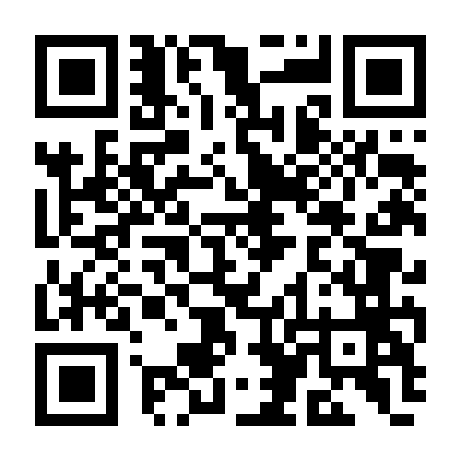
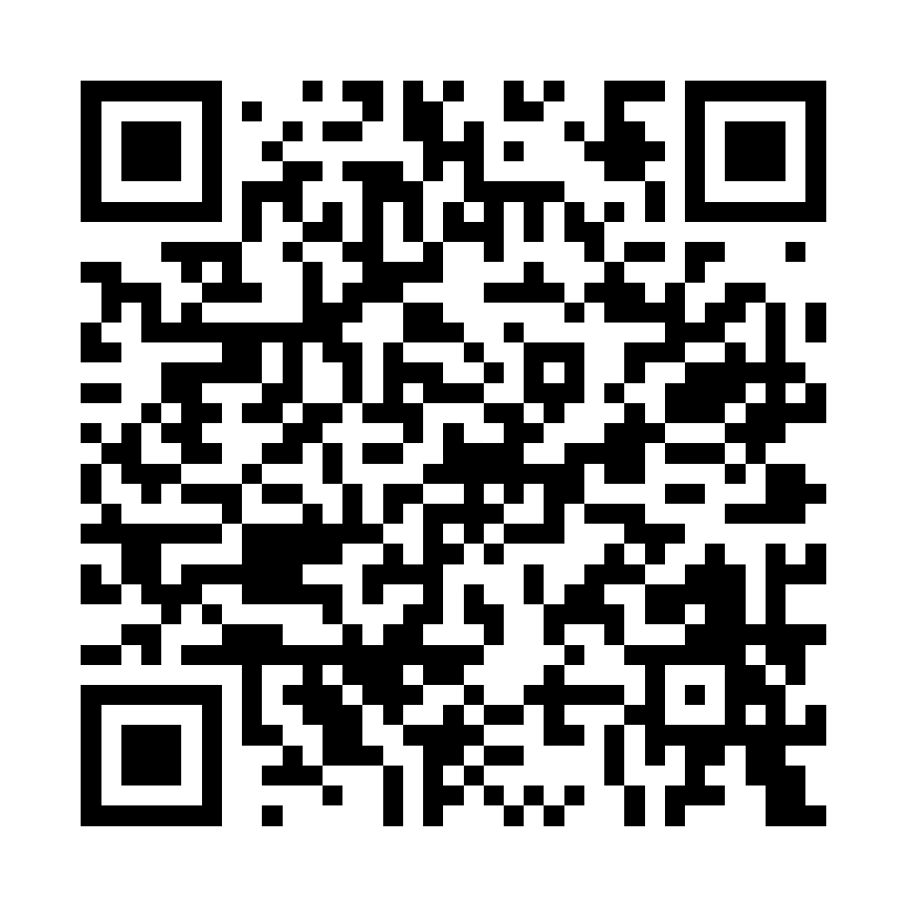
ONE IDEA TO TAKE HOME
The dividing line
STARTUP
ENTERPRISE
Control the route
and the output.
Control every identity, tool and dataset,
then retain the evidence.
Client loop · routing · accuracy · UX · cost
Authorization · licensing · policy · audit · operations
MAKE IT WORK
MAKE IT REPEATABLE
MAKE IT GOVERNABLE
Continue the conversation
kolygri.github.io
THANK YOU
Portfolio
LinkedIn
CLOSE
12
Notes:
TIMING: 12:33:00–12:35:00 · 2:00
TRANSCRIPT
For the startup, control means constraining the model’s route and output well enough to ship. In an enterprise, the control surface expands. You must control every identity, tool and dataset, apply the relevant policy, and retain evidence of the decision.
The journey is still simple enough to remember: make it work, make it repeatable, then make it governable. The implementation gives us three concrete habits. Preserve the original request and make routing explicit. Put deterministic authorization and safety checks in front of execution. Treat evidence as a product output, not an afterthought.
The code also gives us a useful line for the next design review: the model may propose, but only deterministic code may authorize and execute.
Build the smallest useful server first. Keep the tools narrow. Make uncertainty visible. Establish identity, policy and evidence boundaries before adoption makes them expensive to retrofit.
Thank you. The QR codes link to my portfolio and LinkedIn. I would be delighted to continue the conversation after the session.
[Sources]
- https://www.ai-expo.net/europe/agenda/ai-developer/
- https://kolygri.github.io
- https://www.linkedin.com/in/kolygri/

