Slide 1

Exploratory Analysis for US Car Accidents
By
Komal Gogi
Navjot Kaur
December 11th, 2022

Slide 2
Outline
Introduction
Proposed Methods
Preprocessing
Libraries
Feature description
Preliminary Results of Experiments
Descriptive Statistics and Visualization Results

Slide 3
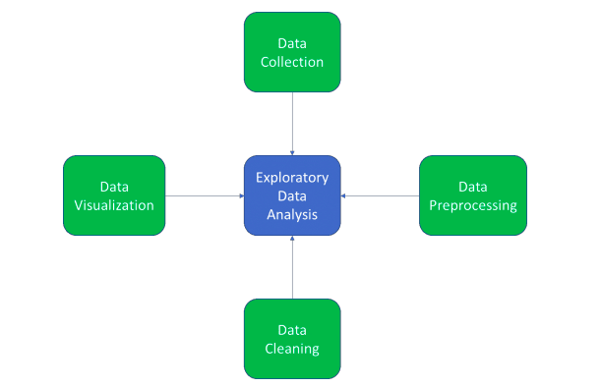
Introduction
What is Exploratory Data Analysis (EDA) ?
Involves performing early investigations on data to find patterns, identify anomalies, test hypotheses, and validate assumptions with the benefit of descriptive statistics and graphical representations.

Slide 4
Introduction
Problem Definition - Even though accidents cannot be predicted, understanding the circumstances that lead to accidents can be informative.
Accident analysis will be performed in 4 steps:
Data Gathering
Data Analysis
Conclusion Drawing
Countermeasures.
Regulate the factors or to alert people to exercise caution in specific circumstance, such as while driving slowly in harsh weather, always adhering to driving rules and regulations.

Slide 5
Proposed Methods
Preprocessing (Data Preparation)
Data is obtained from Kaggle website.
The data is collected for the United Stated of America over the period of 2016 to 2021.
The size of the data is around 1.07 GB (2,845,342 rows × 47 columns).
Steps for Data Preparation
Load the data set file using Pandas.
Look at preliminary information or summary statistics.
Fix any missing/incorrect values.

Slide 6
Proposed Methods
Data Cleaning
The collected data has null values (missing values).
Iterating the number of missing values in each column item and calculating the sum.
Deleted the rows of the missing value.
Data remaining after cleanup – (943,318 rows x 47 columns)

Slide 7
Libraries
Pandas
Matplotlib
Seaborn

Slide 8
Proposed Methods
Feature Description
Column Name | Description
Severity | This tells how severe the accident is. 1- most severe 4- least severe
Start_Time | Start Date and time of accident
End_Time | End Date and time of accident
Start_Lat | Latitude where the accident has started
Start_Lng | Longitude where the accident has started
End_Lat | Latitude where the accident has ended
End_Lng | Longitude of where the accident ended

Slide 9
Column Name | Description/possible outcomes
Distance(in miles) | Length of the occurred accident
Number | Number of accidents occurred at same place
Street | Street of accident occurrence
Side | Side of accident i.e., Left/Right
City | City address
County | County address
State | State address
Zipcode | Zipcode of that location
Country | United States
TimeZone | Shows time zone based on the location of the accident (eastern, central, etc.)

Slide 10
Column Name | Description/possible outcomes
Distance(in miles) | Length of the occurred accident
Description | Where the accident has occurred
Number | Number of accidents occurred at same place
Street | Street of accident occurrence
Side | Side of accident i.e., Left/Right
City | City address
County | County address
State | State address
Zipcode | Zipcode of that location
Country | United States
TimeZone | Shows time zone based on the location of the accident (eastern, central, etc.)

Slide 11
Column Name | Description/possible outcomes
Humidity | In percentage
Pressure | In inches
Visibility | In miles (what was the visibility at time of accident)
Wind_Direction | Direction of Wind
Wind_Speed | Speed of Wind in miles per hour
Precipitation | In inches
Weather_condition | Rainy, cloudy, sunny, foggy etc...
Amenity | True/False
Bump | True/False
Crossing | True/False
Give_Way | True/False

Slide 12
Column Name | Description/possible outcomes
Junction | True/False
No_Exit | True/False
Railway | True/False
Roundabout | True/False
Station | True/False
Stop | A POI (point of interest) annotation which indicates presence of stop in a nearby location
Traffic_Calming | A POI (point of interest) annotation which indicates presence of traffic calming in a nearby location
Traffic_Signal | A POI (point of interest) annotation which indicates presence of traffic signal in a nearby location
Turning_Loop | A POI (point of interest) annotation which indicates presence of turning loop in a nearby location
Sunrise_Sunset | Shows the period of day (i.e., day or night) based on sunrise/sunset

Slide 13
Column Name | Description/possible outcomes
Civil_Twilight | Civil twilight occurs when the sun is between 0 degrees and 6 degrees below the horizon. (Day/Night)
Nautical_Twilight | Nautical twilight occurs when the sun is between 6 degrees and 12 degrees below the horizon. (Day/Night)
Astronomical_Twilight | Astronomical twilight occurs when the sun is between 12 degrees and 18 degrees below the horizon. (Day/Night)

Slide 14
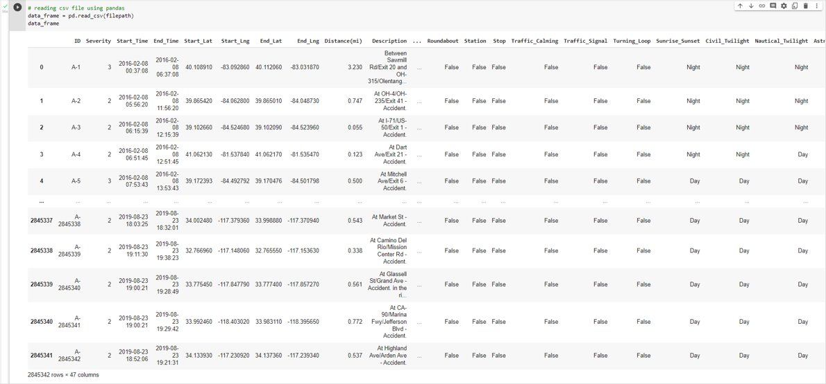
Preliminary results
Original Data

Slide 15
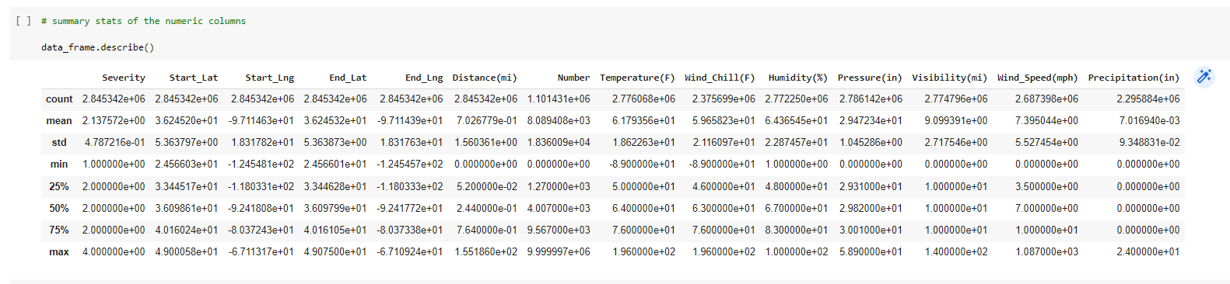
Summary Statistics

Slide 16
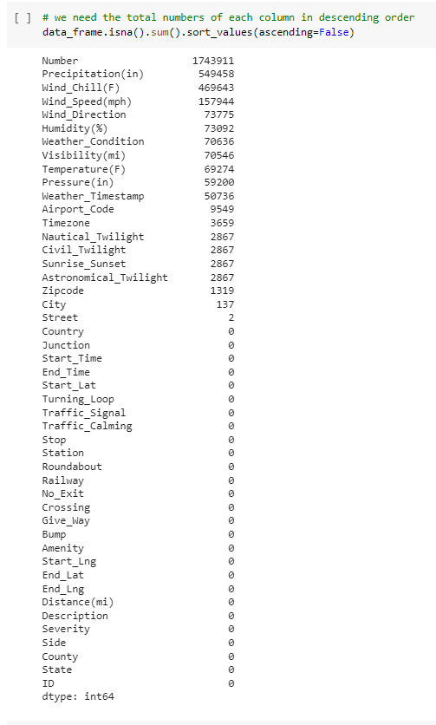
Checking the sum of the missing values in every column

Slide 17
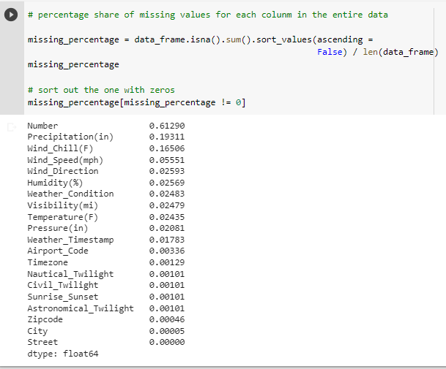
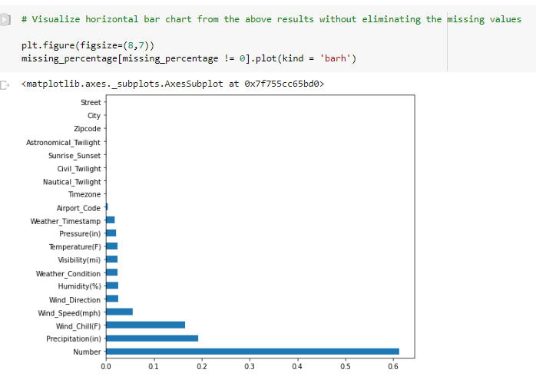
Checking the percentage of missing value
Visualizing with bar plot
From the above results we observe that the columns 'Number', 'Precipitation(in)'and 'Wind_Chill(F)' have the most missing values (20-60% of the data).

Slide 18
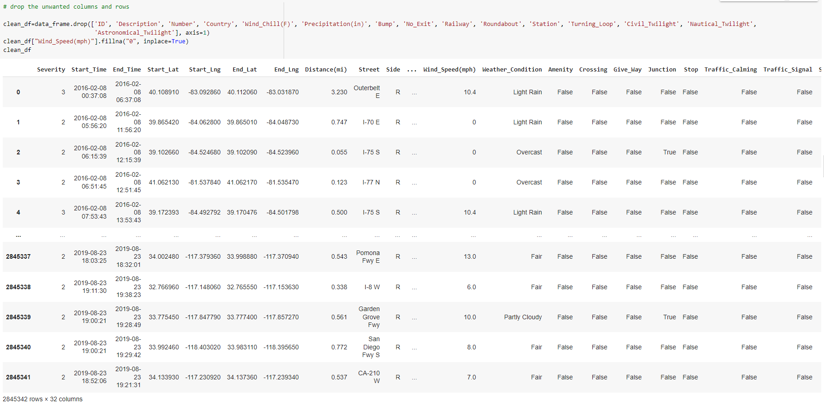
Clean Data

Slide 19
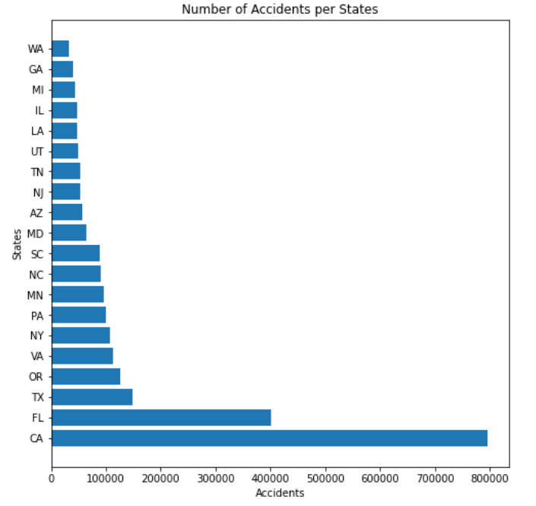
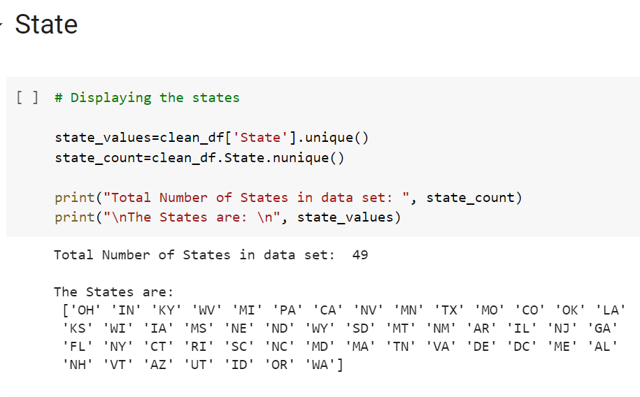
Descriptive Statistics and Visualization Results
The table lists all the state with their code and total number of state present in the dataset i.e. 49
The visualization graph depicts top 30 states, from which we state that CA (California State) has the maximum number of accidents . ​​

Slide 20
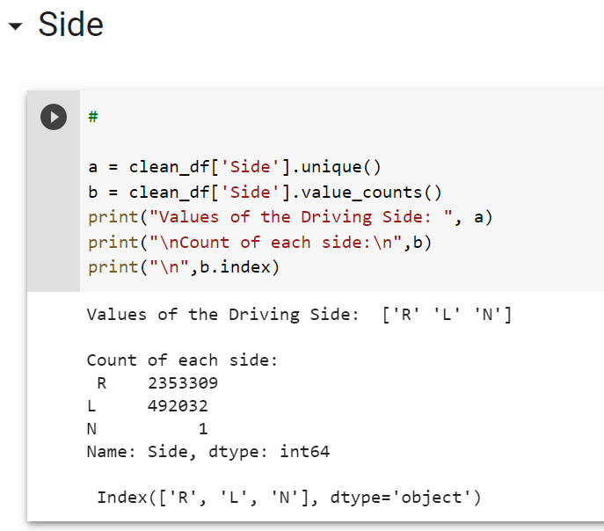
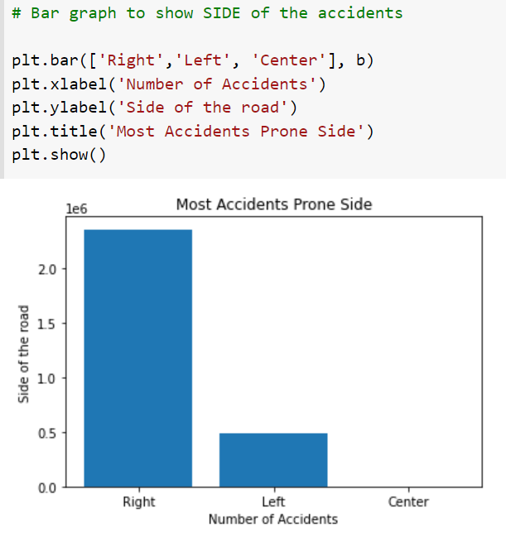
The ‘Side’ attributes depict the side of road at the time of accidents, labeled as left, right and none following the total count.
For visualization bar graph, we observe that that the most of the accidents occur at the right side of the road where as center=0

Slide 21
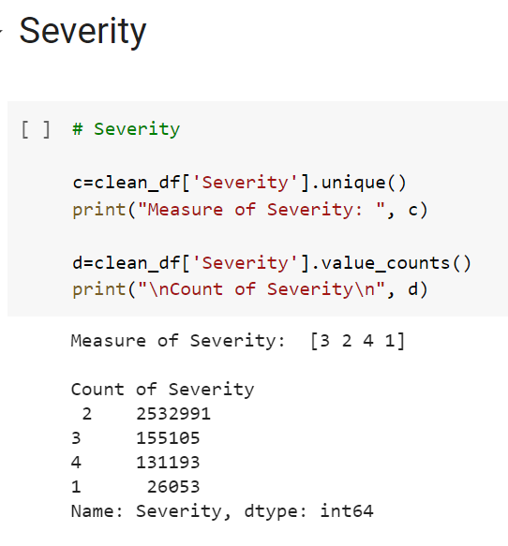
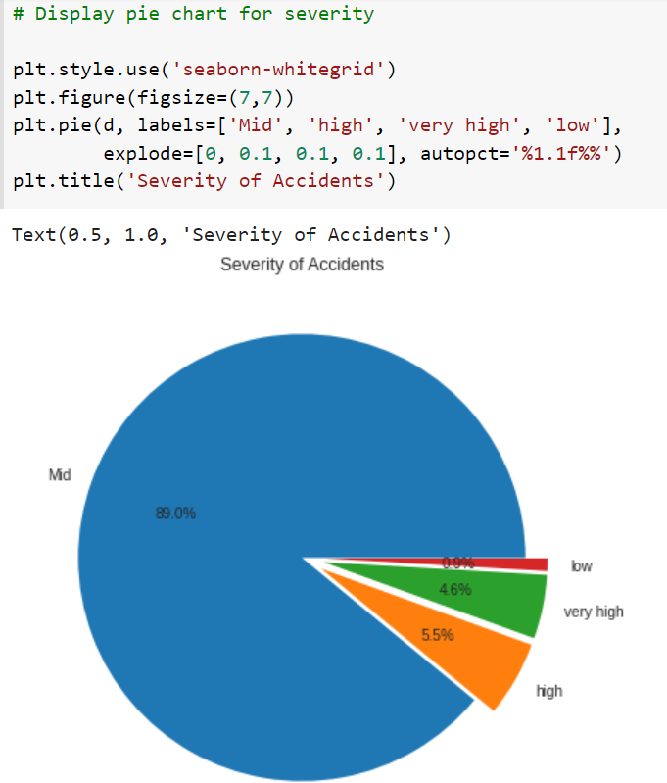
The Severity feature predicts the severity of the accident. Labeled as 1,2,3,4.
The pie chart shows that severity 2 (mid) has maximum number of accidents.

Slide 22
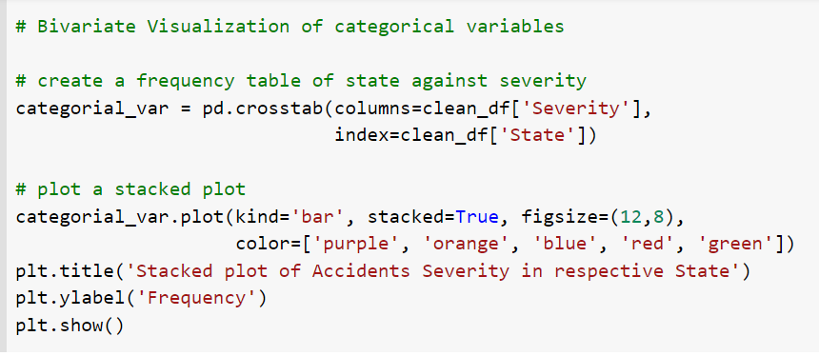
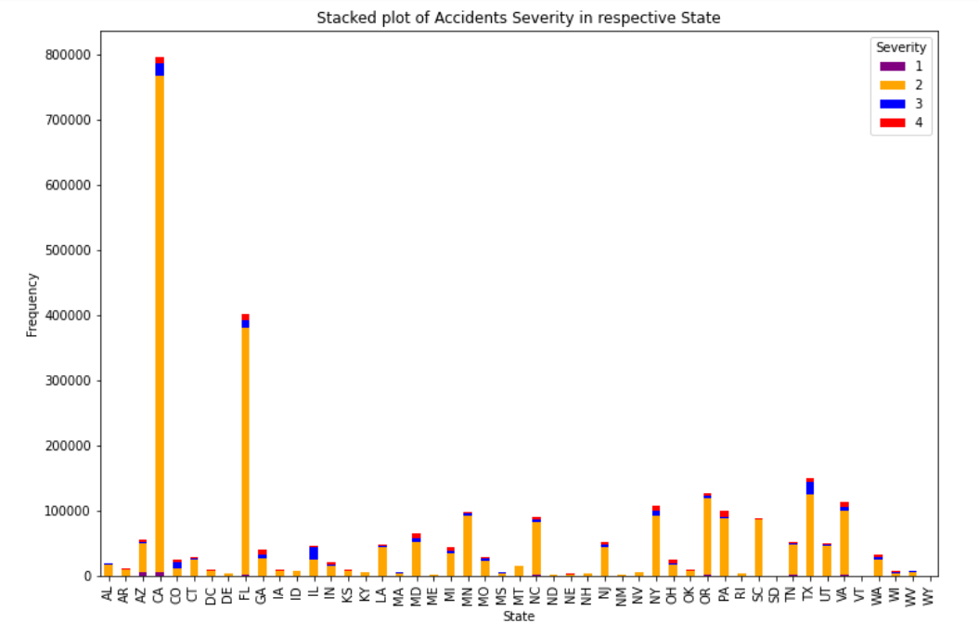

Slide 23
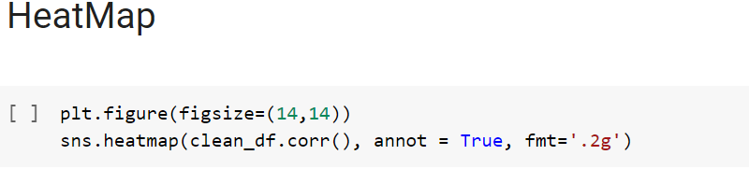
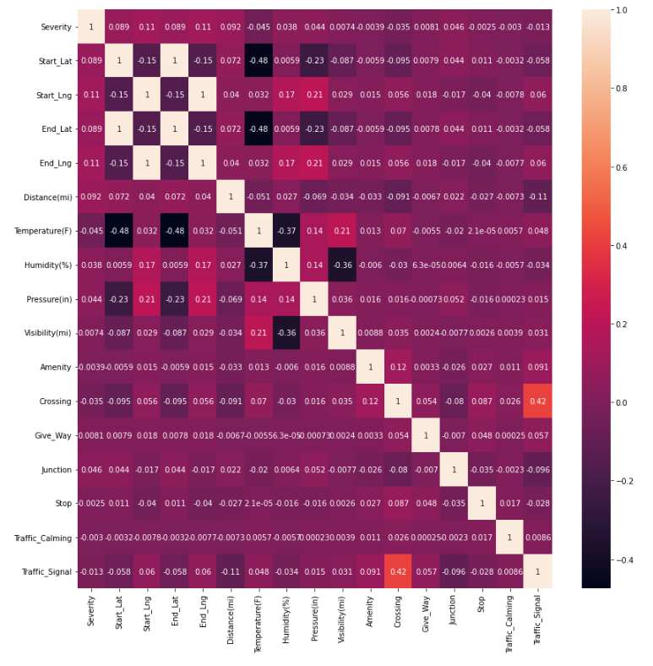
The heat map shows the correlation among all the different attributes. Start_Lat, End_Lat, Start_Lng and End_Lng presents the highest positive correlation of 1, followed by Crossing with Traffic signal presenting the positive correlation of 0.42; and Temperature with Start_Lat as well as Temperature with End_Lat presents the most negative correlation of -0.48.

Slide 24
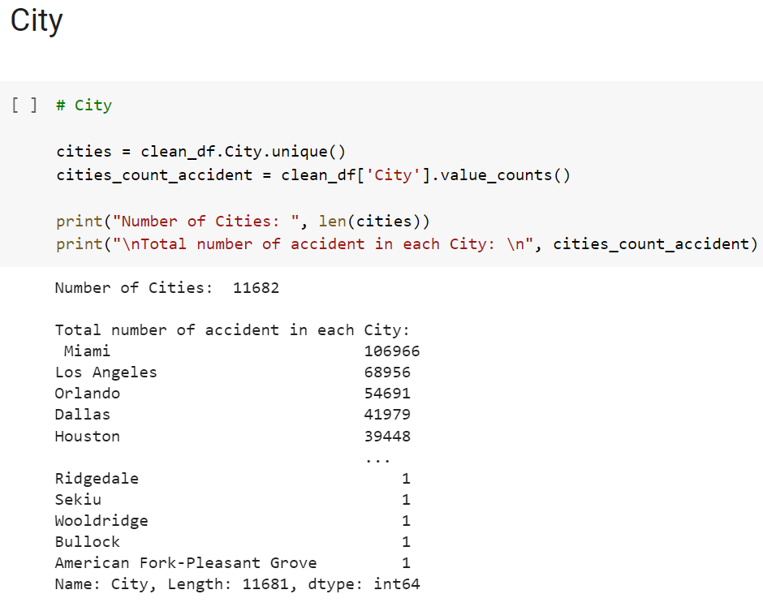
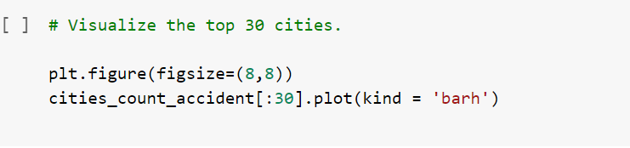
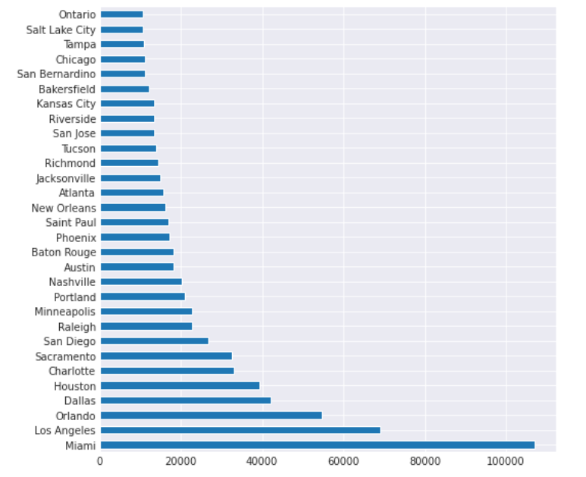
The ‘City’ attribute table shows the total number of cities present in the dataset, along with the total count of accident in every city.
From visualization graph we conclude that Miami city has the maximum number of car accidents.

Slide 25
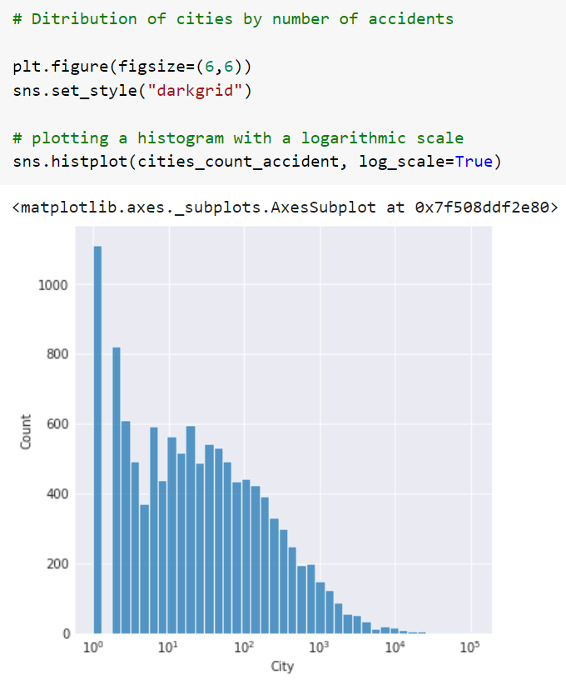
Over 1100 cities have reported only one accident during the entire period. This could either be very good news or it could be a result of missing data. Let’s break cities by accidents into two groups and see their respective distributions

Slide 26
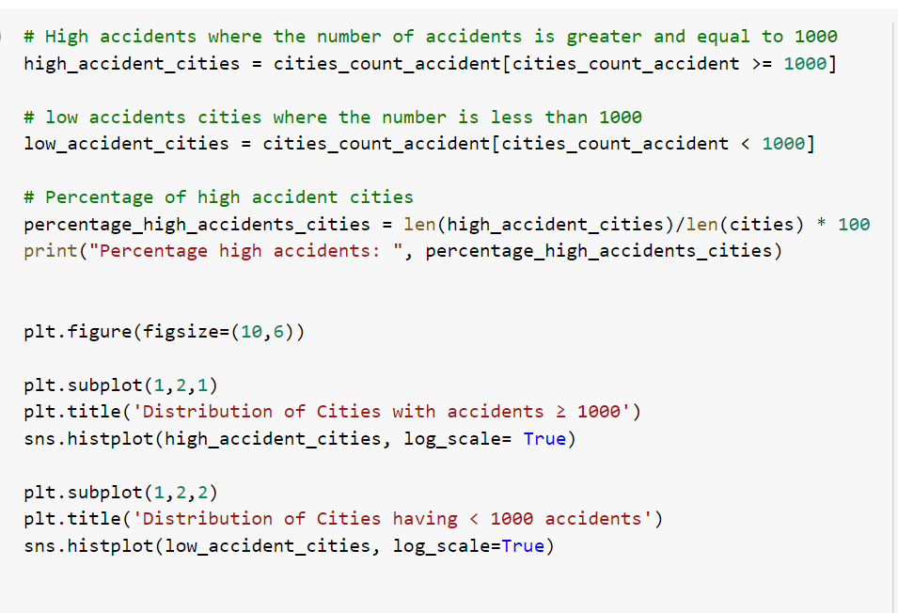
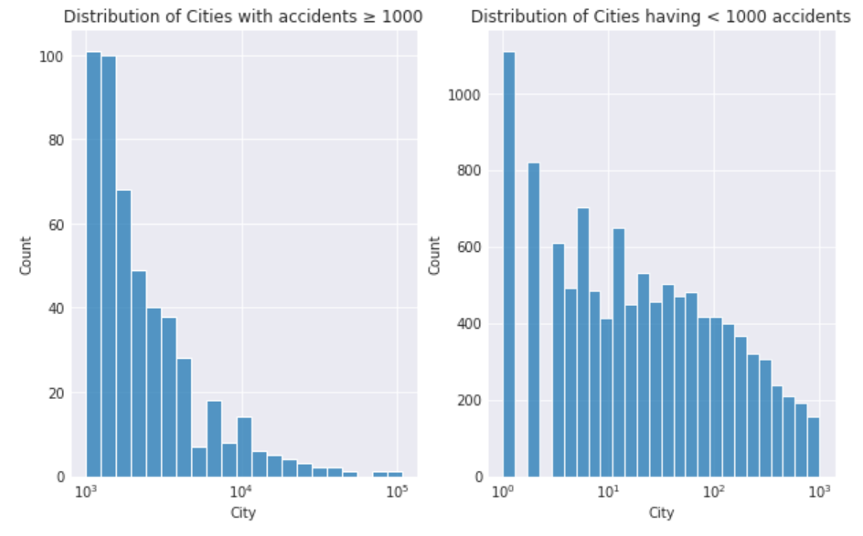
For High:
Almost 100 cities (out of 11682) reported more than 1000 accidents during the period between February 2016 and December 2021.
For Low:
Over 1100 cities have had just one accident in 4 years
The majority of them have witnessed between 10-100 accidents during the period
Accidents by cities follow an exponentially decreasing distribution.

Slide 27
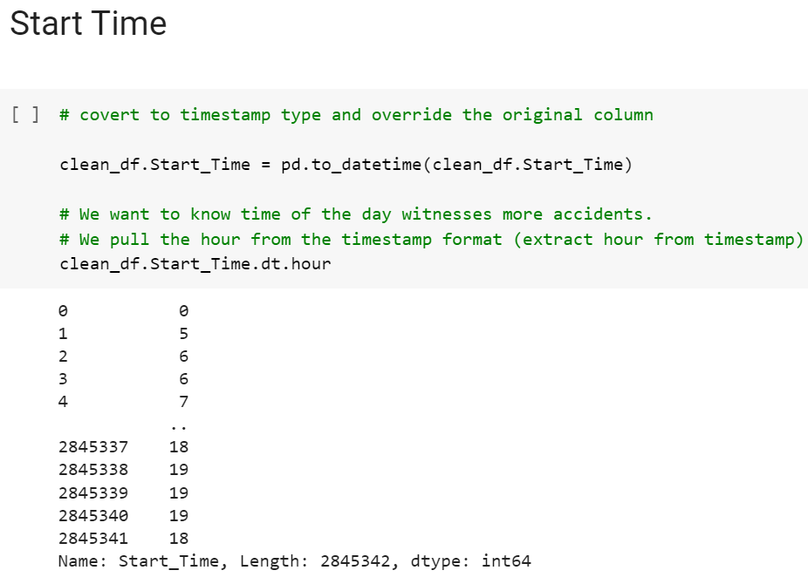
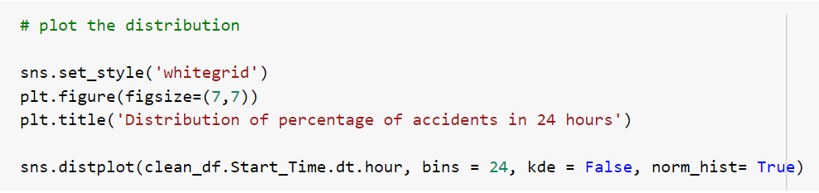
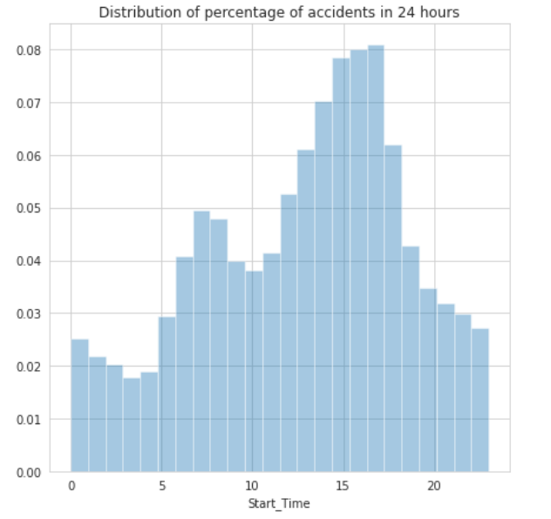
There is one peak of time:
Between 3 pm to 6pm. The rush hours could be leading to more accidents

Slide 28
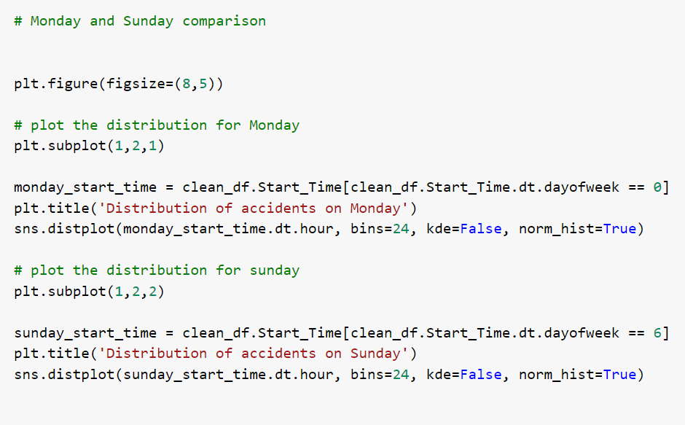
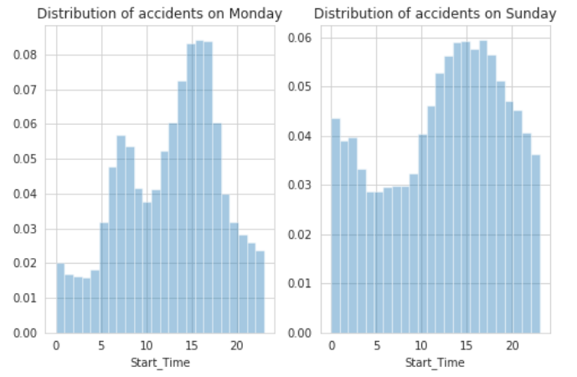
While Monday follows the general 24-hour pattern- two peaks coinciding with work rush; the distribution for Sunday sees a peak between 10 am and 4 pm. This could be due to people going out for leisurely activities on Sundays.

Slide 29
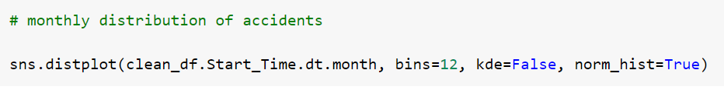
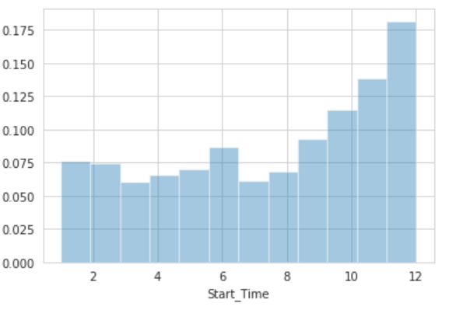
There seems to be a steady upward curve from the second half of the year, This could possibly be due to summer break and then the new school term around August-September.

Slide 30
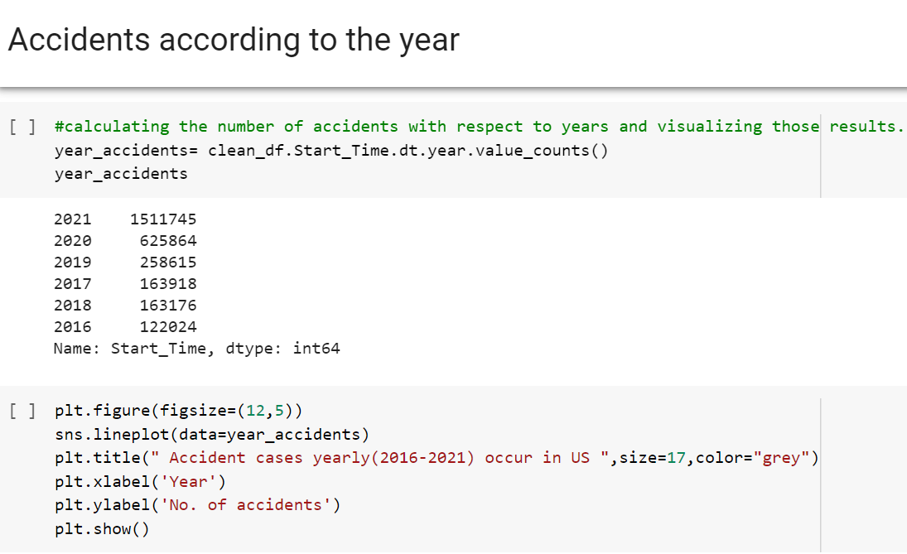
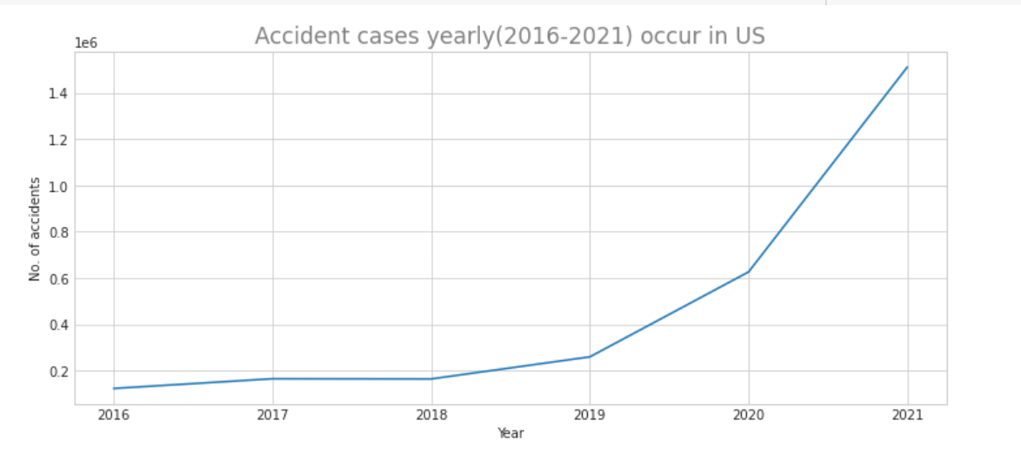
This presents the increase in number of accidents with respect to year. It can be seen that the reported number of accidents in 2021 were more than 1.4 million which is way higher than the reported accidents from 2020.

Slide 31
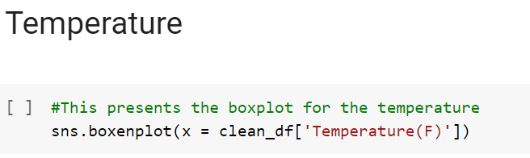
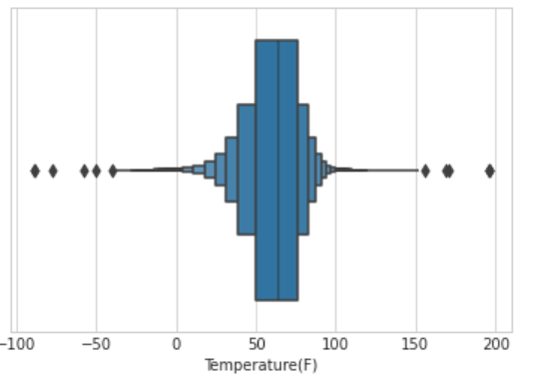
The results shows that most of the accidents takes place in between 50-60 degrees F.

Slide 32
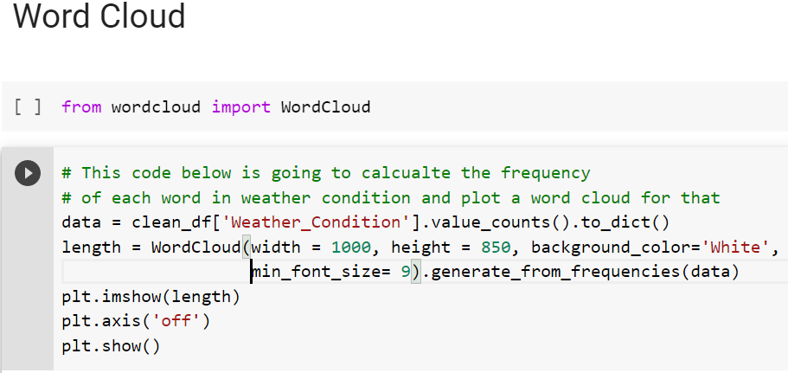
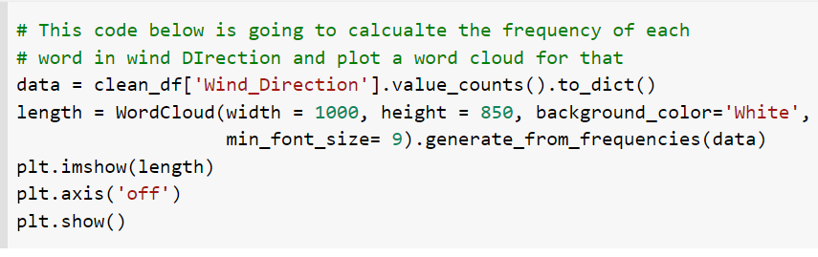
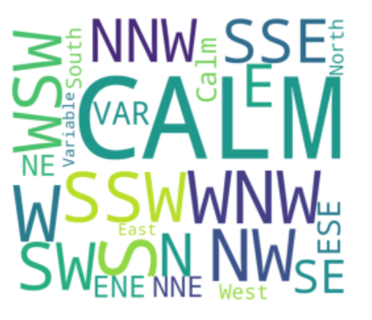
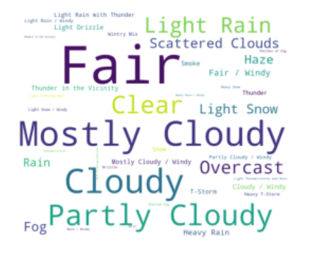
This shows that the most frequent words that are used for Weather Condition is Fair, followed by Mostly Cloudy, Cloudy, Partly Cloudy.
This shows that the most frequent word seen when accidents took place is that the wind direction was Calm.

Slide 33
Observational Results and Inference
In most circumstances, the weather seems to be "Fair" or "Mostly Cloudy", hence it is not a major cause behind the accidents.
Most of the accidents occur when the temperature is in between 50-60 degrees Fahrenheit.
This tells that majority of accidents have severity ~2 means not much higher impact on traffic.
Miami(CITY) had most no of accident cases i.e. 106966
Top 5 Cities which had most number of cases are Miami-106966, Los Angeles-68956, Orlando- 54691, Dallas-41979, Houston-39448
Cities which had least number of accidents are Ridgedale=1 , Sekiu=1 , Wooldridge=1, Bullock=1, American Fork, and Pleasant Grove=1
CA (STATE) had most no of accident cases i.e. 795868
Top 5 States of US which had most no accident cases are: CA-795868, FL-401388, TX-149037, OR-126341, VA-113535

Slide 34
Observational Results and Inference
Most accident occurs between 3:00PM - 6:00PM
Most-deadliest accident hour is 5:00PM
Next highest accident occur between 7:00AM - 8:00AM
Friday had the highest no of accident cases i.e. 492074.
Accident cases are less during weekends i.e. Saturday and Sunday and evenly distributed during business days.
Most no of cases are occurred during December i.e. 473943
The end of the year the number of accidents is quite high i.e. during December, November, October
Year 2021 had max no of accidents i.e. 1511745
Trend is increasing exponentially yearly, sharp rise after year 2020.
Maximum no of cases occurred between temperature range: 50-80 F.

Slide 35
What went well/what did you enjoy about the project?
Got dataset easily from Kaggle
Team co-ordination
Equally divided the project work
Gaining understanding of how various elements impact accidents, analyzing the data, and producing results.
2. What didn’t went well?
Some issues in Latex – which we somehow figured it out.
3. What will be the most important thing you take away from the project?
Define and understand public benefit and user need
Review the quality and limitations of the data
How to improve efficiency
How data science can be applied across all industries

Slide 36
4. Description of what each team member did (amount of work should be roughly equal)
Komal Gogi | Navjot Kaur
Literature Review – 10 papers | Literature Review – 10 papers
Source Code – Data Pre-processing, Attributes - City, StartTime, Heatmap, Bar Stacked graph and Histograms | Source Code – Attributes – State, Severity, Side, Temperature, Word cloud, Accidents according to year.
Overleaf – Latex, wrote my part of the results | Overleaf – Latex, wrote my part of the results
PPT – Equally written | PPT – Equally written
Reference – Wrote 10 papers | Reference – Wrote 10 papers

Slide 37
Thank You

