Slide 1

AJEENKYA D.Y.PATIL SCHOOL OF ENGINEERING, PUNE
DEPARTMENT OF COMPUTER ENGINEERING
ELFS- Efficient Lossless File System
PRESENTED BY:
Shruti Nikam
Advait Pandharpurkar
Komal Patil
Atharva Waghchoure
UNDER THE GUIDANCE OF:
Prof. Amruta Chitari

Slide 2
INDEX
INTRODUCTION
LITERATURE SURVEY
PROBLEM STATEMENT
MOTIVATION & OBJECTIVE
SYSTEM ARCHITECTURE
MATHEMATICAL MODULE(GRAPH)
OUTPUT
CONCLUSION
FUTURE SCOPE
REFERENCES

Slide 3
INTRODUCTION
ELFS (Efficient Lossless File System) is designed as a read-write file system.
It stores data in a way that allows it to be retrieved without any loss of information while also optimizing storage space and access speed.
Inspired by dwarfs/squashfs , ELFS utilizes Zstandard(Zstd) compression.
Provides storage in hot (decompressed) and cold (compressed) pots.
ELFS is scalable and also saves the cost.

Slide 4
LITERATURE SURVEY
Author | Year | Title | Purpose
Sanjay Ghemawat, Howard Gobioff, and Shun-Tak Leung Google | 2022 | Google File System | focuses on integrated compression techniques that optimize storage efficiency while ensuring high performance for data access.
Josef Bacik, Chris Mason FusionIO | 2012 | IBM Research Report | It examines various compression algorithms, emphasizing the need for a balance between compression ratios and processing speed.
Xiang Gao1, Mingkai Dong2, Xie Miao1, Wei Du1, Chao Yu1, and Haibo Chen2,1 | 2019 | EROFS: A Compression-friendly read only file system for resource-scare devices | It introduces a file system designed for resource-constrained devices
Yann Collet | 2019 | Zstandard : A Fast lossless compressison algorithm | designed for both efficient compression and rapid decompression, making it ideal for various applications, including real-time data processing
Di wu,Zizhong Chen,Franck Cappello | 2019 | Efficient lossless compression of numerical data arrays | techniques for efficiently compressing numerical data arrays without loss of information

Slide 5
PROBLEM STATMENT
To solve these problems, we can use smarter systems that adjust to different tasks and save space without slowing down. Using faster hardware and better planning can make things quicker and more reliable.Simple tests help compare performance, and smart tools help understand storage better. Fixing errors and using better methods can make systems safer and easier to grow. Also, reducing extra work like journaling can speed things up.

Slide 6
MOTIVATION & OBJECTIVE
Data Integrity and Reliability: Preservation of Original Data. Data integrity locks for concurrent file operations.
Storage Efficiency: Optimizing Storage Space , Reducing Redundancy , Cold and hot storage pots for file io operations.
Cost Efiiciency: Minimizing the hardware requirements.
Security: Protecting Sensitive Information
Data agnostic filesystem for wide use case.

Slide 7
SYSTEM ARCHITECTURE
Compression: Utilizes Zstd for efficient file compression.
Read-Write Support: Enables both reading and writing of data.
Storage Pots: Manages data in hot (decompressed) and cold (compressed) storage.
Tools:
elfs-mount: Mounts ELFS file systems.
elfs-extract: Extracts data from ELFS file systems.
elfs-make: Creates new ELFS file systems.
elfscat: Displays content of ELFS file systems.

Slide 8
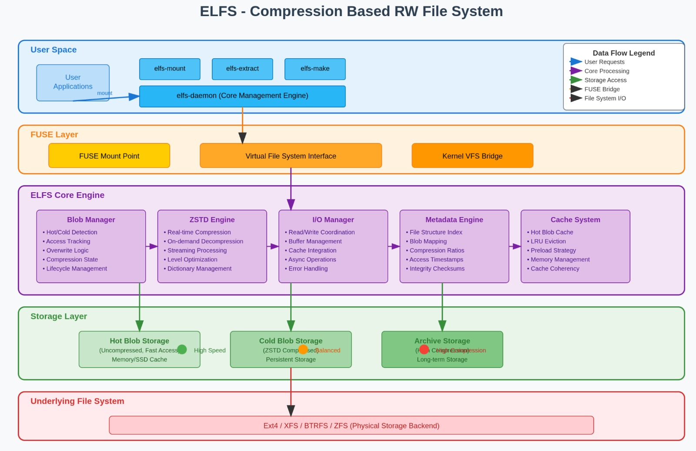

Slide 9
HARDWARE & SOFTWARE REQUIREMENT
COMPONENT | SPECIFICATIONS
Operating System | Arch Linux
Technology | ZStd
Tool | Rust for programming
Processor | Intel 13th Gen Ultra 9
Memory | 32 GB DDR5

Slide 10
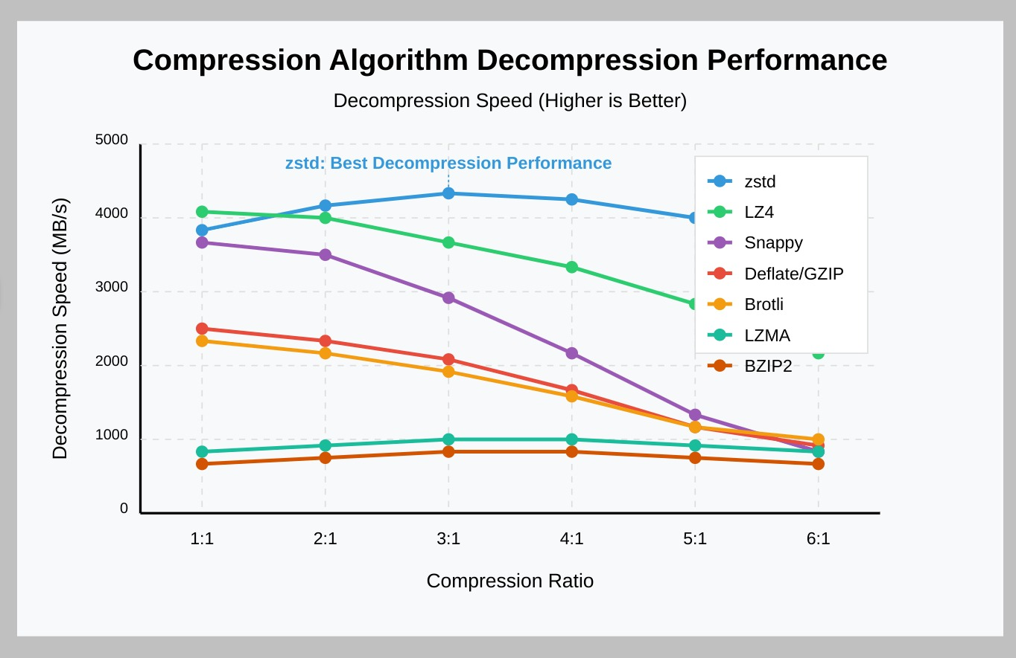
MATHEMATICAL MODEL

Slide 11
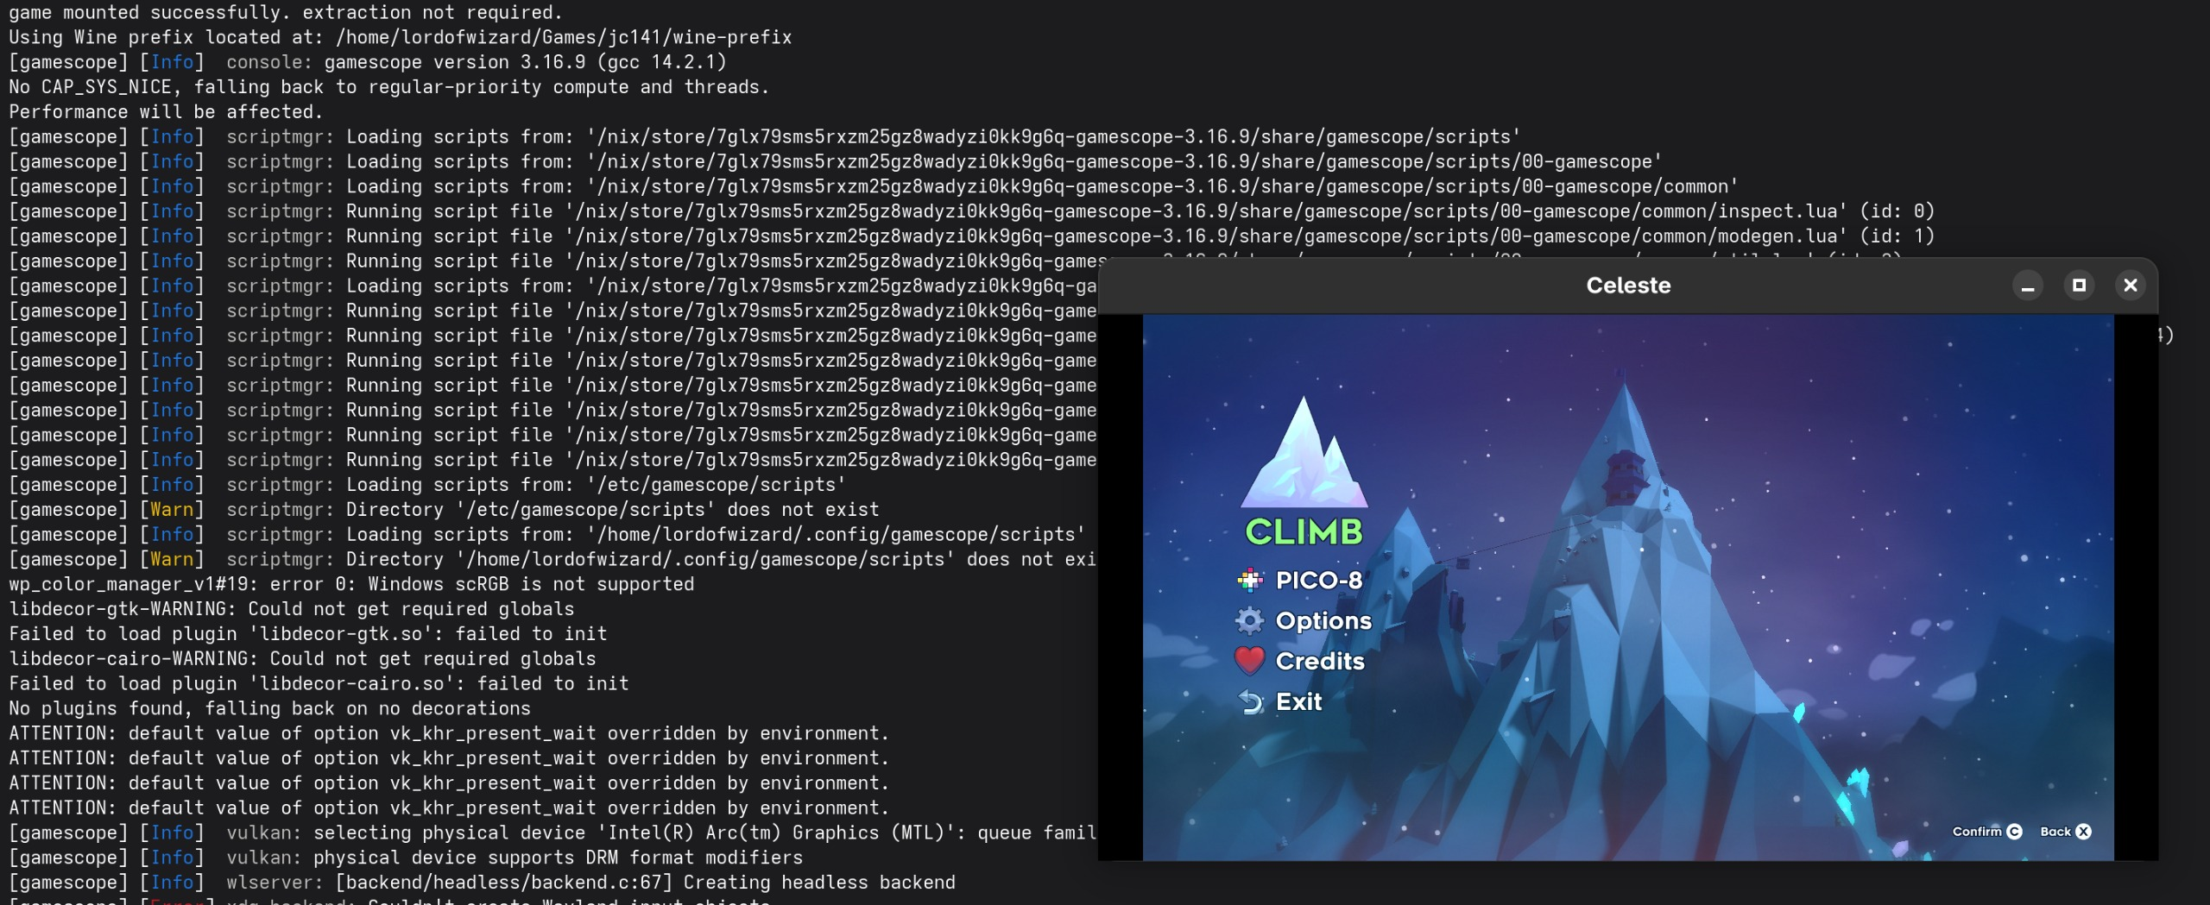
OUTPUT

Slide 12
CONCLUSION
Efficient Lossless File Systems (ELFS) are crucial for modern data management, ensuring data integrity while optimizing storage and performance.
By providing reliable, scalable, and adaptable solutions, ELFS address the growing demands of data-intensive applications.
Their ability to efficiently compress and organize data not only reduces storage costs but also enhances user experience.
Overall, ELFS play a vital role in maintaining the reliability and accessibility of digital information in today's fast-paced technological landscape.

Slide 13
SCOPE
Implementing highly compressed writable filesystem.
Data Integrity ensures that stored data can be retrieved accurately and reliably.
Provide fast data access and retrieval.
Cold and hot storage pots for file io operations.

Slide 14
REFERENCE
L. A. González, G. J. Bishop-Hurley, R. N. Handcock, and C. Crossman, "Behavioral classification of data from collars containing motion sensors in grazing cattle," Compute. Electron. Agric., no. 110, pp. 91-102, 2015.
BENAVIDES, T., TREON, J., HULBERT, J., AND CHANG, W. The enabling of an Execute-In-Place architecture to reduce the embedded system memory footprint and boot time. JCP 3, 1 (2008), 79-89.
Frank Schmuck and Roger Haskin. GPFS: A shared-disk file system for large computing clusters. In Proceedings of the First USENIX Conference on File and Storage Technologies, pages 231-244, Monterey, California, January 2002.
Sanjay Ghemawat, Howard Gobioff, and Shun-Tak Leung Google,” The Google File System”.
Xiang Gao1, Mingkai Dong2, Xie Miao1, Wei Du1, Chao Yu1, and Haibo Chen2,1 1Huawei Technologies Co., Ltd. 2Shanghai Jiao Tong University,” EROFS: A Compression-friendly Readonly File System for Resource-scarce Devices”.
Ohad Rodeh, Josef Bacik, Chris Mason FusionIO , IBM Research Division Almaden Research Center 650 Harry Road San Jose, CA 95120-6099 USA.

Slide 15


