Slide 1
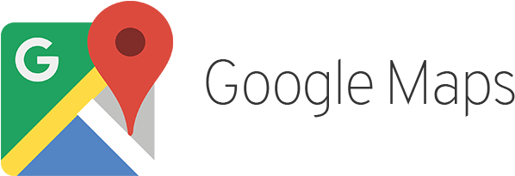

Team 2: Google Map Data System Yijia GU; Christine Nyasha Mundiya;
Komal Patil; Mingze Yuan
ISTM 6202 Relational Database
Team Project Presentation

Slide 2
Business Background
Google Maps is a web-based mapping service developed by Google that allows users to view maps, get driving directions, search for locations, and explore areas in 3D .
Google Maps was first launched in 2005. It provides detailed information about nearly every location on Earth, and also includes real-time traffic updates and transit information (Google, 2022).

Slide 3
Business Problems
What are customers complaining about?
Here are some quoted real user reviews of Google Maps from the Apple Store (2023).
“Wrong estimate time.”
“Thank you for making me violate the paid bridge.”
“It gives me the one route with lanes closed.”
Google Maps cannot collect enough real-time data to satisfy users’ demand.

Slide 4
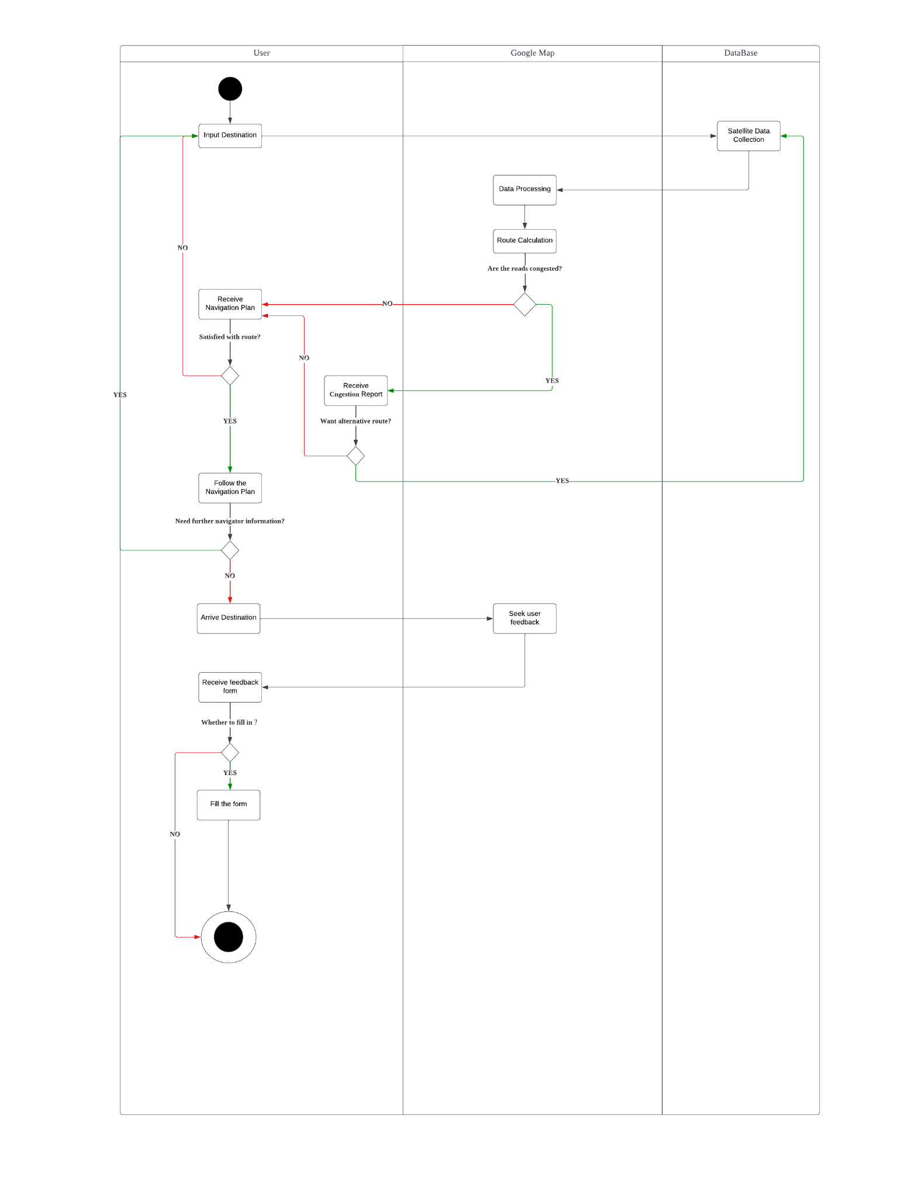
As-Is Business Process Map

Slide 5
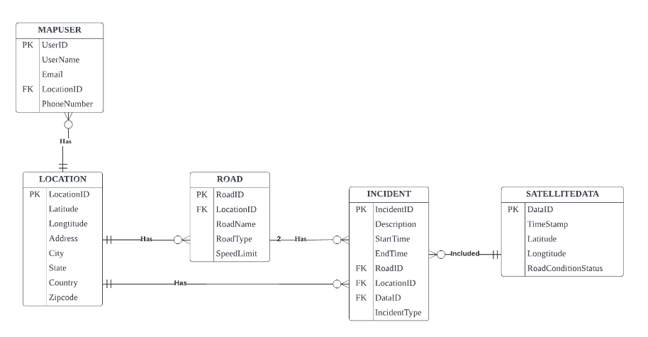
As-Is ERD

Slide 6
IT-Based Solution
A web-based system to allow users to report real-time road information to Google Maps.
Users can report incidents (traffic jams, roadwork, police, accidents) to assist others in choosing/deciding on routes.
Provides an efficient and effective way for users to report real-time road information.
Helps improve safety and reduce congestion on our roads.

Slide 7
How the system works
Users submit reports via the user interface
Users select type of incident to report and provide details such as location, severity and time of occurence.
To verify accuracy of report, Google Maps sends information across users passing through the area in the next 5 minutes.
Upon confirmation, Google Maps recognizes this information as “true”. Performs next step- data analysis.

Slide 8
How the system works ctd…
Data is processed and analyzed using Machine Learning algorithms
The algorithms identify the most critical incidents and prioritize them based on the level of urgency.
The most critical information is displayed first to the users.
Real-time alerts are generated to notify users of incidents in their area so that users can adjust their travel plans accordingly.

Slide 9
TO-BE Business Process
Google Maps provides users with an interactive panel to report report real-time traffic conditions while driving.
The data reported by users is stored in a database.
Users can receive specific reports of events occuring in real-time along their routes together with navigation recommendations from Google Maps.
Compared to previous satellite data on road congestion, the system provides more detailed and accurate real-time traffic reports.
Information includes traffic congestion, accidents, police, road constructions.
Helps Google Maps navigation to accurately estimate arrival time.

Slide 10
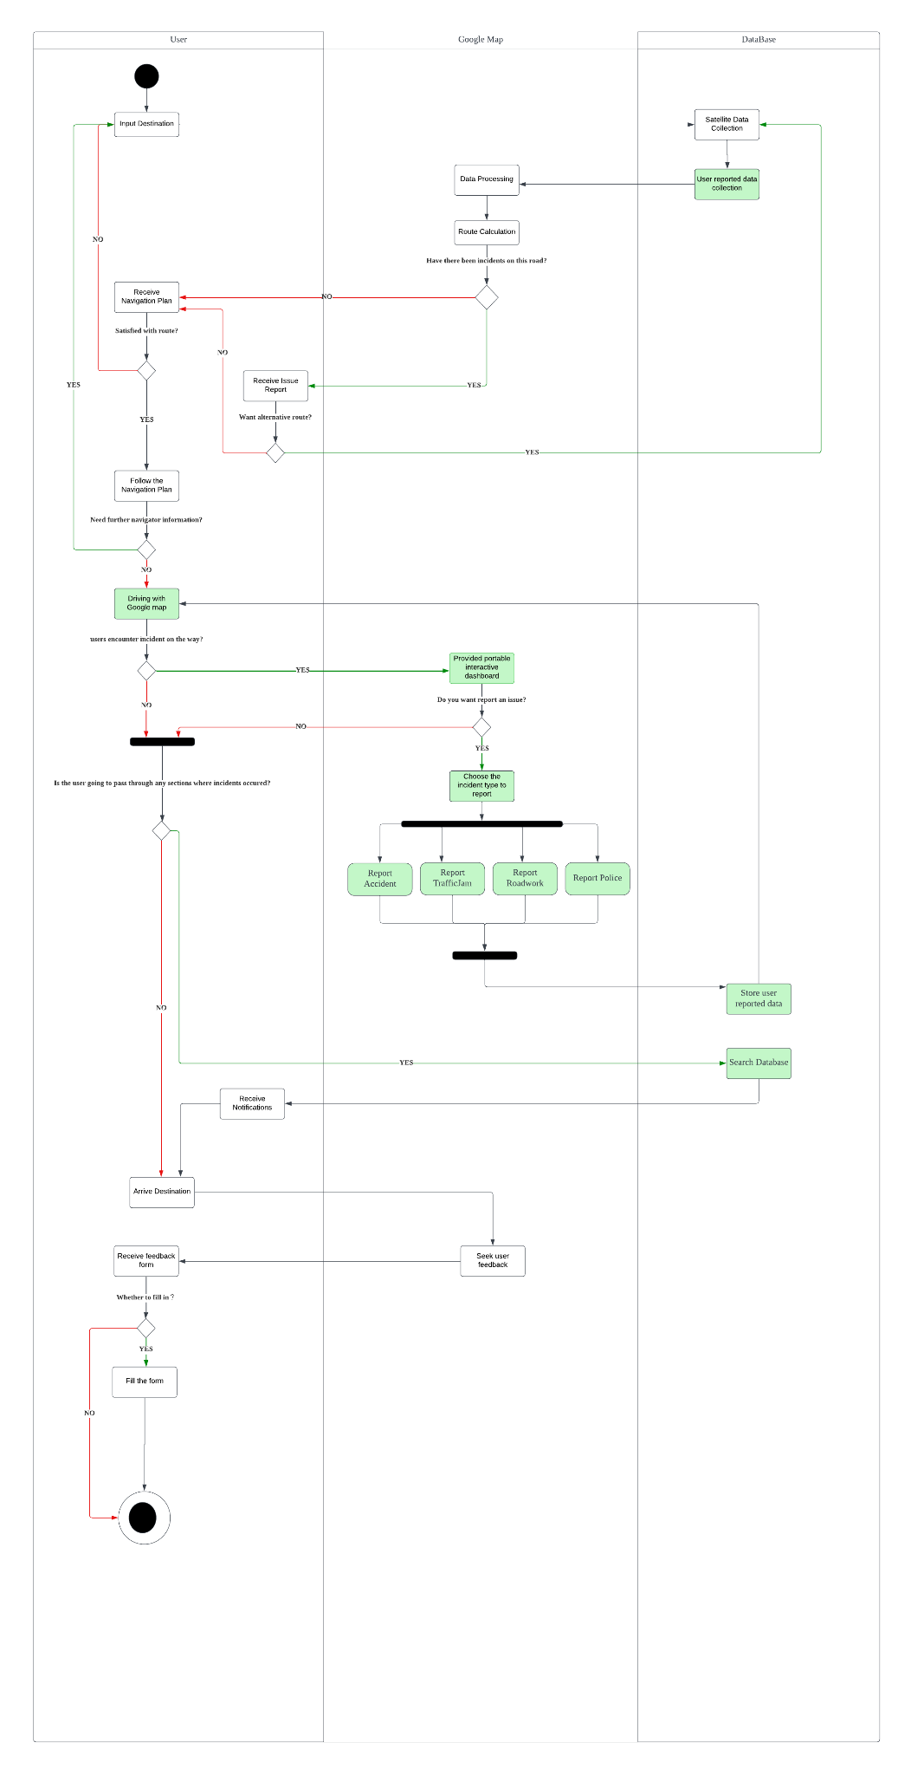
TO-BE Business Process

Slide 11
TO-BE Database (ERD)
To incorporate the new solution into the Google Maps system, the database needs to be updated and expanded to include the necessary entities.
The new system will meet information requirements of the 5C’s in the following ways:
Capture- capturing real-time data on road conditions
Convey- Conveying data in real-time
Create- Creating more accurate and detailed road maps using user provided real-time data
Cradle- Real-time data needs to be cradled or protected to ensure its integrity and to prevent data loss. Robust data security protocols will be implemented.
Communicate- Communicating benefits of new system to users. Encouraging user feedback to optimize Google Maps.

Slide 12
Business Rules
A User can submit 0 or multiple reports, but Report could be only submitted by 1 user.
A User can confirm 0 or multiple confirmations, but Confirmation can be only submitted by 1 user.
A Notification can be sent to 0 or multiple users, and User can have 0 or multiple notifications.
An Incident can receive 0 or multiple confirmations, but a Confirmation should only commit to one incident.
An Incident can trigger 0 or 1 notification, and one Notification should only be trigger by one incident.

Slide 13
Business Rules ctd…
An incident has four subtypes that can overlap, including traffic jams, accidents, police, and road construction.
A Location can have 1 or multiple roads, but one Road only has one location.
A Location can have 0 or multiple users, but one User only has one location.
A Road can have 0 or multiple incidents, and one Incident has only one road.
One or multiple Satellite Data can report 0 or multiple incidents, and one Incidents can have one or more satellite data.

Slide 14
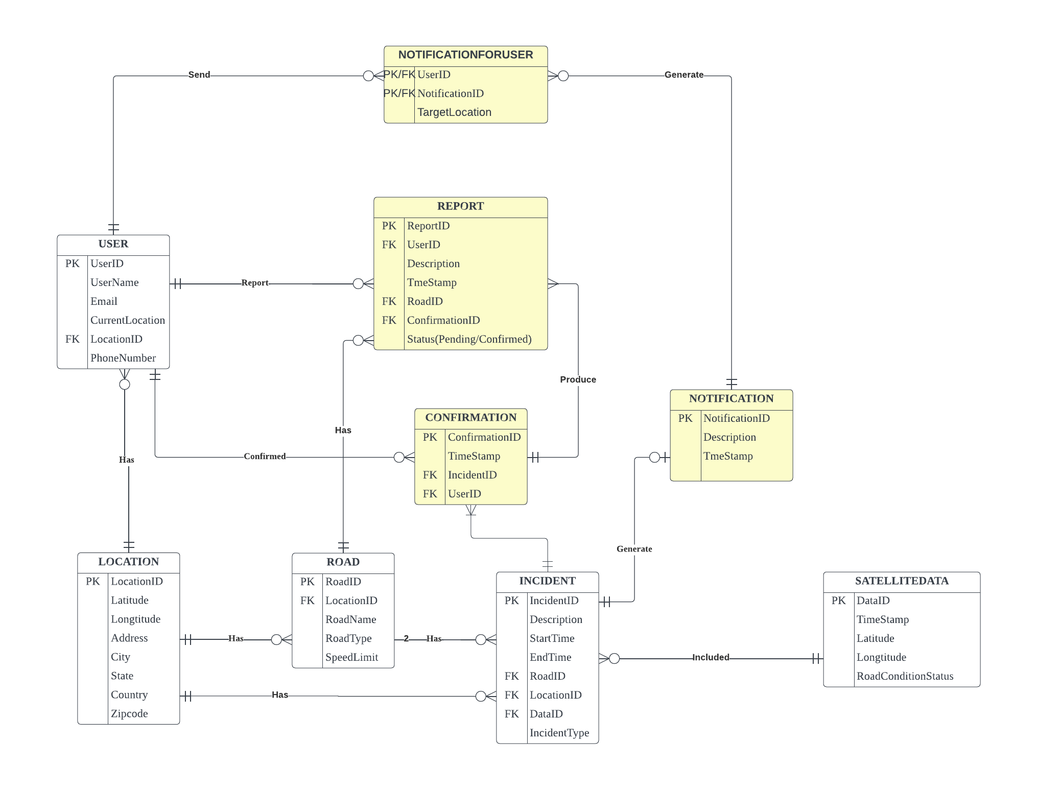
TO-BE Database (ERD)

Slide 15
Business function to data Entity Matrix
Business Function/Data Entities | User Profile | User History | Location | Place Data | Traffic Data | Transit Data | Map Data | Road Incident | Satellite Imagery
Maps & Navigation | X | X | X | X |  |  | X | X | X
Traffic & Routing | X | X | X | X | X | X | X | X | X
Search & Discovery | X | X | X | X |  |  | X |  | X
Advertising | X |  | X | X | X |  | X
Analytics & Insights |  |  | X | X | X | X | X | X | X
Business Operations |  |  | X | X | X | X | X | X | X
Customer Support |  | X | X | X |  |  | X
Partnership Management | X | X | X | X | X | X | X |  | X

Slide 16
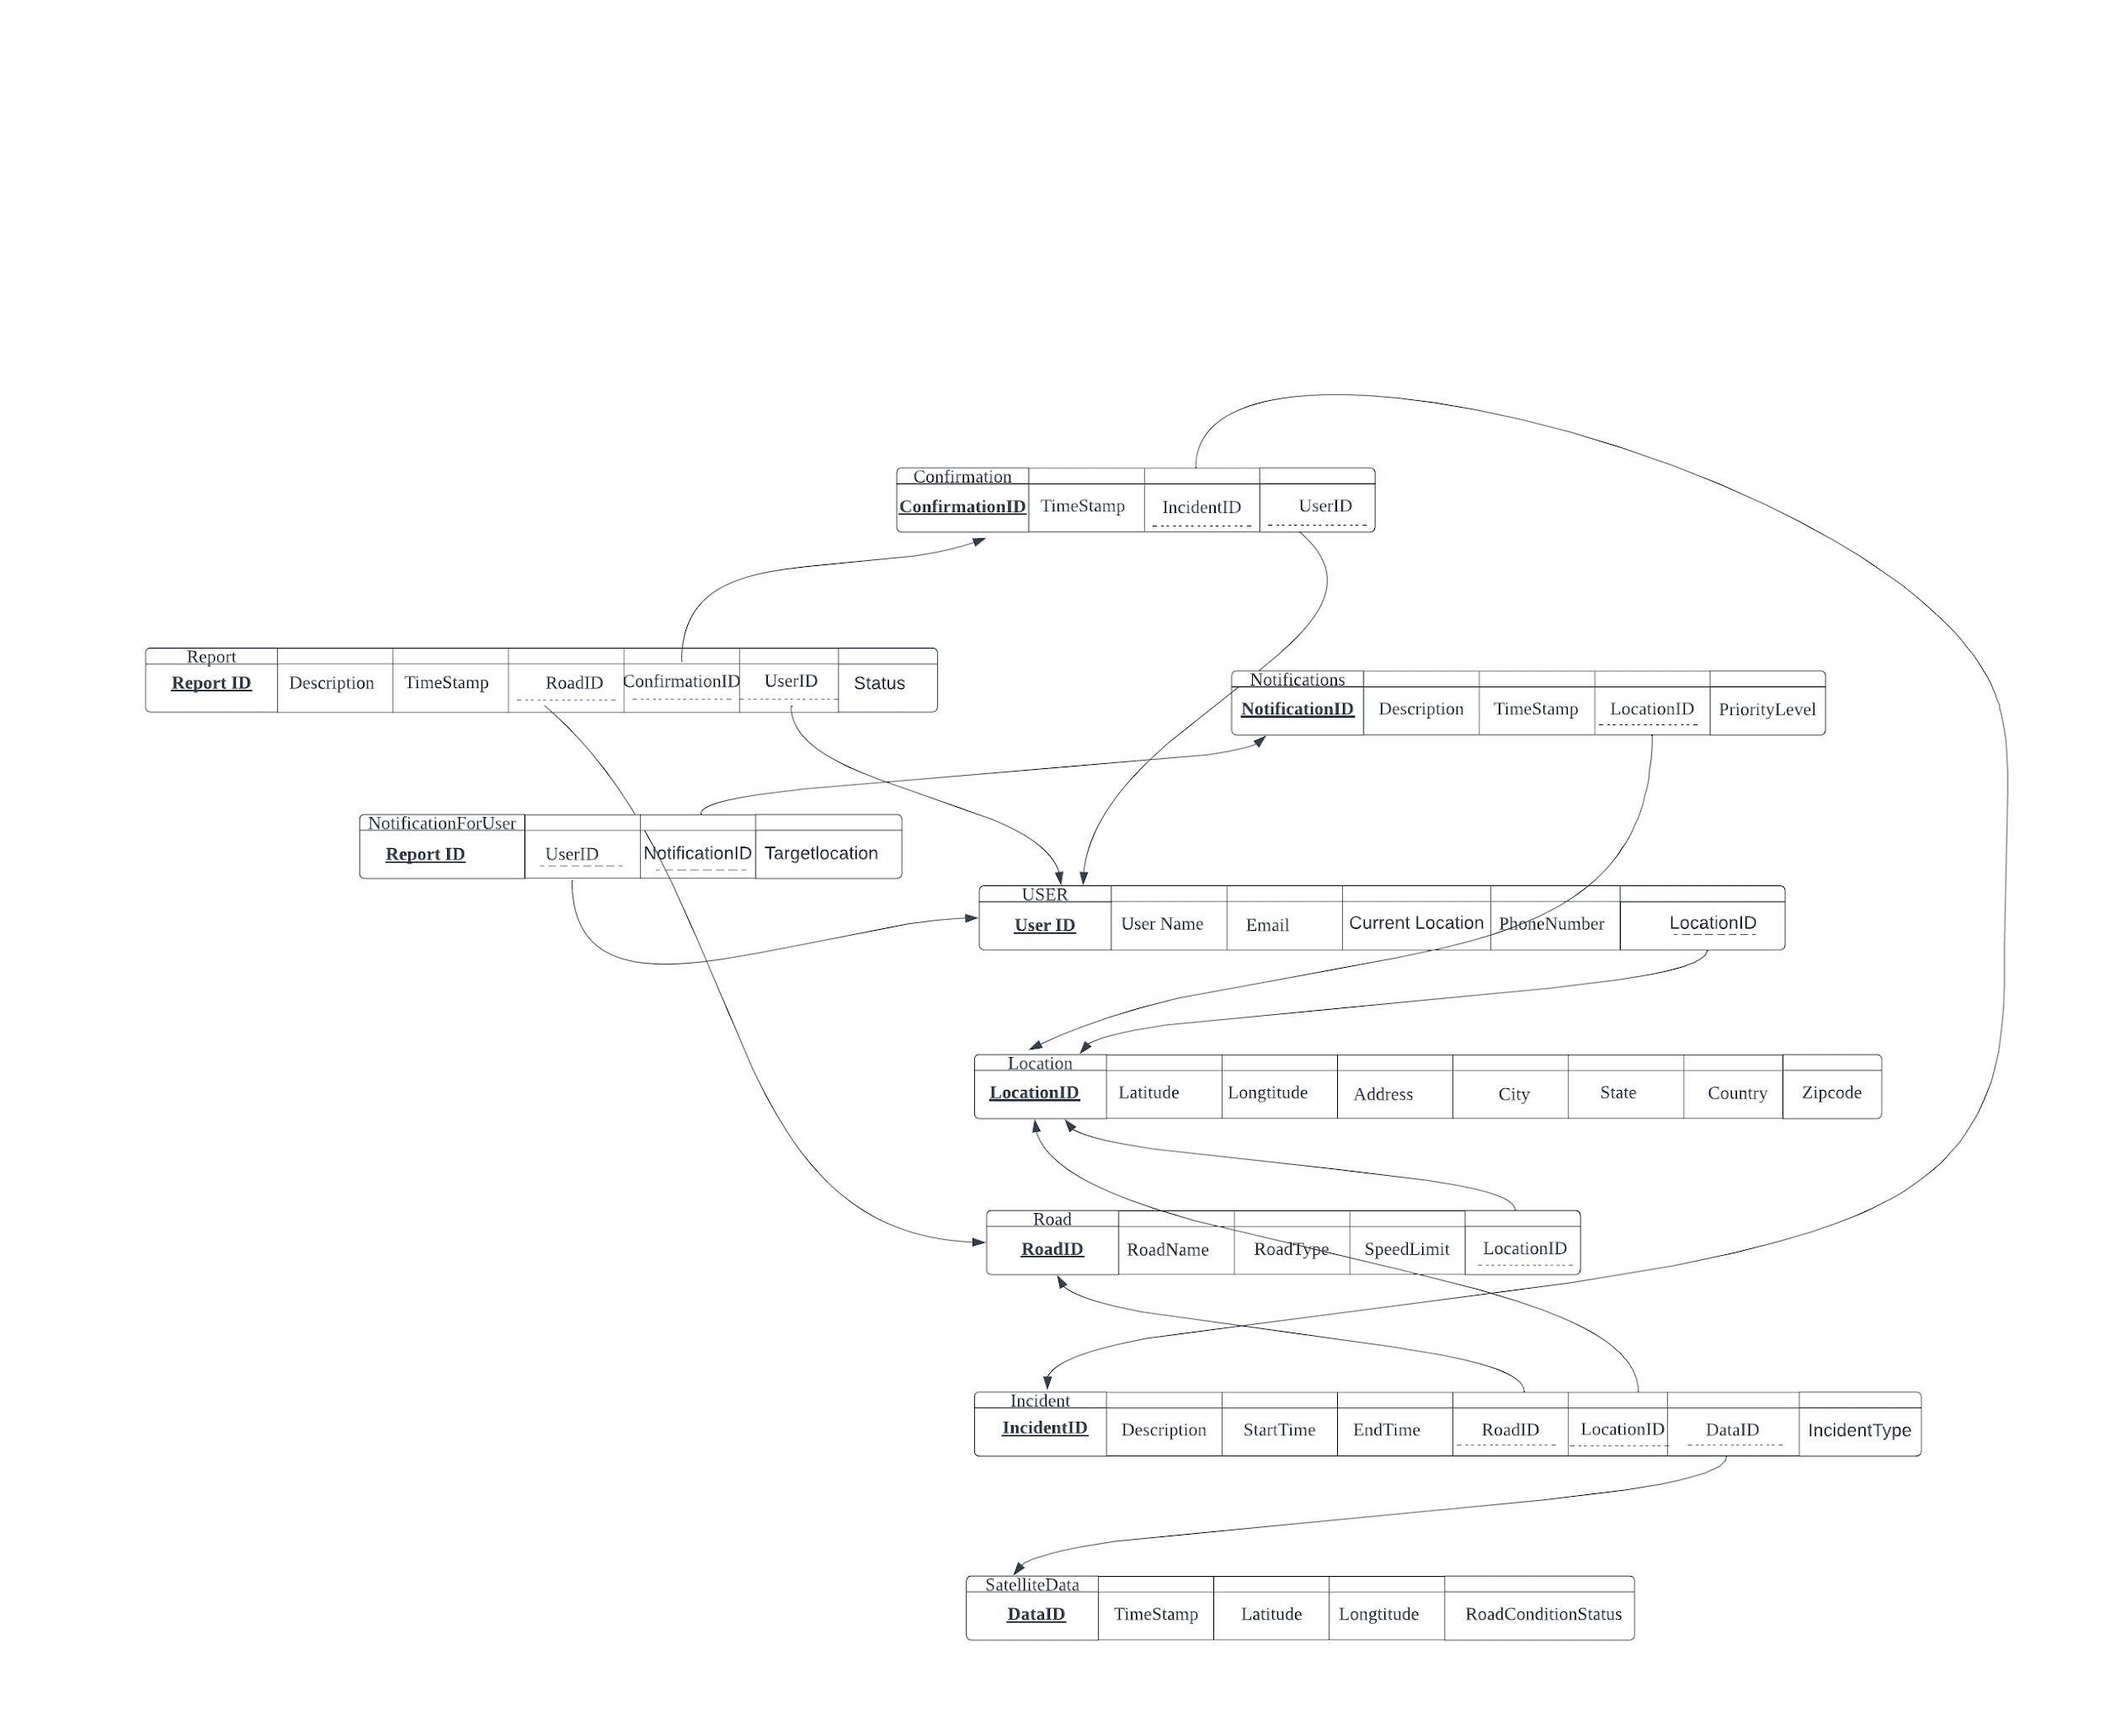
3NF Relational Schema

Slide 17
Section III
Database Implementation
Tables:
- Which datatypes will we use?
- What is our developing order?
SQLs:
- How will we use other functions: views,group by,enum
- How will we constrain our PK and FK?
Results:
- How does one sample look like?

Slide 18
Table Implementation: Data Type
Integer:ID, Speed Limit
Floating-point: Latitude, Longitude
Varchar: Description, state, name
Enum:State, type
Timestamp: Incident Date, Satellite Date

Slide 19
Table Implementation: Develop Order

Slide 20
Table Implementation: Develop Order

Slide 21
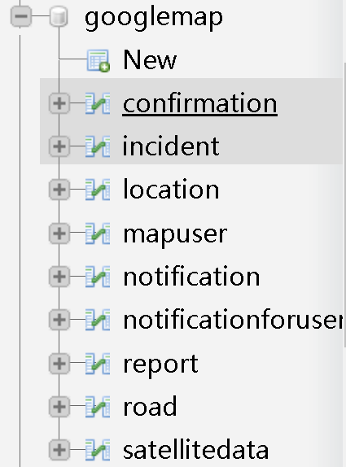
Table Implementation: Develop Order
Insert Into SATELLITEDATA
Values (1,'2023-04-26 15:15:30',38.913611,77.013222,'All right');

Slide 22
Table Implementation: Develop Order
create table road(
RoadID Int(11) not null,
LocationID Int(11) not null,
RoadName varchar(100) not null,
RoadType enum('Freeways','Highways','Arterial','Collector','Local','Pedestrian','Private') not null,
SpeedLimit int(6) not null,
constraint road_PK primary key(RoadID),
constraint road_FK FOREIGN KEY (LocationID) REFERENCES location(LocationID)) ;

Slide 23
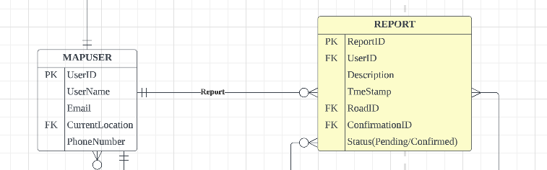
SQL Details
Views: Provide combined result for users
Group by:Provide ordered data for further using

Slide 24
SQL Details
Views: Provide combined result for users
Group by:Provide ordered data for further using
CREATE VIEW ReportOverview AS
SELECT A.UserID, B.ReportID, Status,B.Description,B.TmeStamp
FROM User A,Report B
WHERE A.UserID= B.UserID
Group By B.TmeStamp;

Slide 25
Conclusion
Improvement on existing product
One clear improvement for users’ experience
Use database to solve this requirements.
Potential problem:
Continue improvement from users
Reasonable feedback, guidance as well as award for application

Slide 26

Q&A

