Slide 1
Retail Order Analytics

Slide 2
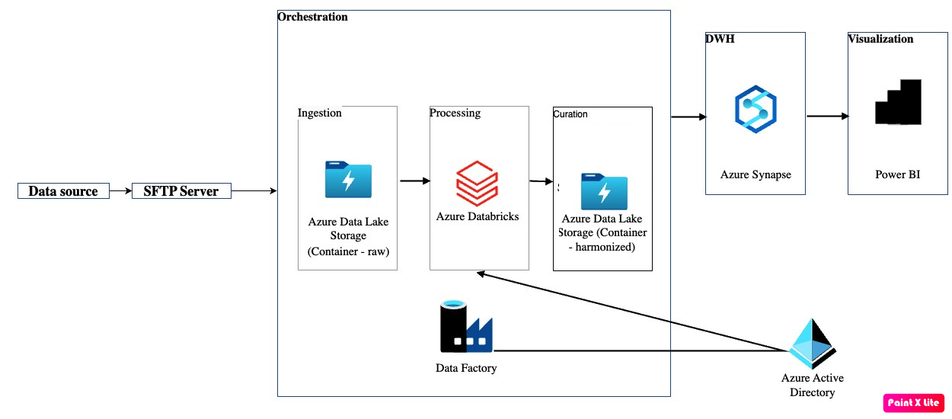
Technical Architecture

Slide 3
Data Processing Flow
As per the requirements, the data flow begins with the source system pushing data to the SFTP server, which will subsequently transfer the data to the Azure ADLS raw container. Azure Data Factory serves as the orchestrator in this setup.
An event trigger is set on the raw container, initiating a pipeline execution. This pipeline calls a Databricks notebook responsible for processing the input data and generating outputs stored in the harmonized container within ADLS.
Two containers are utilized: the raw container for receiving and storing incoming data, with its lifecycle policy configurable based on the desired retention period, and the harmonized container for holding the final processed data. Additionally, the processed data is stored in a SQL table to facilitate access by data warehouse systems and Power BI.
Azure Synapse is deployed for data warehousing and analytical purposes, while Power BI utilizes the stored data to generate dashboards showcasing calculated metrics and KPIs.

Slide 4
Data Processing Flow (contd.)
Since the source system can push complete data multiple times for a specific month, we should perform an incremental load and store the output in a partitioned delta file for efficient processing (using replaceWhere clause while writing output to specific month partition).
To handle data inconsistencies, we implement a validation module before processing the data. (Details in the Inconsistencies slide)

Slide 5
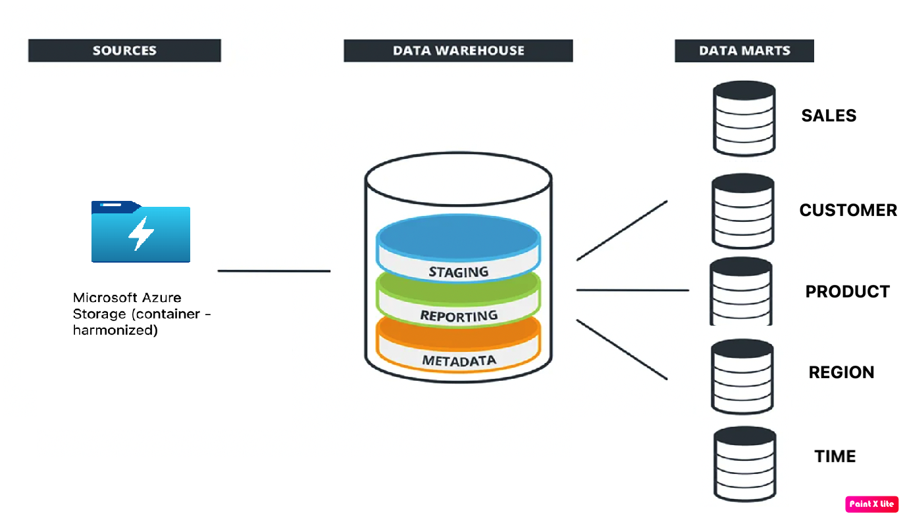
DWH Structure

Slide 6
Inconsistency Analysis & Cleansing
To handle data inconsistencies, we implement a validation module before processing the data. This module marks inconsistent rows with a flag ‘false’ and records that qualify as master data with a flag ‘true’.
In the harmonized layer, we create two folders: MasterData and InconsistentData. The MasterData folder contains data marked as ‘true’, while the InconsistentData folder contains data marked as ‘false’.
For calculating KPIs, we handle inconsistencies by replacing blanks and nulls with a value of 0.

Slide 7
Inconsistency Analysis & Cleansing(contd.)
Other inconsistencies that can be checked for:
Different datatypes in same column
Sales and Quantity is 0, but Profit has non-zero data
Same row id’s leading to duplicate records
ShipDate should be after OrderDate
We can utilize pandas modules for generating a detailed report with insights about the data.

