Slide 1
PredictEvent
Event-Driven Congestion Intelligence for Bengaluru Traffic Police
Theme 2 | BTP × Flipkart Hackathon | Forecast impact → recommend manpower, barricading & diversion

Slide 2
The Problem
• Rallies, festivals, sports, processions, VIP movement, construction & sudden incidents choke Bengaluru's corridors.
• Event impact is not quantified in advance — which corridor, how hard, tomorrow?
• Resource deployment is experience-driven — manpower & barricades decided by gut feel.
• No post-event learning loop — the same mistakes repeat.
• Goal: turn 8,173 historical events into a forward-looking deployment planner.

Slide 3
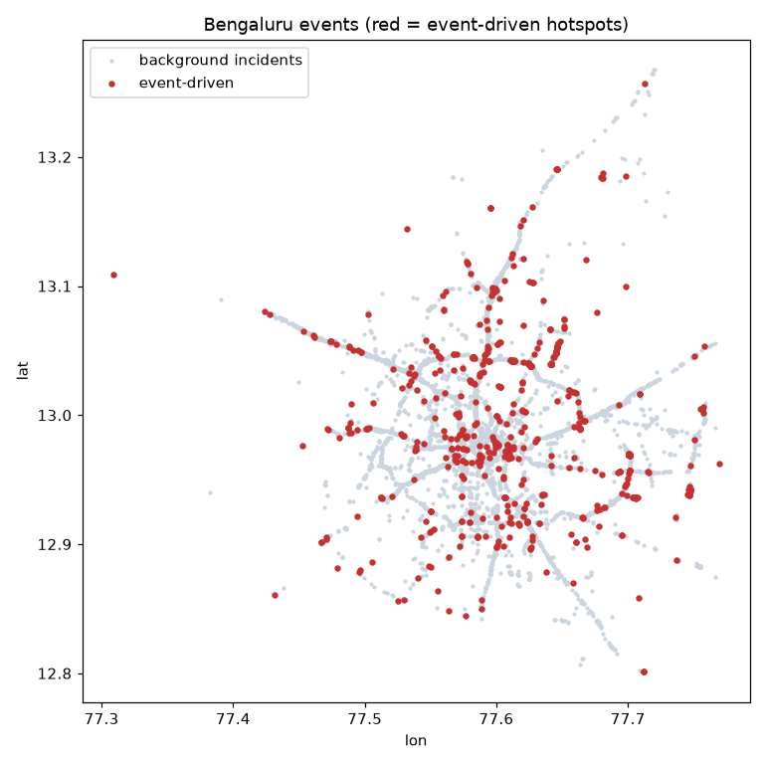
Our Solution
• A laptop-deployable decision-support engine (no GPU) with 3 parts:
– Hotspot Load Forecaster → forecast load per corridor for tomorrow
– Closure-Risk Classifier → barricade & RED/AMBER/GREEN triage
– OR Optimization Engine → SLA-guaranteed officers + coverage-optimal placement
• Uses ONLY the provided ASTRAM dataset. Interpretable, deployable today.

Slide 4
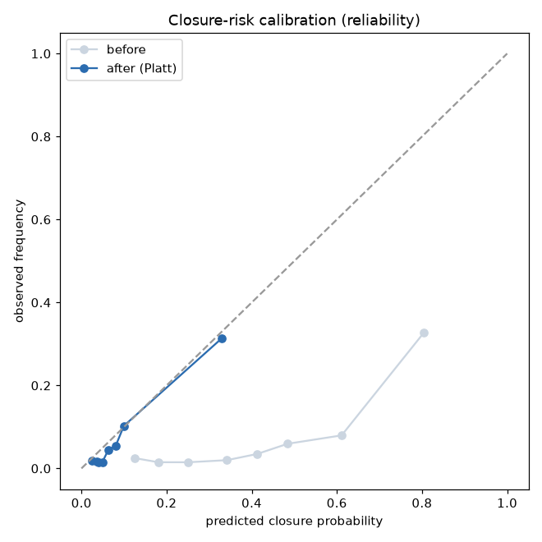
ML Results — honest, time-based split
Component | Result | Baseline
Hotspot Load Forecaster | R² 0.536 · MAE 2.19 | seasonal-naive R² −0.32
Closure-Risk Classifier | ROC-AUC 0.81 · recall 0.83 | random PR-AUC 0.072
Duration Predictor | not reliably learnable | (data limitation, see findings)
Operating point: F2-max on forward-chained OOF preds — catches 83% of closures (a missed closure costs BTP more).
Top drivers (permutation importance): event_cause ≫ corridor > location > vehicle type.
Deep ST-model: MAE 2.12 vs GBM 2.24 (~5% better, R² tied); ensemble R² 0.55. GBM kept in prod.
Calibrated (isotonic): ECE 0.33→0.03; + safety floor max(model, historical) so VIP (rare) isn't under-flagged.
Cross-validated (5-fold expanding): hotspot R² 0.56±0.14, closure AUC 0.73±0.05 — spread, not cherry-pick.

Slide 5
OR Optimization Engine — the differentiator
• We replaced heuristic rules with the forecast→optimize pattern used in deployed police systems.
• Manpower = M/M/c queueing (Erlang-C): officer count sized so expected response wait ≤ SLA (e.g. 5 min) — a number WITH a service-level guarantee.
• Barricade placement = Maximum Coverage Location Problem (MCLP): place P units to cover max risk×load-weighted demand (PuLP/CBC).
• Risk×load weighting: both high-traffic AND high-risk corridors, per OR location-allocation literature.
• Bengaluru real-world context (researched): corridor congestion (ORR East 1.86 .. Magadi 1.13), commute peaks, monsoon, festivals, metro works, heavy-vehicle bans — all scale the deployment.
• Every number is traceable — no black box. Evidence: SMU IJCAI-2019, Vlahogianni 2019, Miao/Easa 2021.

Slide 6
Data Findings That Build Trust
• Timestamps are local IST mislabeled '+00' — proven via bimodal rush-hour signature; we use stored hour as-is.
• closed_datetime is administrative ticket-close, NOT on-ground clearance → exact duration not learnable. We refuse to over-claim it.
• We caught & removed target leakage: end-coordinate flag is filled BECAUSE a closure happened (98% vs 0%) — faked ROC-AUC 1.0.
– Permutation importance exposed it; dropping it gives the honest 0.81.
• Event-driven causes (public_event, procession, VIP, protest) have 40–80% closure rates — the true Theme-2 targets.

Slide 7
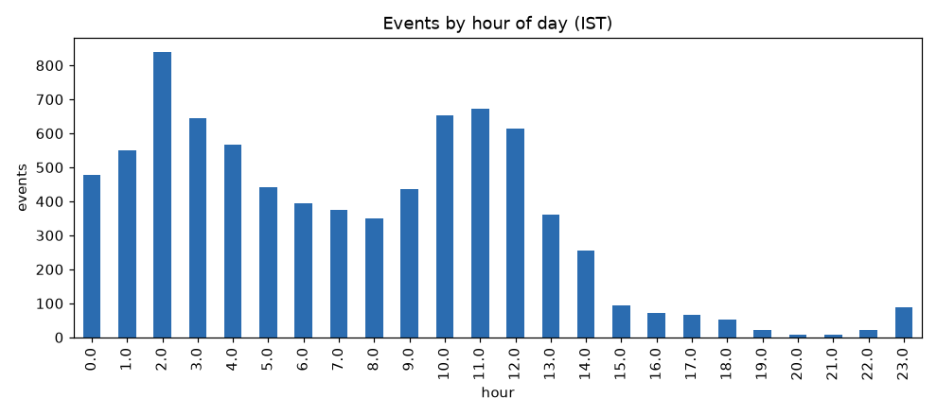
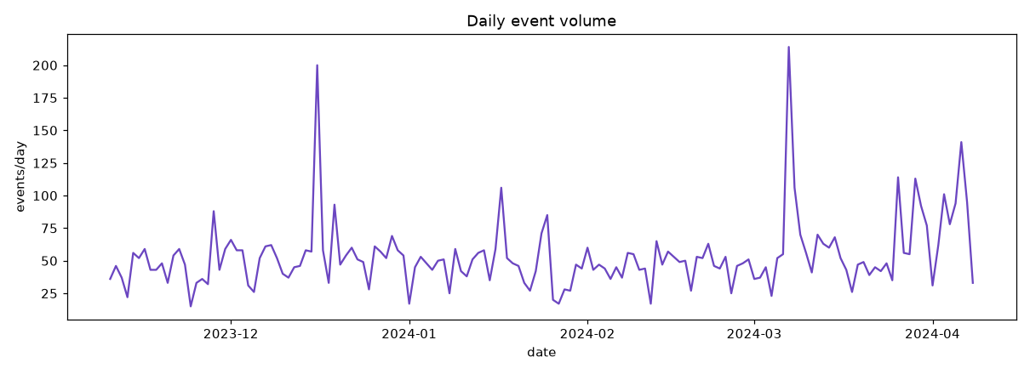
Prototype — Live Demo
• Event Simulator — type an event (e.g. IPL match @ Chinnaswamy) → instant risk %, tier, personnel, barricade & diversion.
• Hotspot Forecast + Manpower — pick a day → corridor load + recommended personnel.
• Live Event Triage — every event ranked by closure-risk with action tier + map.
• Analytics — historical patterns + feature importance.

Slide 8
Where It Fits in BTP's Stack
• BATCS optimizes the SIGNALS — adaptive timing at 165 junctions (CoSiCoSt). Not people.
• ASTRAM SEES the city — awareness, 15-min alerts, microsimulation. (Our dataset's source.)
• Neither produces a prescriptive police-deployment plan.
• PredictEvent DECIDES the deployment — turns ASTRAM's event data into an officer count with a service-level guarantee + coverage-optimal placement.
• A prescriptive module on top of the stack BTP already runs — it extends ASTRAM, doesn't compete.

Slide 9
Why It Wins · Roadmap
• Solves BTP's actual #1 pain — event manpower planning, not a tech demo.
• OR-optimized, SLA-guaranteed deployment — not heuristic rules.
• Honest, leakage-checked metrics — survives a technical jury.
• Plugs into ASTRAM; deployable today; provided-data only.
• Roadmap:
– Live ASTRAM API feed → real clearance timestamps
– Capacitated city-wide MCLP + IP shift-scheduling (ILS/tabu fast replanning)
– Mobile officer app + automatic retraining loop

