Slide 1
WSDL

Slide 2
What is WSDL?
WSDL is an XML notation for describing a web service.
A WSDL definition tells a client how to compose a web service request and describes the interface that is provided by the web service provider
A WSDL definition is divided into separate sections that specify the logical interface and the physical details of a web service. The physical details include both endpoint information, such as HTTP port number, and binding information, which specifies how the SOAP payload is represented and which transport is used.
Interface information describing all the publicly available function.
Binding information about the protocol to be used for invoking the specified web service.
Address information for locating the specified web service.

Slide 3
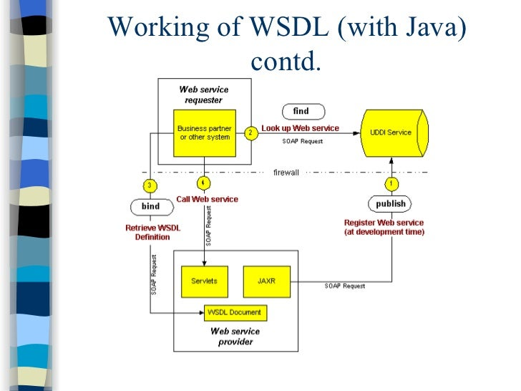

Slide 4
WSDL Document Elements
Definitions: It is the basic element of the WSDL document that contains the definition of one or more services.
Types: The Type element is used to give information about the complicated data types used within the WSDL document.
Message: It contains abstract data that is being used in communication between client and web server. It also defines the data elements for each operation.
portType: It contains the collection of abstract operation supported by one or more endpoints.
Port: It is used to define the single endpoint as an address for the binding.
Services: It is a collection of endpoint networks that specify the port address for the binding.
Binding: It specifies how operations are implemented by concrete protocols and data format features for operation and messaging.

Slide 5
<definitions>
<types>
Definition of types goes here.
</types>
<message>
Definition of a message goes here.
</message>
<portType>
<operation>
Definition of an operation goes here.
</operation>
</portType>
<binding>
Definition of a binding goes here.
</binding>
<service>
Definition of service goes here.
</service>
</definition>

Slide 6
WSDL Key structural element:-
WSDL specification
Abstract part
Concrete part
Types
Messages
Operation
Port type
Interface bindings
Services and Port

Slide 7
Explore WSDL:-
We can explore the WSDL file's service by double-clicking on the Navigator to open the editor.
The overview tab is used to display the general information of the WSDL file, such as:
WSDL Definition
WSDL URL
Namespace
Binding
Soap Version
Style
Definition Parts
Operations

Slide 8
WSDL Limitation
For information on the timeout limits when making an HTTP request or a Web services call, see Callout Limits and Limitations.
Circular references in Apex classes are not allowed.
More than one loopback connection to Salesforce domains is not allowed.
To allow an endpoint to be accessed, register it from Setup by entering Remote Site Settings in the Quick Find box, then selecting Remote Site Settings.
To prevent database connections from being held up, no transactions can be open.

