Slide 1
Project – Titanic
The data has been provided by Kaggle
URL - https://www.kaggle.com/c/titanic/data

Slide 2
Outline
1.Summary
2.Introduction
3.Methodology
4.Results
• Dashboards • Visualization Charts
5.Overall findings
6.Conclusion

Slide 3
Introduction:
In this data the information is provided of all the passengers who travelled in Titanic Cruise Ship back in 1912.
The motive of the data is to get as much information we can get of the survivors.
The data provided is small and easier to analyze.
The data includes the rows and columns with the passengers ID.
The data included 3 different ports from where the passengers were boarded, and they are :
C = Cherbourg, Q = Queenstown, S = Southampton
The survival is represented as:
0 = No, 1 = Yes
And the Pclass is Ticket Class which is represented as:
1 = 1st, 2 = 2nd, 3 = 3rd

Slide 4
Methodology
The Data Cleaning has been done in Excel.
All the duplicate and most null columns and rows has been deleted.
The Data Visualization has been done in Tableau Desktop.

Slide 5
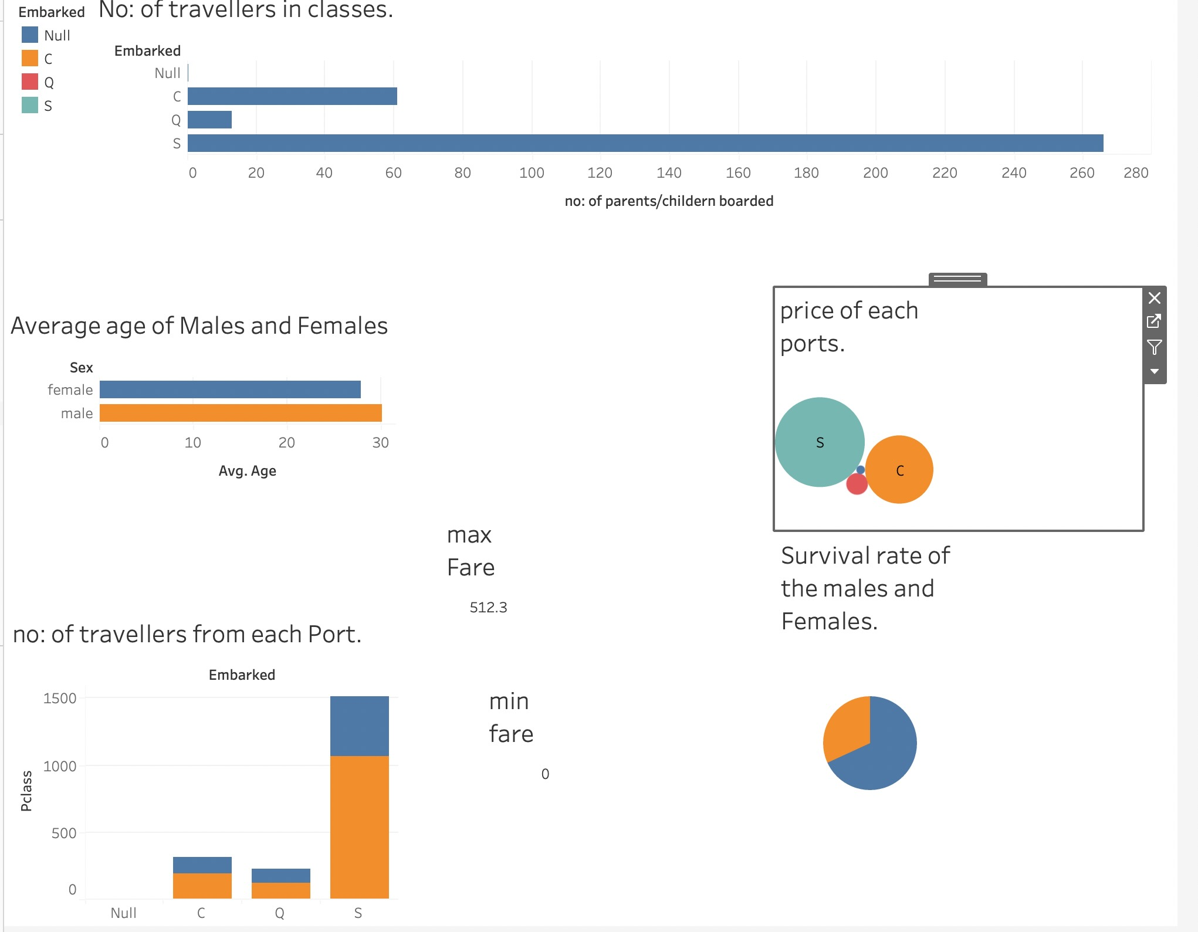
Outcomes of Visualization: This is a dashboard which show multiple visualizations.

Slide 6
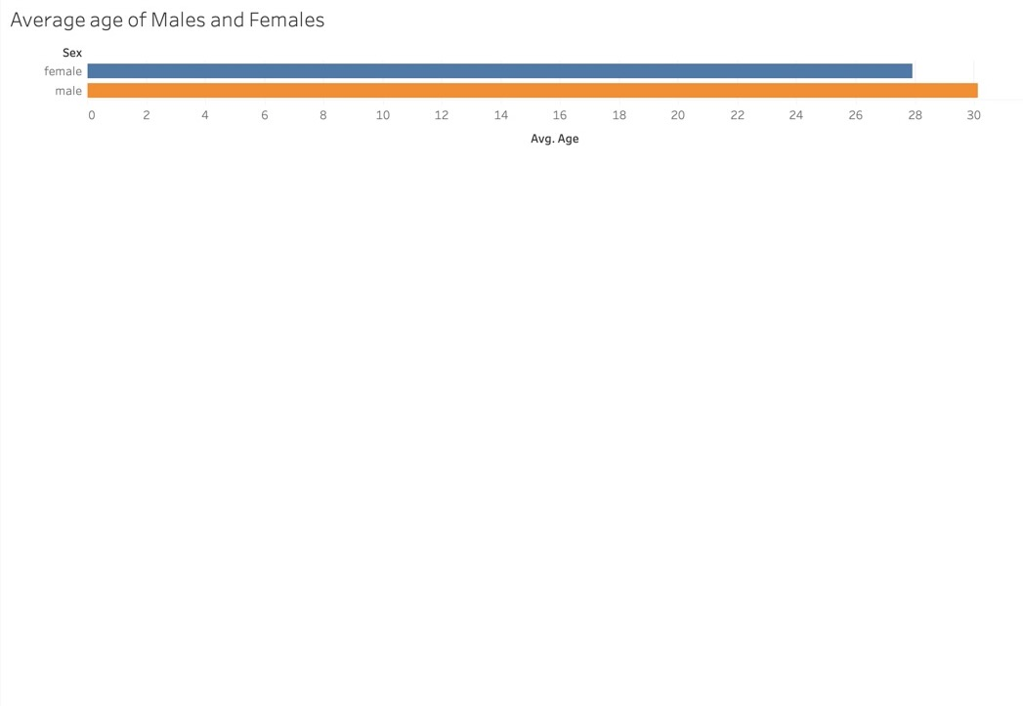
Average Number of males and females:
This Analysis clearly shows the Males travelers were more than females:

Slide 7
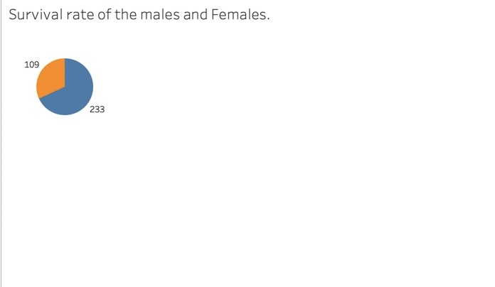
Survival Rate of Males and Females

Slide 8
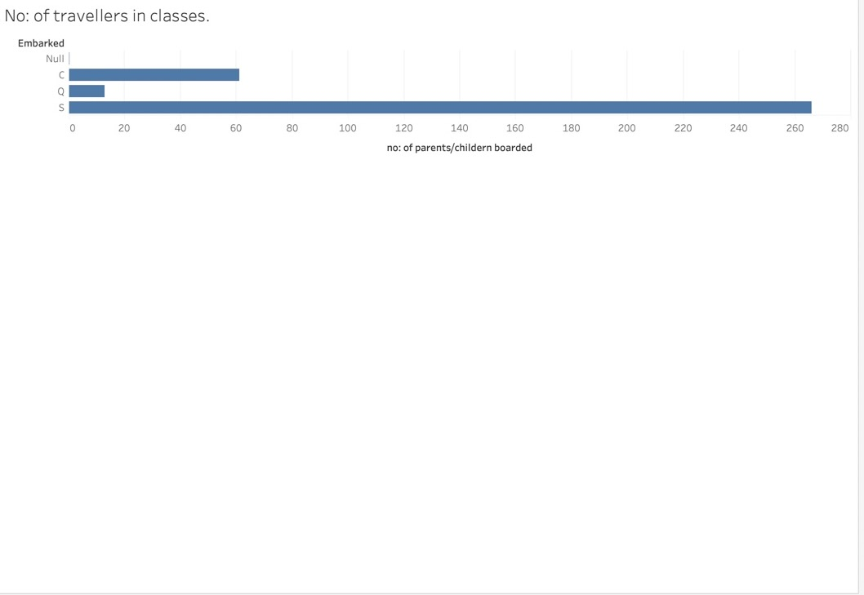
Number of travelers in each class:

Slide 9
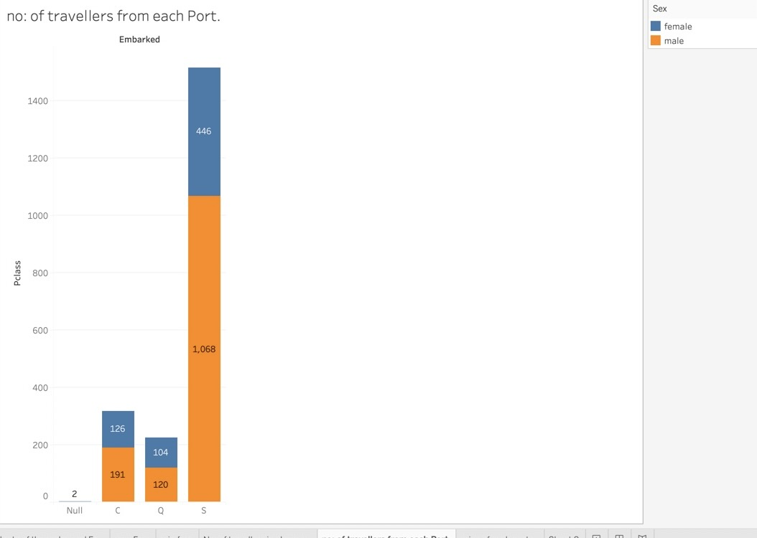
Number of Travelers from each Port

Slide 10
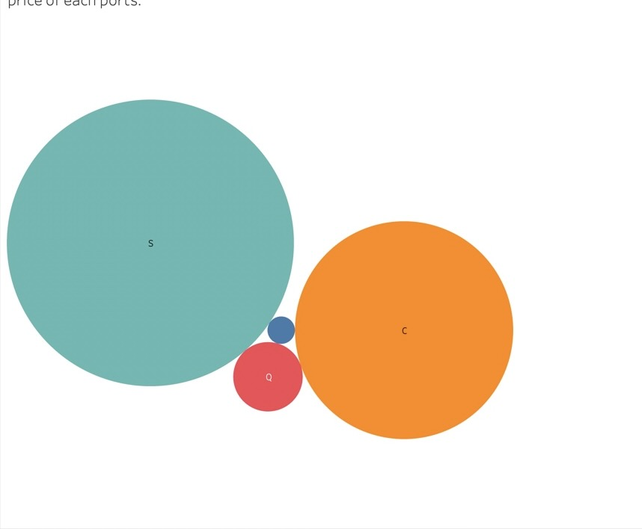
Price at each Port

Slide 11
Finding:
The males Survivor rate is higher than female Survivors
The maximum fare price is - 512.3
The Costliest port is – Southampton
The Cheapest port is – Queenstown
Most of the Travelers were travelling in Class Southampton
Also found there were two females who were travelling with No ticket Purchased which is our data is shown by Null.
We have total number of 233 Male survivor and 109 Female and total number of Travellers were – 891.

Slide 12
Conclusion:
Can do more with analysis if the data was large enough
The data tells us the information recorded in the past and no changes has been made over the years so, Its very accurate.
The Titanic cruise has made maximum profit from the largest port which is Southampton
The survival rate is one forth of the total Travelers.

