Slide 1
Busbooking System

Slide 2

Content
Introduction
Technical Introduction
DFD
ER Digram
Screenshots
Future Scope
Conclusion

Slide 3

INTRODUCTION
Busbooking system is an android app which can help user in book the bus ticket online.
It maintain all the data of the user and bus details booking details and customer details .
It provides bus transpotaion system facilities to reserve seat and cancelation of seat.

Slide 4
TECHNICAL INTRODUCTION
Busbooking system is build on android studio using java,xml and firebase
The frontend part like UI icons layouts etc are built using Xml.
For the logic of and backend part is written using java
For stroring the user data and keep the details of bus and seat booking and manage the login and register.

Slide 5
DATA FLOW DIAGRAM

Slide 6
ER DIGRAM

Slide 7
SOFTWARE REQUIREMENT
Minimum Android version 5.0
HARDWARE REQUIREMENT
GPS required
ANDROID PHONE
RAM 512MB

Slide 8
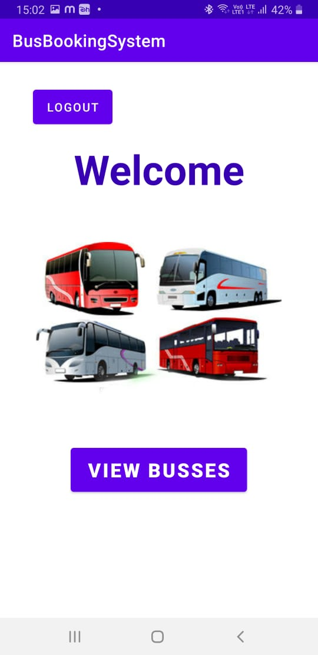
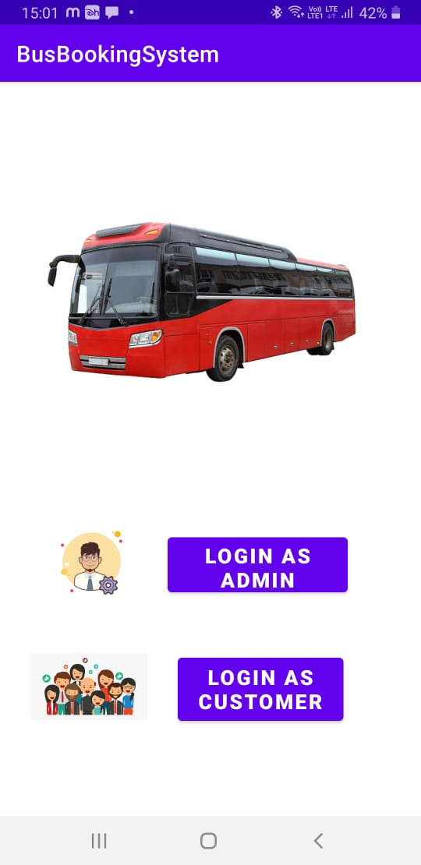
SCREENSHOTS

Slide 9
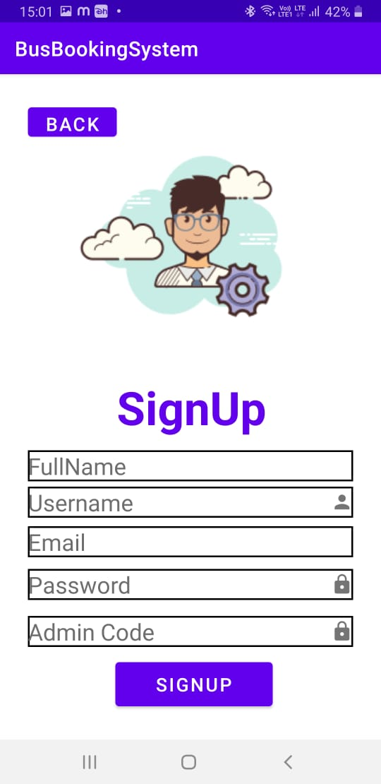
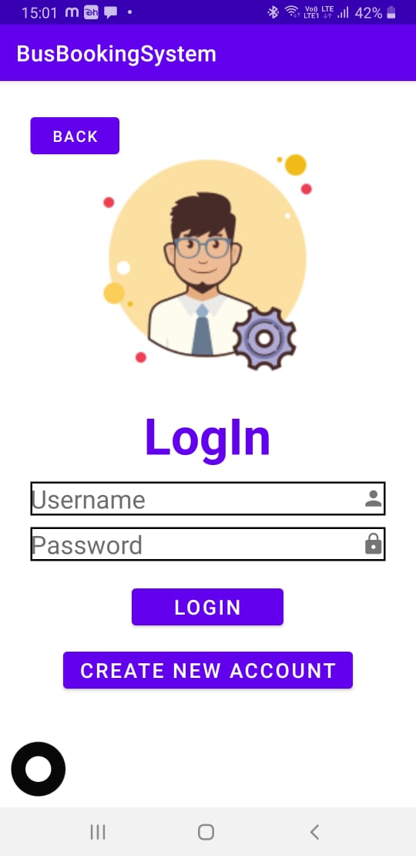

Slide 10
FUTURE SCOPE
Customer use this system to reserve a seat in a bus or view rout of the buses and also able to compare the rout time and price of the bus in their own comfert .
Customer can reserve the seat if they want.
Customer can acces the online system at any time.
Customer can lookup the rout price and class among other things .

Slide 11
Conclusion
Busbooking system is online reservesion system which provide online reservion of bus.
This system is user frindly and accurate .
This system is available for 24*7.
It has no hidden cost

