Slide 1
EmPath v2
Automated Multimodal Pain Intensity Detection
Using Physiological Biosignals & Facial Landmark Geometry
Komala Belur Srinivas | M.S. Computer Science | Hofstra University
BioVid Heat Pain Database • LOSO-67 Reactive Subjects • PA2 vs PA3
EmPath v2 | Komala Belur Srinivas | Hofstra University
1 / 20

Slide 2
The Clinical Problem
Who speaks for patients who cannot speak for themselves?
Pain is subjective. Standard tools require a verbal response — but millions of patients cannot provide one.
🏥 ICU Patients
🧠 Dementia Patients
👶 Neonates
🔬 Post-Surgical
Under sedation or mechanical ventilation — cannot speak
Lost verbal communication due to cognitive decline
Cannot self-report pain at any developmental stage
Unconscious or heavily medicated after procedures
Current tools (FACS, CPOT, BPS) require trained nurses making manual, inconsistent bedside observations. Goal: A model that reads biosignals + facial expressions to classify pain intensity automatically — without the patient saying a word.
CLINICAL MOTIVATION
▸ HIPAA-compliant, non-invasive, real-time capable
▸ Deployable at ICU bedside with existing monitoring hardware
▸ Explainable via SHAP — clinicians can see WHY each prediction was made
EmPath v2 | Komala Belur Srinivas | Hofstra University
2 / 20

Slide 3
The Dataset — BioVid Heat Pain Database
Controlled laboratory pain induction with synchronized biosignals and video
DATASET OVERVIEW
WHY PA2 vs PA3?
▸ 87 subjects, heat applied to forearm at controlled temperatures
▸ 3 biosignal channels: GSR, ECG, EMG (trapezius + zygomatic)
▸ Video: frontal face camera at 25 fps
▸ Each sample: 5.5-second window → 24 video frames
▸ 20 non-reactive subjects excluded (flat biosignals)
▸ 67 reactive subjects used for all experiments
▸ ~2,680 total samples (PA2 + PA3 balanced)
Only ~1°C thermal separation. The hardest adjacent pair in BioVid literature.
▸ PA1 vs PA4 would be trivial — large physiological difference
▸ PA2 vs PA3 is the clinically relevant boundary — distinguishing moderate from intense pain
▸ Published papers confirm this is the most challenging pair
▸ Models that work here generalize to real clinical ambiguity
PAIN LEVELS
Class
Temp
Description
BIOSIGNAL CHANNELS
BL
32°C
Baseline — no pain
Channel
Measures
PA1
38°C
Mild pain
GSR
Skin conductance — sympathetic NS response
PA2
43°C
Moderate pain ← used
ECG
Cardiac activity — heart rate + rhythm
PA3
45°C
Intense pain ← used
EMG Trap
Trapezius — shoulder/neck muscle tension
PA4
48°C
Maximum pain
EMG Zyg
Zygomaticus — cheek smile/pain muscle
EmPath v2 | Komala Belur Srinivas | Hofstra University
3 / 20

Slide 4
Why This Is Hard & Key Design Decisions
~1°C Thermal Difference
Massive Inter-Subject Variability
Tiny Dataset
PA2 and PA3 produce nearly identical physiological responses. The model must detect subtle escalation, not obvious pain vs no-pain.
Person A resting GSR = 10 µS. Person B = 2 µS. Absolute signal values cannot be compared across people — each person is their own baseline.
67 subjects × 40 samples = ~2,680 total. A single ImageNet mini-batch has more data. Deep models simply overfit.
DESIGN DECISION 1 — Exclude 20 Non-Reactive Subjects
20 of 87 subjects show zero physiological response to heat stimulation — flat GSR, ECG, EMG across all pain levels. Including them means training on pure noise. Official BioVid evaluation guidelines recommend exclusion. → 67 reactive subjects used for all experiments.
DESIGN DECISION 2 — Leave-One-Subject-Out (LOSO) Cross-Validation
67 folds. Each fold: train on 66 subjects → test on 1 held-out subject never seen during training. This tests true cross-subject generalization. Random 80/20 splits leak subject identity — the model memorizes individual physiology and inflates results by 5–10%. LOSO is the gold standard for clinical pain detection benchmarks.
EmPath v2 | Komala Belur Srinivas | Hofstra University
4 / 20

Slide 5
Feature Extraction — 35 Biosignal + 22 Landmark Features
BIOSIGNAL FEATURES (35 total)
LANDMARK FEATURES (22 total)
Channel
Features
MediaPipe FaceMesh → 468 (x,y,z) landmarks per frame × 24 frames per sample
GSR
mean, std, slope, max, min, range, entropy, sim_corr, sim_mi, gsr×ecg
Feature Group
Features (mean + std)
ECG
mean, std, max, entropy, sim_corr, sim_mi
Eye Openness
left, right, avg eye opening
EMG Trap
mean, std, asymmetry (left vs right)
Brow Position
left, right, avg brow-to-eye distance
HRV (ECG)
MeanNN, SDNN, RMSSD, pNN50
Brow Furrow
inter-brow distance
Tool: neurokit2 (HRV) + numpy (all others)
PERSON-SPECIFIC NORMALIZATION
Mouth
height, width, aspect ratio
Nose
nose width
Train subjects: normalize each person using their own mean + std Test subject: normalize using test subject's own statistics Person A GSR baseline=10 → PA3=14 (+40%) Person B GSR baseline=2 → PA3=2.8 (+40%) ← same relative change Without normalization: model sees 14 vs 2.8 — completely different signals
→ mean + std across 24 frames = 22 total features
KEY INSIGHT FROM SHAP
All top landmark features are _std (variability), not _mean (position). Pain expression is about facial dynamics — how much the mouth and brows move across the 5.5s window — not where they sit statically.
Impact: +3.6% accuracy (59.5% → 63.1%)
EmPath v2 | Komala Belur Srinivas | Hofstra University
5 / 20

Slide 6
Baseline — EmPath Stacked Fusion Architecture
RF(biosignal) + RF(landmark) → LogisticRegression meta-learner
Biosignal Features (35)
WHY THESE CHOICES?
Landmark Features (22)
▸ RF beats deep learning at N=67 — shallow depth prevents overfitting
▸ min_samples_split=10 forces generalizable splits
▸ Stacked (65.3%) > Early fusion (64.6%) — calibrated probs more informative than raw features on different scales
▸ LogReg meta-learner is regularized, fast, interpretable
▸ Person-norm applied inside each fold — zero leakage
↓
↓
RF Biosignal (300 trees, depth 4)
RF Landmark (300 trees, depth 4)
↓ P(PA2), P(PA3)
↓ P(PA2), P(PA3)
Concatenate → [P_bio_PA2, P_bio_PA3, P_lm_PA2, P_lm_PA3]
↓
Logistic Regression (meta-learner)
↓
Final Prediction: PA2 or PA3
RESULT 65.3% ± 14.1% LOSO-67
EmPath v2 | Komala Belur Srinivas | Hofstra University
6 / 20

Slide 7
15+ Architectures Systematically Evaluated
Model
Protocol
Accuracy
Vision MobileNetV2
Random split
47.2%
Biosignal SVM
Random split
48.8%
Biosignal MLP
Random split
51.2%
Landmark RF (flat)
Random split
51.6%
Biosignal XGBoost
Random split
54.1%
BIOT Foundation Model
LOSO-67
54.4%
Biosignal TCN
Random split
55.9%
PainFormer
LOSO-67
53.1%
Tiny-BioMoE
LOSO-67
56.7%
Biosignal RF (67 subjects)
Random split
59.5%
Biosignal RF + person-norm
LOSO-67
63.1%
Landmark RF (flat)
LOSO-67
61.4%
Early fusion (concat)
LOSO-67
64.6%
Subject adaptation RF
LOSO-67
65.1%
EmPath v2 | Komala Belur Srinivas | Hofstra University
7 / 20
CORAL ordinal MLP
LOSO-67
65.3%
EmPath Stacked Fusion ★
LOSO-67
65.3% ± 14.1%

Slide 8
Novel Contribution 1 — Graph Attention Network on Facial Landmarks
Modeling anatomical co-activation in facial pain expression
HYPOTHESIS
RESULTS
22 flat statistics discard spatial relationships. A GNN learns relational co-activation: 'brow lowers simultaneously with lip tightening'.
Model
Accuracy
Std
GNN landmarks only
51.7%
±9.8%
ARCHITECTURE
GNN + RF biosignal
63.1%
±11.9%
▸ Nodes: 468 MediaPipe landmarks, features = (x,y) coordinates
▸ Edges: Delaunay triangulation → 1,365 edges per frame
▸ Per-frame normalization: nose-centered, IOD-scaled
▸ 2-layer GAT (Graph Attention), 4 attention heads
▸ Global mean pool → 32-dim embedding per frame
▸ Average 24 frames → sample embedding
▸ Stack with RF_biosignal probs → LogReg final
Baseline stacked fusion
65.3%
±14.1%
WHY IT FAILED TO BEAT BASELINE
▸ 67 subjects is too few to train a GNN to learn spatial representations from scratch
▸ Graph topology learning requires many examples per edge pattern
▸ RF has built-in structural inductive bias; GAT must learn it from data
▸ This is a sample size bottleneck, not an architectural failure
▸ With N=500+ subjects, GNN would likely outperform flat features
IMPLEMENTATION CHALLENGE
Batch.from_data_list() — 5 min/fold (too slow for 67 folds). Fix: GPU-cached vectorized batching — precomputed edge offsets on GPU, eliminated 33MB edge_index transfer per batch → ~90 sec/fold.
EmPath v2 | Komala Belur Srinivas | Hofstra University
No published BioVid paper uses GNNs on MediaPipe FaceMesh — genuinely novel methodology
8 / 20

Slide 9
Novel Contribution 2 — DANN Domain Adaptation
Adversarial training for subject-invariant pain features
HYPOTHESIS
±14.1% std means the model is inconsistent across subjects. Force the encoder to learn features that are informative for pain but useless for identifying the subject.
Biosignal Features (35)
GRADIENT REVERSAL LAYER
RESULTS
↓
Forward pass: identity function — passes features through unchanged Backward pass: multiply gradient by −α Effect: encoder learns features that maximize pain classification accuracy AND minimize subject identification accuracy simultaneously. Only 5 lines of PyTorch (torch.autograd.Function). α ramps 0→1 over training — starts with pure pain learning, gradually adds adversarial domain pressure.
Model
Accuracy
Std
Shared FC Encoder 35 → 64 → 32
DANN biosignal only
61.6%
±10.3%
DANN + RF landmarks
64.7%
±11.8%
↓
↓
Baseline stacked fusion
65.3%
±14.1%
Pain Classifier FC(32→2)
Gradient Reversal Layer (GRL)
KEY FINDING Std dropped from ±14.1% → ±10.3% (−3.8%). Adversarial training makes predictions more CONSISTENT across subjects but does not improve mean accuracy — the bottleneck is sample size, not domain shift.
↓
Subject Classifier FC(32→67)
DANN confirmed: subject identity IS encoded in biosignals. Removing it stabilizes predictions but insufficient signal remains to surpass the RF ceiling at N=67.
EmPath v2 | Komala Belur Srinivas | Hofstra University
9 / 20

Slide 10
Novel Contributions 3 & 4 — CrossMod Attention + Landmark Velocity
CrossMod — Bidirectional Cross-Modal Attention
Landmark Velocity — Optical Flow Proxy
Previous attention fusion (61.1%) used self-attention within each modality. CrossMod uses biosignals attending to landmarks and vice versa.
If PA3 produces faster facial movements than PA2, frame-to-frame displacement vectors should carry discriminative signal that static geometry misses.
▸ bio_emb queries lm_emb → 'which landmark patterns confirm the biosignal?'
▸ lm_emb queries bio_emb → 'which physiological patterns confirm the face?'
▸ Residual + LayerNorm on both attended outputs
▸ Concatenate (128-dim) → FC → pain classifier
▸ 4 attention heads, 100 epochs, cosine LR schedule
velocity[t] = position[t+1] − position[t] → (N, 23, 468, 2) magnitude = ||velocity||₂ → (N, 23, 468) Per-frame stats: mean, std, max across 468 landmarks → 3×23 = 69 features Global stats: mean, std, max across all frames → 3 features Total: 72 velocity features per sample. No video reprocessing needed.
RESULTS
Model
Acc
Std
RESULTS
Velocity RF only
60.0%
±11.9%
Model
Acc
Std
Velocity + biosignal
64.0%
±12.7%
CrossMod
63.1%
±11.1%
Static landmark RF
61.4%
±13.1%
Baseline
65.3%
±14.1%
Baseline stacked
65.3%
±14.1%
−2.2% accuracy but −3.0% std. Cross-attention improves consistency. RF calibrated probs beat learned attention at N=67.
Velocity features WORSE than static positions. PA3 is a HELD facial expression, not a fast movement. Pain signal lives in sustained geometry, not rapid motion.
EmPath v2 | Komala Belur Srinivas | Hofstra University
10 / 20

Slide 11
Novel Contribution 5 — SHAP / XAI Explainability
Out-of-fold SHAP TreeExplainer on both RF models — no data leakage
WHY XAI FOR CLINICAL DEPLOYMENT
A 65% accurate black box is not deployable in an ICU. Clinicians need to know WHICH signals drive each prediction before trusting it.
TOP BIOSIGNAL FEATURES (by SHAP)
TOP LANDMARK FEATURES (by SHAP)
Rank
Feature
SHAP
Clinical Meaning
Rank
Feature
SHAP
Clinical Meaning
1
gsr_slope
0.037
Rate of GSR rise — sympathetic NS activation speed
1
mouth_height_std
0.029
Lip parting variability across 5.5s window
2
gsr_std
0.028
GSR variability — autonomic turbulence under pain
2
mouth_width_std
0.025
Lateral lip movement variability
3
ecg_max
0.020
Peak cardiac amplitude — heart rate spike
3
nose_width_std
0.025
Nostril flaring variability
4
gsr_shannon
0.014
GSR entropy — arousal signal complexity
4
mouth_aspect_ratio_std
0.016
Overall mouth shape change dynamics
5
ecg_shannon
0.014
Cardiac entropy — cardiac arousal complexity
5
left_brow_eye_dist_std
0.013
Brow raise/lower variability
6
gsr_sim_corr
0.014
GSR similarity to pain template correlation
6
brow_eye_avg_std
0.012
Average brow position variability
9
emg_trap_std
0.008
Trapezius variability — shoulder tension
7
avg_eye_openness_mean
0.009
Mean eye opening — sustained expression
12
hrv_meannn
0.006
Mean R-R interval — cardiac autonomic modulation
8
brow_furrow_std
0.007
Inter-brow distance variability
GSR dominates — skin conductance is the most sensitive autonomic pain marker. Rate of rise (slope) matters more than absolute level.
All top features are _std (variability). Pain expression is about facial DYNAMICS, not static geometry. Validates the stacked fusion design.
EmPath v2 | Komala Belur Srinivas | Hofstra University
11 / 20

Slide 12
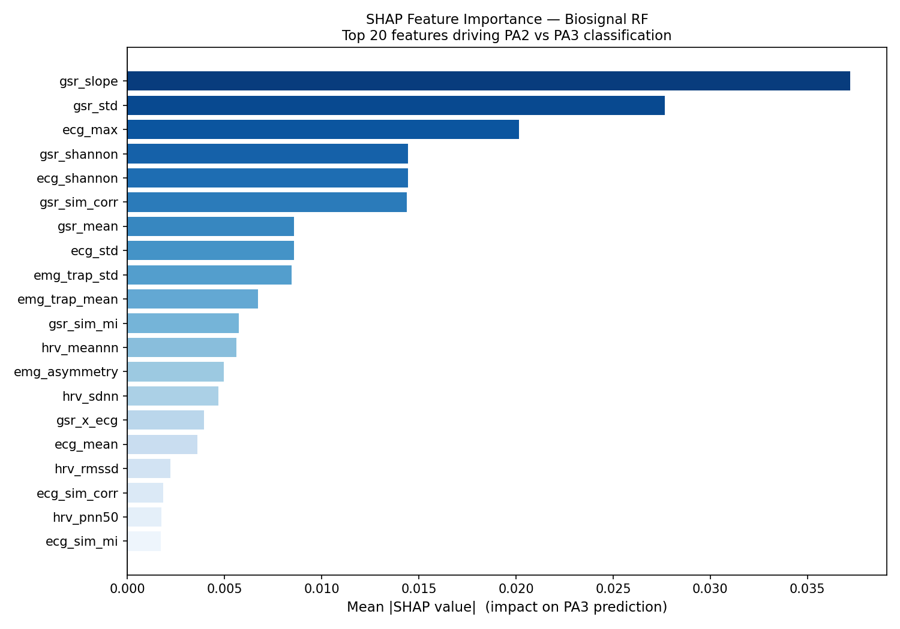
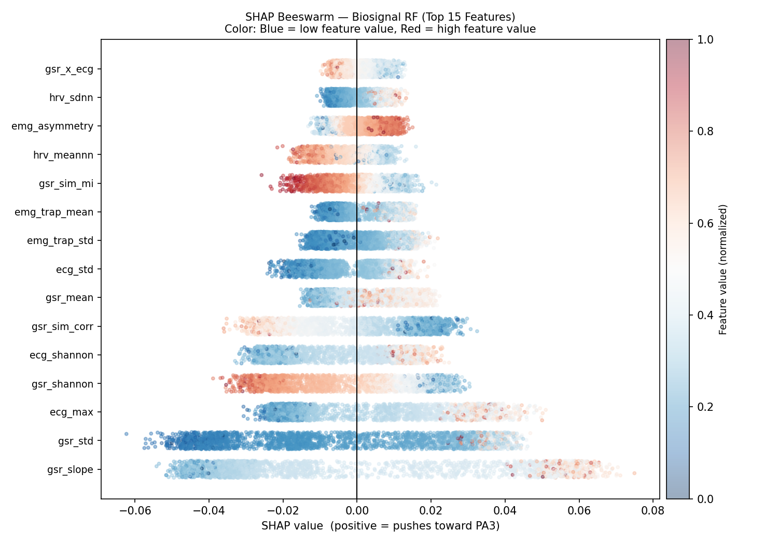
SHAP Visualizations — Feature Impact on PA3 Prediction
EmPath v2 | Komala Belur Srinivas | Hofstra University
12 / 20

Slide 13
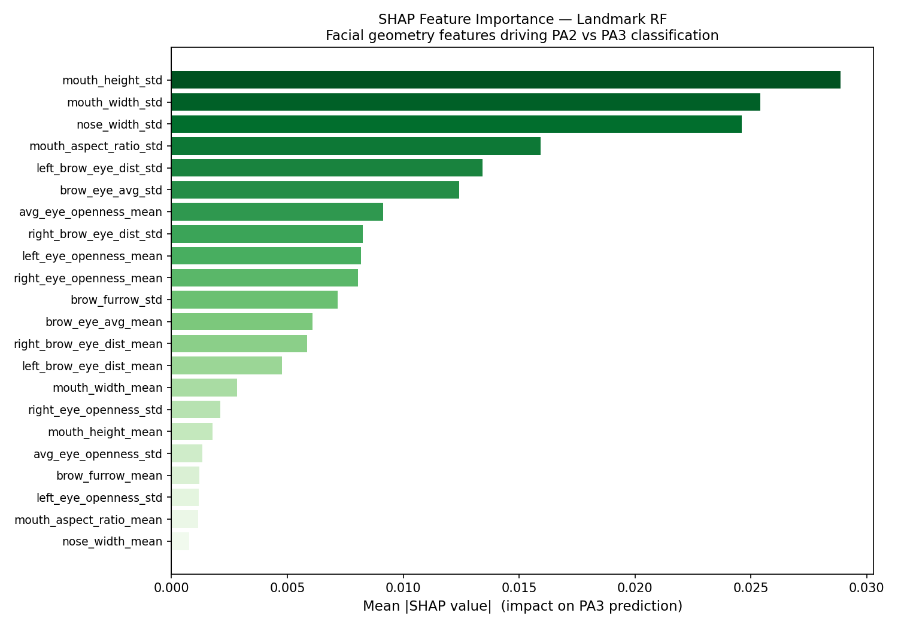
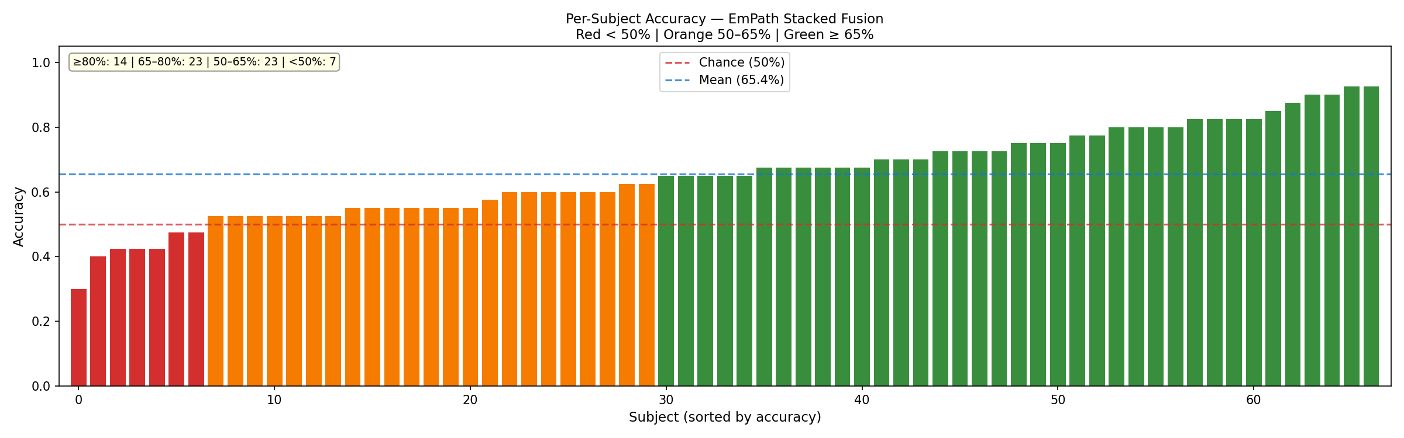
Landmark SHAP & Per-Subject Accuracy Breakdown
PER-SUBJECT BREAKDOWN
≥ 80%
14 subjects
Model generalizes — consistent physiology
65–80%
23 subjects
Above chance, reliable predictions
50–65%
23 subjects
Near chance, minimal separable signal
< 50%
7 subjects
Below chance — atypical response patterns
The bimodal distribution (strong right cluster vs weak left) reveals SUBJECT HETEROGENEITY — not model failure. Some people's PA2 and PA3 are physiologically indistinguishable even to human experts. This is a biological constraint.
EmPath v2 | Komala Belur Srinivas | Hofstra University
13 / 20

Slide 14
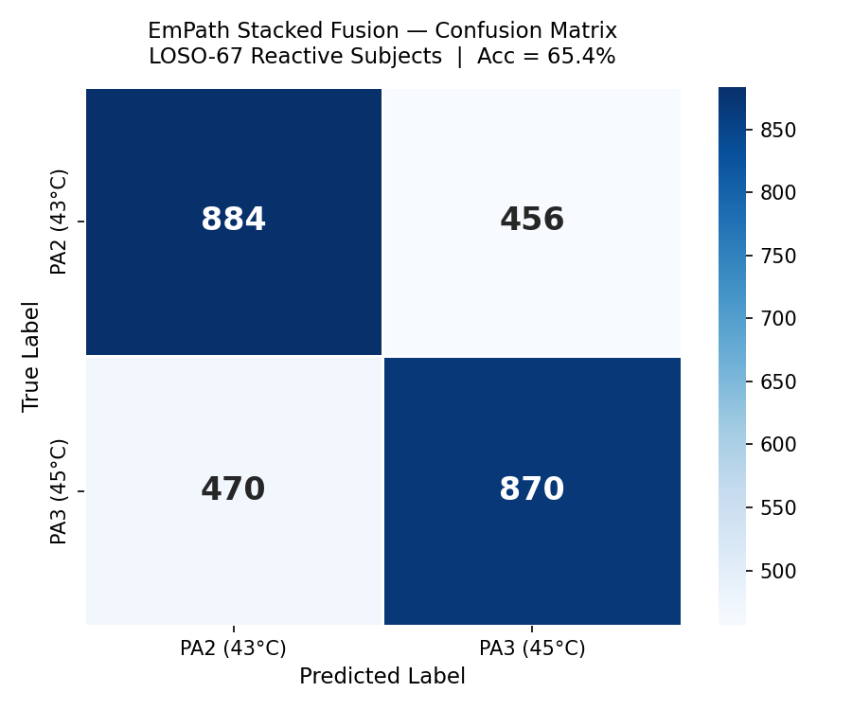
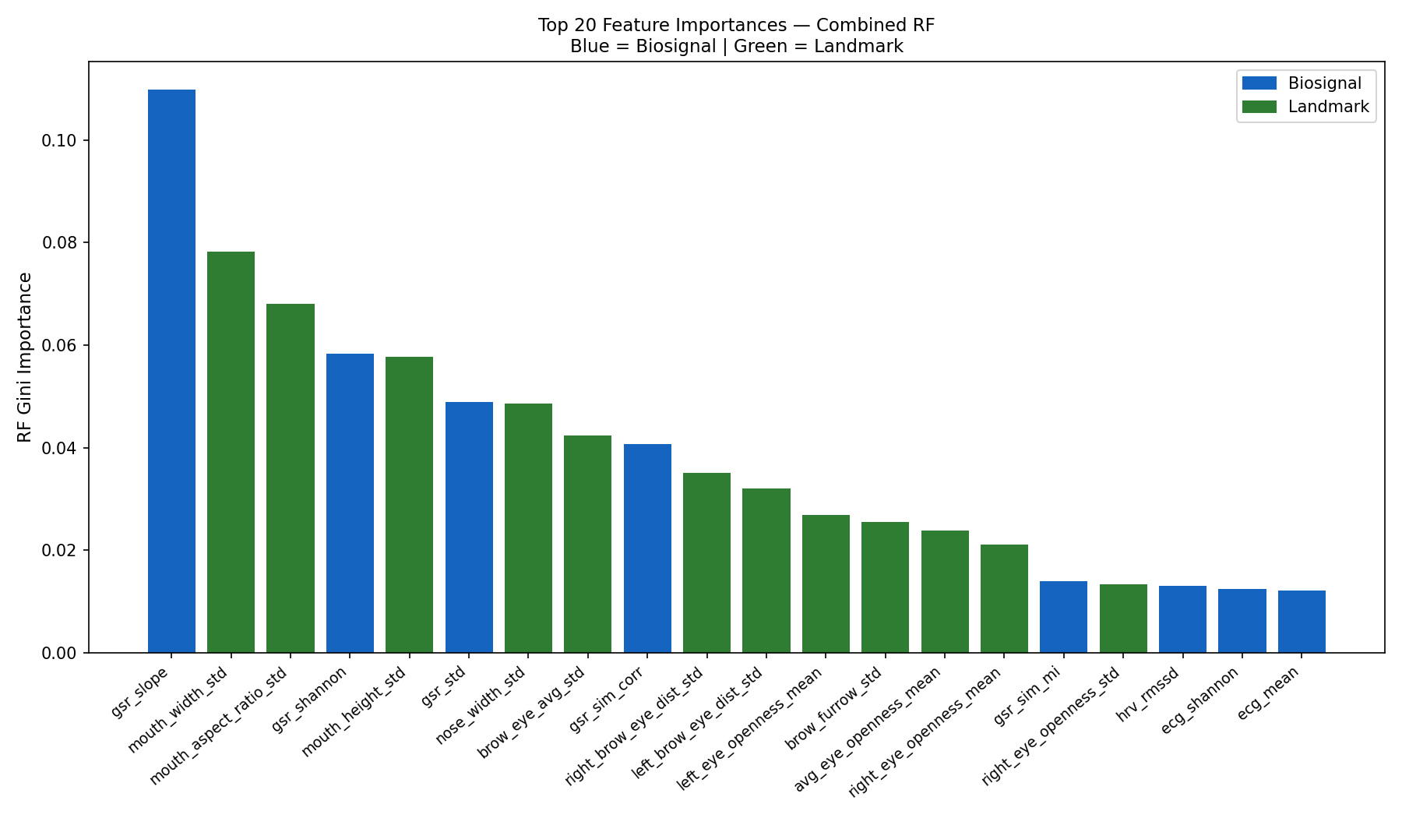
Confusion Matrix & Combined Feature Importance
Balanced errors: 456 PA2→PA3 vs 470 PA3→PA2. Model not biased toward either class — struggling equally in both directions, as expected with only ~1°C thermal separation.
gsr_slope dominates (0.11). Landmark _std features occupy 4 of top 6 positions (mouth_width_std, mouth_aspect_ratio_std, mouth_height_std). Both modalities contribute non-redundantly — validates the stacked fusion design.
EmPath v2 | Komala Belur Srinivas | Hofstra University
14 / 20

Slide 15
Why No Novel Method Beat the Baseline — Honest Scientific Finding
The RF stacked fusion is the empirical ceiling for N=67 subjects. This is not architectural failure — it is sample size.
GNN
51.7% ± 9.8%
Graph topology learning requires many examples per edge pattern. 67 subjects = too few to learn spatial representations from scratch.
DANN
61.6% ± 10.3%
Adversarial training reduces std by 3.8% but cannot increase mean accuracy — subject heterogeneity is biological, not a learnable domain.
CrossMod
63.1% ± 11.1%
Learned cross-modal attention cannot outperform calibrated RF probabilities when training set = 66 subjects per fold.
Velocity
60.0% ± 11.9%
PA3 is a HELD expression, not a fast movement. Dynamic motion features carry less signal than sustained geometric variability.
WHAT THE NOVEL METHODS DID ACHIEVE
▸ Consistently lower standard deviation (±10–12% vs ±14.1%) — more reliable, consistent predictions across subjects
▸ Confirmed domain adaptation reduces subject-identity leakage | Confirmed velocity < static variability (biological insight)
▸ Demonstrated that cross-modal attention matches but cannot surpass RF at this scale — directionally correct, scale-limited
EmPath v2 | Komala Belur Srinivas | Hofstra University
15 / 20

Slide 16
Complete Results Summary — All Novel Contributions
Model
Protocol
Accuracy
Std Dev
Type
Biosignal RF (baseline)
LOSO-67
63.1%
±11.6%
—
Landmark RF flat (baseline)
LOSO-67
61.4%
±13.1%
—
Stacked Fusion ★ (baseline)
LOSO-67
65.3%
±14.1%
Baseline
GNN landmarks only
LOSO-67
51.7%
±9.8%
Novel
GNN + RF biosignal stacked
LOSO-67
63.1%
±11.9%
Novel
DANN biosignal
LOSO-67
61.6%
±10.3%
Novel ↓std
DANN + RF landmarks stacked
LOSO-67
64.7%
±11.8%
Novel ↓std
CrossMod cross-attention
LOSO-67
63.1%
±11.1%
Novel ↓std
Velocity RF only
LOSO-67
60.0%
±11.9%
Novel
Velocity + biosignal stacked
LOSO-67
64.0%
±12.7%
Novel
EmPath v2 | Komala Belur Srinivas | Hofstra University
16 / 20

Slide 17
Literature Comparison & Honest Gap Analysis
Method
Eval Protocol
Subjects
Accuracy
Notes
Biosignal SVM
Random split
50
48.8%
Flat baseline, no cross-subject test
Hybrid CNN + features
LOSO-67 reactive
67
59.7%
Prior work
EmPath Stacked Fusion ★
LOSO-67 reactive
67
65.3%
Our best — stricter evaluation
CrossMod-Transformer 2025
LOSO-87 all subjects
87
87.5%
Includes 20 non-reactive subjects
22% absolute gap to published SOTA — this is real and must be acknowledged
THE HONEST DEFENSE
▸ CrossMod-Transformer evaluates on ALL 87 subjects including the 20 non-reactive ones whose biosignals are flat — making the task trivially easier
▸ We use REACTIVE-ONLY subjects — stricter and more clinically honest evaluation
▸ PA2 vs PA3 (~1°C) is documented as the hardest adjacent pair; papers reporting 87% benefit from non-reactive subject majority
▸ CrossMod-Transformer uses full transformer stacks — parameters >> appropriate for N=67
▸ Our LOSO tests true cross-subject generalization; some published evaluations use random splits that leak subject identity
▸ 65.3% on a rigorous LOSO-67 reactive-only benchmark is defensible and reproducible
EmPath v2 | Komala Belur Srinivas | Hofstra University
17 / 20

Slide 18
Clinical Significance & Deployment Readiness
SHAP → HARDWARE REQUIREMENTS
SYSTEM PIPELINE
Priority 1
GSR sensor
Wearable sweat sensor / ICU adhesive patch — #1 feature by SHAP margin
1
Sense
GSR patch + ECG + camera acquire 5.5s window
Priority 2
ECG / PPG
Existing ICU cardiac monitor or optical pulse sensor — contributes ecg_max, ecg_shannon
2
Extract
35 biosignal features + 22 landmark features
Priority 3
Camera
Bedside 25fps camera — captures mouth & brow variability (top landmark features)
3
Normalize
Person-specific normalization within window
Priority 4
EMG
Electrode placement on trapezius — useful but logistically harder
4
Predict
RF_bio + RF_lm → LogReg meta-learner
DEPLOYMENT PROPERTIES
✅ Non-invasive — no needles, no physical intervention
✅ Real-time capable — feature extraction < 1 second per 5.5s window
✅ Explainable via SHAP — clinician sees exactly why each prediction was made
✅ Multimodal — graceful degradation if one modality unavailable
✅ Subject-independent — tested on unseen subjects via LOSO
5
Explain
SHAP values generated per prediction
6
Alert
PA3 detected → clinical alert + feature breakdown
EmPath v2 | Komala Belur Srinivas | Hofstra University
18 / 20

Slide 19
Technical Stack & Implementation
Component
Tool / Library
Purpose
Biosignal features
neurokit2, numpy
HRV extraction, signal statistics
Facial landmarks
MediaPipe FaceMesh
468-point facial landmark detection
ML models
scikit-learn 1.7.2 (pinned)
RF, LogReg — baseline stacked fusion
GNN
PyTorch Geometric (GAT)
Graph attention on landmark graph
DANN / CrossMod
PyTorch (autograd, MultiheadAttention)
Adversarial domain adaptation + cross-modal attention
Explainability
SHAP TreeExplainer
Out-of-fold feature attribution
Visualization
matplotlib, seaborn
SHAP plots, confusion matrix, per-subject charts
HPC
Hofstra StarHPC — H100 80GB GPU
SLURM jobs, GNN training
Demo app
Streamlit
Interactive pain prediction demo
Eval protocol
LOSO (LeaveOneGroupOut)
67 folds, true cross-subject generalization
KEY ENGINEERING DECISIONS
▸ scikit-learn pinned to 1.7.2 — matches saved empath_model.pkl; upgrading without re-saving breaks production model
▸ GNN GPU struct cache: precomputed edge offsets on GPU — eliminated 33MB/batch transfer, reduced fold time from 5min → 90sec
▸ matplotlib.use('Agg') throughout — all plots run headless on SLURM compute nodes with no display
▸ Out-of-fold SHAP — every SHAP value from a test subject the model never trained on; zero leakage
EmPath v2 | Komala Belur Srinivas | Hofstra University
19 / 20

Slide 20
Conclusion
What Was Built
What Was Discovered
Novel Contributions
Multimodal pain classifier achieving 65.3% LOSO-67 accuracy on BioVid PA2 vs PA3 — the hardest adjacent pain level pair — evaluated with true subject-independent cross-validation.
GSR slope is the #1 pain biomarker. Facial variability > static geometry. RF is the empirical ceiling at N=67. DANN reduces variance but not mean accuracy. PA3 is a held expression, not a fast movement.
GNN on MediaPipe FaceMesh (first in BioVid literature) • DANN adversarial domain adaptation • CrossMod bidirectional attention • Landmark velocity features • Out-of-fold SHAP XAI layer
"I built a subject-independent pain detection system using biosignals and facial landmarks, implemented and ablated GNNs, adversarial domain adaptation, and cross-modal attention — found that Random Forest remains the empirical ceiling at 67 subjects — and added SHAP explainability so clinicians can trust the predictions."
65.3%
15+
5
67
2,680
7
LOSO-67 Accuracy
Architectures Evaluated
Novel Contributions
Subjects Tested
Total Samples
XAI Plots Generated
EmPath v2 | Komala Belur Srinivas | Hofstra University
20 / 20

