Slide 1


PLEDGE TO PROGRESS Sustainability Hackathon
Sponsored By
Your Team Name : Innovative_Idea
Date : 20 April 2023

Slide 2
Problem Statement?
Water wastage:
Mostly developing and least developing countries are facing acute water problem despite having sufficient water reserves most of the time. The main reason is wastage of water. There is no dashboard for users to see how much water is utilized and recommendations to user based on daily usage.

Slide 3
User Segment & Pain Points
Mostly residential apartment have such issues in summer and they are dependent on external supply of water which is very costly. Residential families in metro cities are the primary segment.

Slide 4
Pre-Requisite
We will need water flow sensor using NodeMCU ESP8266.

Slide 5
Tools or resources
Azure Tools: 1. IoT Hub for registering device and receiving messages 2. Power BI for reporting. 3. AAD for users creation and Authentication & Authroization 4. App Insights 5. Azure Cache 6. Azure Cosmos DB for high volume. 7. Synapse for analytics.

Slide 6
Any Supporting Functional Documents
Present your solution, talk about methodology, architecture & scalability
Methodology::
Azure IoT Central device bridge to connect Devices.
IoT central for receiving messages.
Event Hub for storing millions of messages.
Synapse for analysis the data
Cosmos DB for storing data.
Power BI for showing reports.
AAD for authentication and Authroization

Slide 7
Key Differentiators & Adoption Plan
Solutio will helpful for individual user and wole unit to verify its consumption data. Solution will provide the recommendation to particular household to avoid wastage.

Slide 8
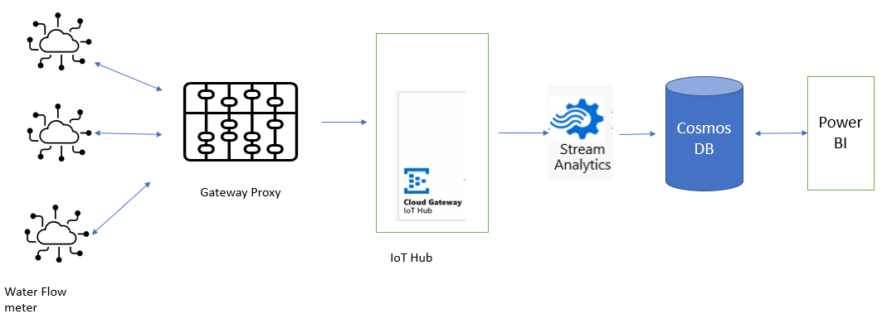
GitHub Repository Link & supporting diagrams, screenshots, if any

Slide 9
Thank You
Team member names

