Slide 1

Ghouls, Goblin and Ghosts
By,
Komala K V

Slide 2
Table of Contents
INTRODUCTION
OBJECTIVE
DIMENSIONALITY REDUCTION
DATA VISUALIZATION
MODELLING AND PREDICTION
CONCLUSION

Slide 3
INTRODUCTION
During Halloween, miniature Ghouls, Goblins and Ghosts ring your doorbell.
Each of the three freaky frights has a different history and personality.
The Ghouls data set have the following columns:-
Columns | Description
id | id of the creature
bone_length | average length of bone in the creature, normalized between 0 and 1
rotting_flesh | percentage of rotting flesh in the creature
hair_length | average hair length, normalized between 0 and 1
has_soul | percentage of soul in the creature
color | dominant color of the creature: 'white','black','clear','blue','green','blood'
type | target variable: 'Ghost', 'Goblin', and 'Ghoul'

Slide 4
OBJECTIVE
To use bone length measurements, severity of rot, extent of soullessness, and other characteristics features to categorize them as Ghouls or Goblin or Ghosts.

Slide 5
DIMENSIONALITY REDUCTION
The column ‘color’ is of no importance in the Modelling.
Hence, the column is dropped
The other features are only values within the range of 0 and 1.
Hence none of the columns are combined.

Slide 6
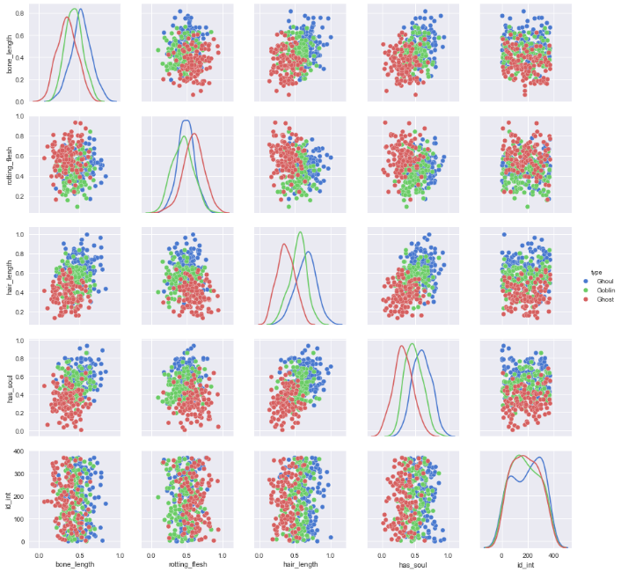
DATA VISUALIZATION
Pair plots
Observation:-
The features are overlapping.
They are spread from 0 to 1 values
None of the columns are isolated.

Slide 7
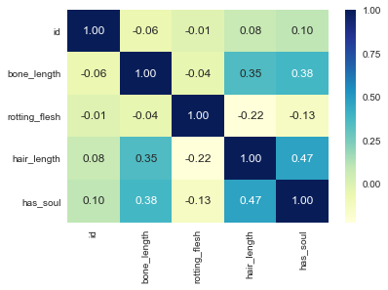
Heat Map:
Observation:-
The columns bone_length, hair_length and has_soul have positive values.
The column rotting_flesh has negative value.

Slide 8
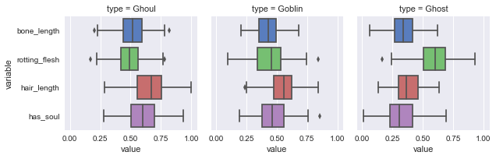
Facet Grid
Observation:-
Shows the outliers in Ghoul, Goblin and Ghost.
Its predominant in rotting_flesh for all the types.

Slide 9
MODELLING AND PREDICTION
The data set is split into 70:30 ratio for the Standard Scalar.
The accuracy score is given in the table after applying different Machine Learning Algorithm for 2 or more classification.
The time difference of Logistic Regression after applying LDA is negligible.
Sl. No | Models | Accuracy Score
1. | Logistic Regression | 76%
2 | Logistic Regression with LDA | 76%
3. | KNN | 68%
4 | SVM | 77%
5. | Decision Tree | 61%

Slide 10
CONCLUSION
The From this we can see that the best algorithm to classify whether it is a Ghoul or Goblin or Ghost is LDA followed by Logistic Regression and SVM.

Slide 11
THANK YOU

