Slide 1
WAVE : A Decentralized Authorization System for IoT via Blockchain Smart Contracts
Wide Area Verified Exchange
What?
- An authorization system spanning different administrative domains without relying on a central authority
- Each party can express fine-grained trust into another party without implicitly having to trust a central third
- Wave connects Sensors, actuators, controllers, drivers, apps and people
Why?
- In a global Internet of Things, who can be trusted to authorize the world?
- Existing authentication systems are centralized
- Attacks on centralized systems are common, and affect all the users

Slide 2
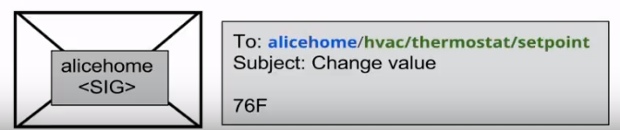
WAVE Components
Entity: We can relate to this as a username / email address. It is the identifies that is associated with permissions. This could a participant, service or an IOT device
Resources: Permissions are granted on resources. You can relate them to filepaths/urls.
Namespace: Resources are grouped into namespaces. You can relate to namespaces as the root-users to grant permissions.
Namespace/resourcepath

Slide 3
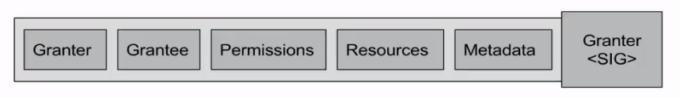
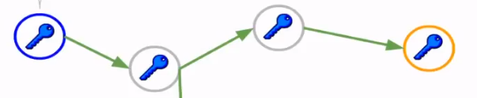
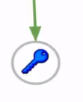
Delegation of Trust:
For other entities, they must receive permissions on different resources via the DoT (Delegation of Trust)
Delegation of Trust Graph:
For other entities, they must receive permissions on different resources via the DoT (Delegation of Trust)

Slide 4
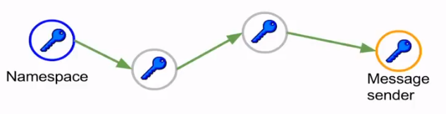
Proof of Authorization
This is the fundamental concept in wave

Slide 5
We have managed to create a system that works basis our requirement, but we still need the following:
-Availability
-Consistency
-Resiliency
We achieve the following three using a Block chain – Ethereum
- WAVE uses the block chain only to store permissions and not the data
- Using Delegation of trust we can grant permissions even if the users are inactive
- Global Synchronized ledger of state
-Once state is in the ledger it can be relied upon to be there

Slide 6
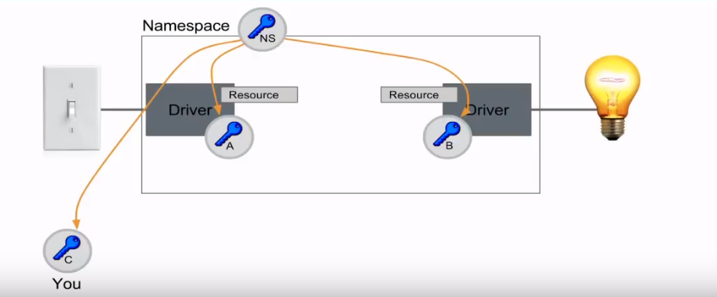
How does block chain work with Wave
Wave Objection Inspection
Registry
Affinity
Aliases

