Slide 1

PYWREN

Slide 2
WHAT IS PYWREN?

Slide 3
Pywren
Pywren serializes a Python function using cloudpickle, capturing all relevant information as well as most modules that are not present in the server runtime.
This eliminates the majority of user overhead about deployment, packaging, and code versioning.
We submit the serialized function along with each serialized datum by placing them into globally unique keys in S3, and then invoke a common Lambda function.
On the server side, we invoke the relevant function on the relevant datum, both extracted from S3.
The result of the function invocation is serialized and placed back into S3 at a pre-specified key, and job completion is signaled by the existence of this key.
In this way, we are able to reuse one registered Lambda function to execute different user Python functions and mitigate the high latency for function registration, while executing functions that exceed Lambda’s code size limit.

Slide 4
WHAT IS AWS LAMBDA?

Slide 5
AWS LAMBDA
AWS Lambda is a compute service that lets you run code without provisioning or managing servers.
AWS Lambda executes your code only when needed and scales automatically, from a few requests per day to thousands per second.
You pay only for the compute time you consume - there is no charge when your code is not running.
With AWS Lambda, you can run code for virtually any type of application or backend service - all with zero administration.
AWS Lambda runs your code on a high-availability compute infrastructure and performs all of the administration of the compute resources, including server and operating system maintenance, capacity provisioning and automatic scaling, code monitoring and logging.
All you need to do is supply your code in one of the languages that AWS Lambda supports (currently Node.js, Java, C#, Go and Python).

Slide 6
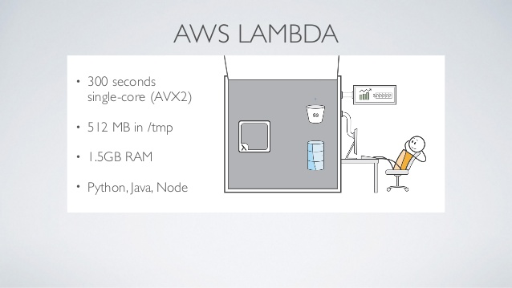

Slide 7
WHAT IS PICKLE?

Slide 8
Pickle
It is used for serializing and de-serializing a Python object structure.
Any object in python can be pickled so that it can be saved on disk. What pickle does is that it “serialises” the object first before writing it to file.
Pickling is a way to convert a python object (list, dict, etc.) into a character stream.
The idea is that this character stream contains all the information necessary to reconstruct the object in another python script.

Slide 9
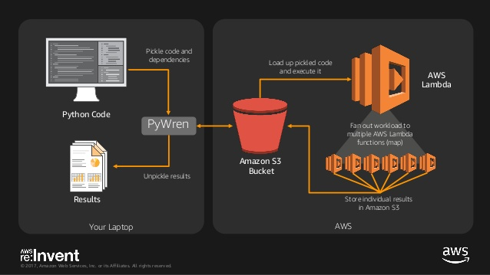

Slide 10
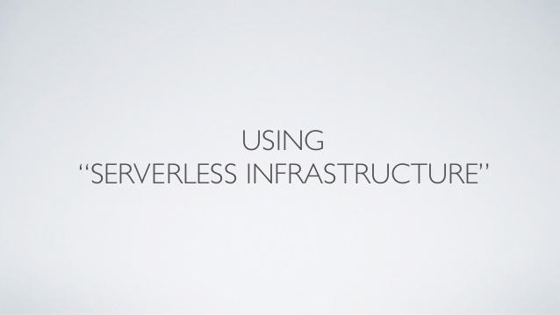

Slide 11
HOW TO GET STARTED WITH PYWREN?

Slide 12
Step1: AWS Configuration
$pip install awscli
Step 2:Installation of Pywren
$pip install pywren
Step 3:Interactive script for pywren
$pywren-setup
Step 4: Run Jupyter Notebook
jupyter notebook --allow-root --ip='127.0.0.1'

Slide 13
Manual Setup
$pywren get_aws_account_id
$ pywren create_config
Pywren create_role
Pywren create_code
Pywren deploy_lambda

Slide 14
REFERENCES
https://www.youtube.com/watch?v=OskQytBBdJU&t=890s
https://github.com/ucbrise/risecamp/tree/risecamp2018/pywren
https://arxiv.org/pdf/1702.04024.pdf

