Slide 1


Slide 2

Objective
To analyze key hospitality metrics across multiple tools

Slide 3




Tools Used

Slide 4
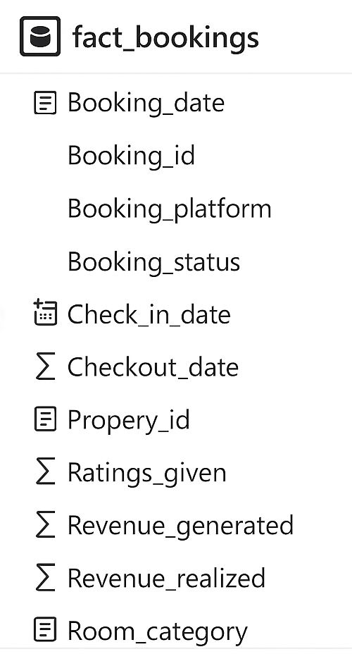
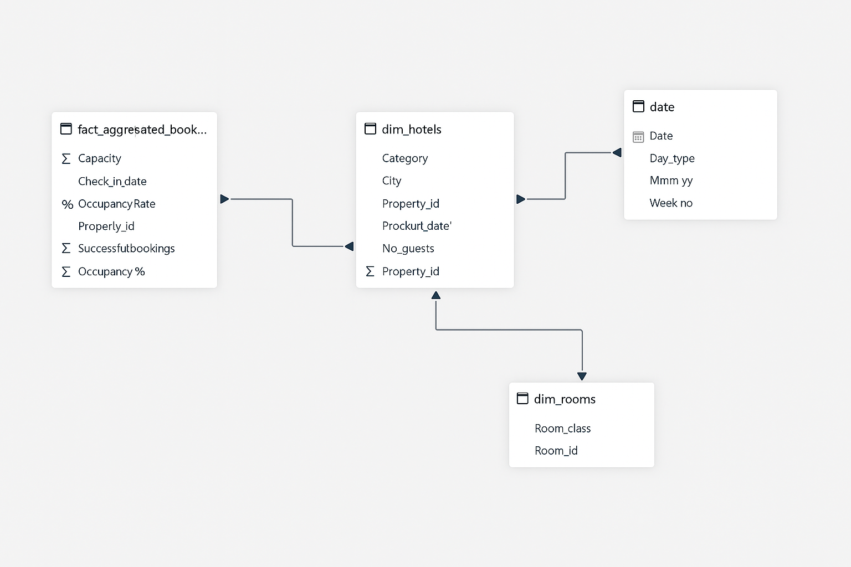
Data Sources

Slide 5
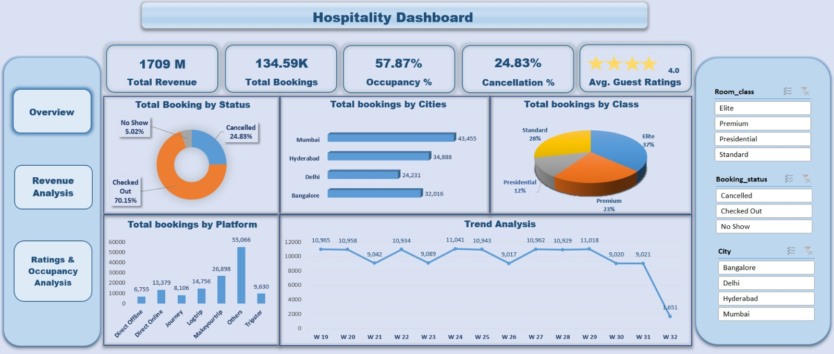
Excel

Slide 6
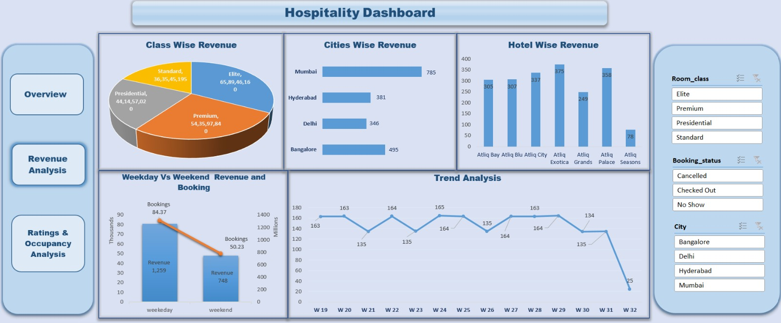

Slide 7
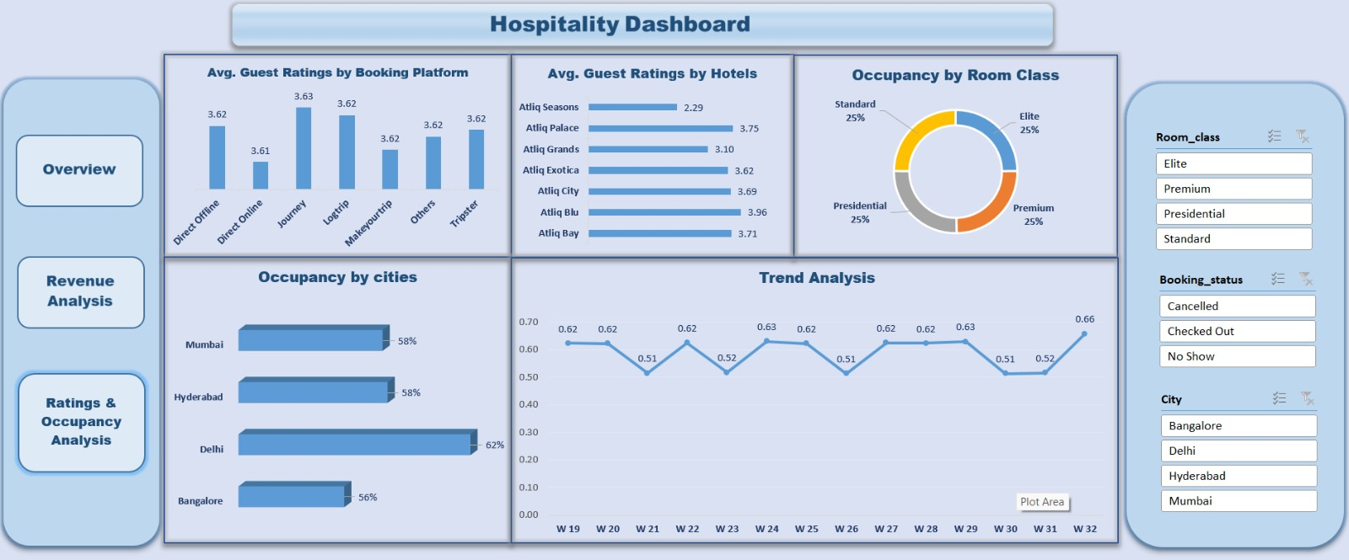

Slide 8
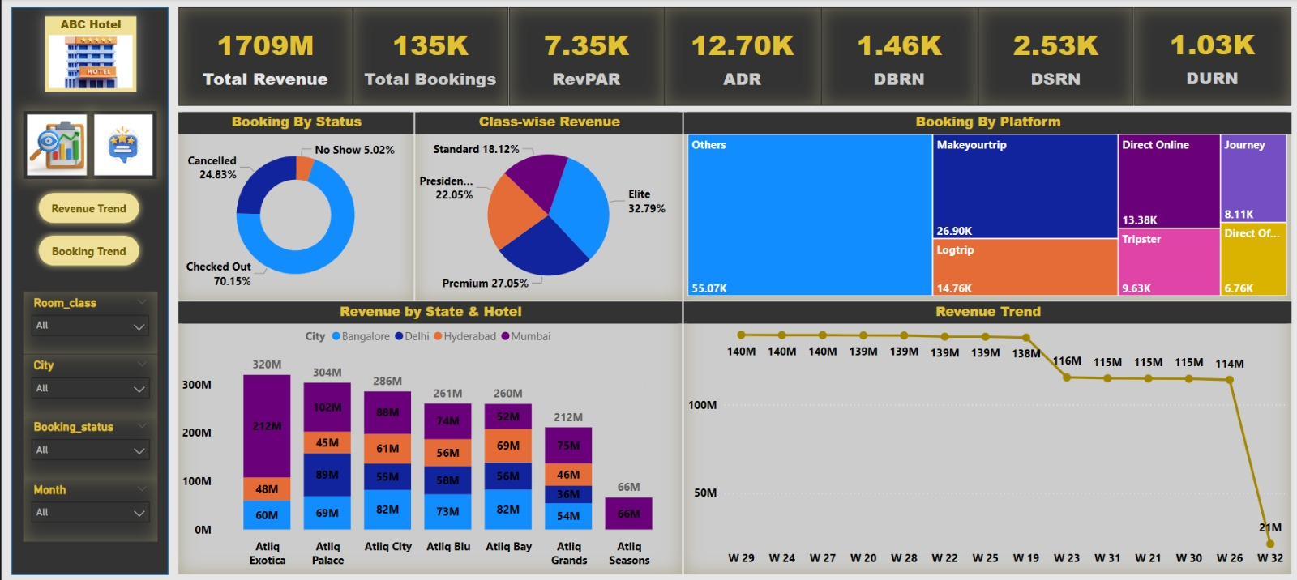
Power Bi

Slide 9
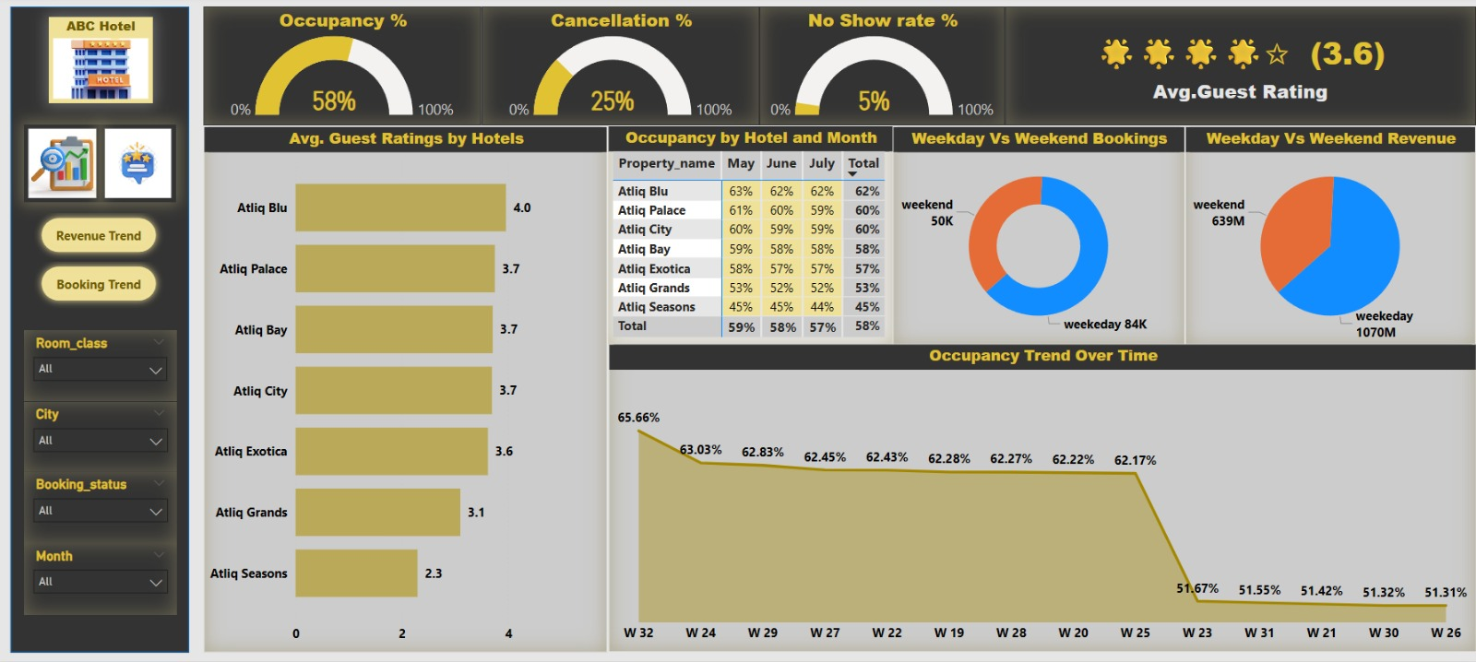

Slide 10
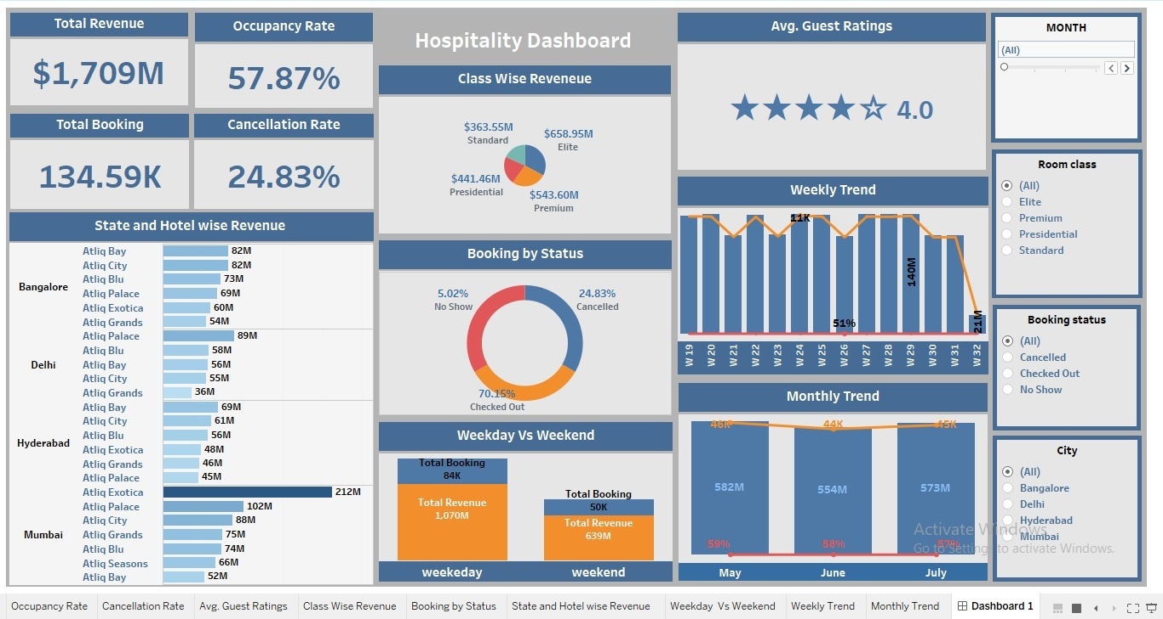
Tableau

Slide 11

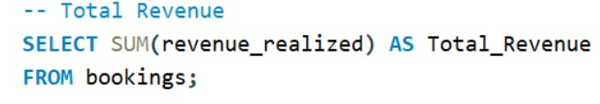

MY SQL

Slide 12

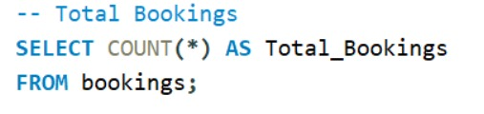




Slide 13

Key Insights & Conclusion
- Mumbai and Bangalore drive the highest revenue
- Occupancy hovers around 58% with spikes in select weeks
- Checked-out bookings dominate at 70%
- Weekday revenue outperforms weekend significantly
- Guest ratings average around 4.0 with some hotel variance

Slide 14
Thank You

