Slide 1

FMCG Warehouse: Optimizing Amazon's Distribution Efficiency
EXCEL CASE STUDY
-BY KOMAL CHAHAL

Slide 2
DATA REQUIREMENTS
Warehouse capacity and utilization
Refill requests and transport issues
Competitor presence
Number of retail shops served
Product weight and storage requirements
Electric supply and distance from the hub
Worker numbers and warehouse establishment year
Issues reported, government certifications, and inspections

Slide 3
PROBLEM STATEMENT
Background: Amazon operates an extensive network of warehouses across various regions.
The Problem : Amazon is experiencing inefficiencies in its warehouse operations. These inefficiencies are affecting the supply chain, leading to stockouts, delivery delays, and Increased costs.
Goal: To identify root causes and propose data-driven solutions to optimize warehouse performance.

Slide 4
METHODOLOGY
Data Preprocessing: Used Power Query for comprehensive data cleaning, enhancing accuracy and consistency.
Analytical Techniques: Applied advanced Pivot Table and charts to analyze warehouse operations and derive actionable insights.
Performance Metrics: Evaluated warehouse performance using metrics such as refill requests, storage issues, transport issues, and workforce distribution.

Slide 5
BUSINESS QUESTIONS
What is the average warehouse capacity size?
How are warehouses distributed across urban and rural areas?
How many retail shops are served by each zone?
What is the average number of workers per warehouse?
What percentage of warehouses have electric supply?
What is the average distance of warehouses from the central hub (zone & region-wise)?
How many warehouses reported storage issues in the last 3 months (zone & region-wise)?
Which zones had the highest refill requests in the last 3 months?
What is the average number of government checks per zone and region?
What is the most common type of government certification?

Slide 6
BUSINESS QUESTIONS
Is there a correlation between workforce size and storage issues?
What is the relationship between warehouse capacity and refill requests?
Which zone reports the highest average transport issues?
What is the average product weight per ton in temperature-controlled warehouses?
Which top 5 warehouses had the highest government checks and what were their storage issues?
How does workforce size differ between urban and rural warehouses?
Does distance from the hub impact transport issues?
How does competitor presence affect refill requests?
Is there a difference in storage issues between certified and non-certified warehouses?
Does warehouse establishment year influence breakdown frequency?

Slide 7
Key Insights
Retail Demand: North Zone serves the highest number of retail shops, indicating strong demand concentration.
Operational Risk: North Zone and Regional Zone 6 report higher storage issues, highlighting operational pressure in these areas.
Capacity vs Refill: Larger capacity warehouses tend to receive higher refill requests, showing alignment between storage capability and demand.
Workforce Impact: Rural areas have more warehouses and higher workforce levels compared to urban areas, reflecting stronger operational presence in rural regions.
Workforce vs Storage Issues: The correlation between workforce size and storage issues is very weak suggesting manpower alone does not reduce operational issues.
Logistics Challenge: North Zone reported the highest number of transport issues last year, indicating potential distribution or logistics challenges.

Slide 8
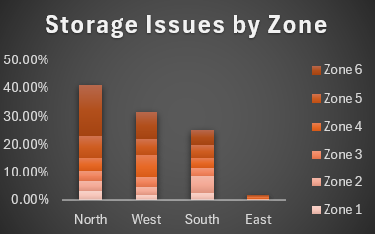
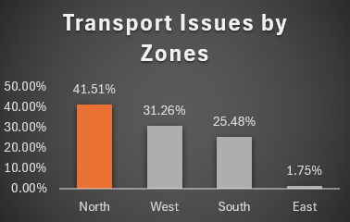
DASHBOARD ACCESS
Click here to Open : ExcelCaseStudy.xlsx

Slide 9
RECOMMENDED ACTIONS
Logistics: Optimize refill schedules and enhance transport routes to reduce delivery delay delays
Storage: Upgrade warehouse storage conditions based on product weight and handling requirements.
Compliance: Streamline government certifications and inspections to minimize operational downtime.

