Slide 1
Database System Enhancement for View Ridge Art Gallery
OMIS 652

Slide 2
About View Ridge Art Gallery
View Ridge Gallery is a small art gallery that has been in business for 30 years.
It sells contemporary fine art.
View Ridge has one owner, three salespeople, and two workers.
View Ridge owns all of the art that it sells; it holds no items on a consignment basis.

Slide 3
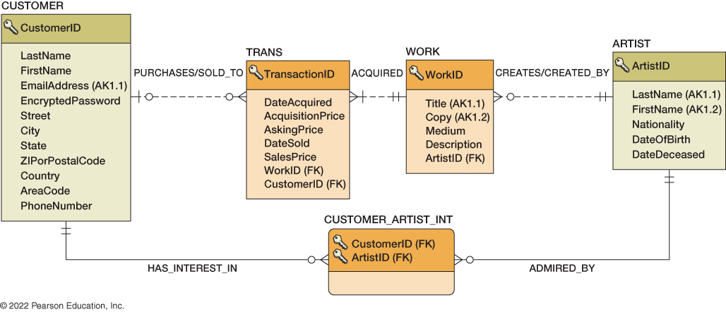
Database Design – Current State

Slide 4
Pain Points
No system for tracking visitor engagement or bookings
No way to capture online reviews or ratings for artworks or artists.
Manual and Unscalable Auction Process
Inefficient Visitor Booking System
No visibility into employee commissions or performance metrics
Unorganized Art Show Scheduling
Disconnected Data Relationships

Slide 5
Solution Approach – Database Redesign
Goal: Enhance gallery operations, customer experience, and employee accountability through a robust relational database design.
Approach:
Identified Pain Points: Lack of visitor tracking, auction records, review system, and employee commission data.
Designed 6 New Functional Tables:
Online Rating: Collects customer reviews for artists and artworks.
Commission Tracking: Logs employee commissions for sold artwork.
Auction Process: Records employee-led auctions and bids.
Visitor Booking: Manages customer bookings for art shows.
Employee Info: Stores staff details involved in sales/auctions.
Art Show Schedule: Tracks shows per artist with dates and pricing.
Integrated with existing tables: Ensured relationaly integrity via foreign keys (e.., linkng WorkID, CustomerID, ArtistID, EmployeeID) Outcome: Improved Data Flow, user interaction, internal accountability, and readiness for analytics.

Slide 6
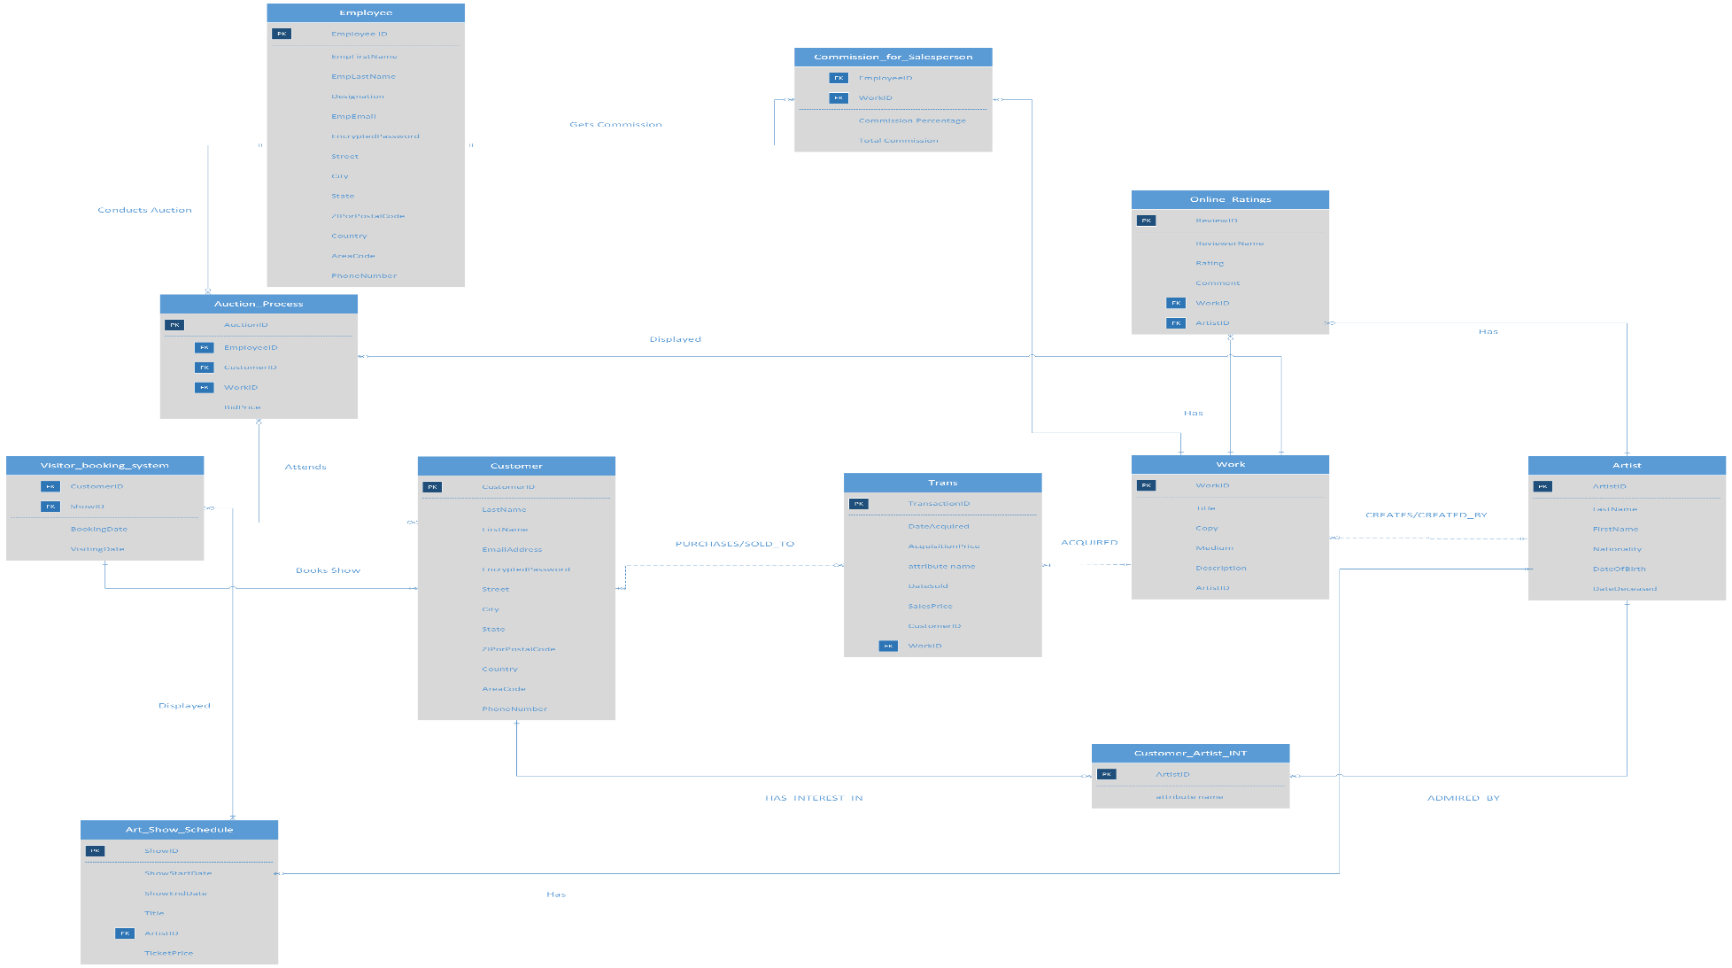
Database Design – Final State

