Slide 1
View Ridge Gallery – Design
OMIS 652

Slide 2
View Ridge Gallery Business
View Ridge Gallery is a small art gallery that has been in business for 30 years.
It sells contemporary fine art.
View Ridge has one owner, three salespeople, and two workers.
View Ridge owns all of the art that it sells; it holds no items on a consignment basis.

Slide 3
Summary of View Ridge Gallery Database
Track customers and their interest in specific artists
Record the gallery’s purchases.
Record customers’ purchases.
Report how fast an artist’s works have sold and at what margin.
Show the artists represented by the gallery on a Web page
Show current inventory on a Web page.
Show all the works of art that have appeared in the gallery on Web pages.

Slide 4
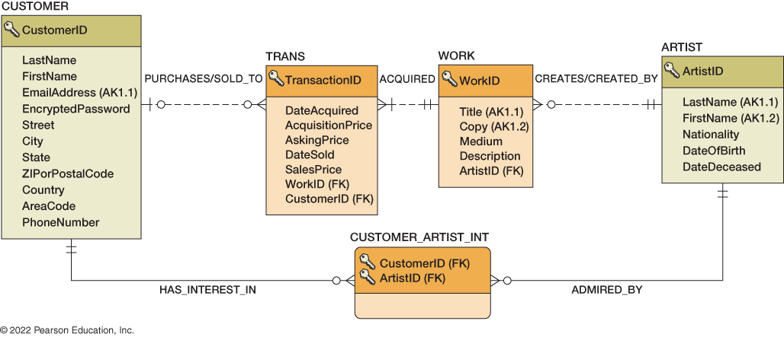
VRG Database Design – Current State

Slide 5
View Ridge Gallery – New Projects
The art gallery would like to expand their current database system with one or more of the following new capabilities:
Auction Process
Artwork Security System
Artwork Supplier Sourcing
Online Review and Ratings
Commission for Salespeople
Gallery Events and Promotions
** This is not an exhaustive list as the gallery is open to new ideas to improve their business.

Slide 6
Project Design Deliverables
Develop a new set of tables (5 – 10 ) for the project
Write a 1-to-2-page summary describing the new functionality from the business perspective. Identify what data will be captured to support the initiative and how it integrates back with the rest of the database system.
Create an ER diagram using MS Visio based on the new feature(s) that shows any relationships to existing entities.
Create a diagram with crow's foot database notation (microsoft.com)
Create a physical database diagram using the SQL Server showing all tables, attributes, and relationships

