Slide 1
View Ridge Gallery – Data
OMIS 652

Slide 2
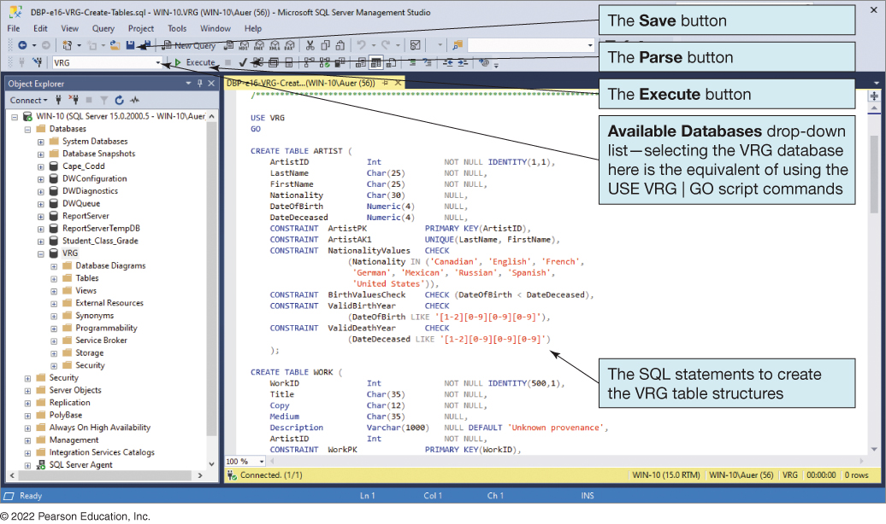
S Q L Script to Create the V R G Table Structure
Your ZID
use [ZID]
use [ZID]
Your ZID
Notes:
In the first screenshot, the save button, the pause button, and the execute button are labeled. Available Databases drop down list, selecting the V R G database here is the equivalent of using the USE V R G pipe GO script commands. The s q l statements to create the v r g table structures.

Slide 3
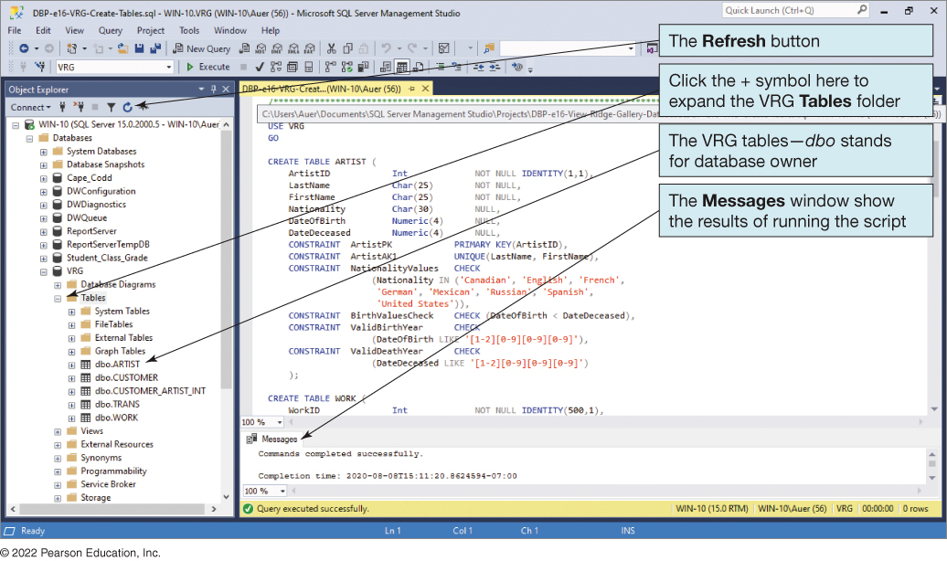
V R G Database Tables
Your ZID
use [ZID]
Your ZID
Notes:
The refresh button is labeled. Click the plus symbol here to expand the v r g tables folder. The v r g tables, d b o stands for database owner. The messages window shows the results of running the script.

Slide 4
Default Values and Data Constraints
Table | Column | Default Value | Constraint
WORK | Description | ‘Unknown provenance’ | Blank
ARTIST | Date Of Birth | Blank | Less than DateDeceased.
ARTIST | Date Of Birth | Blank | Four digits – 1 or 2 is first digit, 0 to 9 for remaining three digits.
ARTIST | Date Deceased | Blank | Four digits – 1 or 2 is first digit, 0 to 9 for remaining three digits.
TRANS | Sales Price | Blank | Greater than 0 and less than or equal to 500,000.
TRANS | Date Acquired | Blank | Less than or equal to DateSold.

Slide 5
Insert New Artist SQL Example
The IDENTITY_INSERT property allows the insertion on non-continuous surrogate key values.
SET IDENTITY_INSERT d b o.ARTIST ON
INSERT INTO ARTIST
(ArtistID, LastName, FirstName, Nationality,
DateOfBirth, DateDeceased)
VALUES (1, 'Miro', 'Joan', 'Spanish', 1893, 1983);
SET IDENTITY_INSERT d b o.ARTIST OFF

Slide 6
Stored Procedures
A stored procedure is a program that is stored within the database and is compiled when used.
In Oracle, it can be written in P L/S Q L or Java.
In S Q L Server 2019, it can be written in T-S Q L or a .NET C L R language.
Stored procedures can receive input parameters and they can return results.
Stored procedures can be called from:
Programs written in standard languages, e.g., Java, C#
Scripting languages, e.g., JavaScript, VBScript
S Q L command prompt, e.g., S Q L Plus

Slide 7
Advantages of Stored Procedures
Greater security
Decreased network traffic
SQL can be optimized
Code sharing
Less work
Standardized processing
Specialization among developers

Slide 8
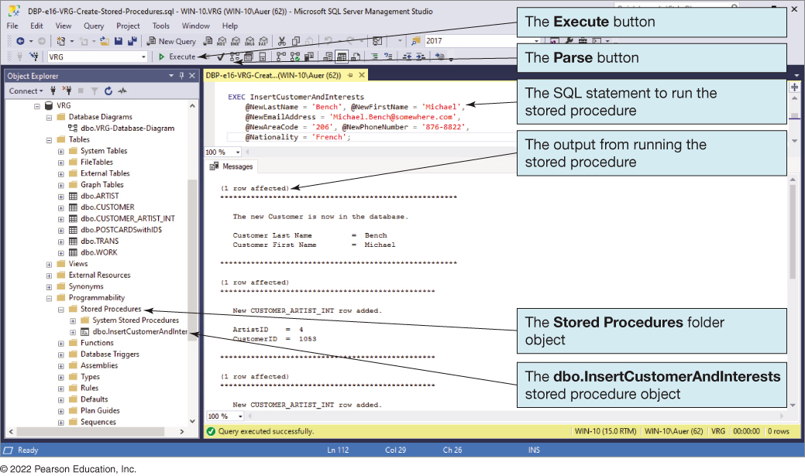
Running InsertCustomerAndInterest Stored Procedure
Notes:
The execute button, the parse button, the S Q L statement to run the stored procedure, the stored procedure folder object and the d b o dot insert customer and interests stored procedure object are labeled.

Slide 9
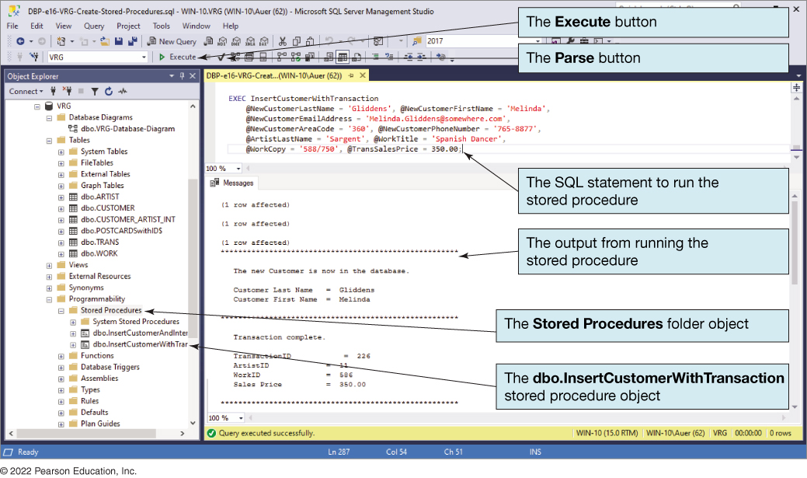
Running InsertCustomerWithTransaction Stored Procedure
Notes:
The execute button, the parse button, the S Q L statement to run the stored procedure, the output from running the stored procedure, the stored procedures folder object, and the d b o dot insert customer with transaction stored procedure object.

Slide 10
Project Data Setup
Populate existing tables with data, minimally:
Insert at least 10 artists
Insert at least 15 artworks
Insert at least 10 customers
Insert at least 20 interests*
Insert at least 15 transactions*
* Stored procedures can be used for this data
** Populate new tables with similar quantities

Slide 11
Project SQL Deliverables
Successfully Run Stored Procedures to
Generate 2 new customer interests
Generate 3 new customer sales transactions
Create and solve 5 unique business SQL questions
Report should cover all data and relationships present in the new database system.
Use joins and aggregate functions for analysis
‘select * from customer’ does not count

