Slide 1
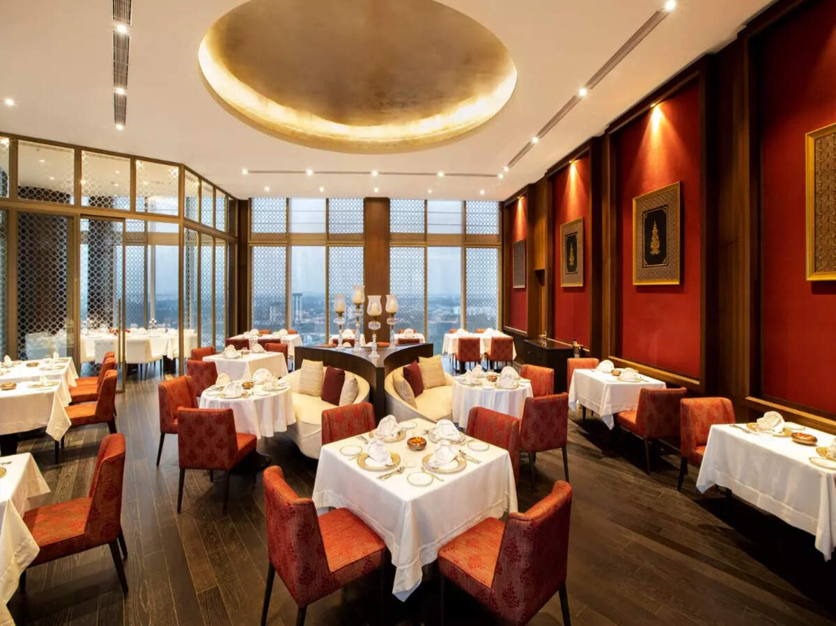


DATA
ON MENU
A Data-Driven Journey into Restaurant Trends with EazyDiner
Presented by:
Komal Galave

Slide 2


INDEX
1
Introduction
2
Business Objective
Website Interface
3
4
Data Collection
5
Insights
6
Conclusion

Slide 3
Why Restaurant Data Matters
Cuisine Distribution
Quality Hotspots
Category Performance
What types of cuisines dominate specific neighborhoods across different cities?
Which areas concentrate the highest-rated restaurants for competitive advantage?
Which restaurant categories offer the most attractive discounts and highest ratings?
Real-World Applications
City-wise Food Guides: Create targeted restaurant recommendations by neighborhood
Food Delivery Strategy: Identify high-demand areas and cuisine preferences
Investment & Franchising: Discover emerging markets and competitive gaps

Slide 4


Business Objective
Better Dining Decisions
Solve Selection Confusion
Use EazyDiner Data
Find Dining Trends
In today’s world, choosing where to eat isn’t just about food — it’s about experience, value, and trust.
With so many restaurants available online, people often struggle to decide “Where should I dine tonight?”
This project aims to bridge that gap using data from EazyDiner.
By collecting and analyzing restaurant information — from ratings and cuisines to prices and locations — we uncover real dining trends that show what people love, where they prefer to eat, and what truly defines a great restaurant experience.

Slide 5
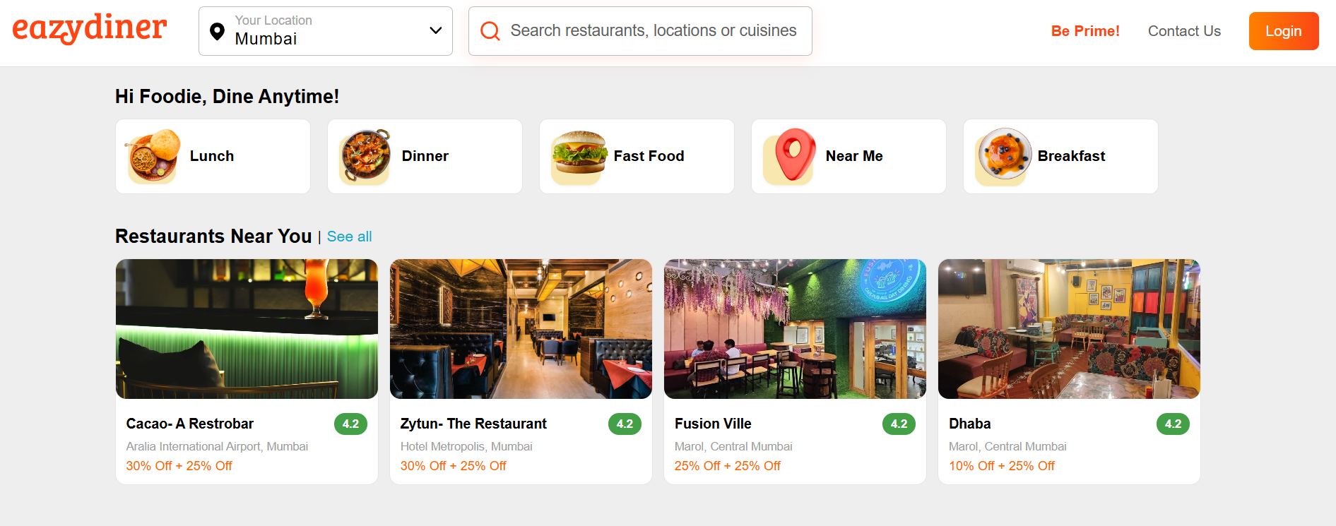
Website Interface

Slide 6
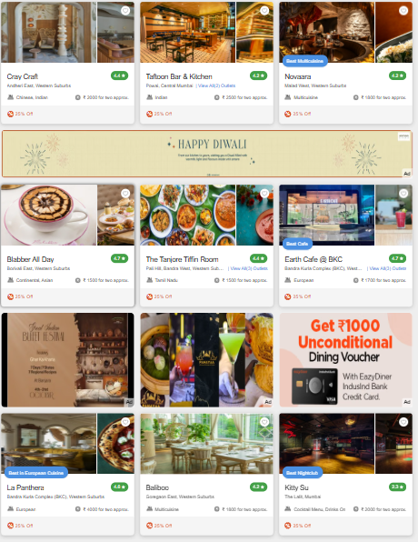
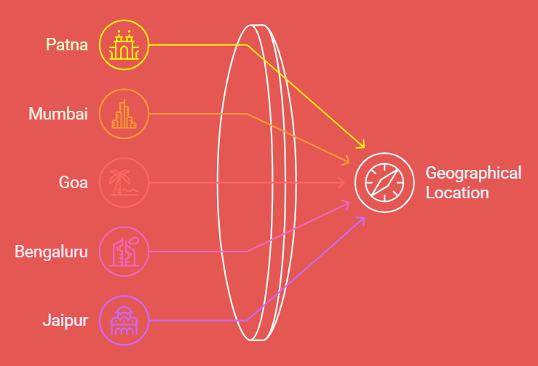
Data Collection Strategy
9 restaurant cards
2
15 pages per city
1
Per page on EasyDiner platform
Comprehensive coverage across regions
3
5 major cities

Slide 7
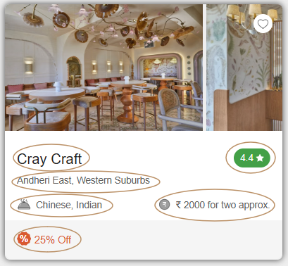
Data Features Extracted
1
Restaurant Name
Unique identifier for each establishment
2
Rating
Customer satisfaction metric (0-5 scale)
3
Location
Geographic coordinates and neighborhood details
4
Cuisine Type
Categories served (Indian, Chinese, Continental, etc.)
5
Cost Range
Approximate per-person pricing
6
Discount Offered
Current promotional rates and deals

Slide 8
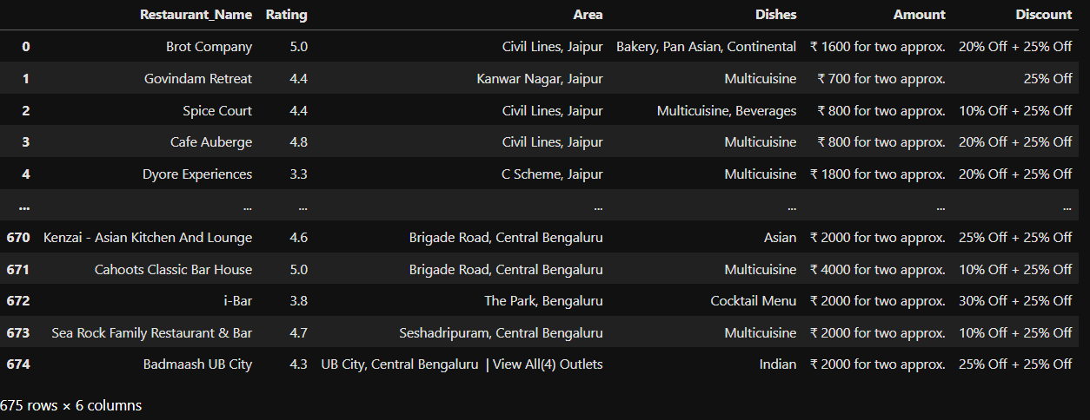
INITIAL SCRAPED DATASET OVERVIEW

Slide 9
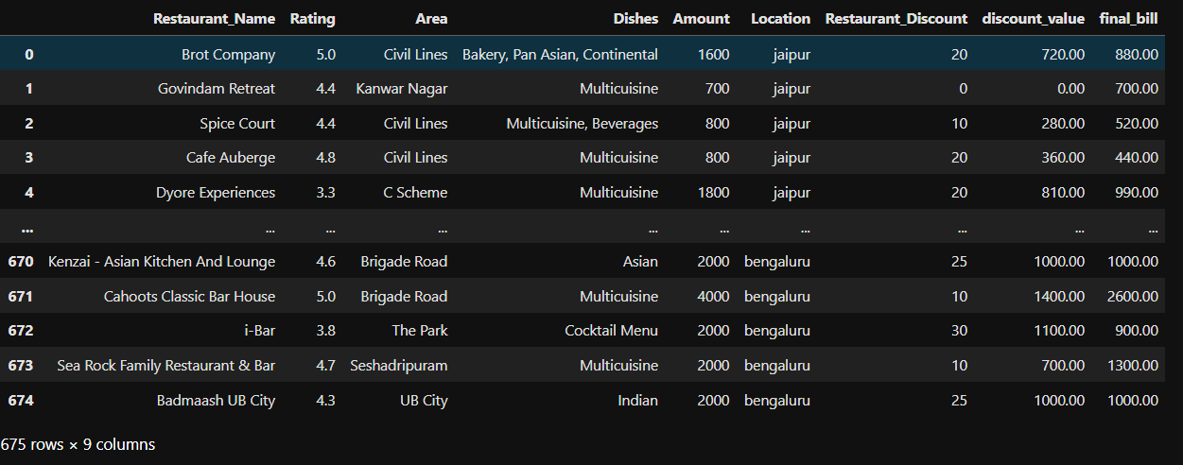
CLEAN DATA READY FOR ANALYSIS

Slide 10
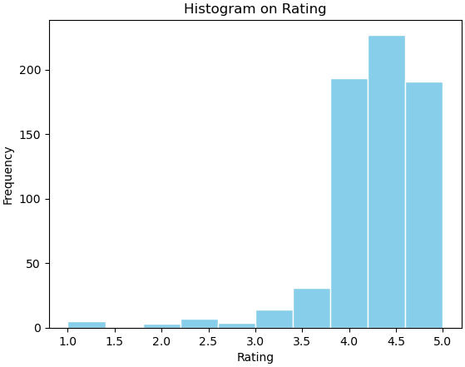

VALUE COUNT OF NUMERICAL COLUMNS
Insight:
Most restaurants are well-rated between 4.0–5.0, showing high customer satisfaction and very few low-rated places.

Slide 11
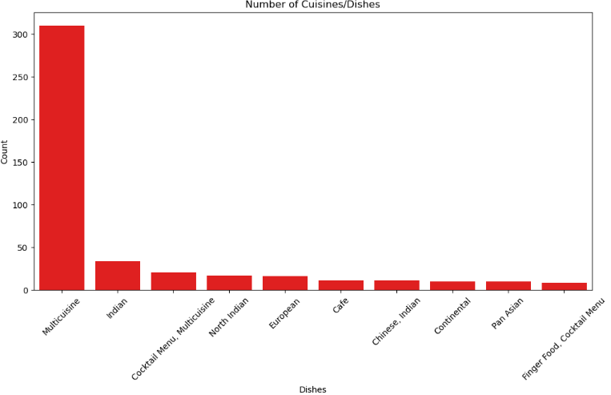

TOP 10 DISHES DISTRIBUTION
Insight
Multicuisine is the most common dish type, with a very high count compared to others.
This shows that customers may favor diversity, making multicuisine options more popular.

Slide 12
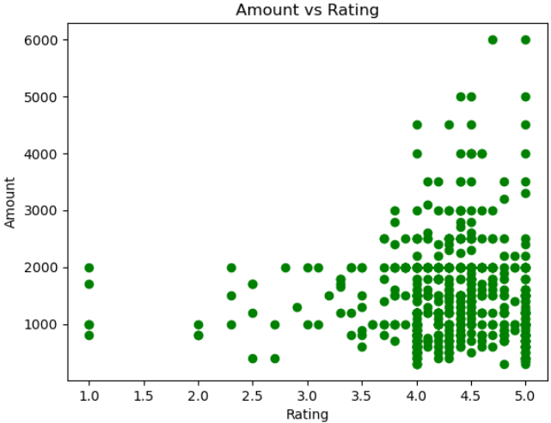

AMOUNT VS RATING
Insight:
Most restaurants have ratings between 3.5 and 5, but the— people spend more money people spend doesn’t depend on the rating or less even if the rating is the same

Slide 13
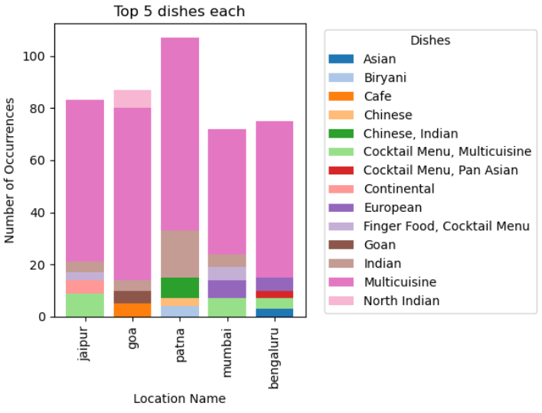

TOP 5 DISHES EACH WITH LOCATIONS
Insight:
Patna has the highest number of popular dishes, and North Indian and Multicuisine dishes are liked the most in all cities.

Slide 14
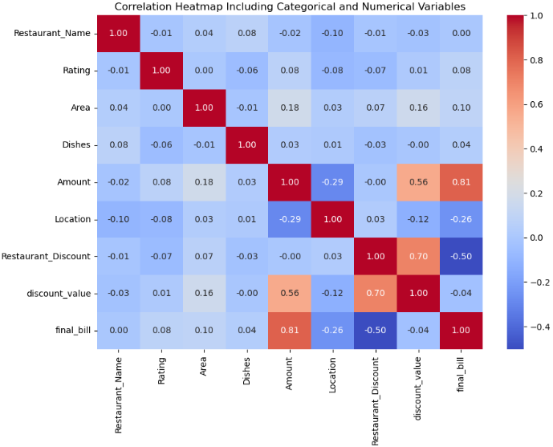

TOP 5 DISHES EACH WITH LOCATIONS
Higher order amounts → higher final bills (strong positive correlation 0.81).
Restaurant discounts and discount values are strongly related (0.70).
Higher discounts reduce the final bill (negative correlation -0.50).
Location affects spending patterns, as some areas show lower spending (-0.29).

Slide 15

Overall Takeaways
Cuisine & Dish Popularity is City-Specific
Restaurant Pricing Varies Significantly Across Cities
This helps understand regional food preferences for restaurant owners or food delivery startups.
Indicates economic tier difference and spending behavior across metros.
Top-Rated Restaurants Are Clustering in Certain Areas
Data-Driven City Guides Can Be Created
The insights can power data-backed food guides, showing: Best-rated dishes, Most affordable locations, Cuisine trends city-wise.
Useful for real estate selection, franchise investment, or launching a new food venture.

Slide 16
THANK
YOU

