Slide 1
Motion capture
Using Computer Vision
A cheap and simplified tool for capturing the movements Of humans

Slide 2
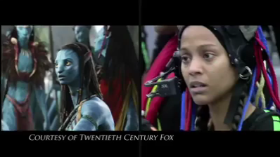
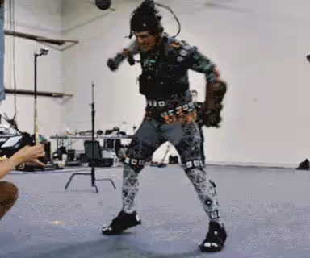
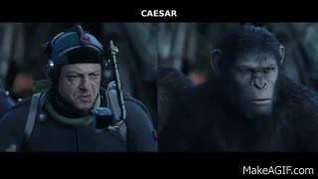
M
O
T
I
O
N
C
A
P
T
U
R
E
Avatar
Thanos
Nowadays we watch the movies like Avenger ,avatar and lord of the ring . These movies are made with the help of motion capture.
Dawn of the Planet of the Apes

Slide 3
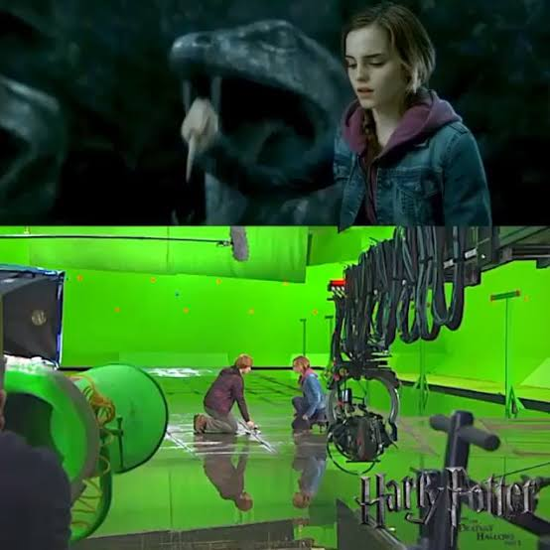

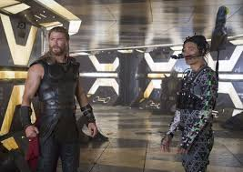
Movies name in which motion capture Is used
Alice in Wonderland Avatar Avengers Beauty and the beast Hulk Stranger thin
The Hobbit Harry Potter Jungle Book Jurassic world King Kong Mowgli Venom Thor

Slide 4
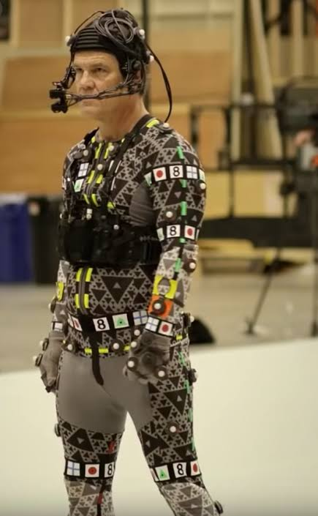
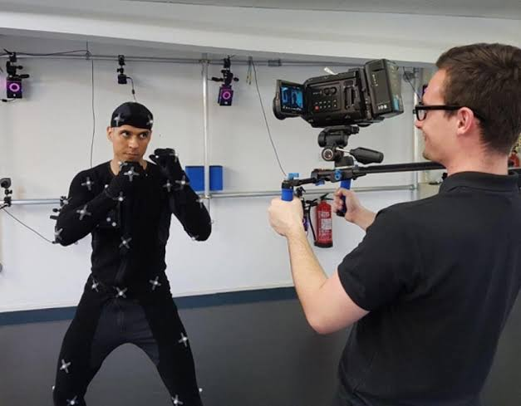
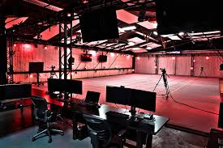
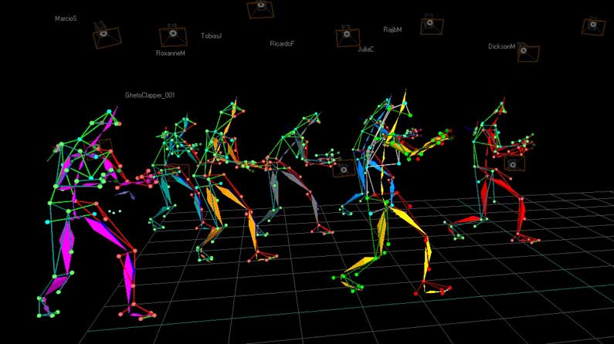
PROBLEM STATEMENT
Their were two major problem in the existing Motion Capture System
GADGETS
ENVIRONMENT
ALTERNATIVE
 | Camera
 | Other hardwares
 | Like Mocap suit
 | Software liscense
 | Maximum $25000
 | Management of a
 | Big studio needed
 | For capturing is
 | Difficult to manage.
 | STUDIO
 | Another alternative
 | For mation capture
 | Is using fluorescent
 | markers
 | NOT SATISFACTORY
Due to advance hardware requirements

Slide 5

Drawbacks Of Existing Motion Capture System
CAMERA
STUDIO
Existing : Minimum 4 Cameras
(stores 2000 frames/sec.)
Our System : Requires single
DV Camera (stores only 25 frames/second)
Existing : Background management, calibration and synchronization.
Our System : Since we are using single DV camera so it does not require any Synchronization and Calibration
Studio costing:
Mocap suit
$500 - $10000
On an average
Camera
$65 - $90 per/hour or 500$ - 800$ per/day
$2000 - $15000

Slide 6
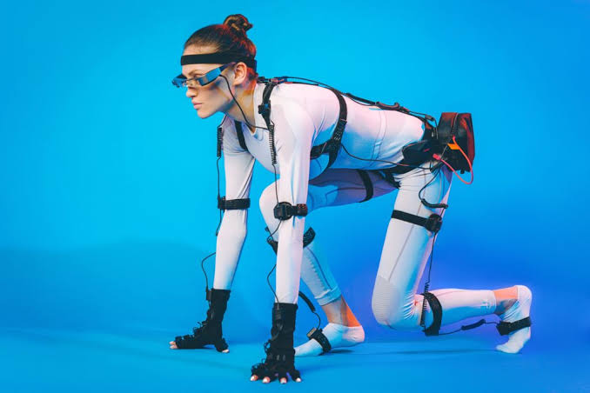
INTRODUCTION
MOTION
CAPTURE
USING COMPUTER VISION
“Motion capture” is the process of capturing movements from real life into a computer.

Slide 7
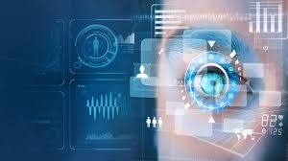
INTRODUCTION
COMPUTER
VISION
“Computer vision” is the field of computer science that focuses on creating digital systems that can process, analyse, and make sense of visual data (images or videos).

Slide 8
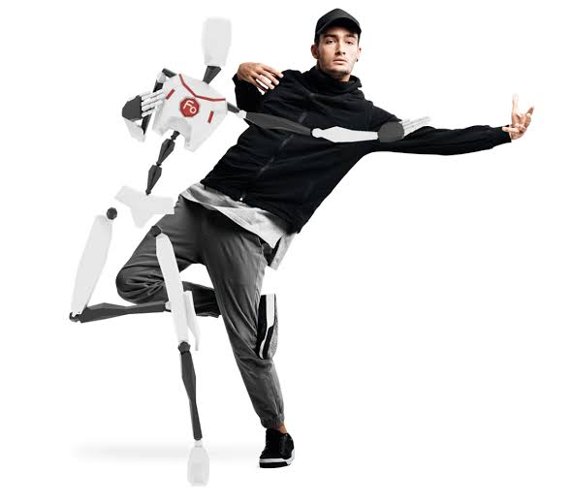

INTRODUCTION
Existing motion capture technology is very expansive and can not be used by the new developers. So, we will be making a low budget motion capture system.
We will be capturing the data by using a single camera.
And then transfers the corresponding data to another Applications like UNITY
By mapping real-world movement on computer generated frames
The idea with using only one DV camera was to simplify the system since it would require no calibration or synchronisation.
It would also make the system cost efficient and available to the general public.
Motion capture
UNITY
Computer
vision
Motion capture is the process of capturing movements from real life into a computer.
Unity is a cross platform use for the creation of 2-d and 3-d games and making our content interactive .
Computer vision is the field of computer science that focuses on creating digital systems that can process, analyse, and make sense of visual data (images or videos)

Slide 9
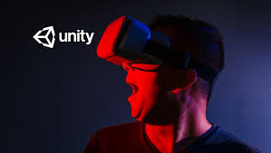

The focus of Unity lies in :
UNITY
Unity is a cross-platform game engine initially released by Unity Technologies, in 2005
Unity now supports over 20 different target platforms for deploying,
Free to use.
Most popular are :
PC
Android
iOS systems
Creating interactive content
Development of 2-D & 3-d content
Creatiors are leveraging Unity’s platform for providing faster crerative content creation and efficient deployment across formats and uses.
Unity privides a set of softwares solutions to create, run and monetize 2D – 3D content for mobile phones, tablets, PC’s

Slide 10


Alternatives Of Unity Software
Motion builder
$1,950 / per year.
Adobe After Effects
PRICING STARTS AT $20.99 PER MONTH.

Slide 11
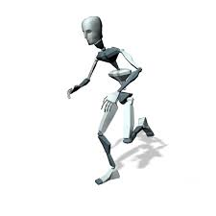
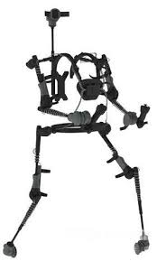
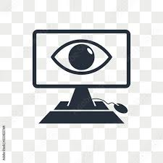
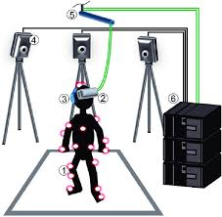
Applications of our system
Human Biomechanics
Markerless & Marker –based motion capture, Clinical Gait Analysis system,Sound & Motion, Psychology, MRI for Human and Underwater Humamn Motion
01
02
Sports
Running , Baseball, Cycling, golf and
Swimming
Engineering
Automotive, Robotics, Marine and Underwater, Aerodynamics.
03
04
Entertainment
Virtual Reality (VR), Animation.

Slide 12
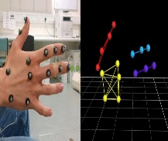
OBJECTIVE,
PURPOSE,
AND SCOPE.
NO NEED OF STUDIO
The main objective of this project is to help the creators by providing the facility of capturing the movements and objects without managing a big studio.
REDUCING THE COST AND MAKING THE PROCESS COST EFFICIENT
WHY COST EFFICIENT ?
We will be using the single DV Camera and there is no need to manage the studio this will ultimately reduce the cost of the system.
WE WILL BE USING COMPTER VISION CONCEPT
We will be using the computer vision concept for capturing the data. Then we will be applying pose estimation and pose logic.
POSE DATA PROVIDING BONE ARCHITECTURE
That pose data will provide us the bone architecture, points. After that this 3-D track data will be converted and then passed to unity

Slide 13
Proposed system
User
Actor
Camera
AI
Detection
Unity
Tracking
Store

Slide 14
FEASIBILITY STUDY
Operation feasibility
By using the interactive user interface user can easily interact with the system and can perform their desired operations very easily. Hence, our system is operationally feasilble.
01
Technical feasibility
Operation feasibility
By using the libraries of python, and python programming language this system can be easily constructed. Hence our system is technically feasible
02
Technical feasibility
Financial feasibility
03
Our moiton capture system does not require any external gadgets ond cross platform subscription,we can easily upload our 3-d track to unity (i.e freely available)
Financial feasibility
04

Slide 15
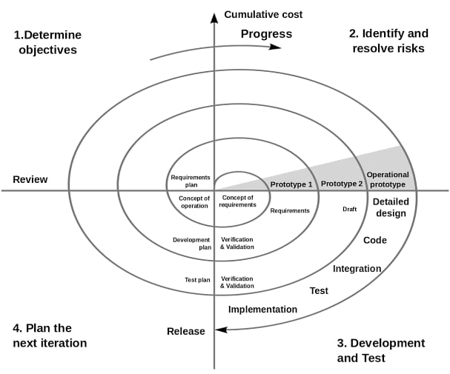
Spiral Model
Spiral model is one of the most important Software Development Life Cycle models, which provides support for Risk Handling. Each loop of the spiral is called a Phase of the software development process.

Slide 16
Gantt Chart
Task | 4Feb-28Feb | 28Feb-9Mar | 10Mar-12Apr | 13Apr-16May | 17may-22may | 23may-28may
Develop project proposal | 27 days
Analysis |  | 10 days
Designing |  |  | 30 days
Coding |  |  |  | 34days
Unit Testing |  |  |  |  | 5 days
Implementation |  |  |  |  |  | 5 days

Slide 17
Hardware Requirements
Client Side
Processor | Dual Core or above
RAM | 4 GB
Disk space | 500 GB
Monitor | 15”
Others | Keyboard, mouse, Internet Connection, and web cam.
Server Side
Processor | Dual Core or above
RAM | 8 GB
Disk space | 500 GB
Monitor | 15”
Others | Keyboard, mouse, Internet Connection.

Slide 18
Software Requirements
Client Side
Web Browser (Google Chrome, Firefox, IE9 or above)
Unity Software
Server Side
Web Browser (Google Chrome, Firefox, IE9 or above)
Windows 10 or above / Linux
VScode
SQliteManager
Python 3.7

Slide 19
Functional Requirements
1.
2.
CAMERA
BACKGROUND LIGHTENING
By using the camera we will be capturing the video & images
Maintaining the lightening service of the environment
3.
4.
SYSTEM
UNITY
A computer system is required in which software will be installed
Unity is used for developing 2-D & 3-D content and show output in the form of 3d model

Slide 20
USE CASE DIAGRAM
CAMERA SETUP
Program launch
Start recording
User
Person detection
Tracking movement
Actor
AI
Store motion data
Import to unity
Show output
unity

Slide 21
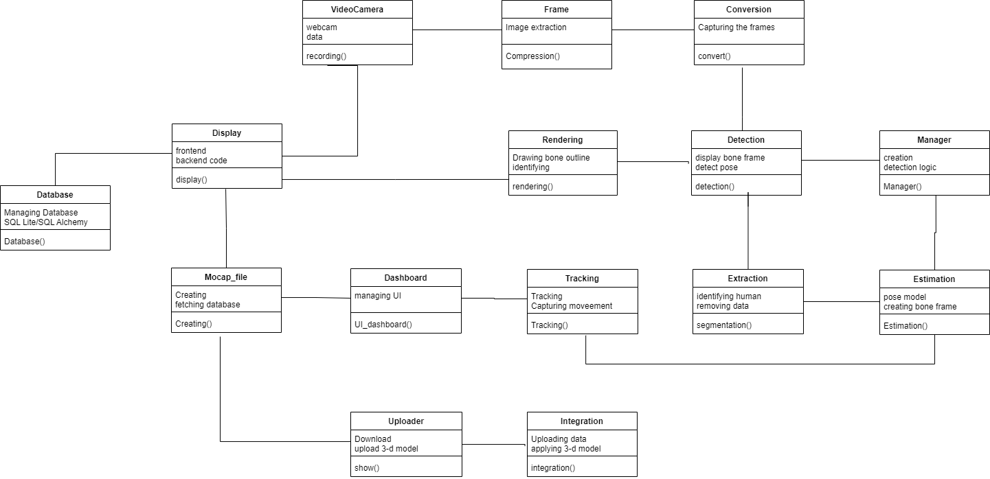
CLASS DIAGRAM
2
2
2
4
2
4
2
1
2
2
2
2
3
2
1

Slide 22
CLASS DIAGRAM

Slide 23
Modules
1.
3.
5.
Video camera handle
This module records the motion of a human
Image conversion system
Bone rendering system
2-D to 3-D visual human motion conversion
This module helps in drawing the bone outline from each pose points.
2.
4.
Image frame extraction
Pose estimation AI loader
extract the images from video and compress it
load the particular pose model and then this model will be applied to the image and it will make the user bone frame

Slide 24
Modules
6.
8.
10.
Pose detection and Frame creation
display the user bone frame and detect the pose .
Database Handler
This model manages the database of user’s previous work using SQLite/SQL Alchemy database software.
Motion capture file creator
this module will help in creating a file which fetch the data from database.
7.
9.
Tracking and capture
track the movement of the points from their location and capture in the form of x axis ,y axis and z axis .
Dashboard system
This module manages the code which provides the user interface better view to user.

Slide 25
Modules
11.
13.
15.
Unity integration
Human body extraction and segmentation
module we upload the data in unity and apply the 3 D Model on the data .
View display Manager
helps in identifying the human body from the image and removes the background of the image.
All the codes related to the fontend and input output of the project are managed by this module.
12.
14.
3D wireframe maker
Mocap manager
In this module we create line and sphere which will displays the output in the form of stick figure.
Mocap manager is used for managing the files and folders and also allow us for the creation and deletion of logics

Slide 26
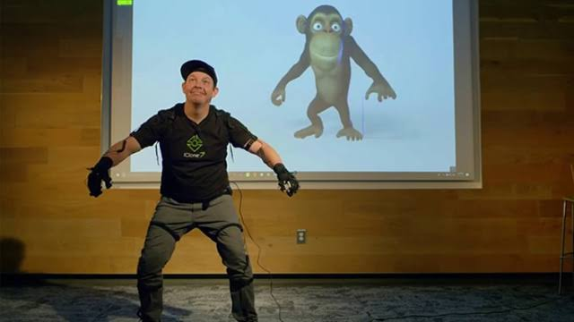
Conclusion
This project will help new developers and independence artist to create movies, games with 3D-engine like – Unity without the needs of big studio and our project will be very helpful to these.

Slide 36
THANK YOU

