Slide 1
IBM University Engagement Project Submission
“Exploring the Power of Agentic AI with IBM Cloud and Orchestrate”

Slide 2

Project Tile – MindCare AI
Domain of Project – Healthcare
Student Name | Recent Passport Photo | Email ID | Mobile number [WhatsApp]
KOMAL GAVIT |  | gavitk496@gmail.com | 9869633586
Recommended font style and size: Font Style: Arial Font Size (Heading): 28
Font Size (Content): 20

Slide 3
Problem Statement -
Agentic AI for Mental Health Awareness & Suicide Prevention
The Challenge
Mental health issues such as depression, anxiety, and suicidal thoughts are growing
worldwide. Stigma, lack of awareness, and limited access to timely help prevent many
individuals from seeking support. Traditional systems are often reactive, leaving gaps in early
detection and preventive care.
The Objective
Build an Agentic AI-powered Mental Health Awareness & Suicide Prevention Agent that is
empathetic, proactive, and safe. The solution should:
1. Promote Awareness & Education – Share accessible resources on mindfulness, coping
strategies, and self-care.
2. Enable Early Detection (RAG) – Use Retrieval-Augmented Generation to identify
distress signals in conversations, journaling inputs, or safe online data.
3. Provide Empathetic Support – Build a conversational agent that listens actively and
responds with empathy (with clear disclaimers: not a substitute for professional medical
advice).
4. Predict & Prevent Risks – Forecast stress peaks, suggest preventive strategies, and issue
alerts when high-risk signals are detected (with consent).
5. Connect to Human Support – Link users to helplines, counselors, or community support
for timely intervention.

Slide 4
Proposed Solution -
Our solution is an AI-powered Mental Health Assistant built using IBM watsonx Orchestrate and IBM Granite models. The assistant provides users with a safe conversational environment where they can openly discuss stress, anxiety, loneliness, and emotional distress.
The AI listens empathetically, asks follow-up questions to better understand the user's emotional condition, and suggests practical coping strategies tailored to their interests and situation.
When users express moderate stress or anxiety, the assistant recommends activities such as:
Mindfulness exercises
Breathing techniques
Journaling
Physical activity
Hobbies
Spending time with family or friends
If conversations indicate severe emotional distress or suicidal intent, the assistant encourages users to immediately contact trusted family members, mental health professionals, or national suicide prevention helplines.
The solution also provides educational articles and mental health resources while clearly stating that the AI is not a replacement for licensed mental health professionals.

Slide 5
Technology Used
IBM watsonx Orchestrate
Used for building and deploying the conversational AI agent.
• GPT-OSS 120B
Used for natural language understanding, empathetic conversation, reasoning, and contextual responses.
• IBM Cloud
Hosts and deploys the AI assistant securely.
• Prompt Engineering
Custom instructions ensure empathetic, safe, and responsible conversations.
• Retrieval-Augmented Generation (Future Scope)
Can retrieve verified mental health articles, coping resources, and educational content from trusted organizations such as WHO and NIMH.

Slide 6
Orchestrate component Used -
Chat Input
Allows users to describe their feelings and emotional concerns.
IBM watsonx AI Agent
Processes emotional conversations and generates empathetic responses.
IBM Granite Model
Granite 4.0 Instruct
Used for understanding emotions, generating responses, and maintaining contextual conversations.
Chat Output
Displays personalized mental health guidance, coping techniques, and supportive conversations.
Prompt Instructions
Controls the AI's behavior by ensuring empathy, safety, and responsible escalation when required.
IBM Cloud Deployment
Hosts the AI agent and enables secure deployment.

Slide 7
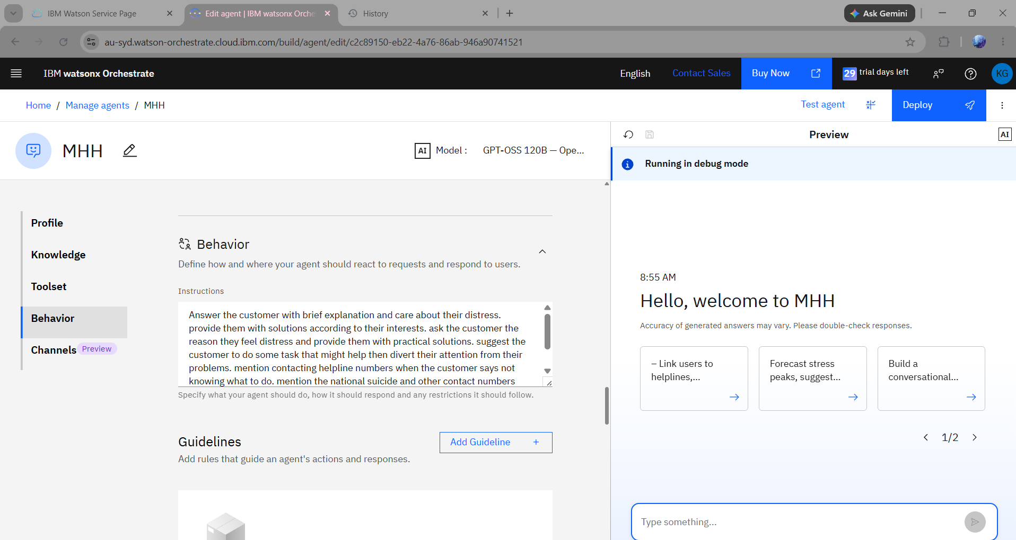
Agent Instructions Screenshot-

Slide 8
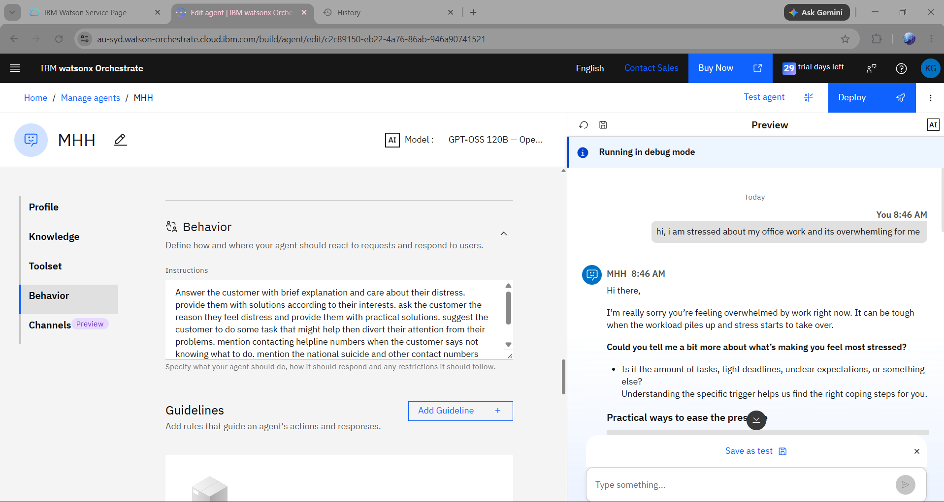
Prompt with output Screenshot:

Slide 9
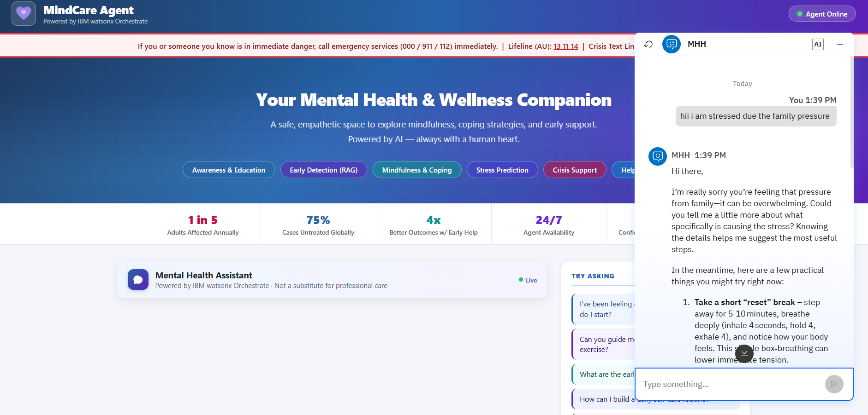

Slide 10
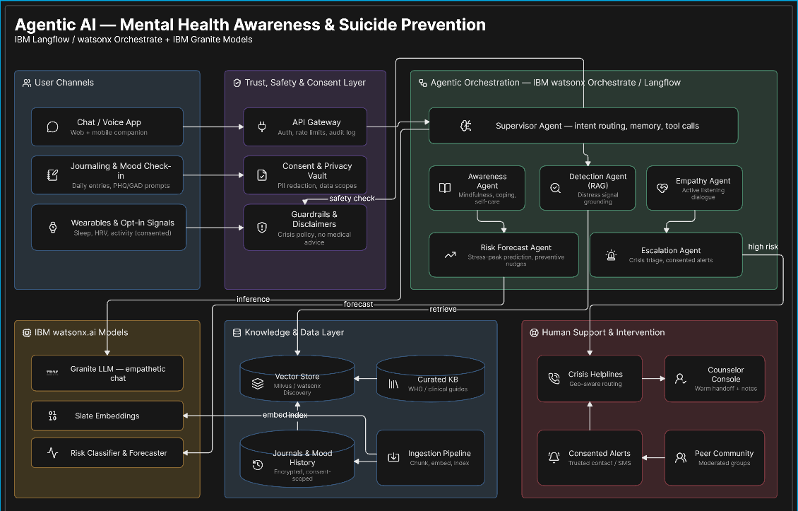
Orchestrate architecture blueprint

Slide 11

Role of Agentic AI in the solution
Role of Agentic AI in MindCare AI
Agentic AI enables the Mental Health Assistant to engage in meaningful, context-aware, and empathetic conversations instead of simply answering predefined questions.
The AI actively listens to users, understands emotional context, asks relevant follow-up questions, and provides personalized coping strategies based on the user's concerns. Rather than offering generic responses, it adapts its guidance according to each conversation.
The system promotes mental health awareness by recommending stress management techniques, mindfulness practices, and educational resources. When high-risk conversations involving suicidal thoughts are detected, the AI responsibly encourages users to contact trusted individuals, mental health professionals, or emergency helplines while clearly stating that it is not a substitute for professional medical care.
This proactive and adaptive behavior demonstrates the principles of Agentic AI by supporting users through intelligent decision-making, contextual reasoning, and safe conversational assistance.

Slide 12
Novelty and Uniqueness
• Empathetic AI conversations rather than simple question answering.
• Personalized coping strategies based on user interests.
• Context-aware follow-up questions.
• Responsible escalation to suicide prevention resources only when necessary.
• Educational mental health awareness integrated into conversations.
• Built using IBM watsonx Orchestrate and Granite models.
• Safe AI behavior with clear medical disclaimers.
• Easily scalable for educational institutions, workplaces, and healthcare organizations.

Slide 13
Git Hub Link
https://github.com/komalgavit/MindCare-AI

Slide 14
Future Scope
Integration with wearable devices to detect stress levels using heart rate and sleep patterns.
Retrieval-Augmented Generation (RAG) using trusted mental health resources such as WHO, NIMH, and government health portals for accurate educational content.
Sentiment analysis to identify emotional trends over time.
Appointment booking with certified therapists and counselors.
Multilingual support for improved accessibility.
Voice-enabled mental health assistant.
Daily wellness check-ins and personalized mood tracking.
·

Slide 15
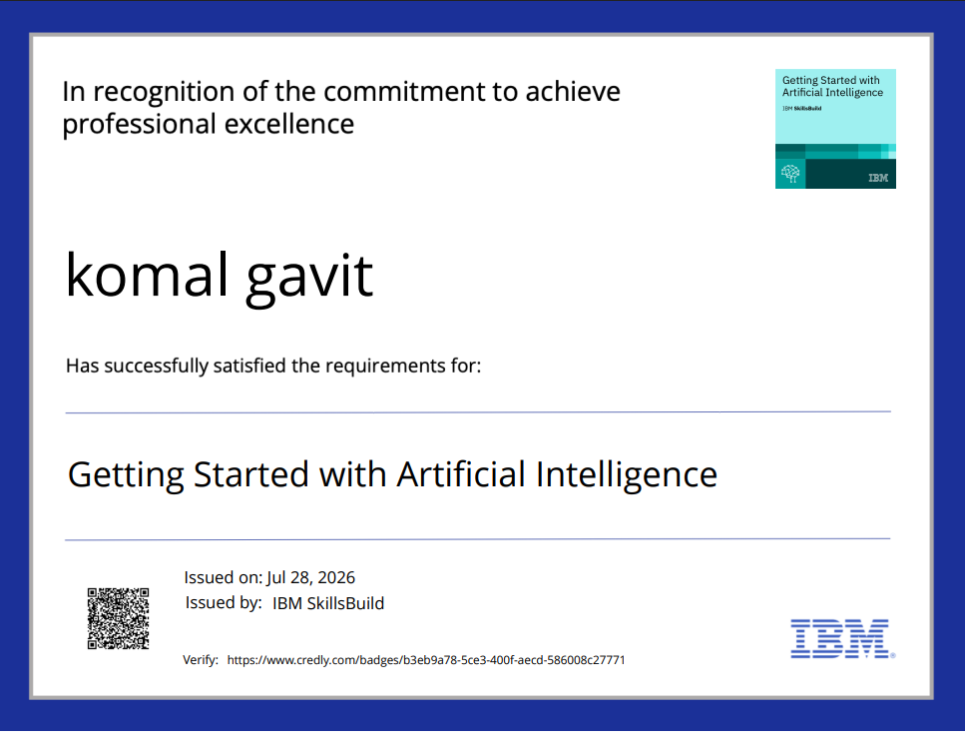
Certificates Earned:

Slide 16
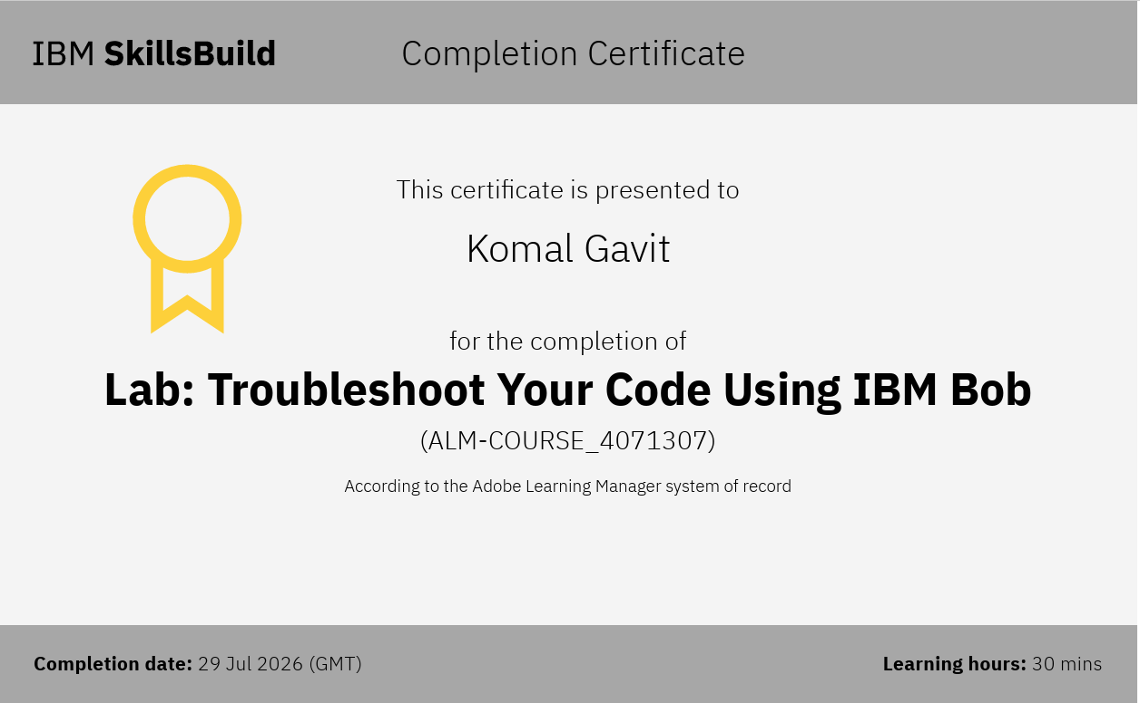
Certificates Earned:​
Add your IBM BOB Certificate

Slide 17


